Slide 1
Youth Lens: Exploring the Impact of the Neighborhood Environment on Health & Well-being
Elizabeth Benninger, PhD, MA
Post-doctoral Scholar, Case-Western Reserve University

Slide 2
My Background
B.A. Social & Community Development Studies, University of the Western cape, Cape Town, South Africa
M.A. Clinical & Community Psychology, Antioch University, Los Angeles, California
PhD Social & Community Psychology, University of the Western Cape, Cape Town, South Africa
Post-Doctoral Research Fellow, Case Western Reserve University, Cleveland, Ohio

Slide 3
“Leaders who do not act dialogically, but insist on imposing their decisions, do not organize the people, they manipulate them. They do not liberate, nor are they liberated, they oppress.”
- Paulo Freire
Notes:
I would like to share this quote with you because it captures the essence of my research approach and the type of leader in the field of psychology that I strive to be which recognizes the value in participatory methods where knowledge is co-created with the participants and communities who my research and teaching practices intend to benefit. My research additionally supports the increased investment in inclusive participatory and action-oriented methodologies.

Slide 4
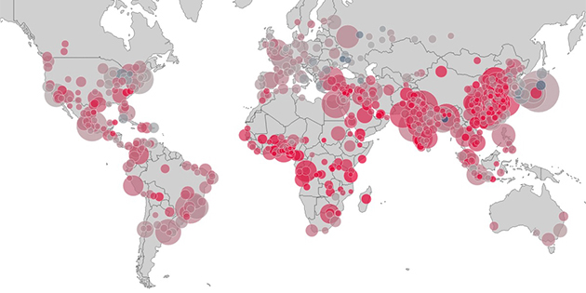
Urban Health
More than half of the world’s population lives in urban environments and this is expected to rise to an estimated 67% by 2030 (UN Population Fund, 2019)
Substantial urban environmental health concerns include:
Automobile crashes
Pedestrian injuries and fatalities
Indoor/outdoor air pollution, water quality
Lead exposure
Obesity
Depression and other mental health challenges
Notes:
-Currently, more than half of the world’s population lives in urban environments and this is expected to rise to an estimated 67% by 2030.
-While urban environments have the potential to provide additional resources to support and enhance the well-being of the population, such as opportunities for employment, healthcare, education, and recreation, these environments also face high concentrations of poverty along with other socioeconomic and health inequities. These inequities are especially apparent among children
UN Population Fund (2019) Urbanization. Accessed April 25, 2019 at https://www.unfpa.org/urbanization

Slide 5
Child Health Disparities & Health Equity
Child Health Disparities: Inequitable differences in health based on demographic characteristics of persons under the age of 18
Child Health Equity: children having the same opportunities to survive, develop and attain their full potential
Notes:
Within urban environments throughout the world, exist a number of child health disparities. Defined as Children defined Inequitable differences in health based on demographic characteristics of persons under the age of 18
One of my overarching research goals is to move towards child health equity, which means that children regardless of race, culture, nationality, geographic region, etc. will have the same opportunities to survive, develop and attain their full potential

Slide 6
Social Determinants of Health
Notes:
The Social Determinants of Health provides a useful framework for understanding health disparities, capturing the complexity of children’s health and environment. The World Health Organization defines the Social Determinants of Health as “the conditions in which people are born, grow, live, work and age.”^{i} These conditions are inclusive of societal structures, institutions, policies, and distributions of power and resources and mediated by social interactions.^{ii} Aligned with the social determinants of health framework, structural racism has been identified to be a key determinant of population health and that a focus on it is essential for advancing health equity. More specifically, Bailey et al. (2017) define it to be “the totality of ways in which societies foster racial discrimination through mutually reinforcing systems of housing, education, employment, earnings, benefits, credit, media, health care, and criminal justice (p. 1453).”^{iii}

Slide 7
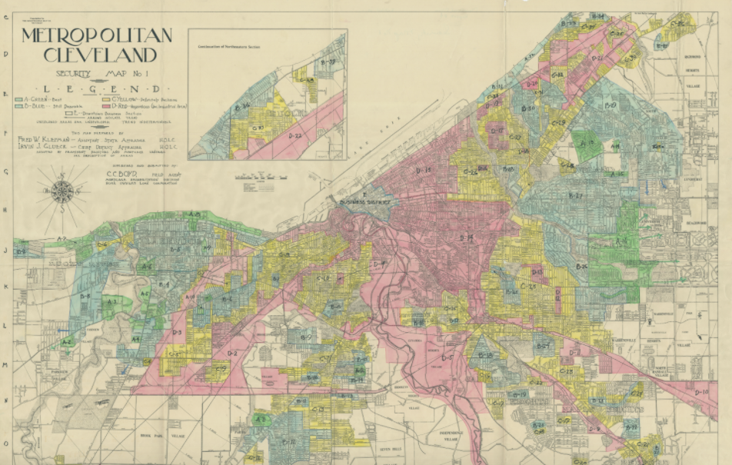
“Concentration of negro population in this area is the heaviest in the city. Area is characterized by its heavy relief rolls, high disease and mortality rate, crime and unemployment. This is the most undesirable area in entire city.”
The Ohio State University Libraries, 2013. Federal HOLC "Redlining" Maps for Ohio Cities.
Notes:
-Disparities in the survival and health prospects of children from different backgrounds exist today and these are not random.
-They systematically follow historical roots of social disadvantage linked not only to wealth but also to ethnicity, education and rural-urban divides, among other factors.
-The burdens of both disease and mortality are often highest among the most disadvantaged
- This is reflected in urban neighborhoods within the city of Cleveland, where misguided racist historical policies, such as redlining and racial zooming, still hold a negative impact on the health prospects of children
- For example: An estimated 42.2% of African Americans in the city live below the poverty level (compared to 24.7% of whites, and an estimated 64% of African American households are receiving SNAP benefits (compared to 28% of whites) Might be good to compare to white populations for these two statistics.
In Cleveland, redlining maps rated the black and immigrant neighborhoods with a low grade regarding investment desirability, limiting residents’ access to mortgage insurance or credit. Historically redlined neighborhoods tend to experience greater challenges as it pertains to neighborhood infrastructure and, in turn, economic opportunity.

Slide 8
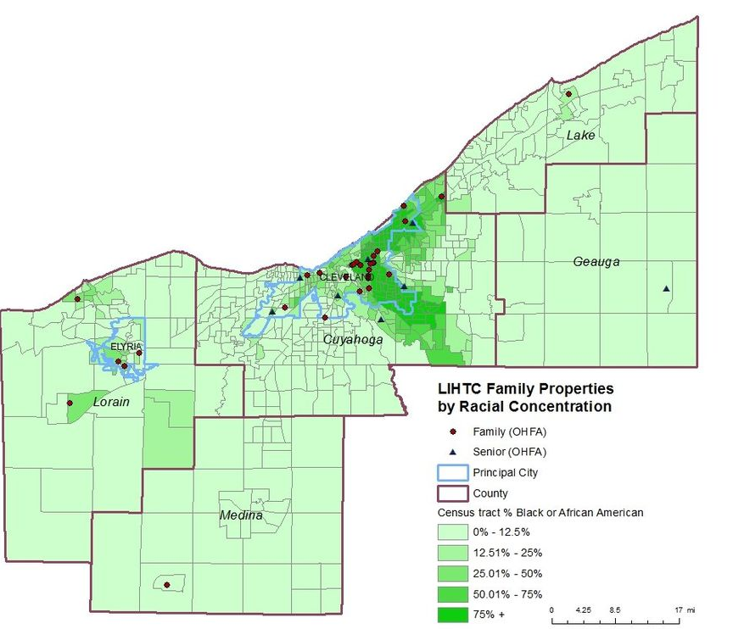
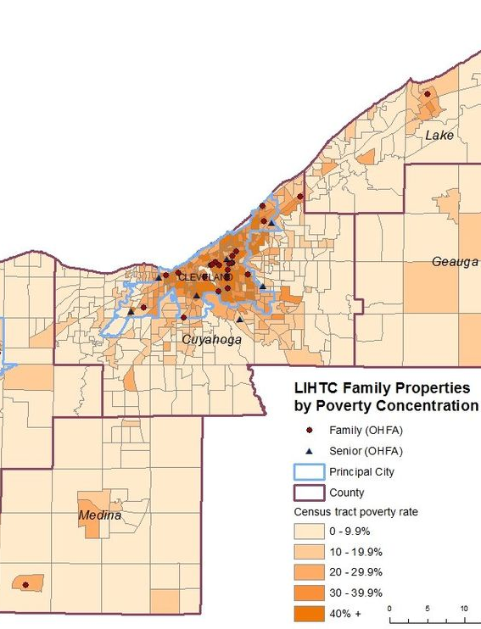
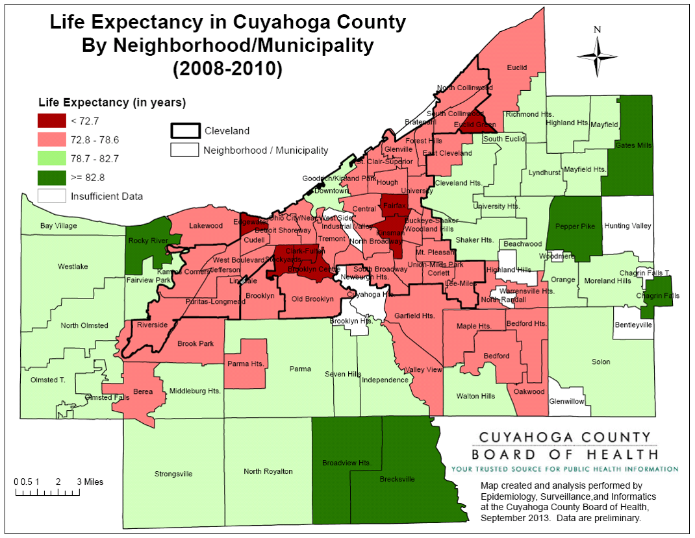
Mapping Health Disparities in Cleveland
Kirwin Institute, 2019
Notes:
Today, the population of Cleveland remains residentially segregated by race, and the neighborhoods with the highest median household incomes are majority White, while the areas with the lowest median household incomes are those compromised of the largest Black, Hispanic and Latinx populations. Although this study specifically focuses on Cleveland, this trend in racial segregation and health disparities mirrors that of many urban cities throughout the United States.
Within Cleveland, racial disparities are further pronounced with infant mortality rates, in the US among Blacks (16 per 1,000 live births) and Hispanics (10.3 per 1,000 live births) substantially higher than for Whites (9.3 per 1,000).
NEO CANDO system (2012). Center on Urban Poverty and Community Development, MSASS, Case Western Reserve University. Retrieved at http://neocando.case.edu
Iceland, J. & Weinberg, D. (2002). Racial & Ethnic Segregation in the United Stated. Retrieved at : https://www.census.gov/library/publications/2002/dec/censr-3.html
ntrated within the same neighborhoods which were redlined and segregated years ago

Slide 9
Study Aim
Utilizing a participatory methodology with children and youth the aims of this study are to:
Aim One: Explore the perceptions of children & youth related to how experiences of poverty, stress and adversity within their neighborhood environment shapes their health.
Aim Two: Understand how social, built, and structural resources buffer the potential negative impact of adversity and promote health and well-being.
Aim Three: Investigate and prioritize child and youth-centered strategies for creating neighborhood environments which will promote their health and well-being.
Notes:
Within the context of structural violence, the studies incorporate an additional focus on the self-identity and its impact on health and well-being.

Slide 10
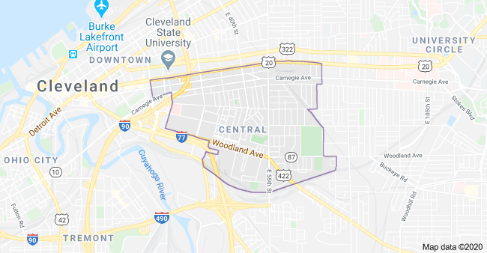
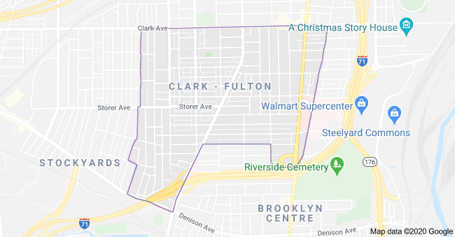
Participants & Sampling
Phase 1: Approx. 20 youth ages 14-18 from the Central & Clark-Fulton Neighborhoods
Phase 2: Approx. 20 children ages 9-13 from Central & Clark-Fulton Neighborhood, co-led by local youth
Notes:
I am in the early stages of data collection in Cleveland. The study follows a similar design as the Cape Town study however an additional focus on physical health in addition to mental health and expanding the age groups to be inclusive of children and youth.
Currentlty I have two groups of 10 youth (ages 14-17)from the Central and Clark-Fulton Neighborhoods, which also represent some of the diversity of the childhood experience in Cleveland
-They will go through similar stages as the South Africa project. The youth will then take the lead as my co-researchers and collect data with younger children (9-12 year olds) within their neighborhoods.

Slide 11
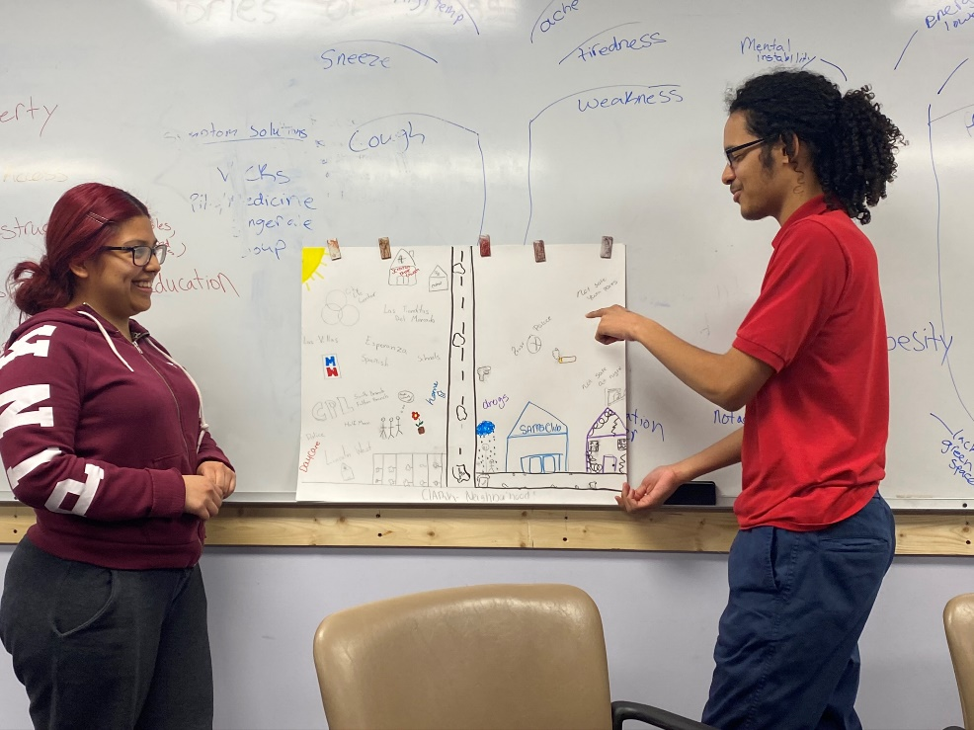
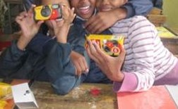
Research Design
Focus Group Discussion
Photo Voice
Community Mapping
Children’s Delphi

Slide 12
Study Significance
Benefits of Research:
Study is unique and crucial in its aim to further understand child and youth perspectives on their health and well-being
Inform interventions and policies which seek to improve community child well-being, promote health, and reduce community violence
Inform theory and practice in child psychology, child studies, and public health
Support children as valid research collaborators
Future directions:
Need for further research on how children conceptualize health & wellbeing within various social contexts and across age groups.
Research measuring impact of child participation design
Notes:
Urgent need for health enhancing opportunities to assist with building a healthy self-concept among South Africa’s children
.Research has indicated a healthy self-concept to be critical for child well-being and connected to children’s social and emotional development
Low levels of self-concept have been linked to aggression, depression, eating disorders, adjustment problems, suicide, and shame
Higher levels of self-concept are linked to academic, school, and social success
Risks associated with poverty and systematic oppression can have an additional negative impact on a child’s self-concept
While current research has been effective in quantitatively measuring the multiple domains of a child’s self-concept, there is very little research focused on the child’s subjective conceptualisation and meaning assignation of the self
no research studies which explore this amongst children within a South African context of poverty and violence
Benefits of Research:
Inform interventions and policies which seek to improve community child well-being, promote mental health, and reduce community violence
Inform child psychological theory and practice

Slide 13
Contact Information
Elizabeth Benninger, PhD
Email: elizabeth.Benninger@case.edu

