Slide 1

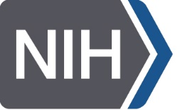

COVID 19 and our Cleveland Community
Nora G. Singer, M.D.
Director, Division of Rheumatology
Medical Director, MHS Clinical Trials and Clinical Research Unit
Co-Director Cleveland Coronavirus Research Task Force
Case Western Reserve University
and
Jonathan Karn, Ph.D.
Chair, Department of Molecular Biology & Microbiology
Director, CWRU/UH Center for AIDS Research
Co-Director Cleveland Coronavirus Research Task Force
Case Western Reserve University
Need NCATS
National Institute of Allergy and Infectious Diseases

Slide 2
Disclosures
Dr. Karn discloses the following financial relationships with commercial entities that produce health-care related products or services relevant to the content of this lecture:
Shareholder: ABBV, EDIT, FATE, GILD, MDT, REGN, RMD, BMY, VRTX
Dr. Singer has no relevant disclosures.

Slide 3
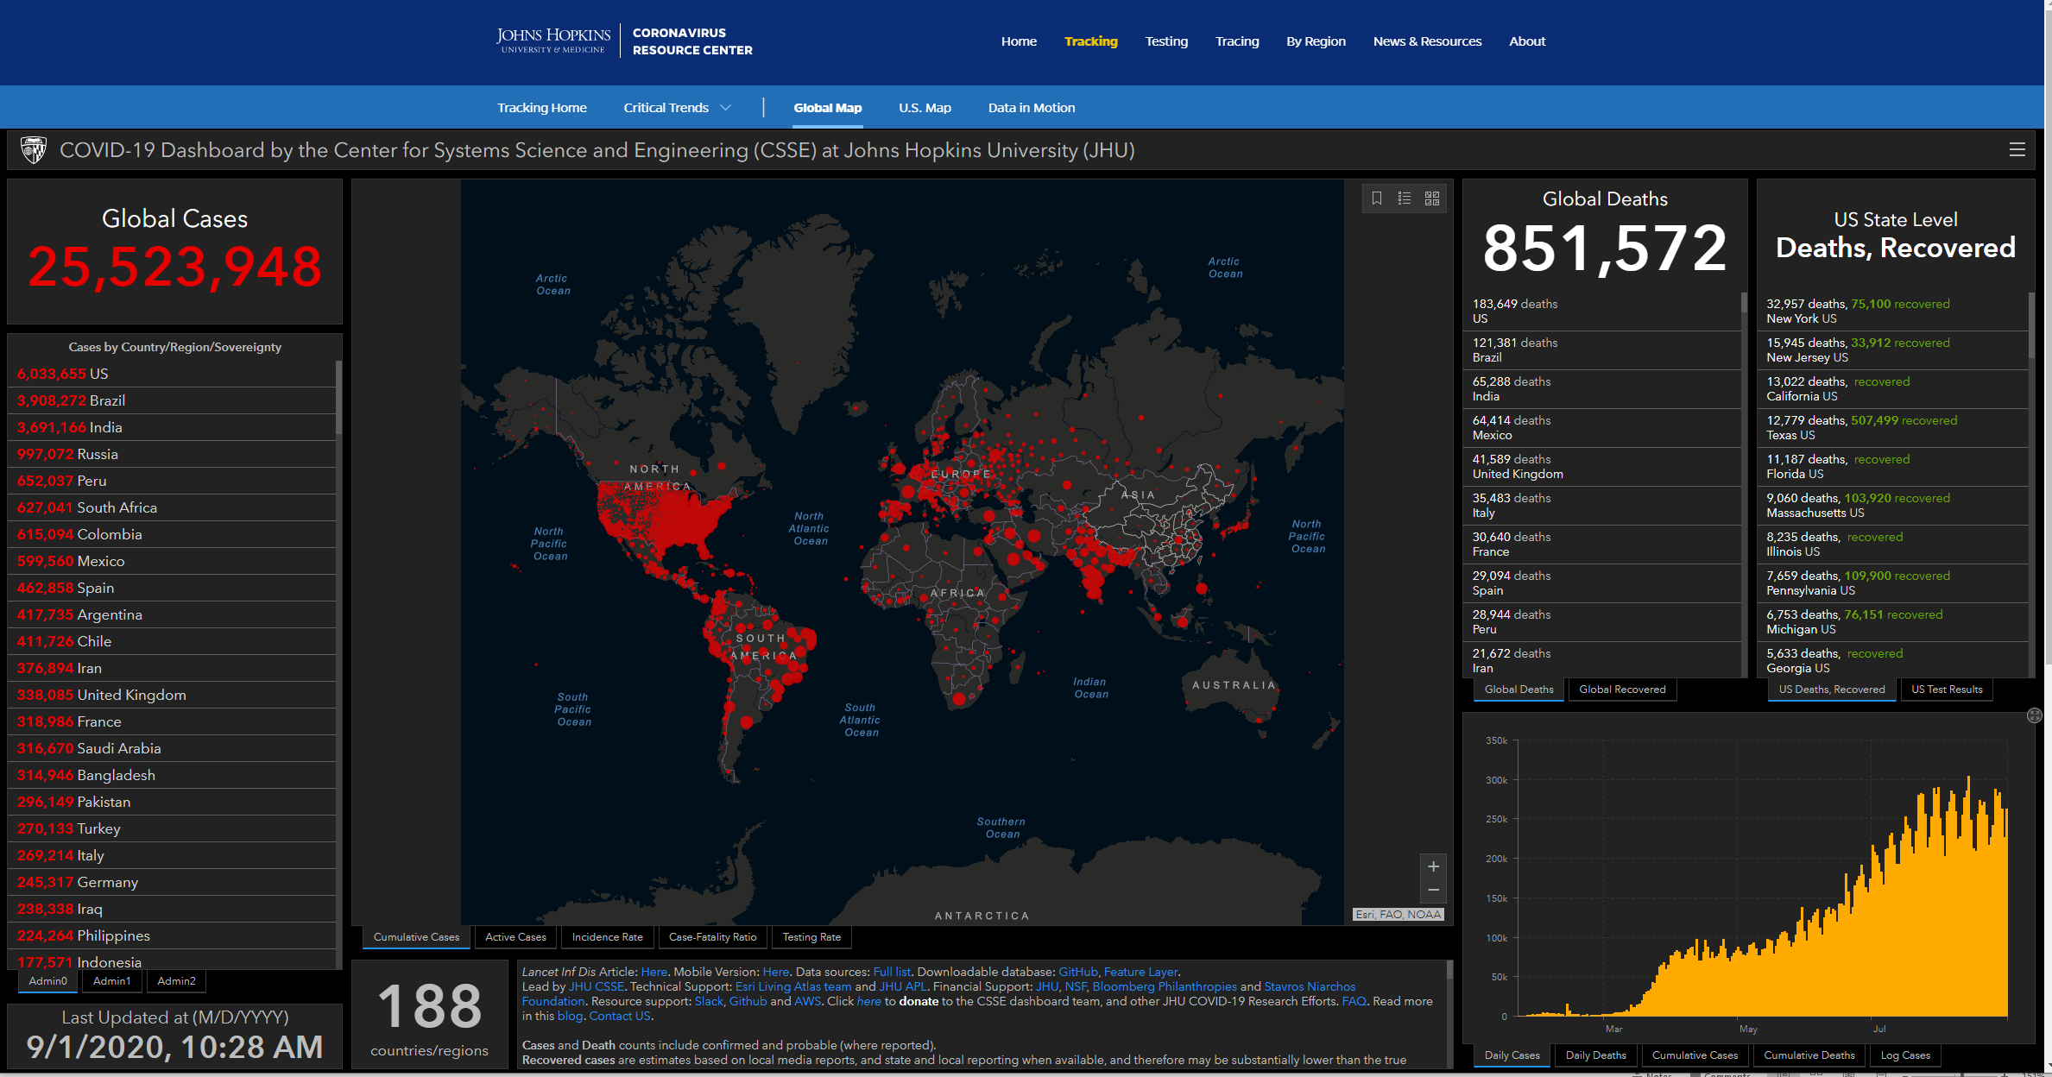
SARS-CoV-2 pandemic is now a leading cause of death

Slide 4
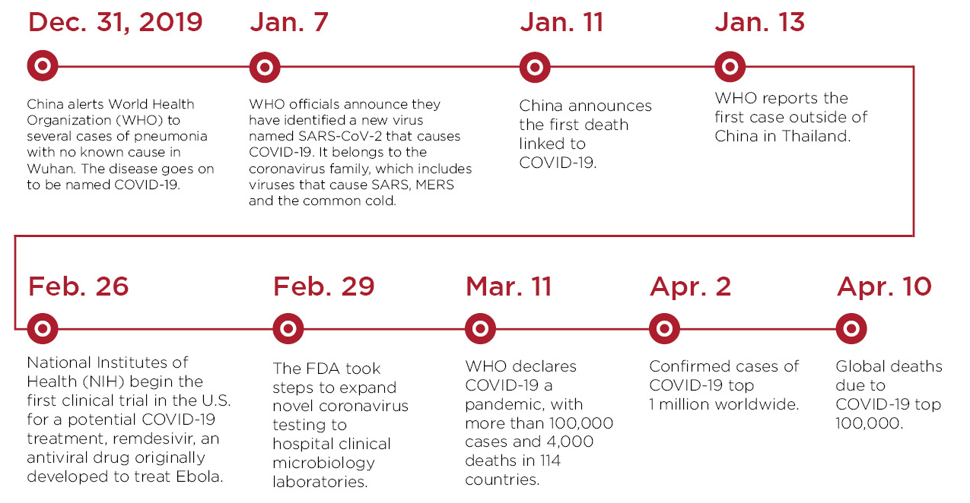
SARS-CoV-2 Epidemic Timeline

Slide 5
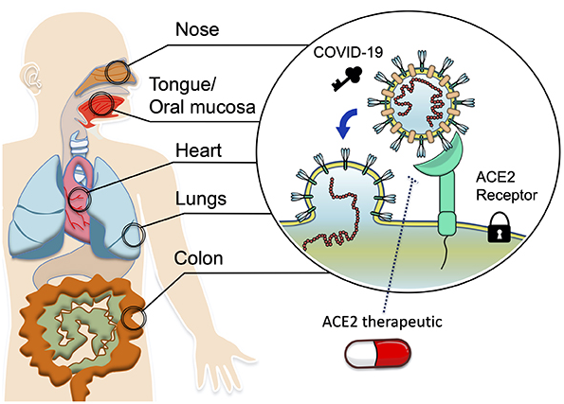
Lesson 2: Follow the receptor
SARS-CoV-2 utilizes ACE2;
SARS-CoV-2

Slide 6
COVID19- what is known
RNA virus
Family of common cold viruses ”coronaviridae”
Similar to SARS (outbreak Toronto) and MERS (carried by camels)
Some people asymptomatic while others get very sick and die
Transmission is airborne- respiratory virus
Masks reduce how many individuals are infected
Treatments under study but no one works
Prevention is critical
When people become ill avoid artificial ventilation if at all possible

Slide 7
COVID19- what is not known
Why are some people asymptomatic and some people get very sick unknown
Older age, obesity, diabetes, non-Caucasian all risk factors for severe disease
Which medicines work best at different stages of disease
Does having COVID infection prevent re-infection?
How long can old infection prevent re-infection?
Are B-cells that make antibodies or T-cells most important for long term immunity?
Which vaccines will work best and for how long?

Slide 8
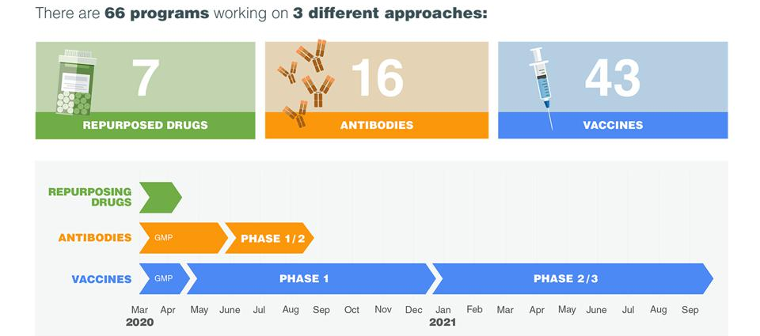
SARS-CoV-2 Epidemic: Accelerating research by following the HIV playbook

Slide 9
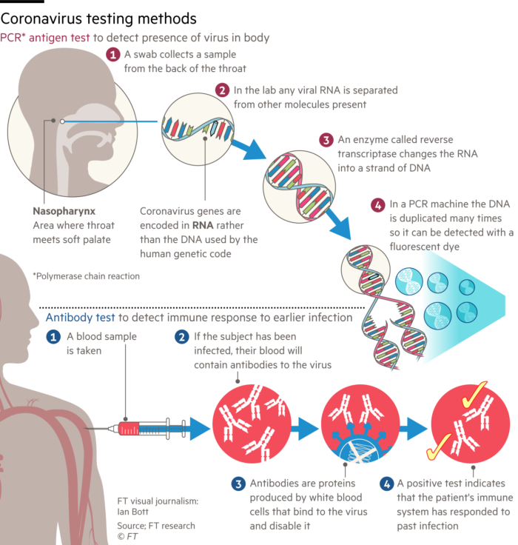
COVID assays are key to surveillance and developing therapies
RNA-based assays
Only semi-quantitative
High false negative rates (>5%), manageable false positive rates
Don’t distinguish between replicating virus and RNA fragments
Too slow, too complex, too expensive for large population studies
Antibody-based assays
High false positive rates
Don’t detect early stages of infection

Slide 10
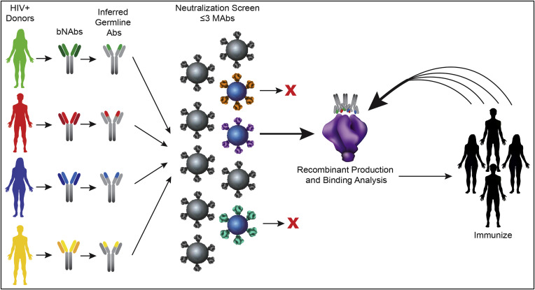
Mimic the immune response
Passive immunotherapy with broadly neutralizing antibodies (bNAbs)

Slide 11
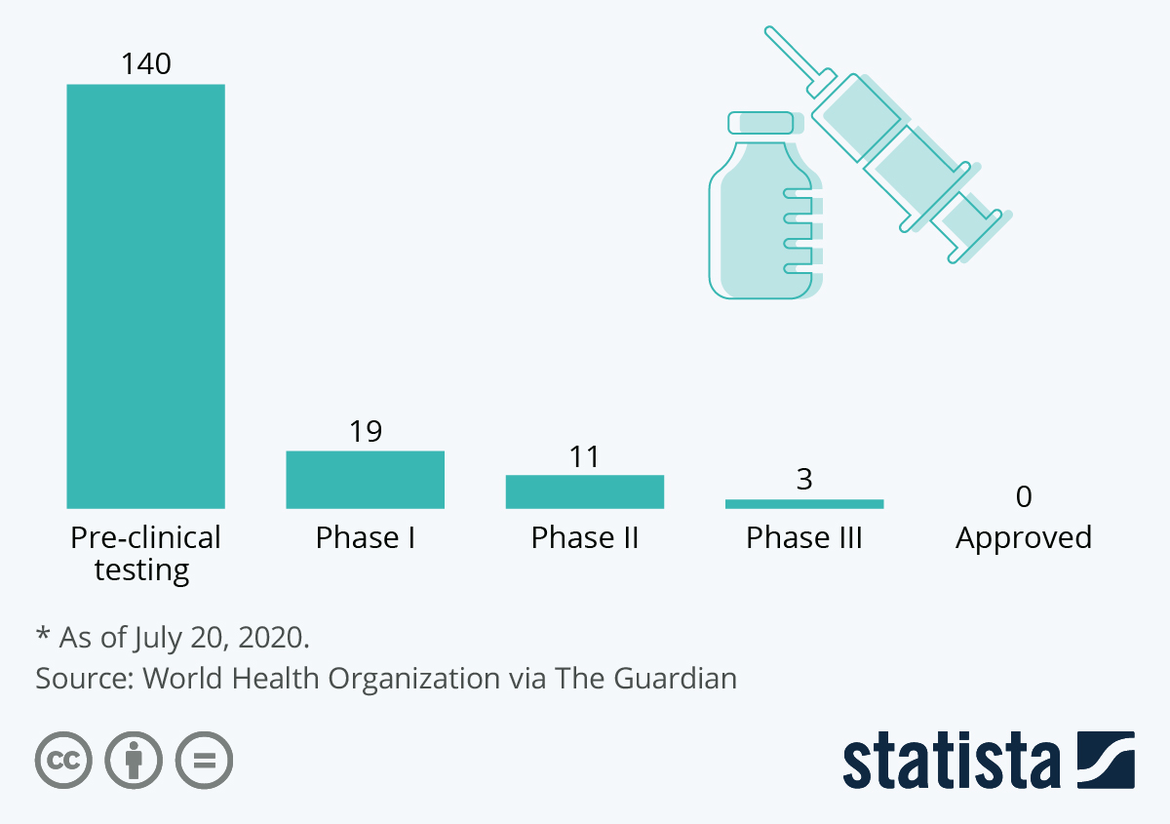
Vaccines need rigorous population studies
How close is the world to a Coronavirus vaccine
The Good News:
Vaccines appear to be safe and elicit neutralizing antibodies
The Bad News:
Most patients rapidly lose antibody responses
Patients can be reinfected
The unknown:
How durable is the protective effect, if any?
Will vaccines attenuate disease if they don’t protect?

Slide 12
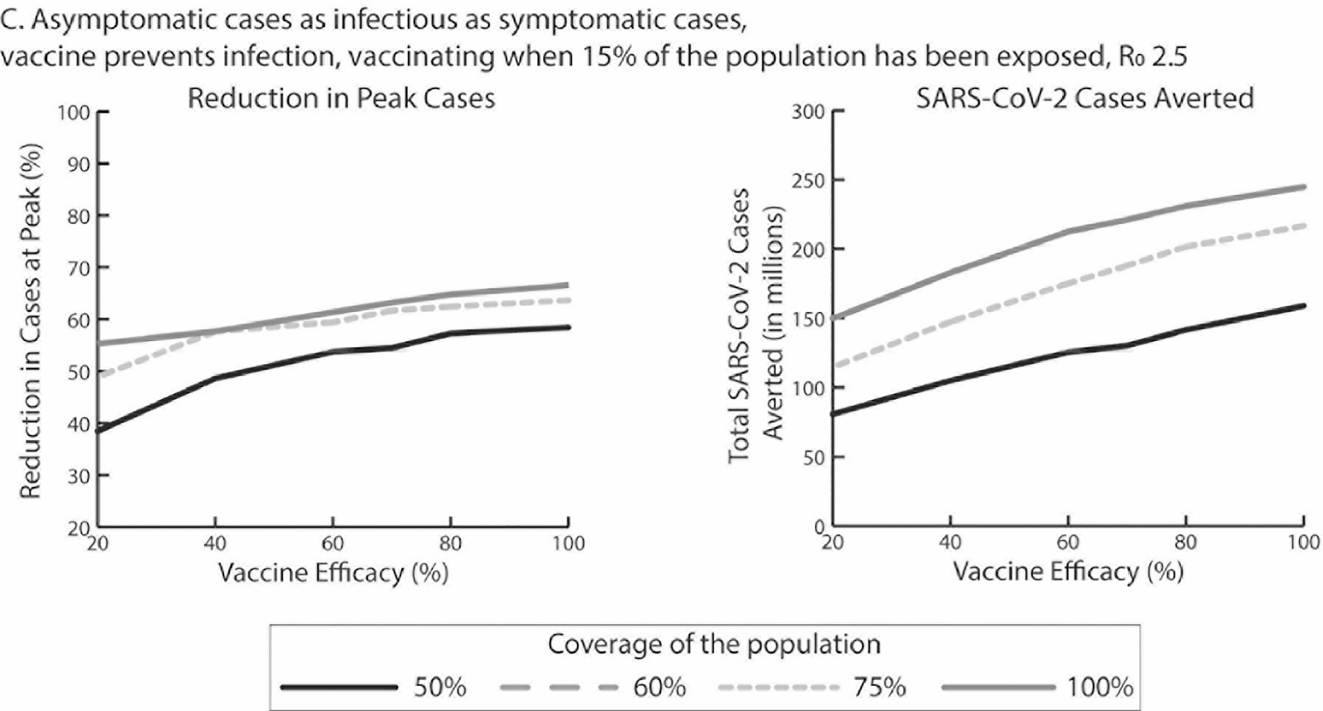
Vaccines need rigorous population studies
High vaccine efficacy is needed to stop an epidemic as the sole intervention
When vaccination occurs after 15% of the population has already been exposed, the resulting reduction in the peak is, at most, 65%.
Bartsch et al., Amer. J. Preventive Med. Published:July 15, 2020 DOI:https://doi.org/10.1016/j.amepre.2020.06.011

Slide 13
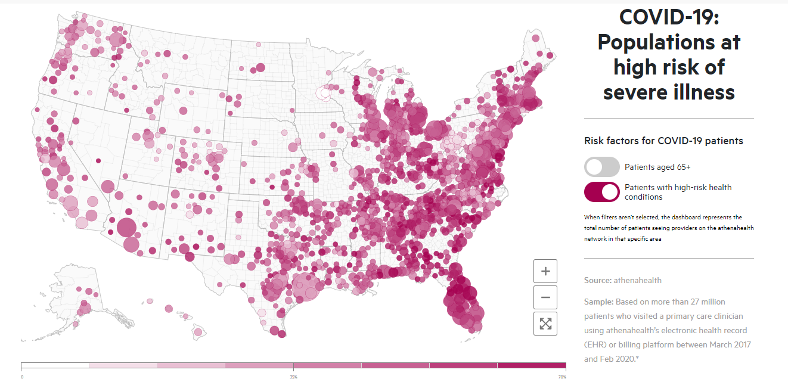
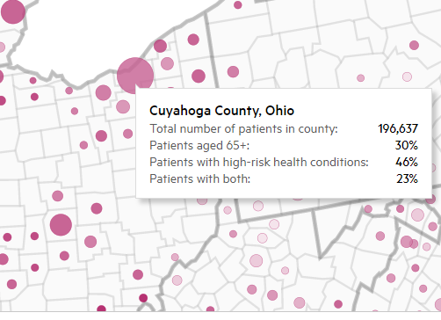
Lesson 9: It is very hard to reach the people who are most at risk
At risk populations for COVID
Patients are considered to be at higher risk if they are aged 65+ or documented as having any of cardiovascular disease, lung disease, diabetes, cancer, chronic kidney disease, liver disease, severe obesity; or who smoke or are immunocompromised.

Slide 14
Which of this information is most important to the community?
How should we make this information available to the community?
What is the best way to get community input into the research study design?
Should we try and identify members of the community to join our research work-groups?

Slide 15
To what extent is the population interested in vaccines?
Who should we talk to about participation in clinical trials for vaccinations to prevent COVID19?
Once the FDA approves one or more vaccines will that make the community seek vaccines?
What are the trust issues with vaccines in clinical trials and vaccines given clinically?
How can maximize that community seeing the doctors involved as trustworthy?
Will the community being receptive to comparing how well different vaccines work in a clinical study?

