Slide 1


Kimberly Kiley, MA
Research and Evaluation Specialist
Trauma Programs
FrontLine Service

Slide 2
Kiley, K. A., Sehgal, A. R., Neth, S., Dolata, J., Pike, E., Spilsbury, J. C., & Albert, J. M. (2018). The effectiveness of guided imagery in treating compassion fatigue and anxiety of mental health workers. Social Work Research, 42(1), 33-43.

Slide 3
Guided Imagery’s Role
Trauma-Exposed Staff
Stress Symptoms
Potential for Better Quality of Care

Slide 4
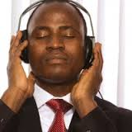
Guided Imagery as a Self-Care Tool
Will listening to prerecorded guided imagery on mp3 players 3 times per week for 4 weeks reduce state anxiety, perceived stress, and compassion fatigue in FrontLine Service workers?

Slide 5
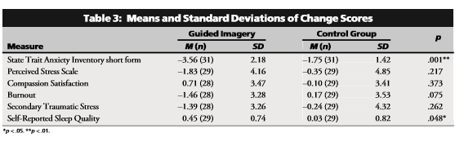

Slide 6
Self-Report Sleep Rating Before and After 4 Weeks

Slide 7
Knowledge Base
Compassion Fatigue, Secondary Traumatic Stress, Burnout
Resiliency
Stress reduction techniques: guided imagery, yoga, meditation, breath work
Employee wellness initiatives and considerations to reduce barriers to usage
Applying Trauma Informed Care into various settings
The affects of violence on children and families

Slide 8
Role at FrontLine Service’s Trauma Department
Training
  Trauma Informed Care
  Staff Resiliency
Internal staff resiliency
  Group facilitator
  Yoga instructor
Evaluation
  Data management
  Satisfaction surveys
  Consultation
Literature Review
Other duties as assigned

