Slide 1







Slide 2
Barriers to access & perceptions of massage therapy among patients at 5 public health centers.
Perceptions
Barriers to access
Luxury
Wellbeing
Healthcare
Sexual
Cost
Knowledge
Availability
Knowledge Experience Understanding

Slide 3
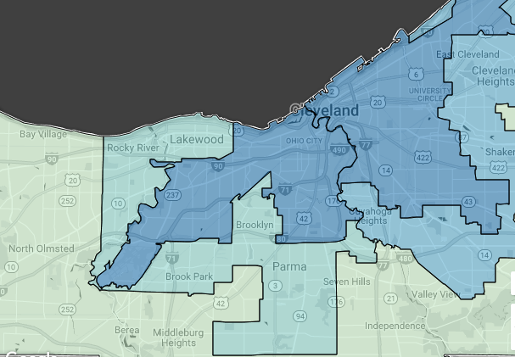
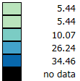
% below federal poverty level
*Data & map from NEO CANDO 2010+

Slide 4
Barriers
Stress 71%
Cost
Location
Knowledge
Chronic Pain
53% from LMT (n=314)
Perceptions
Not inappropriate
Healthcare = Luxury
Anxiety 43%
Knowledge
Back Pain 83%
Experience
77% had massage (n=423)

Slide 6

Thanks!
Any questions?
Diane Mastnardo
dmastnardo@gmail.com

