Slide 1
Research Opportunities: pipelines & Tools for investigators at MetroHealth
Community Based Research Network (CBRN)
September 10, 2020
Noreen Roman, MBA, MT(ASCP)
Manager, Clinical Research Unit Operations
Program Manager, Case Western Reserve University Network Capacity
Point of Contact, Trial Innovation Network Case Western Reserve CTSC

Slide 2

Overview
Pipelines & Opportunities for Clinical Researchers
  Federal
  Industry
  Foundation/Community
Resources for MetroHealth Investigators
Research in a COVID-19 world

Slide 3

Pipelines for Clinical Research - FEDERAL
    Federal Notices & Newsletters
    Case Clinical and Translational Science Collaborative (CTSC) – $48M multi-institutional (CCF, MH, UH Clinical and Translational Science Award)
      Core Support for Research: Regulatory, Informatics, Network Capacity Hub Research Capacity, Community and Collaboration, etc…
      Multiple CTSC Monthly Pilots - $10,000
      6 CTSC Annual Pilots - $50,000
      Trial Innovation Network (TIN)

Slide 4
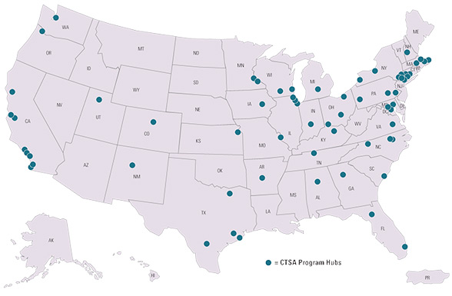
Pipelines for Clinical Research - FEDERAL
Clinical and Translational Science Awards
Ohio has 3 CTSA Awards!:
CWRU
Ohio State
Cincinnati Children’s

Slide 5
Pipelines for Clinical Research - FEDERAL FUNDING
    Case Clinical and Translational Science Collaborative (CTSC) – $48M multi-institutional (CCF, MH, UH Clinical and Translational Science Award)
      Core Support for Research: Regulatory, Informatics, Network Capacity Hub Research Capacity, Community and Collaboration, etc…
      Research Education and Support
      Newsletters and FOAs
      CTSC Monthly Pilots - $50,000
      CTSC Annual Pilots - $10,000
      Trial Innovation Network (TIN)

Slide 6
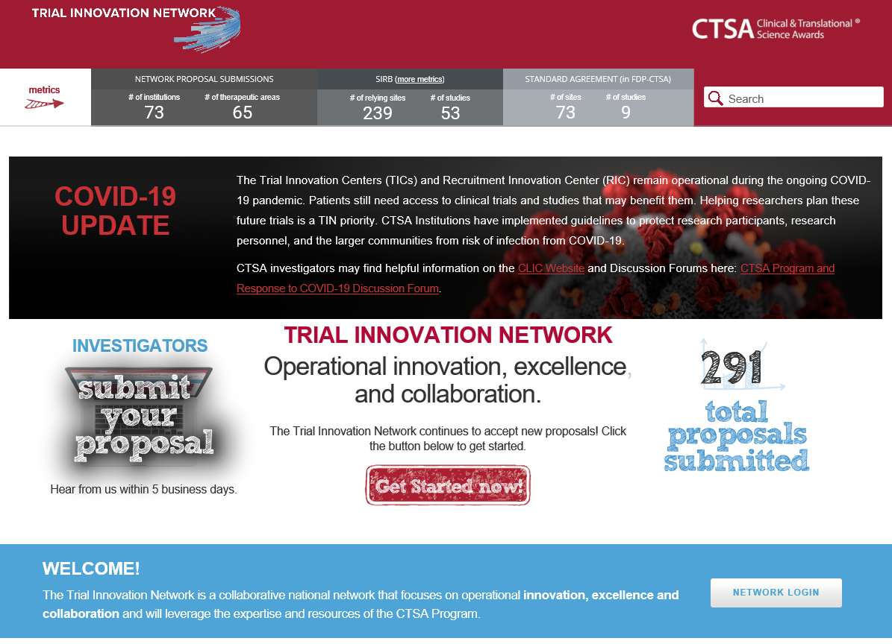
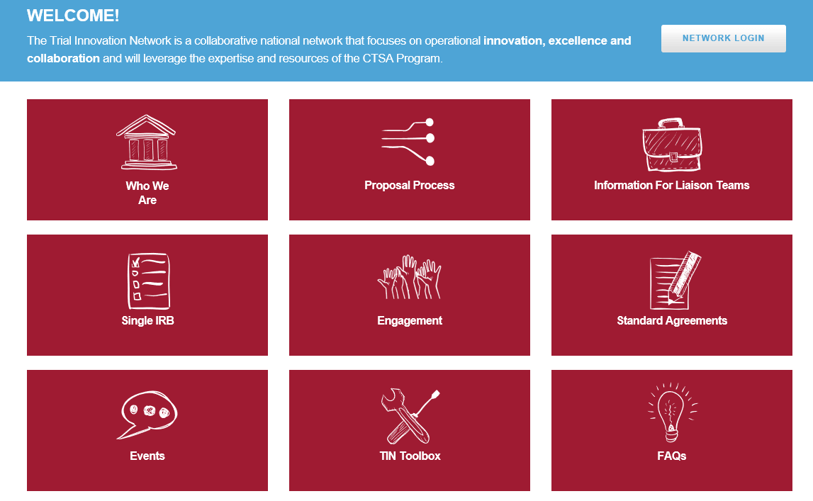
Pipelines for Clinical Research - FEDERAL
TRIAL INNOVATION NETWORK (TIN): HTTPS:// TRIALINNOVATIONNETWORK.ORG

Slide 7
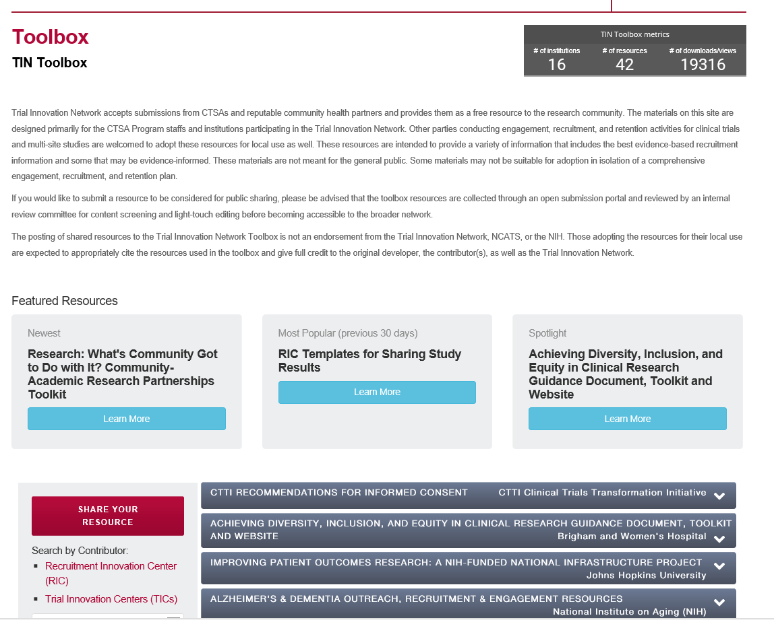
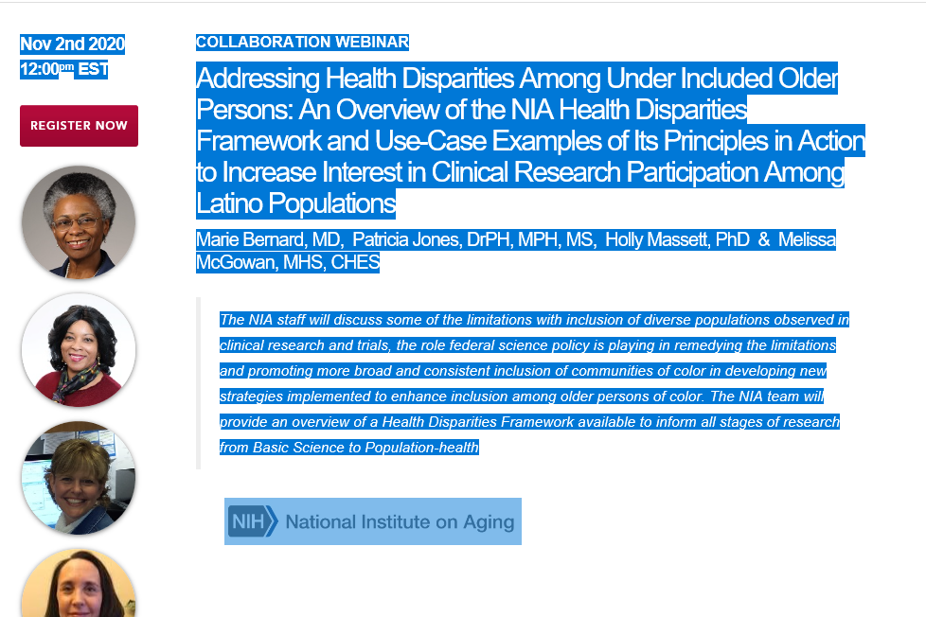
Pipelines for Clinical Research - FEDERAL
TRIAL INNOVATION NETWORK (TIN): HTTPS:// TRIALINNOVATIONNETWORK.ORG

Slide 8

Pipelines for Clinical Research - INDUSTRY
Institutional Industry Affiliations
TriNetX Trial Connect -- Industry Opportunities –
    from 25+ leading Pharmaceutical Companies/HCOs
    Phase I-Phase IV Clinical Trials
    Weekly opportunities delivered by dashboard
    Drill Electronic Health Record for feasibility assessments

Slide 9
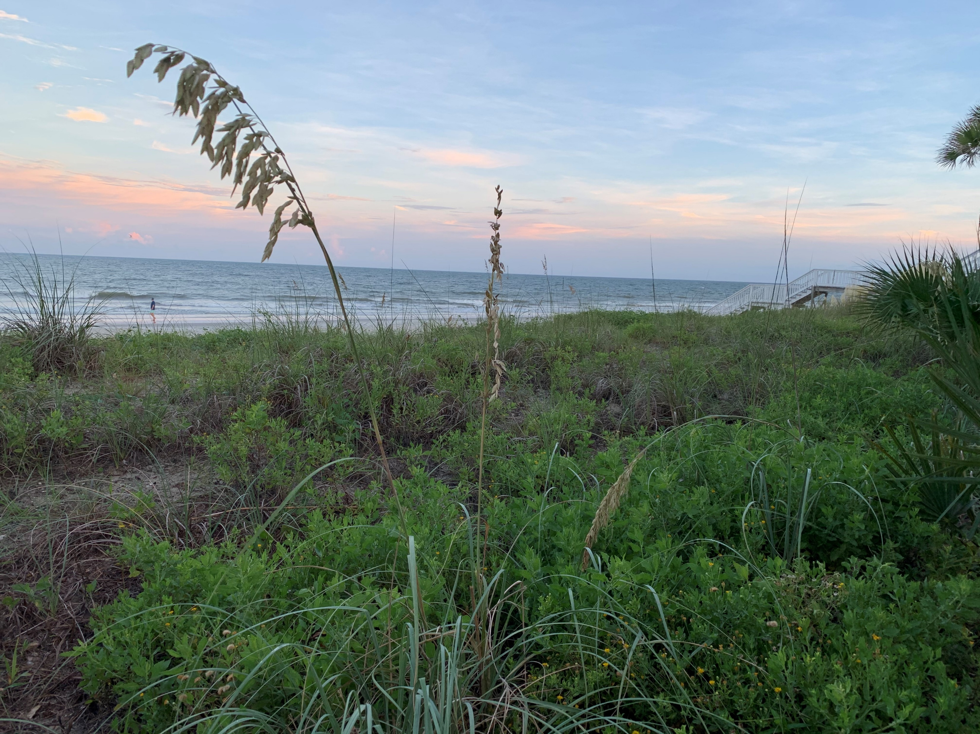
Resources for MetroHealth Investigators

Slide 10
Resources for MetroHealth Investigators – Research Education
Research Education & Concierge: (CTSC) Ellen Divoky
Other CTSC Education and Training (CTSC)
    Clinical Research Scholars Program (leads to MS in Clinical Research - Post-doc and Pre-Doc scholars)
    Clinical Research Graduate Certificate (biostats, epidemiology and study design) – Physicians, Nurses, dentists, pharmacists interested in conducting or collaborating

Slide 11
Resources for MetroHealth Investigators – MHRI
MetroHealth Research Institute
1) Clinical Research Unit
2) Clinical Trials Unit
3) Institutional Review Board
4) Scientific Review Board
5) Office of Sponsored Programs
Including Contracting and Industry Budgeting

Slide 12
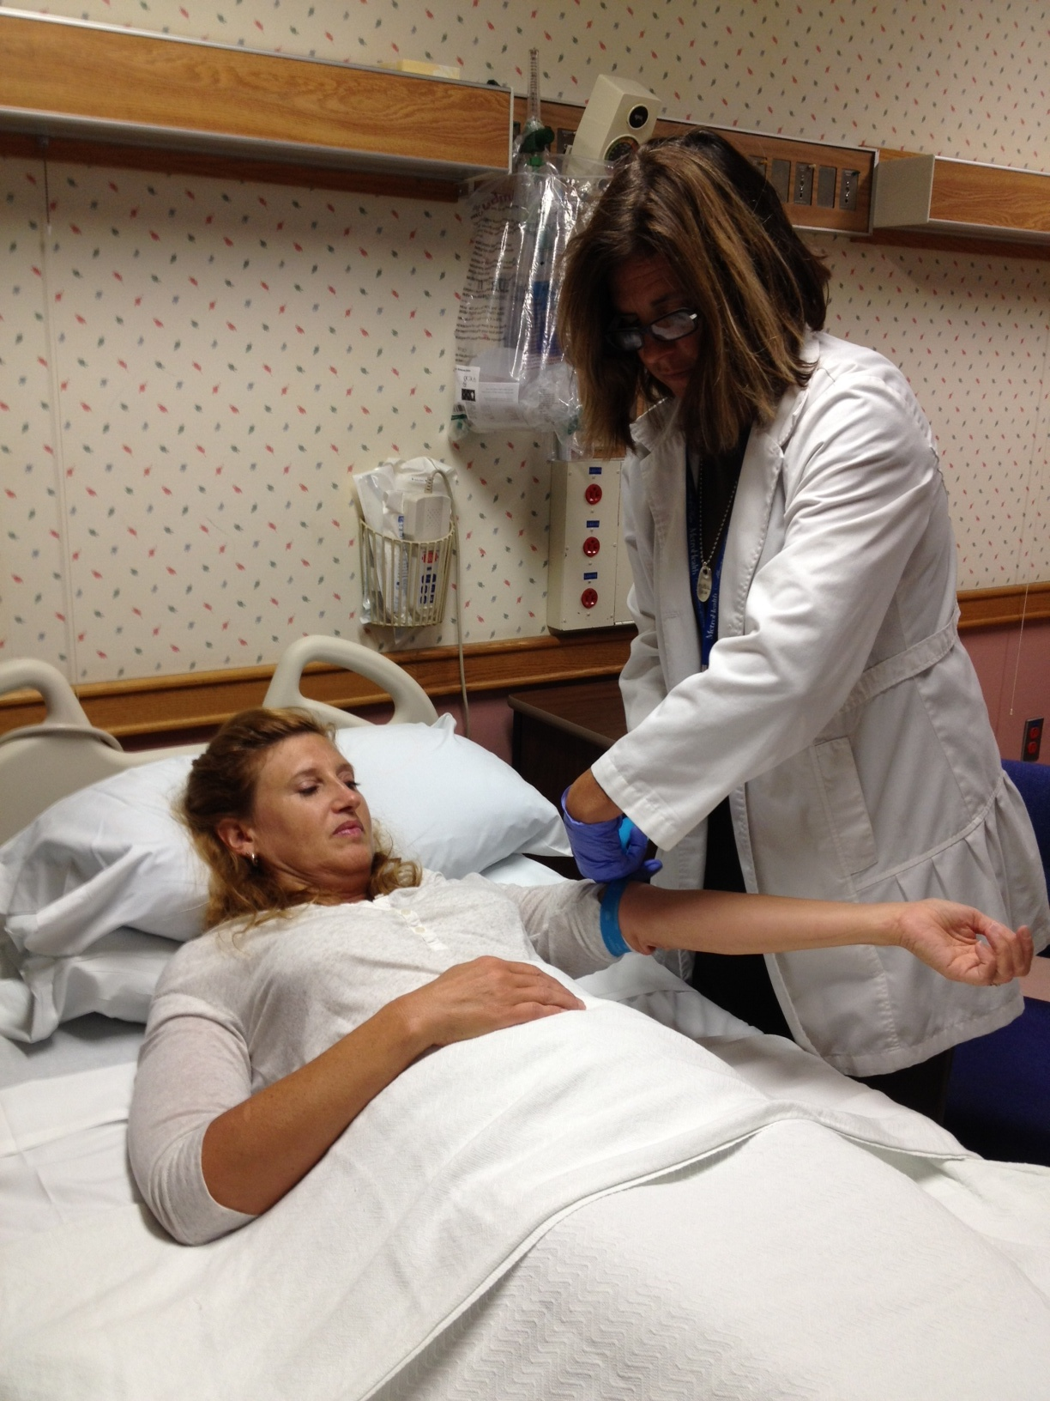
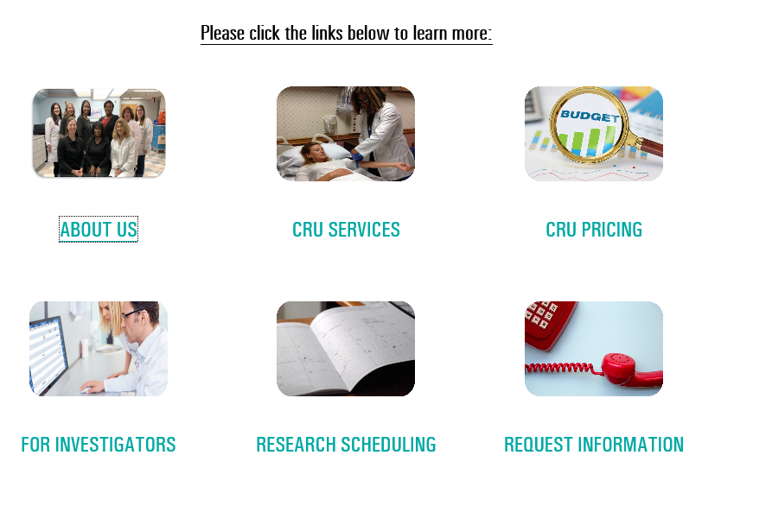
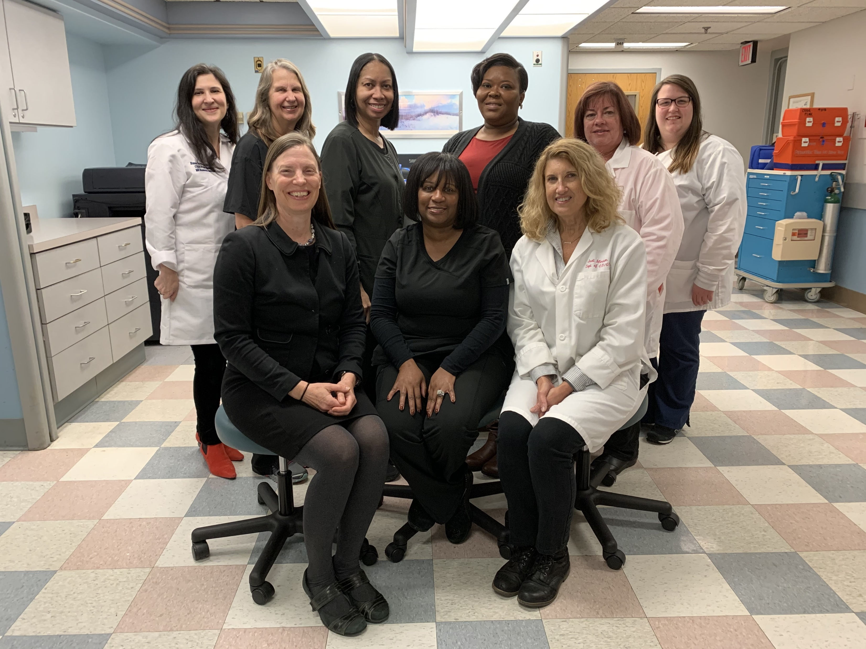
Resources for MetroHealth Investigators –
Clinical Research Unit

Slide 13

Resources for MetroHealth Investigators –
Research Informatics
MetroHealth Clinical Informatics
Research Informatics Tools:
  Slicer-Dicer
  Explorys
  TriNetX
  I2B2 and more

Slide 14

Research in a COVID-19 World
Pivoting Research (early 2020)
COVID Research Committee
COVID Research
  First Responder
  Anti-coagulation
  Convalescent Plasma
  Monoclonal antibody
  Vaccine (to come)
  Outpatient (to come)

Slide 15

THANK YOU ! Questions & Answers

