Slide 1
Targeted Management Intervention for African-American Men with TIA/Stroke (TEAM)
Principal Investigators:
Martha Sajatovic, MD
Carolyn Harmon Still, PhD, MSM, AGPCNP-BC, CCRP

Slide 2
Brief Study Summary
To find out if a group educational and behavioral intervention, called TargetEd MAnageMent Intervention (TEAM), helps African-American men with reducing their stroke risk factors.
The TEAM approach is intended to reduce the unacceptably high rates of stroke and stroke complications in African-American (AA) men who have experienced mild deficit stroke or transient ischemic attack (TIA, mini-stroke).
Preliminary data suggests that blood pressure and other biological markers that predict stroke risk are improved with TEAM. Interventions are co-delivered by a nurse educator and peer educator.

Slide 3
AIMS
Aim 1: To test the effects of TEAM vs. WL on systolic BP and serum high–density lipoprotein cholesterol (HDL) in AA men with stroke or TIA
Aim 2: Test if process elements of self-management (stroke knowledge, self-efficacy, perceived social support) and proximal health behaviors (taking medications to reduce stroke risk factors, diet, exercise and smoking) mediate TEAM vs. WL’s impact on primary and secondary health outcomes (systolic BP, diastolic BP, serum lipids, HbA1c) over a 12-month time period.
Secondary Aims: Assess impact on health outcomes while considering contextual variables such as stress, discrimination, depression, anxiety, social roles, and health literacy.

Slide 4
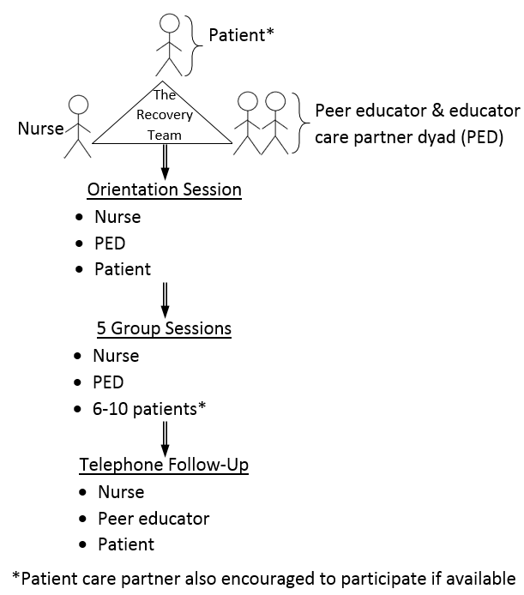
TEAM Intervention

Slide 5
Inclusion Criteria
Self-identified AA Male
Age ≥ 18
Stroke/TIA within last 5 years
Barthel Index of > 60 (completed by the study team)
Able to participate in groups
Exclusion Criteria
Unable or unwilling to provide consent
Stroke due to sickle-cell disease

Slide 6
Initial Enrollment Timeline
 |  | Quarterly | Cumulative
Year 1 | Q1-Q2
 | Q3 | 10 | 10
 | Q4 | 10 | 20
Year 2 | Q1 | 10 | 30
 | Q2 | 10 | 40
 | Q3 | 13 | 53
 | Q4 | 13 | 66
Year 3 | Q1 | 14 | 80
 | Q2 | 13 | 93
 | Q3 | 13 | 106
 | Q4 | 14 | 120
Year 4 | Q1 | 20 | 140
 | Q2 | 20 | 160
 | Q3-Q4
Year 5 | Q1-Q4

Slide 7
Enrollment Progress
We are open for enrollment
  Progress has been delayed due to COVID and technological challenges
  There are currently 4 participants enrolled
We are looking for approximately 16 African American men for the first cohort
We anticipate that our first session will begin in 5 weeks

Slide 8
Changes for COVID
Virtual enrollment
Planned modifications to assessments:
  Home blood pressure monitoring
  Visits to University Hospitals Dahms clinical research unit
  Nutrition assessments done virtually
Virtually – delivered TEAM program using zoom or similar on-line platform

Slide 9
For referrals, please contact the research assistant, Michaela Broadnax (216) 286-4362 or Michaela.Broadnax@UhHospitals.org
For clinician use: Principal Investigator, Carolyn Harmon Still (216) 368-6338 or Carolyn.Still@UHhospitals.org)

