Slide 1

Climate Change and Zoonotic Diseases: Impacts on
Ecosystems and Human Health. Case study Rift Valley Fever, South Africa
Robert F. Brand Ph.D.
Watershed Program Manager
Cell: 216 213 9083
rbrand@ccbh.net

Slide 2
Definitions
Zoonosis – zo-o, animal, and nosos (Greek), a disease communicated to man from lower (order) animals (Chambers Twentieth Century Dictionary). Infection or disease transmissible from animals to humans under natural conditions (Merriam-Webster).
Zoonotic – adjective from zoonosis; disease spread by a virus that lives in non-human animals in natural surroundings, and transmitted to humans, it will mutate and spread starting a chain of infection.

Slide 3
Problems with Definitions:
Basic Concepts + Anthropocene
Words profoundly influence behaviour.
Natural Conditions: No longer apply in Post-human age. Zoonosis is the result of ecosystem destruction and imbalance.
Animals and humans. Implying humans are not animals, something different, ‘higher’ than ‘mere’ animals.
Man: generic use for humanity, excludes females who equal 50% of humans.
Notes:
To make meaningful change, we need to move beyond the Anthropocene, into the concept of ‘Postanthropocene’ or ‘Post-human’ age, which does not put humans at the centre of all things. The challenges include global warming with the concomitant climate change, species extinction, ocean acidification, ecosystem destruction and depletion, human mass migration, intolerance and the re-emergence of fascism, xenophobia, misogyny and anti-intellectualism. See Kruger, 2016.
Barad, K., 2007. Meeting the universe halfway: quantum physics and the entanglement of matter and meaning. Durham, Duke University Press.
Thomas Young’s 1801 double-slip experiment showed electrons could have both wave or particle-like behaviour, but not simultaneously later used in quantum mechanics entanglement theory of matter.

Slide 4
Zoonosis:
Causes of Increasing Infections
High impact diseases tend to be zoonotic, emerge from wildlife; HIV, SARS, COVID-19.
Zoonotic transfer of pathogens to humans increasing destruction of natural ecosystems for global food production, raw materials; timber, mining and urban development.
E.G.’s: Road construction: Africa; bushmeat, mining. Asia; wetmarkets, Palm oil plantations. Brazil; clearing rain forests, beef production.
Increasing humans contact with wild animals, the reservoir of novel viruses.

Slide 5
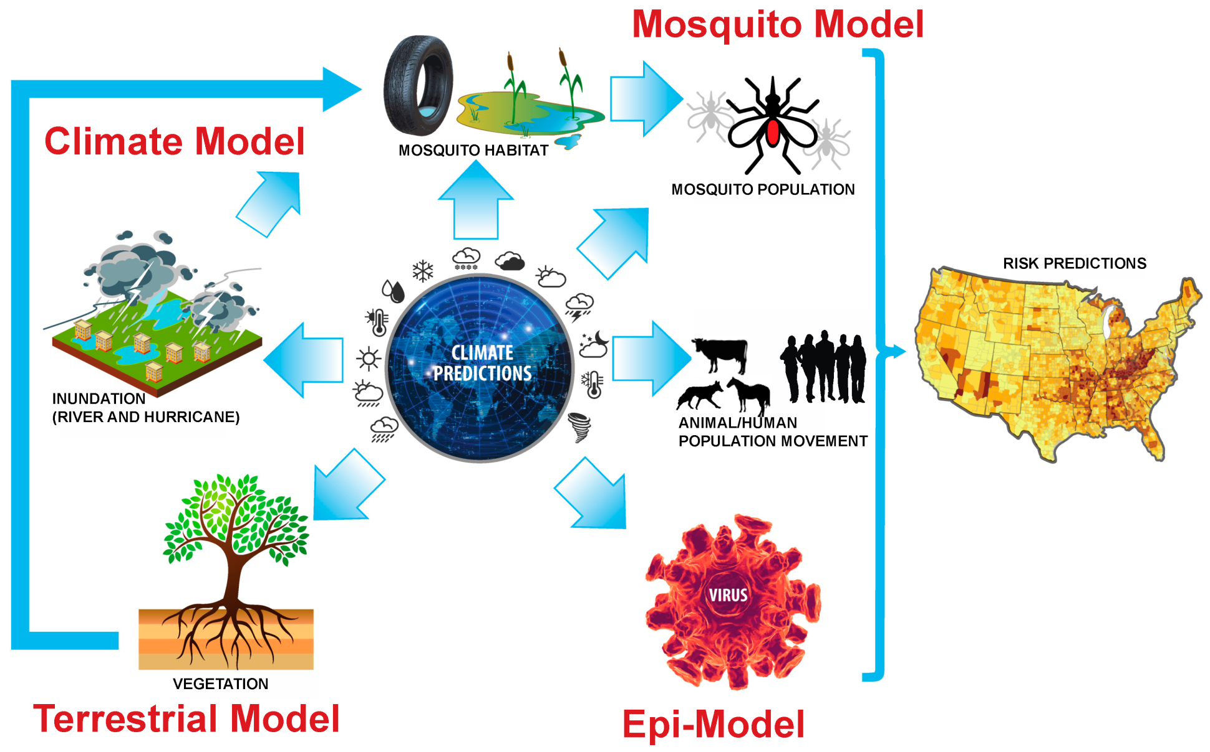
Climate impacts, Zoonosis, Human Health
https://www.bing.com/ accessed 19th February, 2021

Slide 6
Zoonosis Transfer
Viral transfer primarily within 6,495 mammals: wild and domestic herbivours; goats, sheep, cattle, camels, pigs, rats, bats, primates.
Other vertebrate animals; fish, amphibians, reptiles and birds. Bird flu is an exception.
Rabies best-known and most feared of all zoonotic diseases – (prior to COVID!). Infections route unknown, but zoonotic transmission from pigs suggested.
Notes:
iral – COVID-19, SARS, MURS, RVF, Bacterial, Protozoans

Slide 7
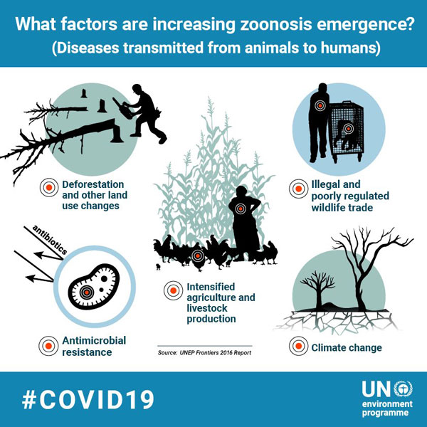
Climate Change > Ecosystem + Human Health > Zoonosis
https://www.bing.com/ accessed 19th February, 2021
Notes:
Illustration showing connection with: Increasing human population, needing more food, clearcutting of forests, and plowing of grasslands for planting, releases CO2, reduces albedo, increased consumption, increase in use of vehicles emitting CO2, reducing biodiversity and indigenous wild areas bringing more people in contact with more wild animals, viruses, bacteria and invertebrate vectors. Global warming increases energy available, intensity and frequency of storms, more cutting of trees reduces Carbon sequestration, cooling effects of trees, reduces precipitation. Freezing days reduced, allowing invasive and pathogenic species increase. Increases imbalance in ecosystems and zoonosis.

Slide 8
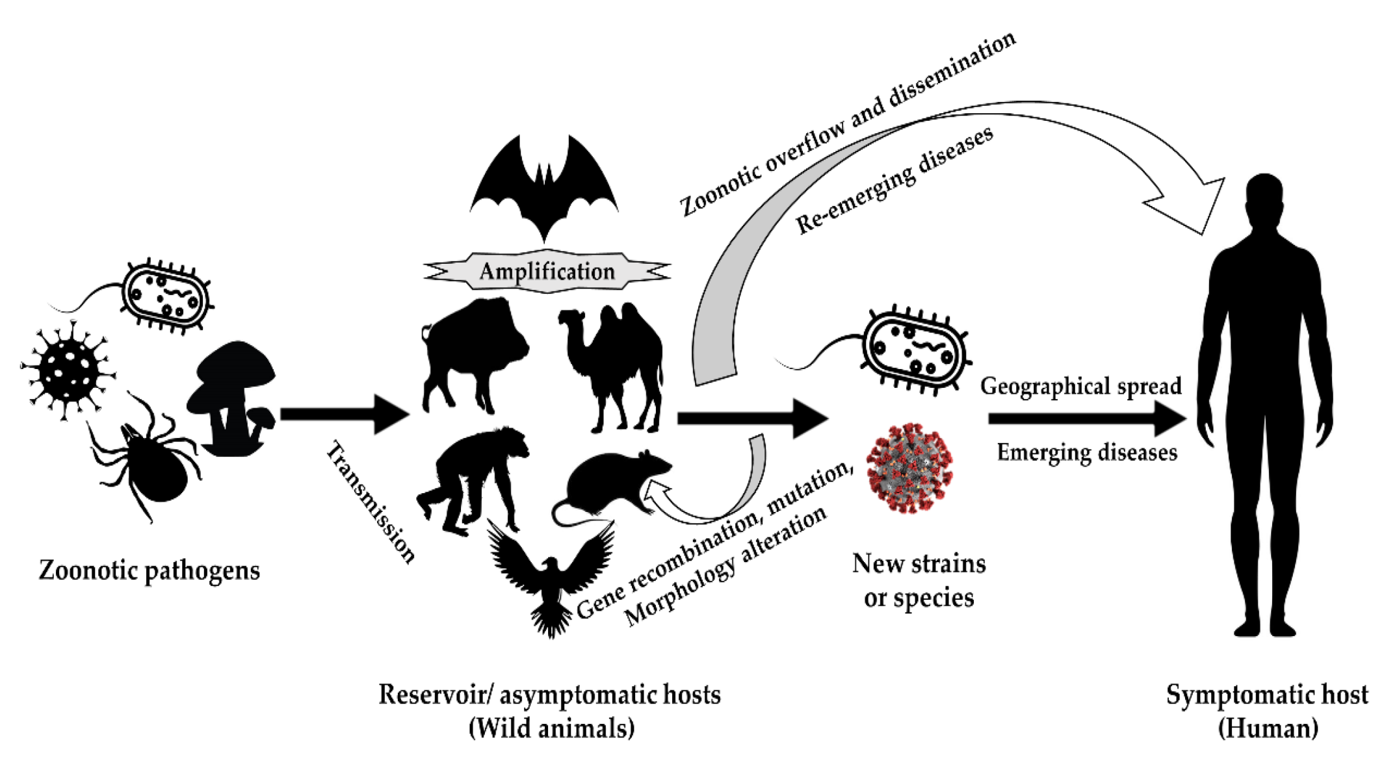
Zoonotic Disease Transmission
https://www.bing.com/ accessed 19th February, 2021

Slide 9
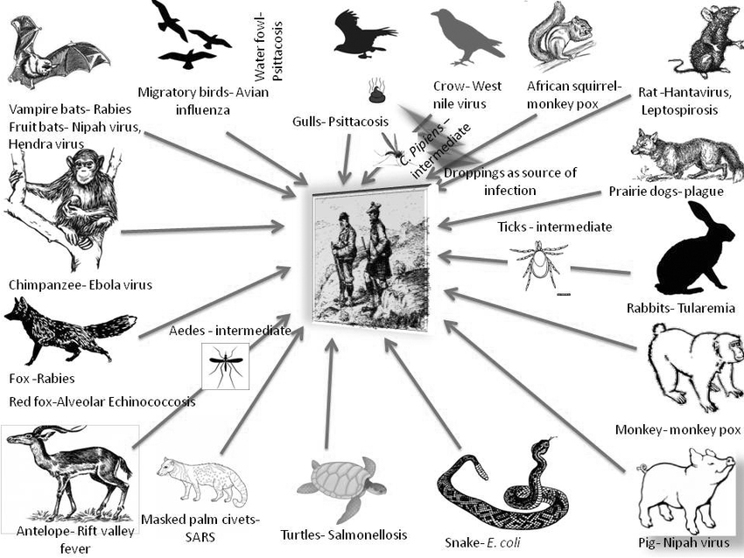
Zoonotic transfer to Human
Image: Microsoft Bing, zoonotic disease transmission. Accessed 18th February, 2021
Notes:
Image: Microsoft Bing, zoonotic disease transmission. Accessed 18th February, 2021

Slide 10
Zoonotic Diseases in the US
Of major national health
concern.
Examples of tick, mosquito-borne diseases
Vector-borne diseases tripled from 2004 to 2016
Nine new pathogens introduced since 2004
US has 14 fourteen vector-borne diseases
Six are spread by ticks
Seven by mosquito
One by fleas – the plague
Rocky Mountain Spotted Fever (RMSF)
Lyme disease
West Nile virus
malaria
Zika
Dengue fever
Notes:
Lyme disease, West Nile virus, malaria, Dengue fever, Anthrax, bacterial infection caused by Bacillus anthracis endemic to arid regions in Africa, common in domesticated grazing herbivores; cattle, sheep, goats, camels, horses, and pigs. Originally found in wildlife including megaherbivours; elephants and giraffe.
Other zoonotic diseases in the US of concern; Anaplasmosis; parasite of ruminants. Babesiosis infection eukaryotic parasite. Ehrlichiosis flu-like bacterial infection.
References
US Global Research Program, Chapter 5.
The number of vector-borne diseases tripled in US 2004 to 2016 (CDC)
Nine new pathogens spread by mosquitoes & ticks discovered or introduced in the US since 2004 (CDC)
Possible introduction of Rift Valley Fever Virus

Slide 11
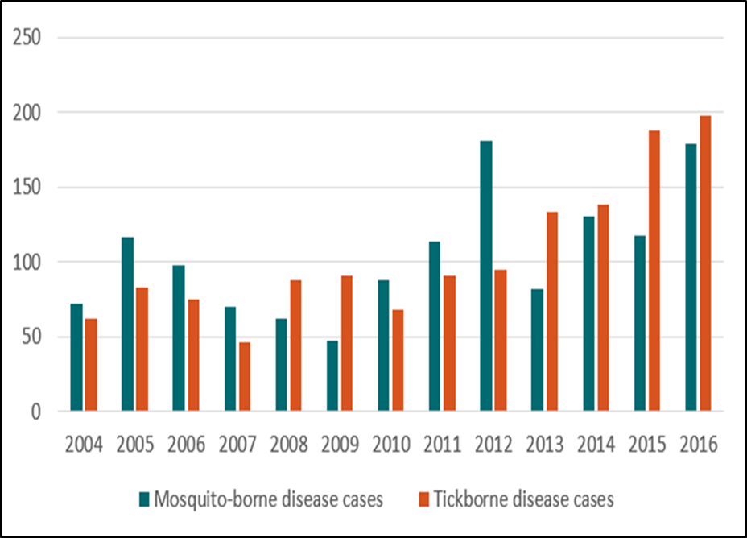
Ohio and Cuyahoga:
Zoonotic Disease Increase
Mosquito-Borne and Tick-Borne Disease Cases in Ohio (2004-2016
About the data: Centers for Disease Control and Prevention. National Notifiable Diseases Surveillance System, Annual Tables of Infectious Disease Data. Atlanta, GA. CDC Division of Health Informatics and Surveillance, 2005-2017.
Notes:
Ohio Department of Health: https://odh.ohio.gov/wps/portal/gov/odh/know-our-programs/zoonotic-disease-program/resources/lyme-disease

Slide 12
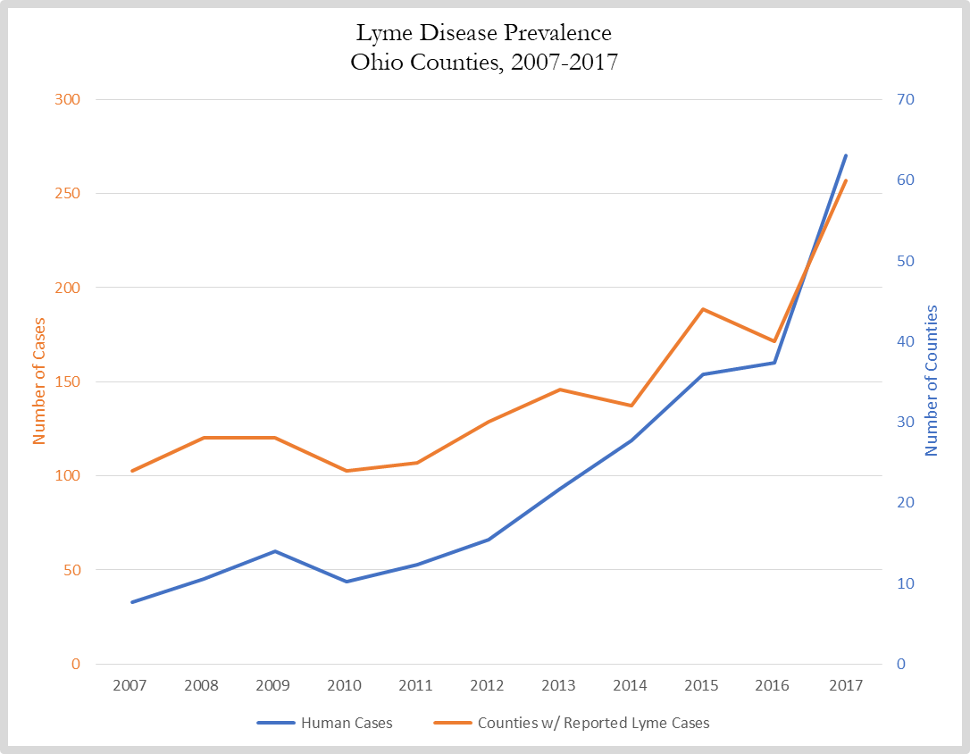
Lyme Disease
Source: Ohio Department of Health
Notes:
https://odh.ohio.gov/wps/portal/gov/odh/know-our-programs/zoonotic-disease-program/resources/lyme-disease

Slide 13
Climate Change & Zoonosis, link? Rising CO2
CO2: Pre-2000 < 400 ppm. 2020 > 416 ppm
More heat days - Longer growing seasons
Fewer freezing days killing invasive, non-indigenous, pathogenic species
Deforestation and land clearing, decreases natural ecosystems
Decreases albedo, increases temperature
Built/urban development creates, novel habitats, increase breeding sites for vectors

Slide 14
Zoonotic Diseases in Ohio
Cuyahoga/Ohio Vector-borne diseases 2017
Malaria (56), LaCrosse encyphalitous (4), Jamestown Canyon (2), Unspecified California (11).
Travel-associated mosquito-borne diseases; Ohio (2018)
Chikungunya virus – 3
Dengue Fever – 3 most wide-spread global disease, found in 125 countries.
Zika – 4
West Nile Virus – (27 cases)
Cattle, sheep farming in arid US states possible infection route for Rift Valley Fever (RVF) vectors
Notes:
Statistics from Ohio Department of Health, 2016 at; http://www.odh.ohio.gov/zdp. (ODH, 2017).
3 cases of Chikungunya, 4 cases of Zika virus, 56 cases of Malaria, and 3 cases of Dengue Fever. Dengue Fever is now found in 125 countries, and is regarded as the
most wide-spread global disease (ODH, 2017, 2018).
Rift Valley Fever (RVF) vectors (http://mcevbd.wisc.edu/).

Slide 15
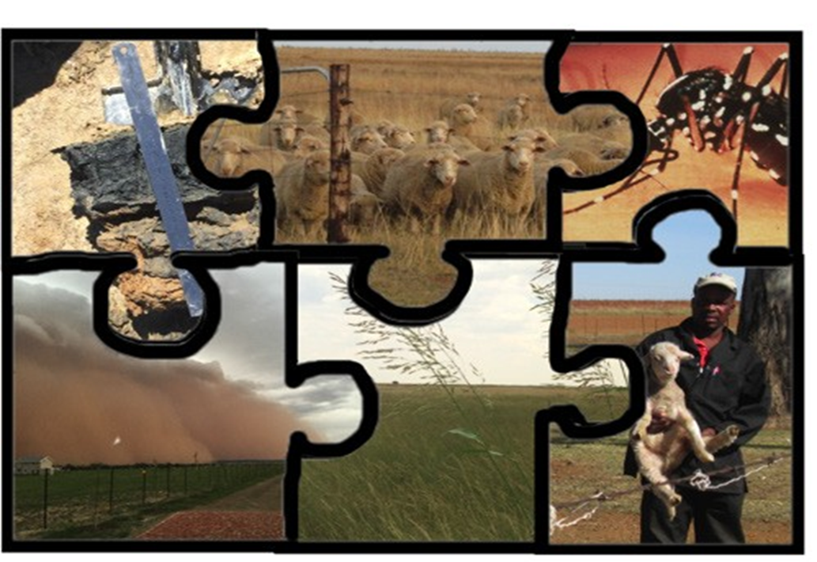
Zoonosis, A Personal Account:
Understanding Rift Valley Fever

Slide 16
Zoonotic Research in South Africa:
The Puzzle of Rift Valley Fever
Highly complex: Field Work: vegetation, botany, geology, soils, climatology, weather, rain, mosquito. Laboratory Analysis; virology, veterinary, entomology, epidemiology, sample & data analysis plus curation.
Numerous Partners; Local, National, International.
Expensive > 1 Meg $ 000’s annually.
Long-term; 5 years minimum.
Non-scientists: Farmers, farm labourers, politicians, administrators, interested public, business.
Many meetings, workshops and symposia.
Education: Presentations & pamphlets in suitable language; Afrikaans, Sesotho, Setswana, Tswana.
Notes:
There are 11 officially spoken languages in South Africa. Zulu and Xhosa are Nguni-based languages, not common in the Free State and Northern Cape, the sites for the RFV study.

Slide 17











Partners
The project depicted is sponsored by the U.S. Department of Defense, Defense Threat Reduction Agency. The content of the information does not necessarily reflect the position or the policy of the federal government, and no official endorsement should be inferred.

Slide 18
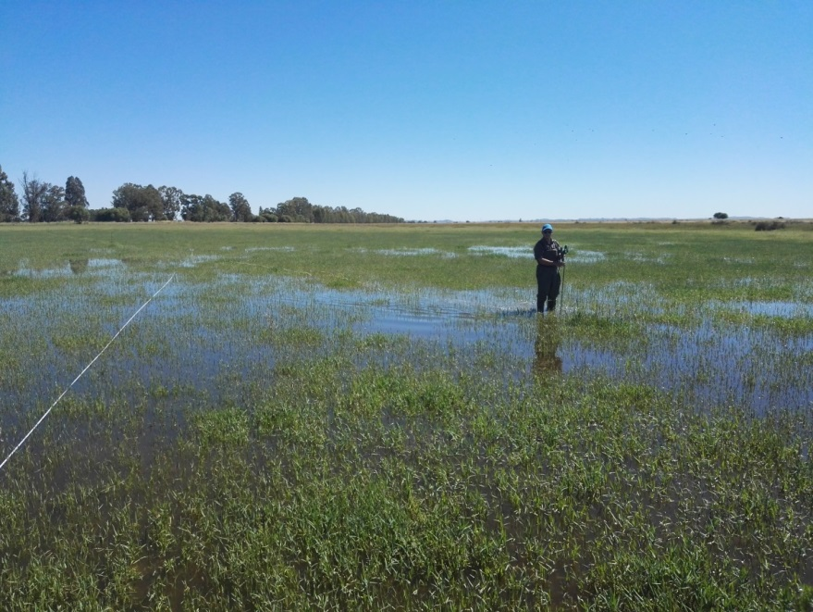
A One Health Approach: Ecological and Epidemiological Understanding of Rift Valley Fever Virus (RVFV)
RVF remains a mysterious virus.
Confined to Africa and Arabian.
Outbreaks, rarely predicted, sporadic, large, occur in non-human animals.
Close association with heavy rainfall and flooding.
The 2010-2011 outbreak infected 300 human, in close contact with blood or meat from infected sheep and cattle.
Infected 800 cattle, 700 goats, & 16,500 sheep.
Virus infects wild antelope and buffalo but affects are largely unknown.
Notes:
Rostal MK, Ross N, Machalaba C, Cordel C, Paweska JT, Karesh WB. (2018) Benefits of a One Health approach: An example using Rift Valley fever. One Health 5:34-36. DOI: 10.1016/j.onehlt.2018.01.001.

Slide 19
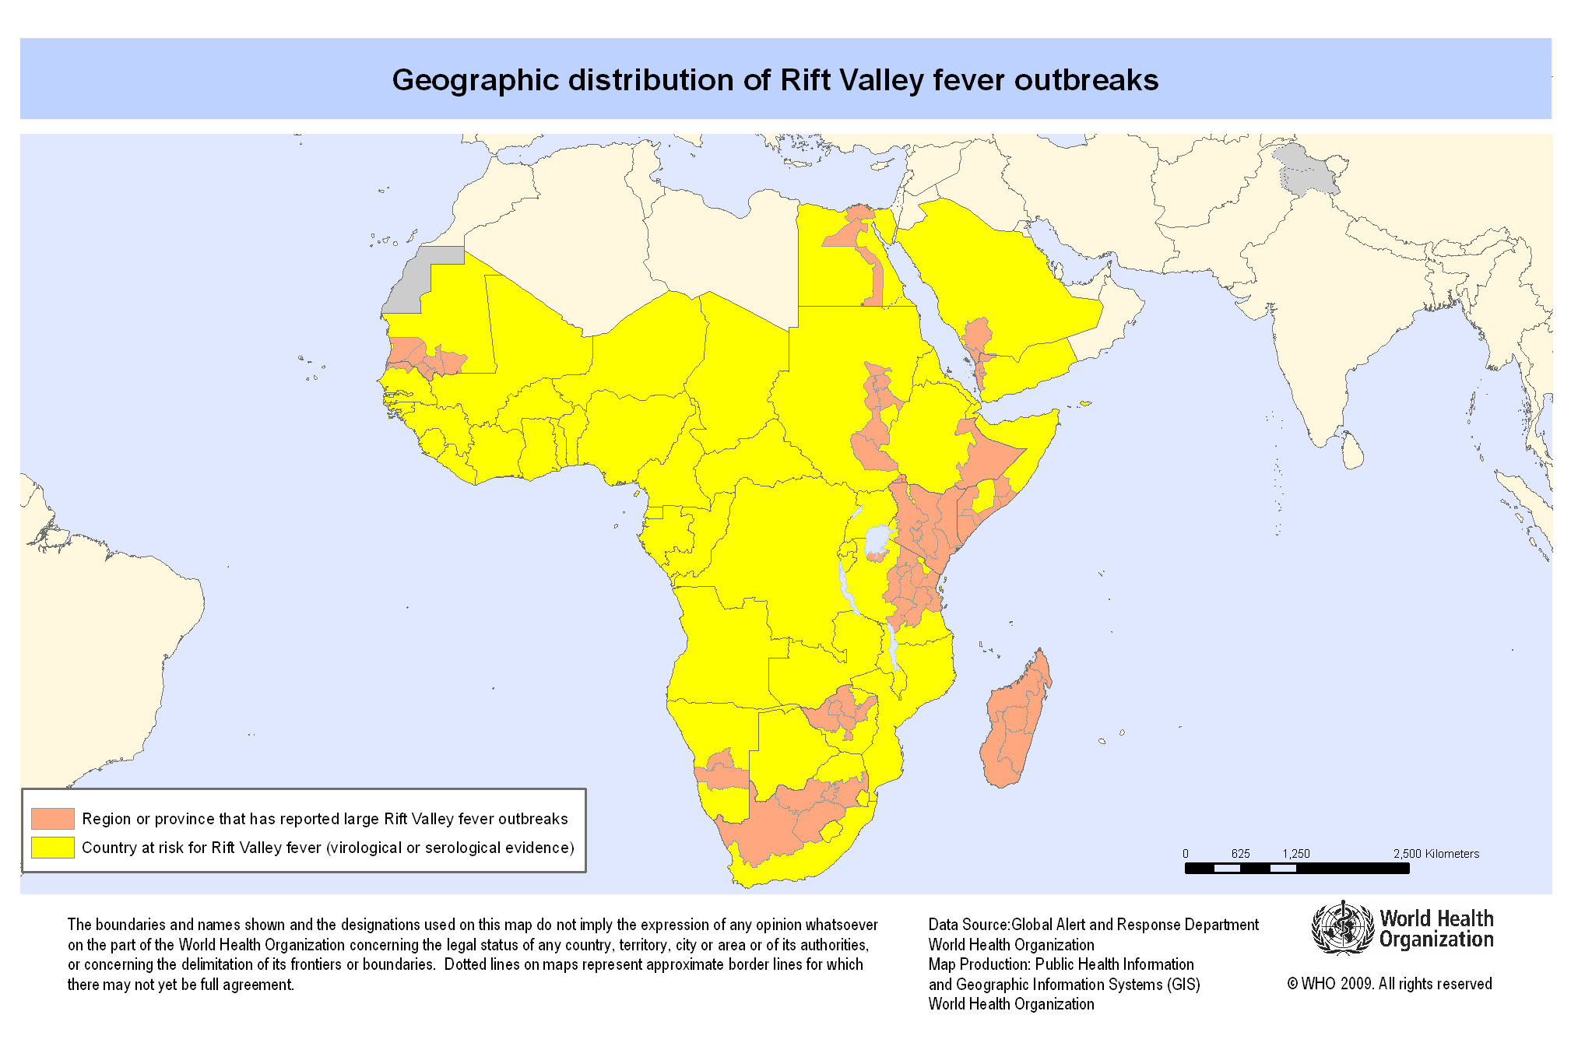
Rift Valley Fever in Africa

Slide 20
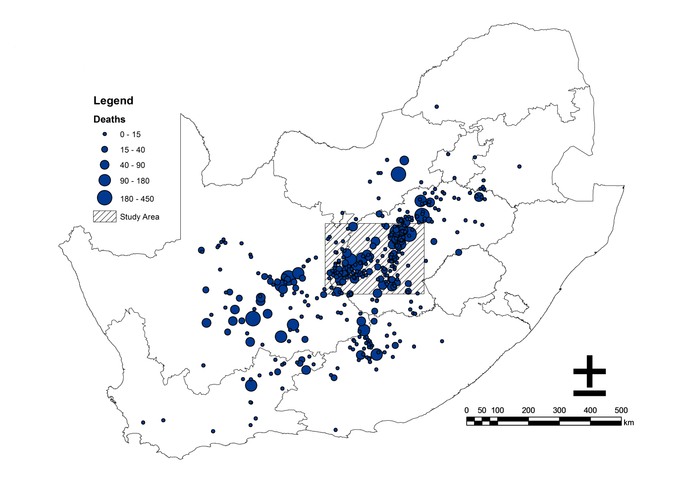
Free State study area for 2010 Rift Valley Fever outbreak, South Africa

Slide 21
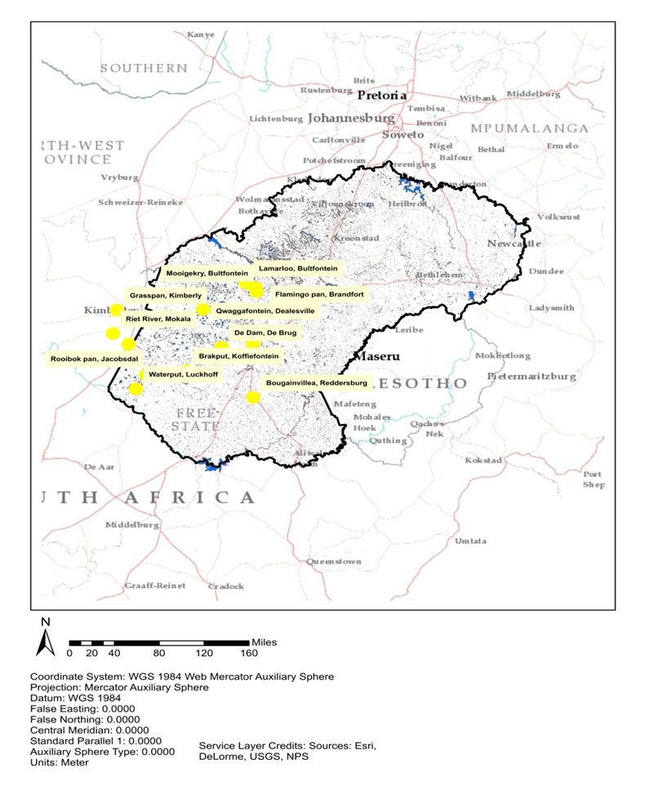
Assess > 50 farms on 40 000 km2 Select 15 - 22 study sites

Slide 22
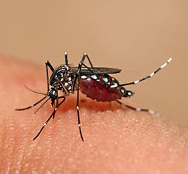

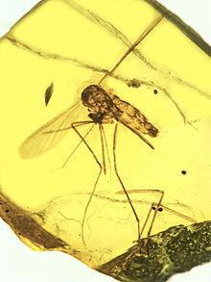
What is Rift Valley Fever?
First identified in the Rift Valley, Kenya in 1924.
Arbovirus - arthropod-borne Zoonotic disease – spread by Aedes mosquitoes > 700 species, Culex amplifying vector > 1000 sp.
Mosquitoes 200 Mil years old, in amber 100 My.
Phlebovirus genus, cause disease in domestic and wild ruminants spread to humans, causing;
Haemoragic fever, retinitis, hepatitis, neurological disease and death.
Up to 100% abortions in ewes.
Outbreaks every 20 years; 3 in South Africa ; 1950-51, 1974-5, 2010-2011
Notes:
RFV poses a threat with globalization and the potential transport of an RVFV-infected mosquito, animal, or person. retinitis, hepatitis, neurological disease or hemorrhagic fever and cause death
Reference
Rostal MK, Cordel C, van Staden L, Haydon D, Paweska JP, Karesh WB, Cleaveland S, Matthews L, Ross N. (2020) Predictors of Livestock Mortalities and Abortions During the 2010 Rift Valley Fever Outbreak in Central South Africa. Pathogens 9:914. DOI: 10.3390/pathogens9110914.
Msimang V, Thompson PN, Jansen van Vuren P, Tempia S, Cordel C, Kgaladi J, Khosa J, Burt FJ, Liang J, Rostal MK, Karesh WB, Paweska JP. (2019) Rift Valley fever virus exposure amongst farmers, farm workers, and veterinary professionals in central South Africa. Viruses 11:140. DOI: 10.3390/v11020140.

Slide 23
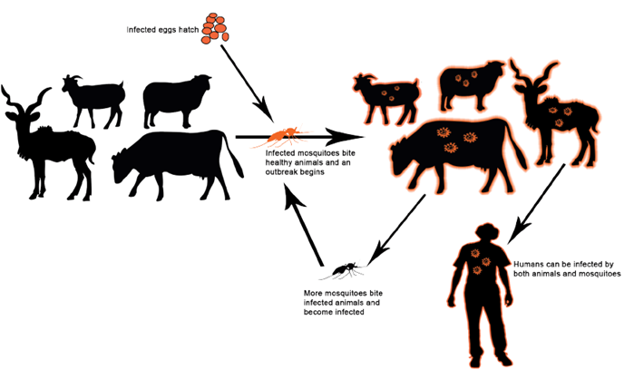
Rift Valley Fever Zoonosis; Cycle of infection via vector
Copyright; EcoHealth Alliance and the National Institute for Communicable Diseases (NICD).
Notes:
Rostal MK, Liang JE, Zimmermann D, Bengis R, Paweska JP, Karesh WB. (2017) Rift Valley fever: Does wildlife play a role? International Journal of Laboratory Animals 1–12. DOI: 10.1093/ilar/ilx023.

Slide 24
Ecology of RVF virus during inter-epidemic periods poorly understood
Outbreaks correspond with the warm phases of the EI Niño/Southern Oscillation, increase rain.
Primarily spread by infected Aedes mosquito bite 4-5 species, & Culex as secondary vector.
Herbivours grazing in wetlands, Aedes habitat, fly 300m only. Culex fly 5 km, amplify.
Second method; Virus spread transovarially, desiccation resistant eggs survive long enough to maintain the virus between outbreaks.
Low level of RVFV transmission occurs during inter-epidemic periods in wildlife, livestock.

Slide 25
Context for the ecology and wetland vegetation study in South Africa
Cost of RVF 2008–2010: R 295.3 million >$60 mil.
Total deaths: 8877 farm animals+ 24 humans
Total outbreaks on 489 farms, widespread.
Species | Susceptible | Cases | Deaths | Destroyed
Sheep | 265 080 | 13 117 | 8 078 | 512
Cattle | 70 445 | 738 | 448 | 7
Goats | 5 993 | 157 | 86 | 11
Goats/sheep | 5 163 | 269 | 204 | 1
Wild species | 9 344 | 52 | 52 | 0
Camelidae | 227 | 5 | 5 | 0
Buffaloes | 146 | 4 | 4 | 0
Totals | 356 398 | 14 342 | 8 877 | 530
Data derived from RSA, OIE Report 17, pp. 98.

Slide 26
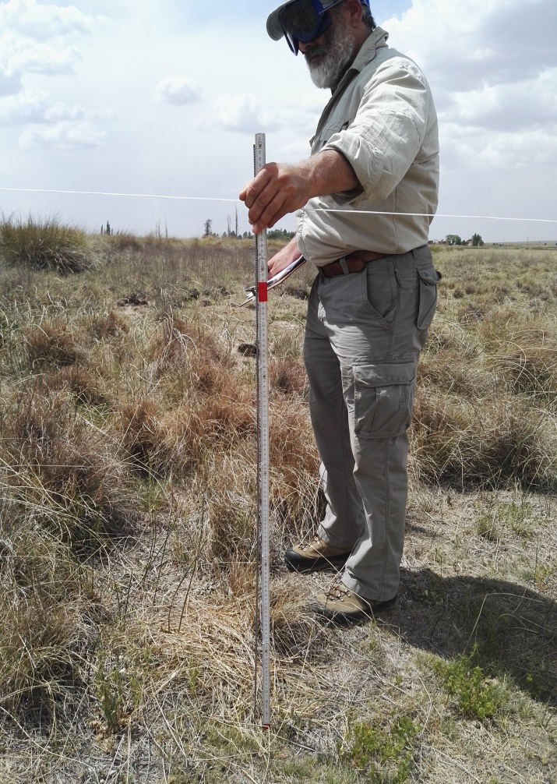
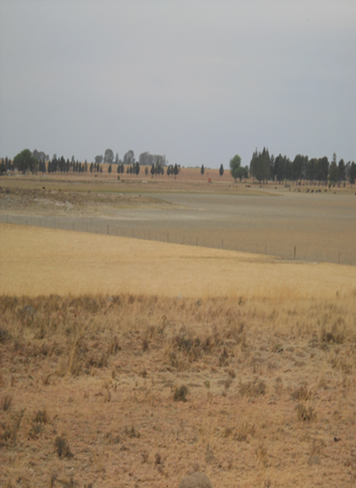
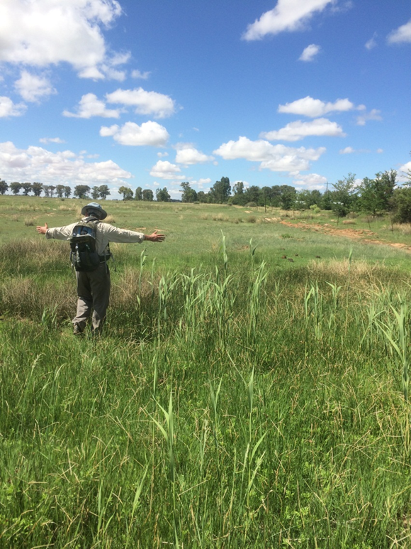
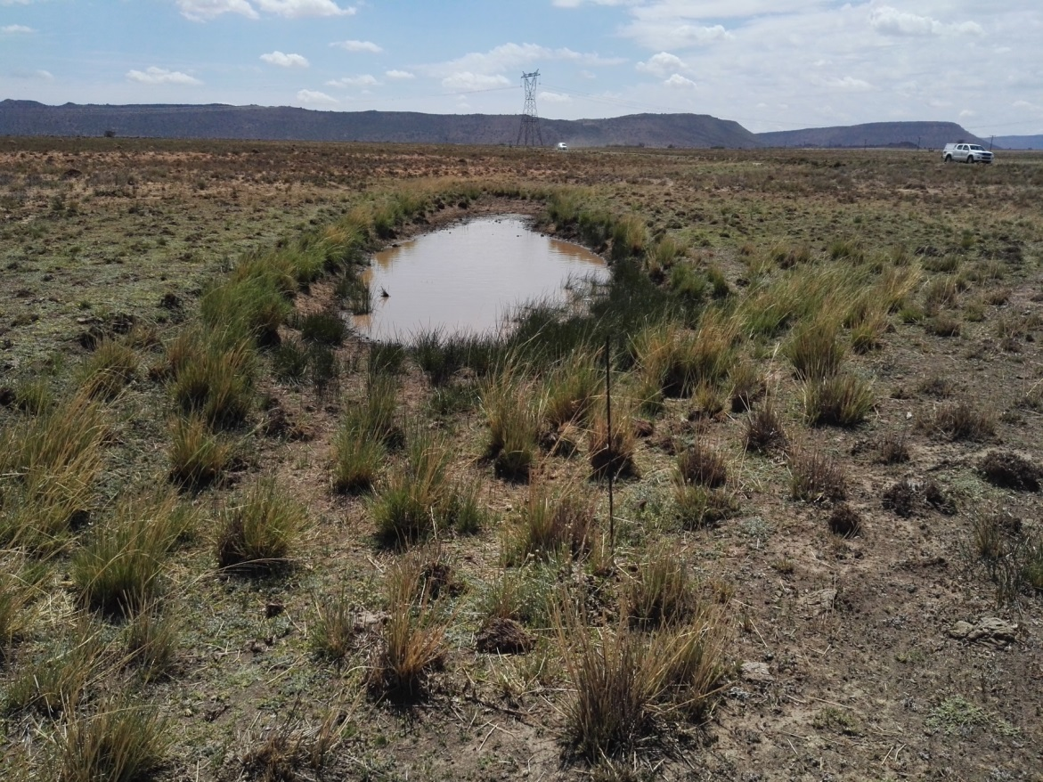
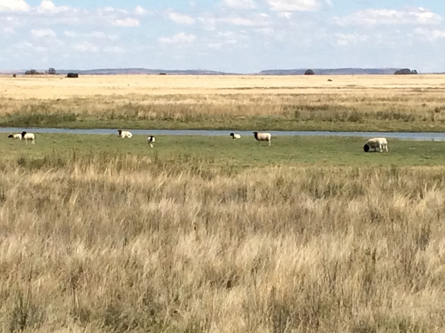
Assess 22 Wetlands & 132 relevés Collect 200 Plants
Notes:
Brand, R.F., Rostal, M.K., Kemp, A., Anyamba, A., Zwiegers, H., Van Huyssteen, C.W., Karesh, W.B., Paweska, J.T., February 20, 2018, A phytosociological analysis and description of wetland vegetation and ecological factors associated with locations of high mortality for the 2010-11 Rift Valley fever outbreak in South Africa. PLOS ONE. https://doi.org/10.1371/journal.pone.0191585

Slide 27
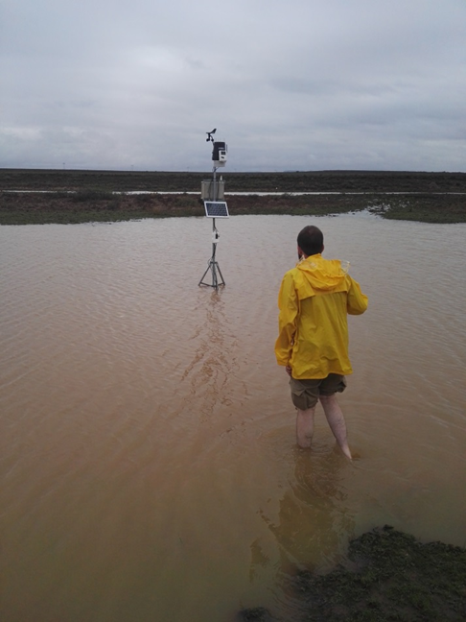
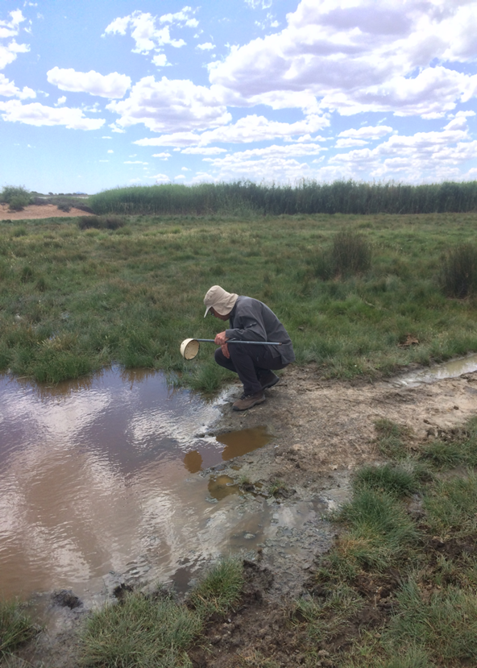
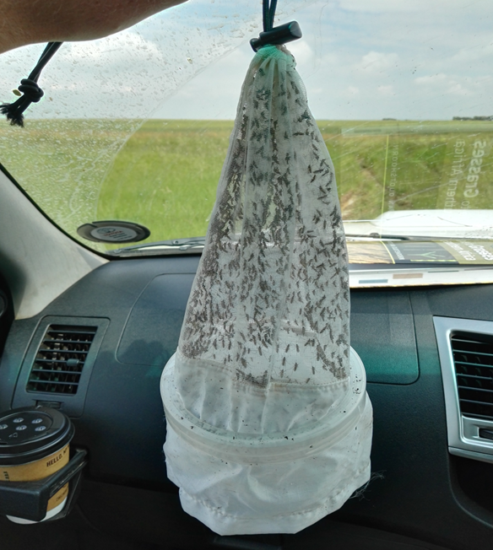
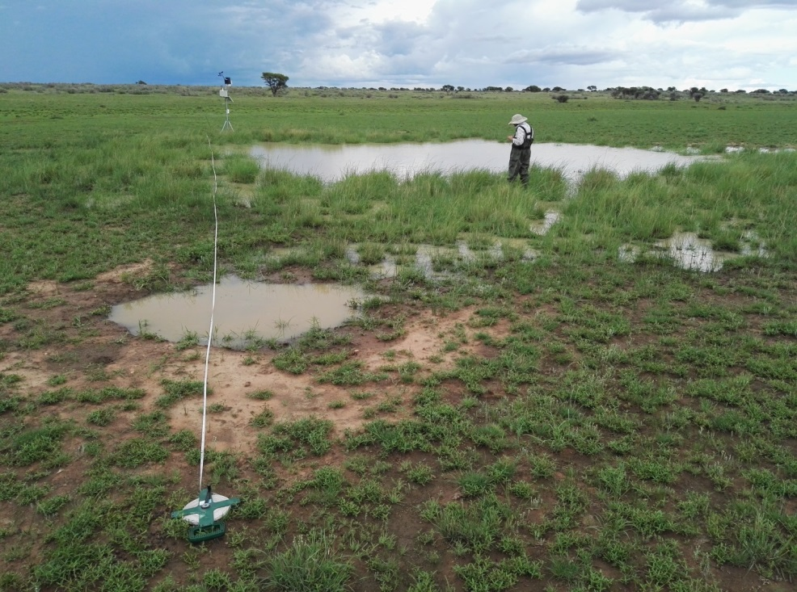
Mosquito; 115000 collect, 5000 identified. 22 Weather Stations installed

Slide 28
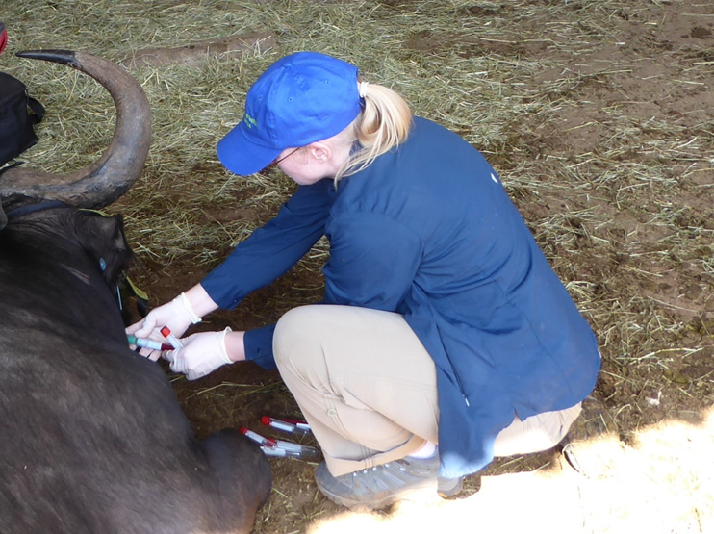
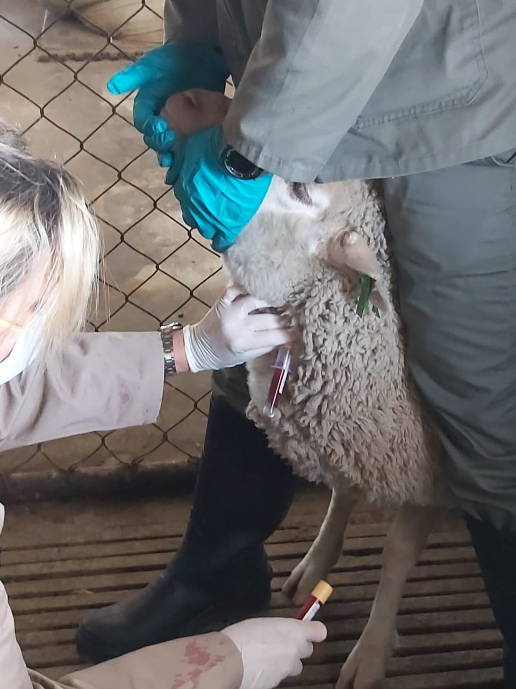
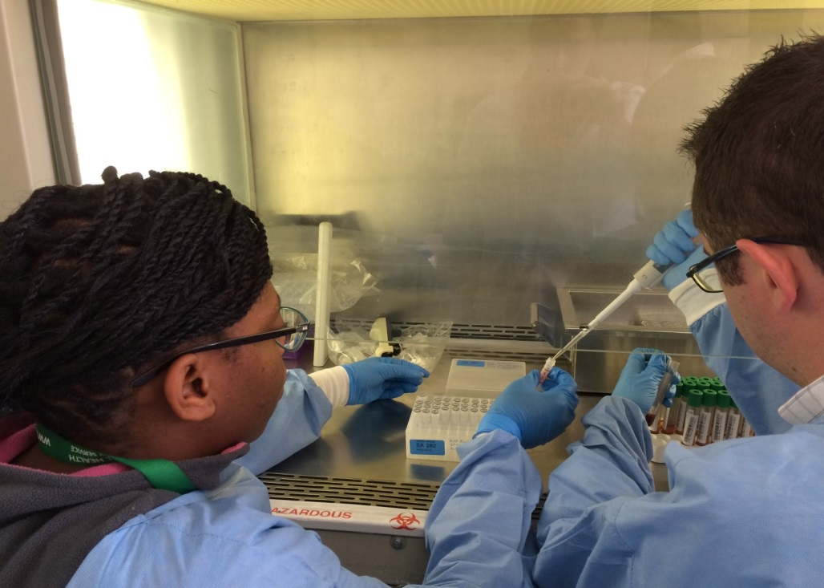
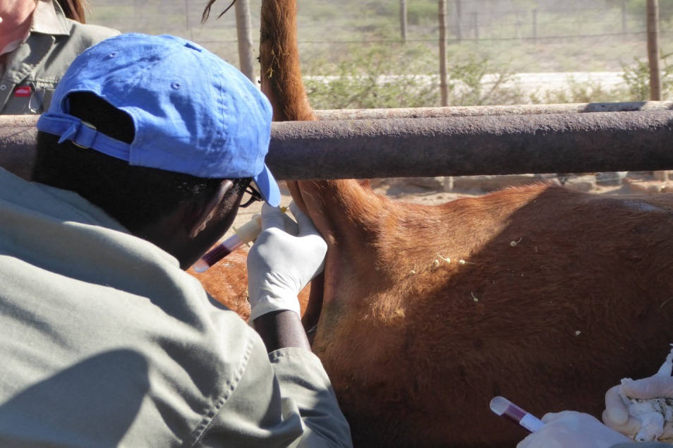
Blood sampling; livestock, 6458, antelope/buffalo, 2475, human serology, 1247
Lab work; 10180 analysed
Notes:
Msimang V, Thompson PN, Jansen van Vuren P, Tempia S, Cordel C, Kgaladi J, Khosa J, Burt FJ, Liang J, Rostal MK, Karesh WB, Paweska JP. (2019) Rift Valley fever virus exposure amongst farmers, farm workers, and veterinary professionals in central South Africa. Viruses 11:140. DOI: 10.3390/v11020140.

Slide 29
RFV Data Collected
22 sites & 132 relevés assessed over 40,000 km2.
> 200 plants identified, described and vouchered.
± 120 soil samples collected and analysed.
>115000 mosquitoes collect & 5000 identified.
Publications: peer reviewed: 7, and others: 6
International seminars: 6, workshops: 4
Bloodwork: livestock, 6458; antelope/buffalo: 2475.
Numbers of humans tested for serology: 1247
22 weather stations installed at sites.
Student degrees: 5 (+2 US) masters, 1 (+3 US) PhDs produced – 5 undergrad students.
Notes:
RVF References
Rostal MK, Cordel C, van Staden L, Haydon D, Paweska JP, Karesh WB, Cleaveland S, Matthews L, Ross N. (2020) Predictors of Livestock Mortalities and Abortions During the 2010 Rift Valley Fever Outbreak in Central South Africa. Pathogens 9:914. DOI: 10.3390/pathogens9110914.
Verster AM, Rostal MK, Liang JE, Kemp A, Brand RF, Anyamba A, Schal R, Paweska JT, Karesh WB, van Huyssteen CW. (2020) Selected wetland soil properties correlate to Rift Valley fever livestock mortalities reported in 2009-10 in central South Africa. PLoS One 15(5):e0232481. DOI: 10.1371/journal.pone.0232481.
Ngoshe Y*, Avenant L*, Rostal MK, Karesh WB, Paweska JP, Bagge WB, Jansen van Vuren, JP, Kemp A, Cordel C, Msimang V, Thompson P. (2020) Patterns of Rift Valley fever virus seropositivity in domestic ruminants in central South Africa four years after a large outbreak. Scientific Reports 10:5489. DOI: 10.1038/s41598-020-62453-6.
Msimang V, Thompson PN, Jansen van Vuren P, Tempia S, Cordel C, Kgaladi J, Khosa J, Burt FJ, Liang J, Rostal MK, Karesh WB, Paweska JP. (2019) Rift Valley fever virus exposure amongst farmers, farm workers, and veterinary professionals in central South Africa. Viruses 11:140. DOI: 10.3390/v11020140.
Brand R, Rostal MK, Kemp A, Anyamba A, Zweigers H, van Huuysteen C, Karesh WB, Paweska JP. (2018) A phytosociological analysis and description of wetland vegetation and ecological factors associated with locations of high mortality for the 2010-11 Rift Valley fever outbreak in South Africa. PLoS One 13(2): e0191585. DOI: 10.1371/journal.pone.0191585.
Rostal MK, Ross N, Machalaba C, Cordel C, Paweska JT, Karesh WB. (2018) Benefits of a One Health approach: An example using Rift Valley fever. One Health 5:34-36. DOI: 10.1016/j.onehlt.2018.01.001.
Rostal MK, Liang JE, Zimmermann D, Bengis R, Paweska JP, Karesh WB. (2017) Rift Valley fever: Does wildlife play a role? International Journal of Laboratory Animals 1–12. DOI: 10.1093/ilar/ilx023.

Slide 30
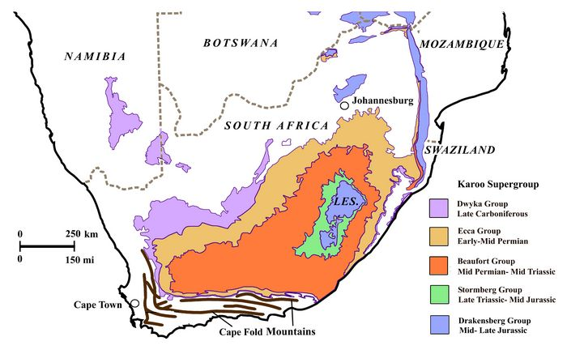
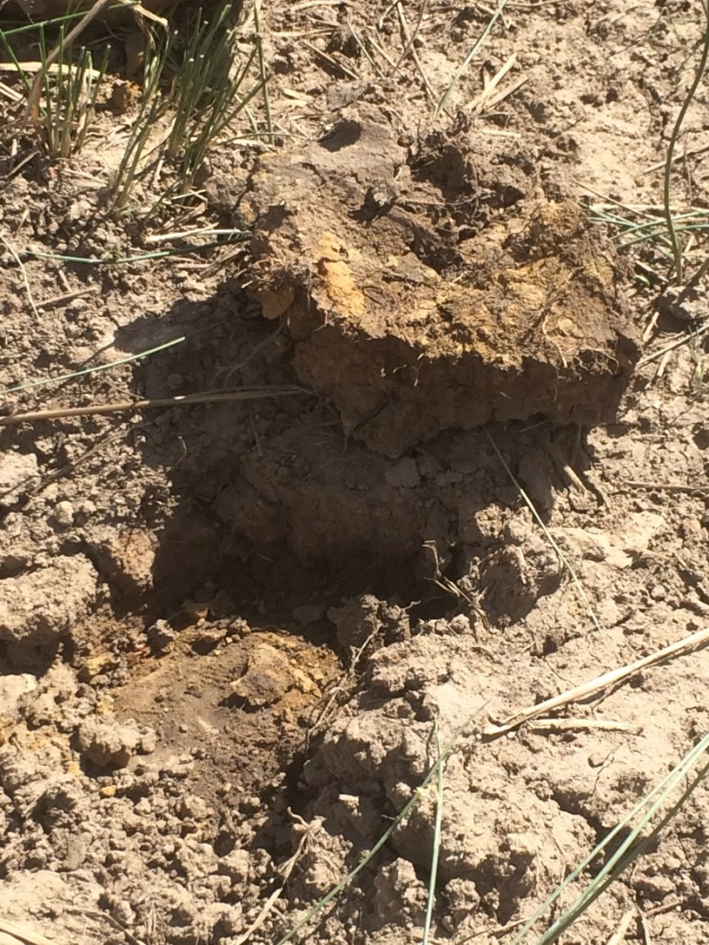
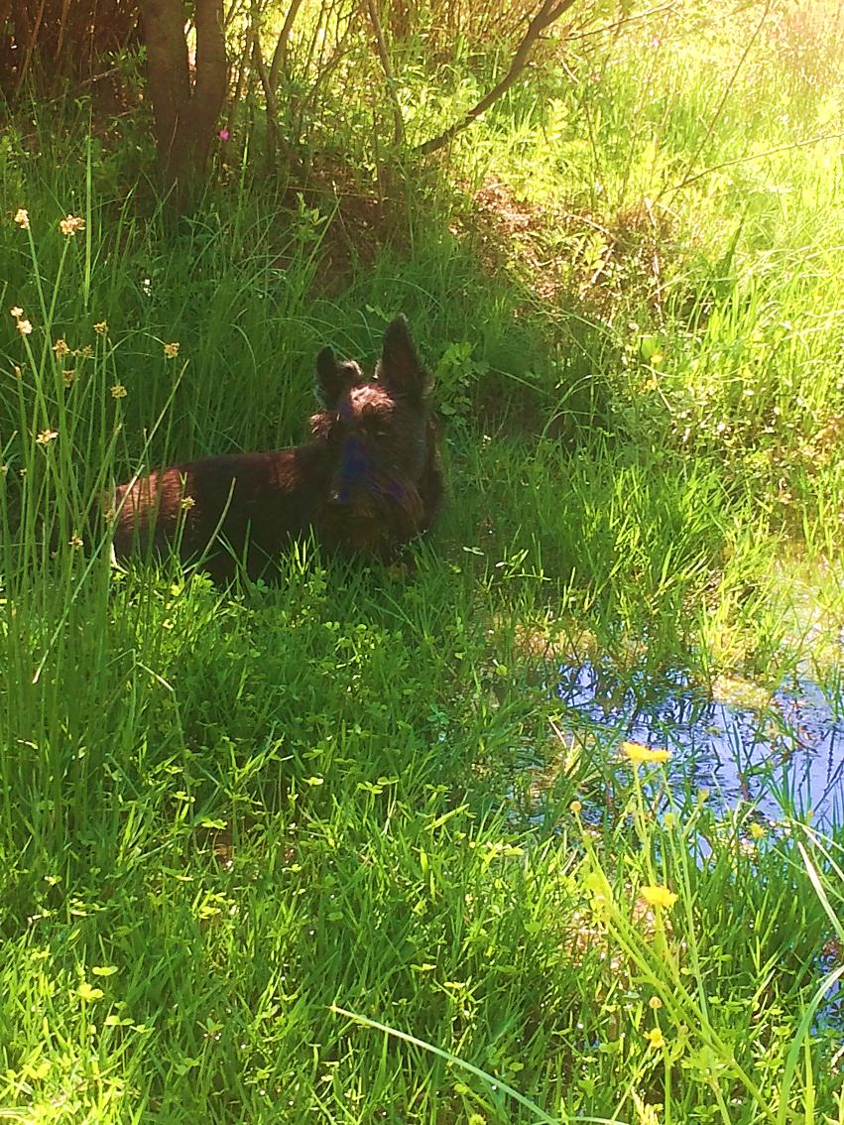
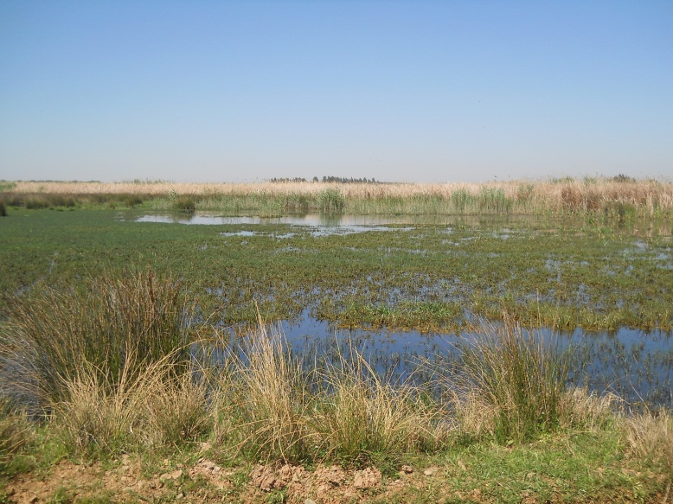
Results and findings: Ecological Relationships
Geology; Ecca, Beaufort series and
High clay-content soils, forming
Wetland categories 2, non-saline upland depressions
Juncus/sedge plant associations 2 flooding periods from heavy rain
Notes:
Verster, AM., Liang, JE., Rostal, M.K., Kemp, A., Brand, R.F., Anyamba, A., Cordel, C., Schall, R., Paweska, J.T., Karesh, W.B., van Huyssteen C.W., May 18th, 2020. Wetland soil properties correlated to reported-Rift Valley fever mortalities in central South Africa. PLoSONE 15(5):e0232481.https://doi.org/10.1371 https://www.researchgate.net/publication/341470813

Slide 31
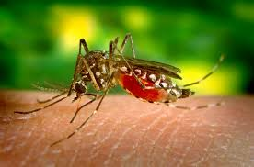
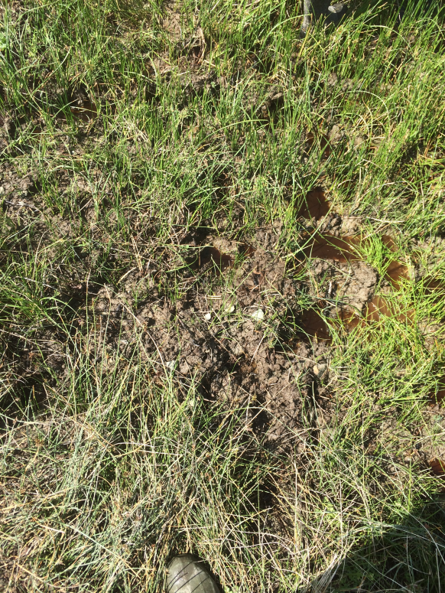
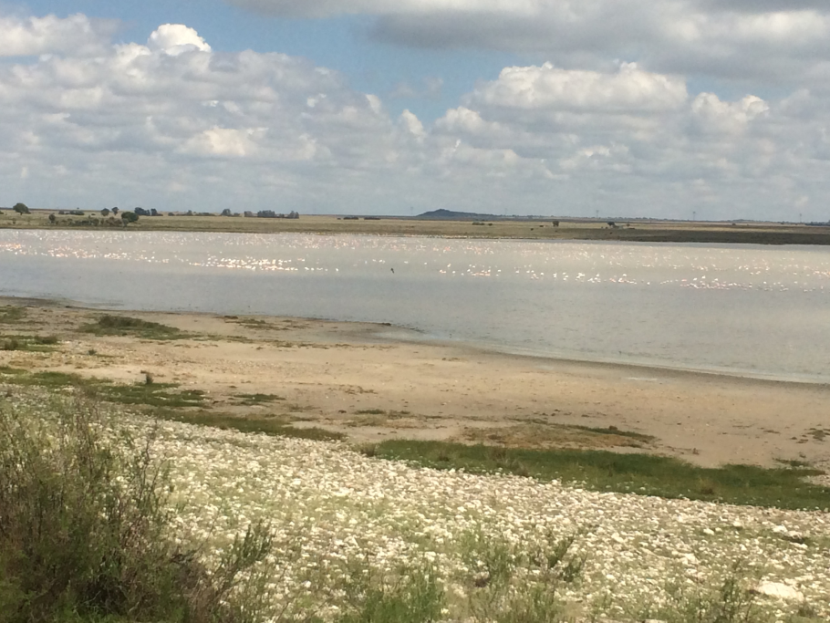
Survival of mosquito eggs and Virus
Survival factors: Virus may aestivate during inter-outbreak periods:
Clay soils
Vegetation matrix
Wetlands
Hypothesis for spreading
Extra-cellular nucleic acids found in aquatic + soil sediments
Transformed by >40 bacteria species able to modify their physiology to absorb and integrate DNA into their genome
Possible mechanism for RVFV?
Wetland birds may spread virus on legs, feathers, or blood in guts

Slide 32
Conclusion: Climate Change Impact on Zoonosis & RFV.
More frequent and intense outbreaks.
Better Understand environmental parameters.
Build resilience – develop affordable vaccine.
Change behaviour – more information.
Education via papers & workshops - farmers, workers, scientists, students, media.
Develop management policy – Governments, Veterinarians, Healthcare workers, public.
Ongoing monitoring, evaluation, reassessment.

Slide 33
US and Globally; What’s Needed for
Ecosystems & Human Health?
Zoonosis increase in intensity & frequency.
Policies needed – ecosystem + human health.
Collaboration – regional, national, international.
Protection of indigenous biodiversity.
Resources are limited – Earth is finite.
Limits to (human) population growth – Malthus 1798 biological population growth curve.
Population & Economics – Ricardo 1821.
Economics; Alvin Toffler 1970 ‘Limits to Growth’
Notes:
Malthus, Thomas Robert (1798). An Essay on the Principle of Population. Oxfordshire, England: Oxford World's Classics. ISBN 978-1450535540.
Ricardo, David (1821). On the Principles of Political Economy and Taxation. John Murray.
Alvin Toffler, (1970). Future Shock, ‘Limits to Growth’, Bantam Books.
Alvin Toffler, (1980). The Third Wave, Bantam Books.

Slide 34
Climate Change & Zoonosis: Importance for Health Care Workers? What can You Do?
Increased extreme weather as CO2 levels rise
Increase in people with zoonotic disease.
This is; You, family, friends, patients!
Provide Health Care knowledge on zoonosis.
Importance of Education; self, others.
Steps you can take: reduce consumption.
Women's rights to reproductive health.
Reduce human impact on ecosystems.

Slide 35
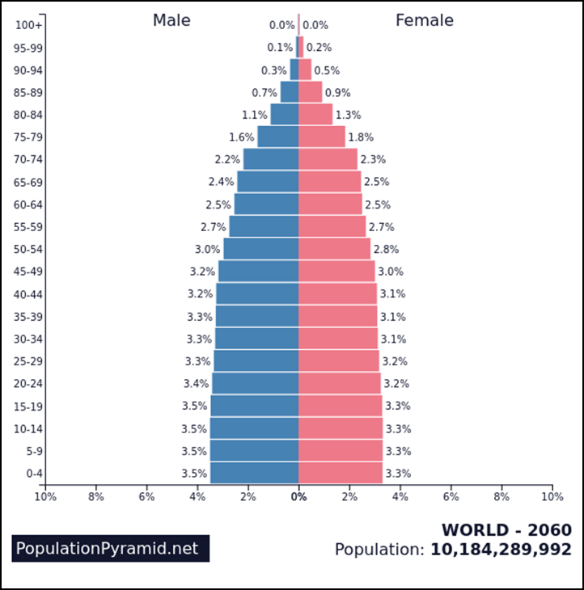
Human Population 2060, when you retire at age 65!
Climate Change and Zoonosis
World population 2060
10,184,289,992
2100 ±11 Gig
Habitat destruction
Urban development
Agriculture Increase
Raw materials
Industry demands
Greenhouse Gases
Notes:
Reference:
Population of WORLD 2060 - © December 2019 by PopulationPyramid.net, made available under a Creative Commons license CC BY 3.0 IGO: http://creativecommons.org/licenses/by/3.0/igo/. Accessed: February 18th 2021.

Slide 36
Questions?
Robert F. Brand
Office: 216-201-2001 x 1236
Cell: 216 213 9083
rbrand@ccbh.net

Slide 37
References
Eidson, Millicent. "Zoonotic disease". Encyclopedia Britannica, 4 Jan. 2018, https://www.britannica.com/science/zoonotic-disease. Accessed 18 February 2021)
Nava, A., et al., 2021. Anthropogenic drivers and Infectious Diseases diversity, Conference: EcoHealth Congress. DOI: 10.13140/RG.2.2.12103.52642.
A study by Simpson et al., in 2013, suggested at least 320,000 different viruses infect the 6,495 mammal species. If all vertebrates, invertebrates, plants, lichens, mushrooms, and brown algae are included an estimate of 100,939,140 viruses is made. This does not include viruses of bacteria, archaea, and other single-celled organisms (https://www.virology.ws/2013/09/06/how-many-viruses-on-earth).
Uddin, M., et al., 2020. Ecology of bat drinking behaviour and AMR patterns of Sal spp., Staphylococcus spp. and E. coli recovered from faecal droppings of bats and water in Dakar. International Journal of Infectious Disease, Volume 101, supplement 1. DOI: https://doi.org/10.1016/j.ijid.2020.09.060
Malthus, Thomas Robert (1798). An Essay on the Principle of Population. Oxfordshire, England: Oxford World's Classics. ISBN 978-1450535540.
Ricardo, David (1821). On the Principles of Political Economy and Taxation. John Murray.
Alvin Toffler, (1970). Future Shock, ‘Limits to Growth’, Bantam Books.
Alvin Toffler, (1980). The Third Wave, Bantam Books.
Rift Valley Fever (RVF) References
Linthicum K., Davies F., Bailey C., and Kairo A., 1984. Mosquito species encountered in a flooded grassland dambo in Kenya. Mosq News. http://cat.inist.fr/?aModele=affichN&cpsidt=89 13484
Britch S.C., and Linthicum K.J., 2007. Rift Valley Fever Working Group. Developing a research agenda and a comprehensive national prevention and response plan for Rift Valley fever in the United States. Emerg Infect Dis., Volume 13, Number 8. Available from http://www.cdc.gov/EID/content/13///e1.htm
Rostal MK, Cordel C, van Staden L, Haydon D, Paweska JP, Karesh WB, Cleaveland S, Matthews L, Ross N. (2020) Predictors of Livestock Mortalities and Abortions During the 2010 Rift Valley Fever Outbreak in Central South Africa. Pathogens 9:914. DOI: 10.3390/pathogens9110914.

Slide 38
References
Verster AM, Rostal MK, Liang JE, Kemp A, Brand RF, Anyamba A, Schal R, Paweska JT, Karesh WB, van Huyssteen CW. (2020) Selected wetland soil properties correlate to Rift Valley fever livestock mortalities reported in 2009-10 in central South Africa. PLoS One 15(5):e0232481. DOI: 10.1371/journal.pone.0232481.
Ngoshe Y*, Avenant L*, Rostal MK, Karesh WB, Paweska JP, Bagge WB, Jansen van Vuren, JP, Kemp A, Cordel C, Msimang V, Thompson P. (2020) Patterns of Rift Valley fever virus seropositivity in domestic ruminants in central South Africa four years after a large outbreak. Scientific Reports 10:5489. DOI: 10.1038/s41598-020-62453-6.
Msimang V, Thompson PN, Jansen van Vuren P, Tempia S, Cordel C, Kgaladi J, Khosa J, Burt FJ, Liang J, Rostal MK, Karesh WB, Paweska JP. (2019) Rift Valley fever virus exposure amongst farmers, farm workers, and veterinary professionals in central South Africa. Viruses 11:140. DOI: 10.3390/v11020140.
Brand R, Rostal MK, Kemp A, Anyamba A, Zweigers H, van Huuysteen C, Karesh WB, Paweska JP. (2018) A phytosociological analysis and description of wetland vegetation and ecological factors associated with locations of high mortality for the 2010-11 Rift Valley fever outbreak in South Africa. PLoS One 13(2): e0191585. DOI: 10.1371/journal.pone.0191585.
Rostal MK, Ross N, Machalaba C, Cordel C, Paweska JT, Karesh WB. (2018) Benefits of a One Health approach: An example using Rift Valley fever. One Health 5:34-36. DOI: 10.1016/j.onehlt.2018.01.001.
Rostal MK, Liang JE, Zimmermann D, Bengis R, Paweska JP, Karesh WB. (2017) Rift Valley fever: Does wildlife play a role? International Journal of Laboratory Animals 1–12. DOI: 10.1093/ilar/ilx023

Slide 39


