Slide 1
Fossil Fuels and Health:
A frame that expands the picture
Timothy Ciesielski ScD MD MPH
Senior Research Associate
Mary Ann Swetland Center
for Environmental Health
Case Western Reserve University

Slide 2
Outline
1. Issue Framing: How do we talk about the
health costs of fossil fuel use?
2. What does Public Health have to say?
What is the evidence?
How is it connected?
3. What should we do with this this evidence?
4. Discussion and Questions

Slide 3
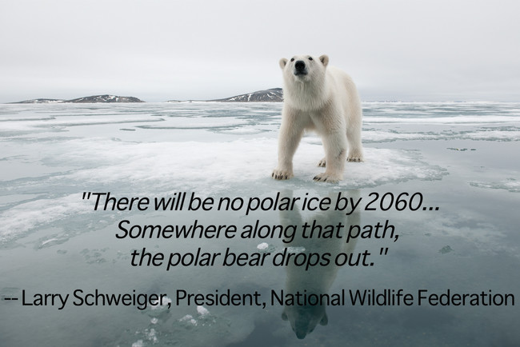
How do we typically talk about the problems with fossil fuel burning?
What is the first topic that usually comes up?
Ecosystem destruction
http://www.viralnova.com/polar-bear-week/

Slide 4
These discussions are very important . . .
but are they persuasive to everybody?
Maybe not
Some people do not seem concerned about these effects (even though they should be)
These effects can seem
far away
and mostly in the future

Slide 5
So if some people don’t care about arctic animals in 2060 . . .
what do they care about?
http://adoptafamily.org/
http://coloradoparentingmatters.org/2011/07/14/strengthening-families/
http://www.dailymail.co.uk/news/article-1345691/Families-babies-hit-hardest-Coalition-cuts.html

Slide 6
What if the use of fossil fuels had already harmed and was actively continuing to harm
Your family
Your friends
Your community
Your country
. . . and everyone else on the planet
It is
and the public health literature can tell this story

Slide 7
If people understand how unsustainable energy sources are already hurting their loved ones . . .
they can better perceive the problem and start talking with others about solutions
Others?
Governments (local and national)
Hospitals
Health Systems and Payers
Corporations
Organized Religions
Trade Associations
Educational Institutions etc.

Slide 8
To a large extent you
(the students and faculty here today)
already have a broad understanding of the health effects of fossil fuels that are mediated by climate change
and you know that fossil fuels are not the only driver of climate change
but we also cannot forget that climate change is not the only effect of fossil fuels
Notes:
The evidence we survey today suggests that we know enough beyond climate change to move away from fossil fuels now

Slide 9
Discussion Frames: A Ven Diagram of Health Effects
Climate Change
Effects
Fossil Fuel Mediated Climate Change Effects
Fossil Fuel
Effects

Slide 10
If we exclusively use the frame of climate change
effects beyond climate are discussed as
“latent co-benefits of mitigation” rather than ongoing documented harms
Is the term “co-benefits” . . .
helpful?
misleading?
Is removing harm a “bonus”?
or is it remediation and justice?

Slide 11
In other words,
The documented human suffering, inequity, and disease that flows from the use of fossil fuels is
insufficiently described when it is labeled as a “co-benefit” of climate change mitigation
Rather than an afterthought,
these are the first and well documented
(if poorly appreciated) harms of fossil fuels

Slide 12
Just to be clear:
We need the frame of climate change.
It is necessary.
Is it sufficient?
An additional frame to consider:
The public health impact of fossil fuels

Slide 13
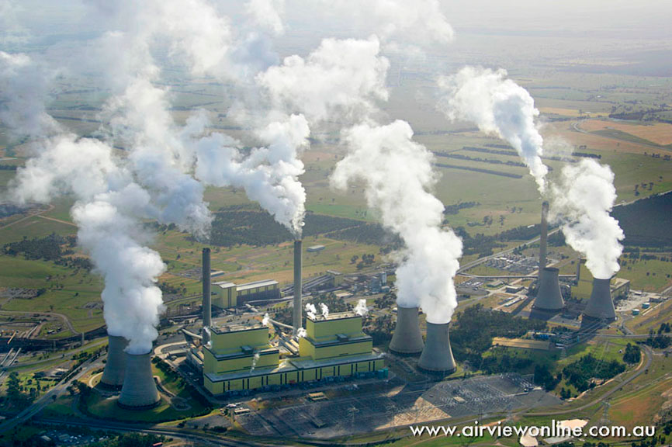
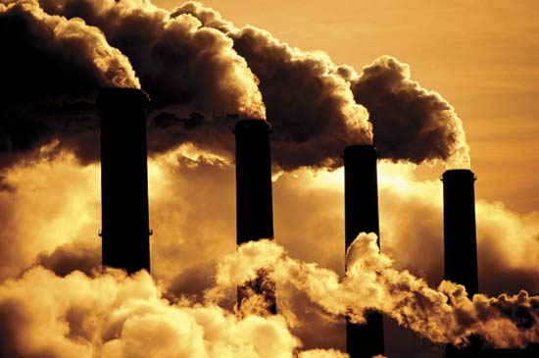
What is this doing to us?
What is this doing to our loved ones?
http://hardenup.org/climate-change/causes-of-climate-change/burning-fossil-fuels.aspx
http://www.britannica.com/science/global-warming/images-videos/Factories-that-burn-fossil-fuels-help-to-cause-global-warming/87019

Slide 14
The Public Health Impact
of Fossil Fuel Burning
Let’s start with
Climate Change Related Health Effects
more frequent severe weather events
(these come with injuries, illnesses, and deaths)
- changing C0₂ levels and temperatures may
increase allergens and asthma symptoms
Decreased quality or quantity of water supplies in some areas and increased probability of civil conflict
heat related disease and deaths increase
disease carrying insects further expand their geographic ranges (i.e. Malaria can go wherever the Anopheles mosquito goes)
http://www.cdc.gov/climateandhealth/effects/

Slide 15
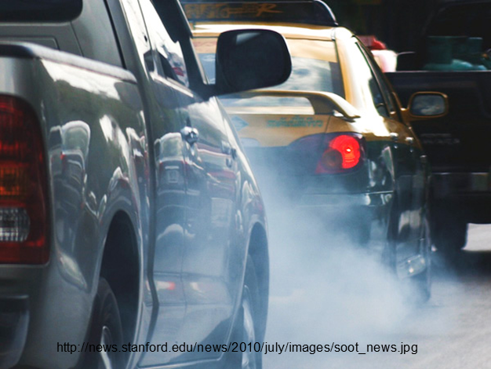
The Public Health Impact
of Fossil Fuel Burning
Ok . . .
these are the common problems that are discussed when public health people discuss climate change
These problems
are huge and serious
but . . .
Acting requires
changes
so maybe some are not convinced yet

Slide 16
The Public Health Impact
of Fossil Fuel Burning
If we think just a little more broadly about the burning of fossil fuels, we find a wide range of additional health issues to discuss.
Some of these issues are just now emerging but some are already very well described and have been harming our health for years.

Slide 17
The Public Health Impact
of Fossil Fuel Burning
Mercury in Fish
Burning coal has filled our dwindling global fish stocks with a potent neurotoxicant (methylmercury)
This has created major problems in Public Health.
Should we eat fish?
Which ones?
How much?

Slide 18
Mercury in Fish
Burning coal spews mercury into the air. It then falls on the ocean, is converted to methylmercury, enters the ocean food chain, and gets concentrated in certain fish.
https://www.whoi.edu/multimedia/mercury-cycle/b
Fish are one of our key sources of omega-3 polyunsaturated fatty acids (DHA in particular) which are key for developing brains
Methylmercury is toxic to developing brains ...
Notes:
https://pubmed.ncbi.nlm.nih.gov/18789910/
https://pubmed.ncbi.nlm.nih.gov/18332715/
https://www.ncbi.nlm.nih.gov/pmc/articles/PMC4728620/
https://www.nature.com/articles/ngeo1134

Slide 19
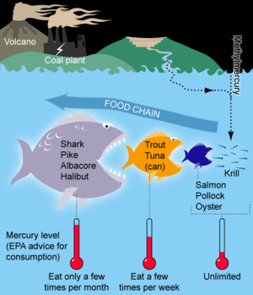
Mercury in Fish
Thus, burning coal has injected one of the worst known neurodevelopmental toxins into one of our most important sources of neurodevelopmental nutrients
https://en.wikipedia.org/wiki/Mercury_in_fish
Notes:
http://www.regiscollege.edu/about/atb-2015-09-24.cfm
https://en.wikipedia.org/wiki/Mercury_in_fish

Slide 20
Mercury in Fish
Fish eating advice and advisories:
A near term necessity that distracts us from the fundamental drivers
Public Health Nutrition vs. Toxicology
We argue about who should eat, what amount, of which fish, how often . . . instead of emphasizing that coal has driven this problem.
Details:
https://pubmed.ncbi.nlm.nih.gov/21211794/
https://pubmed.ncbi.nlm.nih.gov/18332715/
https://pubmed.ncbi.nlm.nih.gov/17047219/
www.epa.gov/international-cooperation/mercury-emissions-global-context
https://www.fda.gov/food/consumers/advice-about-eating-fish
https://www.fda.gov/media/102331/download
https://epa.ohio.gov/portals/35/fishadvisory/fishadvisory_pamphlet.pdf
Notes:
https://en.wikipedia.org/wiki/Mercury_in_fish

Slide 21
The Public Health Impact
of Fossil Fuel Burning
Mercury in Fish
If we care about our children’s brains
We should care about coal burning and fish
and of course . . .
we should also care about making sure that we harvest the ocean in a sustainable way
http://pubweb.epa.gov/mercury/about.htm
https://www.youtube.com/watch?v=p6Jabn5rhtk
Notes:
https://en.wikipedia.org/wiki/Mercury_in_fish

Slide 22
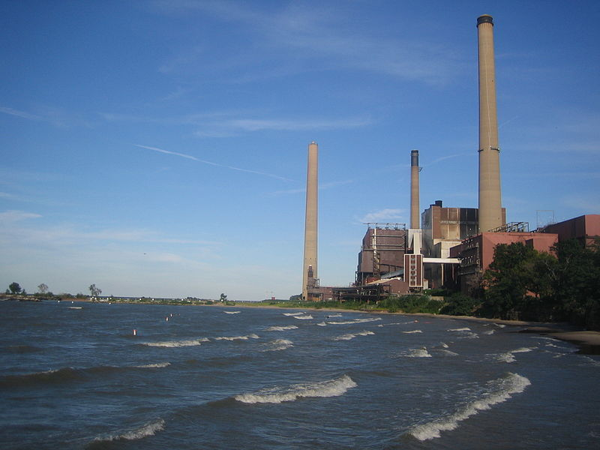
Mercury in Fish
Local relevance:
Avon Lake NRG Power Plant
https://www.gem.wiki/Avon_Lake_Power_Plant
https://www.wkyc.com/article/news/local/lorain-county/what-do-you-think-about-the-avon-lake-coal-plant/95-545725804
Still pumping mercury into the air and directly into the water as well (up to 389 million gallons of waste water into the lake every day) Discharge permits are renewed every 5 years after public comment . . . 2022 is next. https://commons.wikimedia.org/wiki/File:Avon_Lake_power_plant.jpg https://www.cleveland19.com/story/705857/few-changes-on-states-annual-fish-eating-list/
Notes:
https://en.wikipedia.org/wiki/Mercury_in_fish

Slide 23
The Public Health Impact
of Fossil Fuel Burning
Emerging Evidence:
Ocean food web collapse
It turns out that CO2 from fossil fuel burning is acidifying the oceans, and this may result in the disruption or collapse of ocean food chains. . .
leaving few fish to harvest anyway
https://pubmed.ncbi.nlm.nih.gov/26460052/
Notes:
http://www.regiscollege.edu/about/atb-2015-09-24.cfm
https://en.wikipedia.org/wiki/Mercury_in_fish

Slide 24
The Public Health Impact
of Fossil Fuel Burning
Emerging Evidence:
Ocean Food Degradation
Global Evidence is now emerging that most humans do not eat enough Omega-3 (EPA/DHA) https://pubmed.ncbi.nlm.nih.gov/33184396/
and if we go full circle back to climate change
Warming waters alone are reducing the Omega-3 content of our global fish harvest
(down 10-60% by 2100) https://pubmed.ncbi.nlm.nih.gov/31512173/
Notes:
https://pubmed.ncbi.nlm.nih.gov/31512173/
41. Olsen, S. F. et al. Intake of marine fat, rich in (n-3)-polyunsaturated fatty acids, may increase birthweight by prolonging gestation. Lancet 2, 367–369 (1986).
42. Ciesielski, T. H. n-3 and preterm birth: what can we learn from the heterogeneity?. Public Health Nutr. 23, 2453–2454 (2020).
43. Grosso, G. et al. Omega-3 fatty acids and depression: scientifc evidence and biological mechanisms. Oxid. Med. Cell Longev.
2014, 313570 (2014).
44. Larrieu, T. & Laye, S. Food for mood: relevance of nutritional omega-3 fatty acids for depression and anxiety. Front. Physiol. 9,
1047 (2018).
45. Burhani, M. D. & Rasenick, M. M. Fish oil and depression: the skinny on fats. J. Integr. Neurosci. 16, S115-s124 (2017).
46. Facchinetti, F., Fazzio, M. & Venturini, P. Polyunsaturated fatty acids and risk of preterm delivery. Eur. Rev. Med. Pharmacol.
Sci. 9, 41–48 (2005).
47. Chen, C. Y., Chen, C. Y., Liu, C. C. & Chen, C. P. Omega-3 polyunsaturated fatty acids reduce preterm labor by inhibiting
trophoblast cathepsin S and infammasome activation. Clin. Sci. 132, 2221–2239 (2018).
48. Elliott, E., Hanson, C. K., Anderson-Berry, A. L. & Nordgren, T. M. Te role

Slide 25
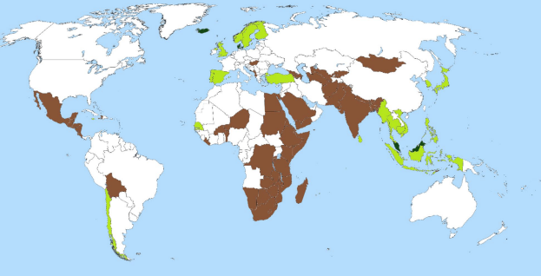
Ciesielski and Williams 2020
Countries with very insufficient average daily
Omega-3 intake in 2010 - labelled in brown
https://pubmed.ncbi.nlm.nih.gov/33184396/

Slide 26
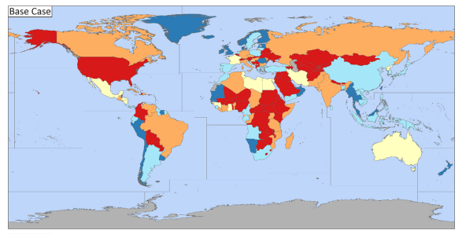
Columbo et al 2019
Countries with very low per capita Omega-3 (DHA) production from fish in 2019 - labelled in red
https://pubmed.ncbi.nlm.nih.gov/31512173/

Slide 27
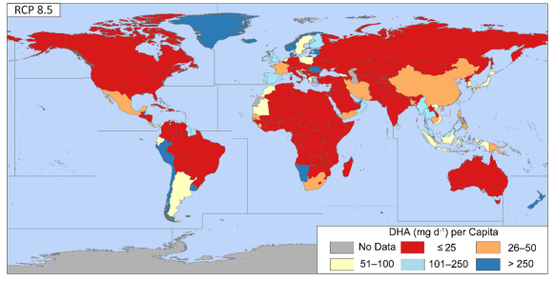
Columbo et al 2019
Countries with very low per capita Omega-3 (DHA) production from fish in 2100 - labelled in red
https://pubmed.ncbi.nlm.nih.gov/31512173/
And these dire estimates only reflect changes due to water temperature alone (homeoviscous adaptation). They do not account for overfishing and habitat loss etc.

Slide 28
If these findings are corroborated . . .
Where are we going to get the omega3?
Well . . . not likely from fish, but algae and terrestrial plants could be of great use here
If we keep burning coal we may:
further raise the mercury content of fish
lower the omega-3 content of fish
run the risk of having no fish
and current estimates suggest that the habitual diets of most humans already fail to provide enough omega3
Notes:
(re: depression and pregnancy health)

Slide 29
The Public Health Impact
of Fossil Fuel Burning
Reduced nutrient content of plant based foods
Elevated CO2 levels appear to decrease the nutritional content of plant based foods
and this can put people in some areas
(parts of Africa), at risk for deficiencies
(e.g. zinc deficiency).
https://pubmed.ncbi.nlm.nih.gov/24805231/
https://pubmed.ncbi.nlm.nih.gov/26217490/
https://pubmed.ncbi.nlm.nih.gov/26189102/
Notes:
Myers SS, Zanobetti A, Kloog I, Huybers P, Leakey AD, Bloom AJ, Carlisle E, Dietterich LH, Fitzgerald G, Hasegawa T, Holbrook NM, Nelson RL, Ottman MJ, Raboy V, Sakai H, Sartor KA, Schwartz J, Seneweera S, Tausz M, Usui Y. Increasing CO2 threatens human nutrition. Nature. 2014 Jun 5;510(7503):139-42. doi: 10.1038/nature13179. Epub 2014 May 7.
Dietterich LH, Zanobetti A, Kloog I, Huybers P, Leakey AD, Bloom AJ, Carlisle E, Fernando N, Fitzgerald G, Hasegawa T, Holbrook NM, Nelson RL, Norton R, Ottman MJ, Raboy V, Sakai H, Sartor KA, Schwartz J, Seneweera S, Usui Y, Yoshinaga S, Myers SS. Impacts of elevated atmospheric CO₂ on nutrient content of important food crops. Sci Data. 2015 Jul 21;2:150036. doi: 10.1038/sdata.2015.36. eCollection 2015. PMID: 26217490
Myers SS, Wessells KR, Kloog I, Zanobetti A, Schwartz J. Effect of increased concentrations of atmospheric carbon dioxide on the global threat of zinc deficiency: a modelling study. Lancet Glob Health. 2015 Oct;3(10):e639-45. doi: 10.1016/S2214-109X(15)00093-5. Epub 2015 Jul 15.
PMID: 26189102

Slide 30
The Public Health Impact
of Fossil Fuel Burning
Even if we ignore all of these negative effects we would still have to think about the adverse effects of coal burning on:
Respiratory Health
particulate matter (PM),sulfur dioxide (SO2),
oxides of nitrogen (NOX) from coal burning are
linked to asthma symptoms, emergency room visits, increased susceptibility to viral respiratory infections, and lung cancer
https://noharm-uscanada.org/sites/default/files/documents-files/828/Health_Effects_Coal_Use_Energy_Generation.pdf

Slide 31
The Public Health Impact
of Fossil Fuel Burning
Additional effects of coal burning:
Cardiovascular Health
particulate matter (PM2.5) from coal burning has
been linked to cardiovascular disease,
atherosclerosis, and cardiovascular related
deaths
https://noharm-uscanada.org/sites/default/files/documents-files/828/Health_Effects_Coal_Use_Energy_Generation.pdf

Slide 32
The Public Health Impact
of Fossil Fuel Burning
Additional effects of coal burning:
Adverse Pregnancy Outcomes
particulate matter (PM),sulfur dioxide (SO2)
NO2, CO, and ozone from coal burning have been linked to low birthweight,
preterm delivery
https://noharm-uscanada.org/sites/default/files/documents-files/828/Health_Effects_Coal_Use_Energy_Generation.pdf
https://pubmed.ncbi.nlm.nih.gov/31195672/

Slide 33
The Public Health Impact
of Fossil Fuel Burning
The scale of the Public Health impacts of coal burning in China alone are staggering:
“Coal combustion in China’s power plants causes an estimated 250,000 deaths per year”
Scientific Evidence of Health Effects from Coal Use in Energy Generation
Erica Burt, MPH
Peter Orris, MD, MPH
Susan Buchanan, MD, MPH
https://noharm-uscanada.org/sites/default/files/documents-files/828/Health_Effects_Coal_Use_Energy_Generation.pdf
Notes:
https://pubmed.ncbi.nlm.nih.gov/24831676/

Slide 34
The Public Health Impact
of Fossil Fuel Burning
Even if we put all of this aside . . .
We would still have to consider
the health issues,
injustices,
and costs associated with fossil fuel extraction
These could easily fill a second talk!
https://www.apha.org/policies-and-advocacy/public-health-policy-statements/policy-database/2019/01/28/impacts-of-unconventional-oil-and-gas-industry
https://www.sciencedirect.com/science/article/pii/S1353829212001852
https://www.ncbi.nlm.nih.gov/pmc/articles/PMC6344296/
https://sydney.edu.au/medicine/research/units/boden/PDF_Mining_Report_FINAL_October_2012.pdf

Slide 35
Fossil Fuel Extraction Occupations
“Working on site in the oil and gas extraction industry is inherently dangerous, with a fatality rate of 15.6 per 100,000 workers (four times higher than the overall rate among U.S. workers).”
“Beyond physical hazards, such as falls, published studies . . . have reported high concentrations of, and increased exposures to, airborne toxic chemicals that often exceed existing health standards or acceptable risk levels.”
https://www.apha.org/policies-and-advocacy/public-health-policy-statements/policy-database/2019/01/28/impacts-of-unconventional-oil-and-gas-industry
http://www.bls.gov/iif/oshwc/cfoi/osar0018.htm
Notes:
These exposures include respirable silica, nitrogen oxides, sulfur dioxide, particulate matter, formaldehyde, heavy metals, carbon monoxide, volatile organic compounds (e.g., benzene, trimethyl benzene, xylenes, aliphatic hydrocarbons, and polycyclic aromatic hydrocarbons), ozone, and methane

Slide 36
Social and Environmental Injustice
of Fossil Fuels
Who is willing to work in a coal mine?
Are they wealthy?
Can they afford a lawyer?
What other jobs are available in the area?
Who lives near the oil/gas extraction sites?
processing sites?
power plants?
Who lives near highways?

Slide 37
The Public Health Impact
of Fossil Fuel Burning
Finally we have to consider the possibility that new extraction technologies can solve these problems . . .
Are Fracking and Natural Gas solutions?
No.
https://www.nejm.org/doi/full/10.1056/NEJMp1913663

Slide 38
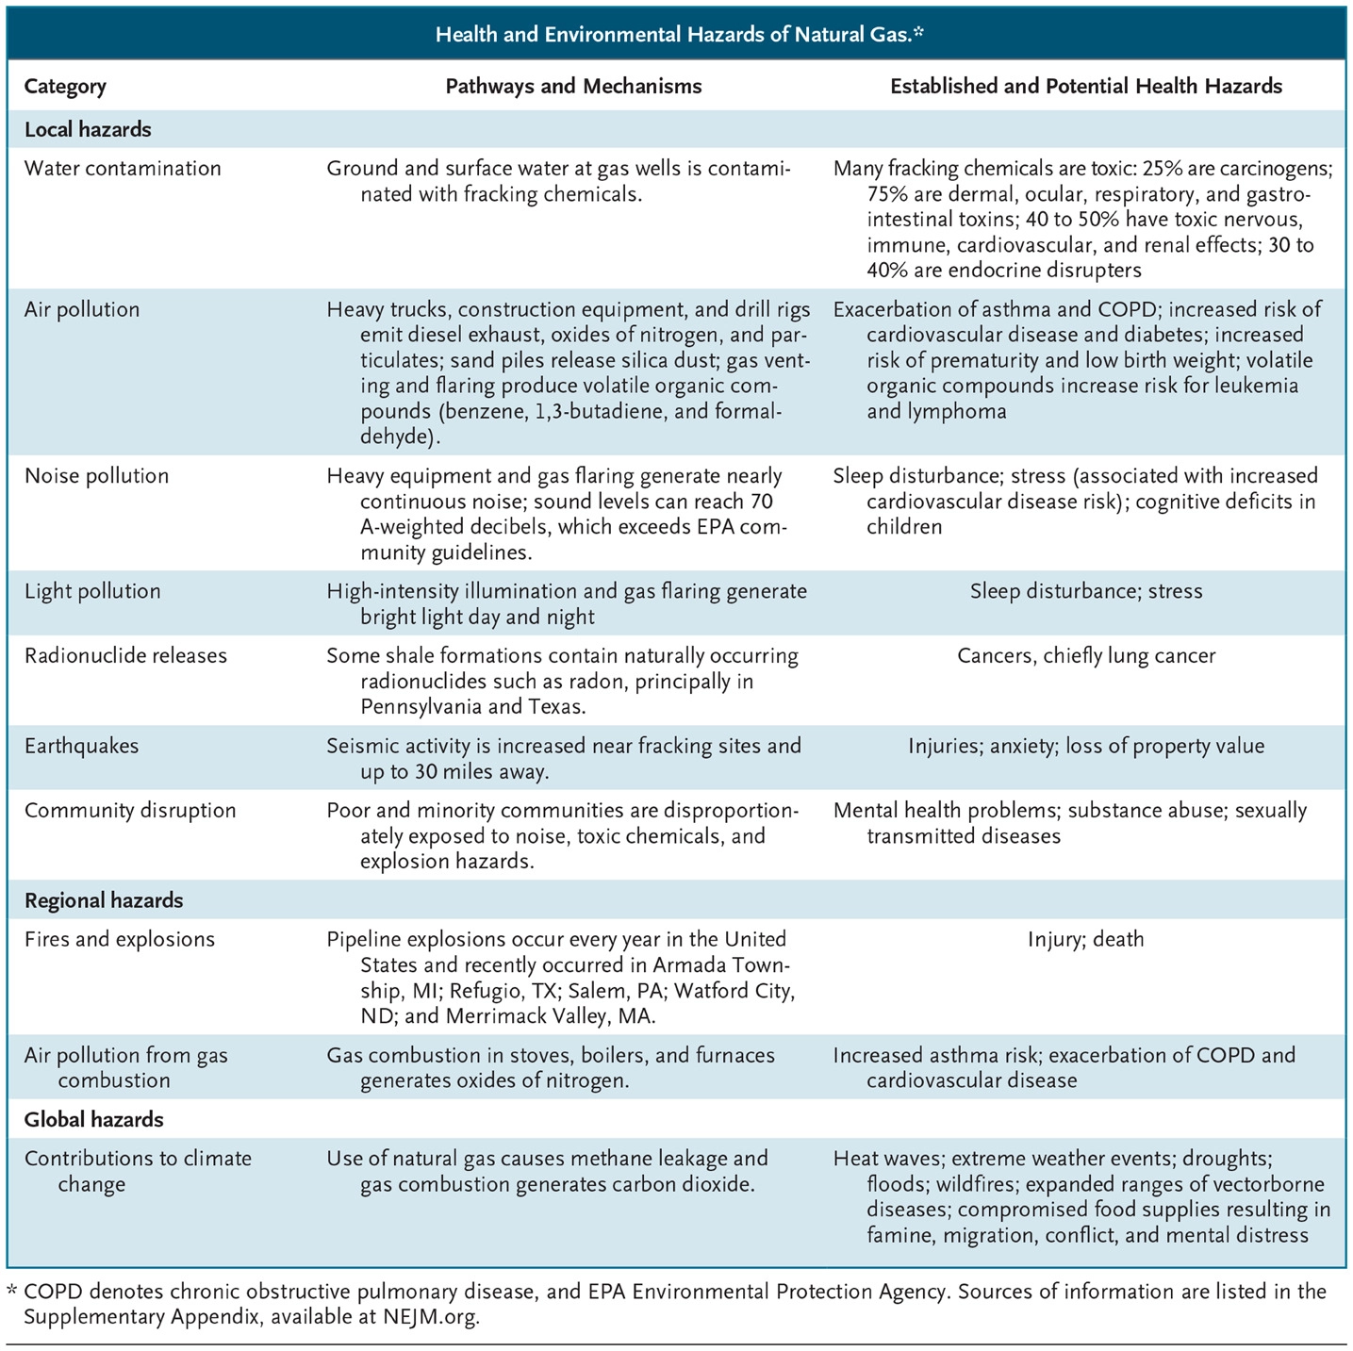
https://www.nejm.org/doi/full/10.1056/NEJMp1913663

Slide 39
Total Public Health Impacts of Fossil Fuel Based Energy
These impacts are enormous and can’t be easily estimated
The more we look, the more consequences we find, and the more we realize that none of us is immune from the health problems associated with burning fossil fuels.

Slide 40
Total Public Health Impacts of Fossil Fuel Burning
Maybe if we start to talk more broadly about the immediate and personal human health impacts . . .
people will see that the health of their family and friends are at stake right now.
This may spur people to engage, discuss changes, and act.

Slide 41
Ok that’s the evidence, now
what do we do with it?
My Take:
If we do not learn to act sustainability:
we will continue to hurt ourselves
in a large variety of ways
and we may create problems that we can’t fix
Notes:
41

Slide 42
But it is totally possible to change and we can do it
new clean sustainable technologies are almost ready to provide us with the power we need
We need to encourage our government and our industries to bring them into the mainstream ASAP
https://www.sciencedirect.com/science/article/pii/S0301421510008694 https://www.sciencedirect.com/science/article/pii/S0301421510008694 https://www.nature.com/news/polopoly_fs/1.14873!/menu/main/topColumns/topLeftColumn/pdf/507300a.pdf
Notes:
Trancik JE. Renewable energy: Back the renewables boom. Nature 2014; 507: 300-2.
Trancik JE. Innovation: Clean energy enters virtuous cycle. Nature 2015; 528: 333.
Delucchi MA, Jacobson MZ. Providing all global energy with wind, water, and solar power, Part II: Reliability, system and transmission costs, and policies. Energy Policy; 39: 1170-90.
Jacobson MZ, Delucchi MA. Providing all global energy with wind, water, and solar power, Part I: Technologies, energy resources, quantities and areas of infrastructure, and materials. Energy Policy 2011; 39 Pages 1154-69.
https://www.sciencedirect.com/science/article/pii/S0301421510008694
https://www.sciencedirect.com/science/article/pii/S0301421510008694
https://www.nature.com/news/polopoly_fs/1.14873!/menu/main/topColumns/topLeftColumn/pdf/507300a.pdf
42

Slide 43
Other thoughts about the evidence?
Other opinions and ideas about what to do with the evidence?
Thank you for your attention, and for the chance to meet with you today.
Notes:
Trancik JE. Renewable energy: Back the renewables boom. Nature 2014; 507: 300-2.
Trancik JE. Innovation: Clean energy enters virtuous cycle. Nature 2015; 528: 333.
Delucchi MA, Jacobson MZ. Providing all global energy with wind, water, and solar power, Part II: Reliability, system and transmission costs, and policies. Energy Policy; 39: 1170-90.
Jacobson MZ, Delucchi MA. Providing all global energy with wind, water, and solar power, Part I: Technologies, energy resources, quantities and areas of infrastructure, and materials. Energy Policy 2011; 39 Pages 1154-69.
43

Slide 45
Assuming a well-paying replacement job could be found for everyone working at the Avon Lake coal fired power plant . . .
Could it be closed?
Who would like to conduct natural experiment studies (pre vs. post plant closing)?
For the folks living nearby . . .
Would ER Asthma visits go down?
What about MI/Stroke?
What about low birth weight and preterm birth?

Slide 46
Review Questions
If you care about brain health and child development you should care about sustainable energy practices.
true
false
Why?
Burning fossil fuels has contaminated our global fish supply with mercury. Mercury is toxic to developing brains.

Slide 47
In addition to the contamination of fish with mercury, what is another way that the use of fossil fuels threatens our ocean-based food supply?
Excess CO2 acidifies the ocean.
This harms many forms of life that produce calcium carbonate shells (like plankton). Since many other animals eat plankton, ocean acidification could disrupt ocean food webs, and cause a catastrophic collapse of our fish supply.

Slide 48
Does the burning of fossil fuels impact our plant-based food supply?
yes
no
How?
Elevated atmospheric CO2 reduces the nutritional content of plant based foods. In particular it is known to lower the zinc content of some plant based foods. This is critical in regions of the world where the local diet supplies low levels of zinc (parts of Africa).

Slide 49
Fossil Fuel Burning is known to increase the incidence of:
Respiratory Conditions (asthma exacerbations, emergency room visits, increased susceptibility to viral infections)
Cardiovascular Conditions (atherosclerosis, Cardiovascular related deaths - such as heart attacks)
Lung Cancer
Low Birth-weight
none of the above
all of the above

Slide 50
Which of these health effects are completely mediated by changes in climate?
Respiratory Conditions (asthma exacerbations, emergency room visits, increased susceptibility to viral infections)
Cardiovascular Conditions (atherosclerosis, Cardiovascular related deaths - such as heart attacks)
Lung Cancer
Low Birth-weight
none of the above
all of the above
These effects have been happening.
These effects continue to happen.
They would happen even if the climate did not change.

Slide 51
Other Resources
https://www.psehealthyenergy.org/
https://poweringhc.org/conference/
https://pubmed.ncbi.nlm.nih.gov/31195672/

Slide 54
Occupational Exposures at Fracking Sites
respirable silica
nitrogen oxides
sulfur dioxide
particulate matter
formaldehyde
heavy metals
carbon monoxide
volatile organic compounds (e.g., benzene, trimethyl benzene, xylenes, aliphatic hydrocarbons, and polycyclic aromatic hydrocarbons)
ozone
methane
hydrogen sulfide (sometimes deadly) . . . etc.
https://www.apha.org/policies-and-advocacy/public-health-policy-statements/policy-database/2019/01/28/impacts-of-unconventional-oil-and-gas-industry
http://www.bls.gov/iif/oshwc/cfoi/osar0018.htm

Slide 55
In addition to the health effects of fossil fuel burning that are already present today, please name some of the climate mediated effects that we expect to see much more of in the near future:
more frequent severe weather events (these come with injuries, illnesses, and deaths)
the quality or quantity of water supplies in some areas are expected to decrease and which may lead to deprivation and civil conflicts
the number of heat related deaths will likely increase
disease carrying insects are expected to further expand their geographic ranges (i.e. the Anopheles mosquito may spread north and take Malaria with it)
http://www.cdc.gov/climateandhealth/effects/

