Slide 1
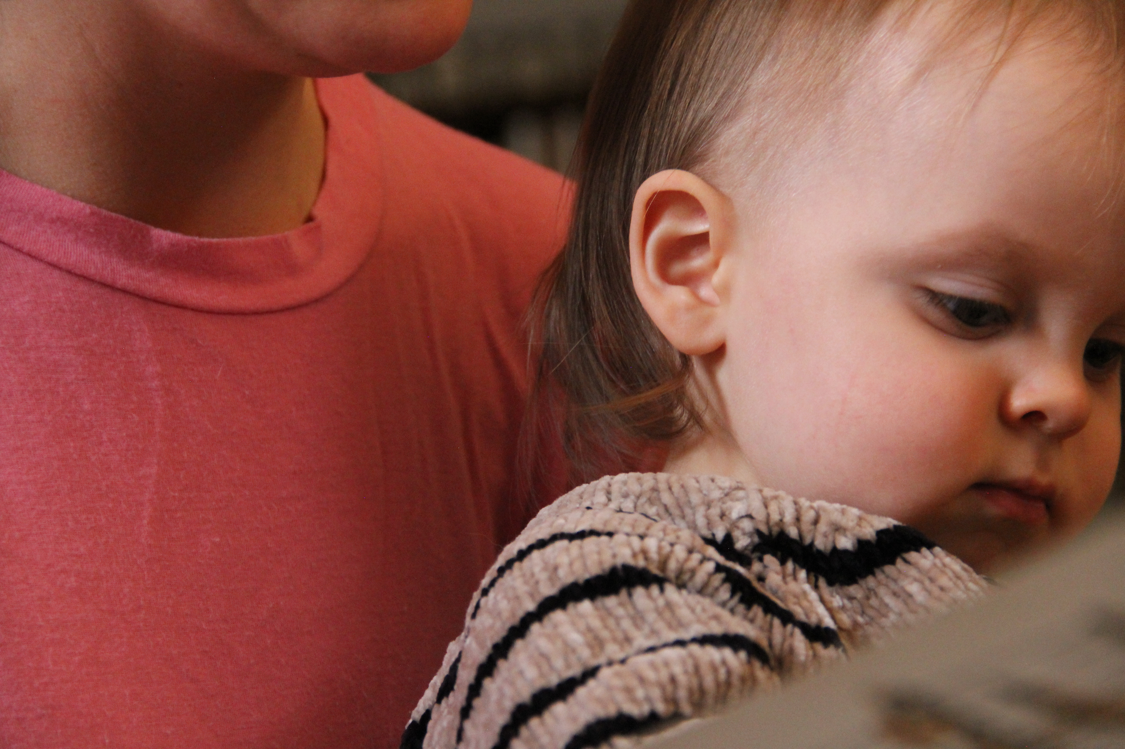
A simple proposal
ORGANIZED PUSH: Nothing changes unless we push.
By decolonizing (see e.g. https://drive.google.com/file/d/1Z1cgCF8OscxTfWZhR6JjgmAI1OuH9EQt/view )
Creating a global constitutional convention that is pluralistic and self-critical, using history
Adapting who we are to create a new hybrid sensibility that draws on indigenous traditions – e.g., collective continuance or Maori “all matter matters” – as well as scientific and Enlightenment autonomy
See for more: https://www.earthsystemgovernance.org/ & http://hdr.undp.org/en/2020-report Or join us: http://www.philosophersforsustainability.com/conference2021/

