Slide 1
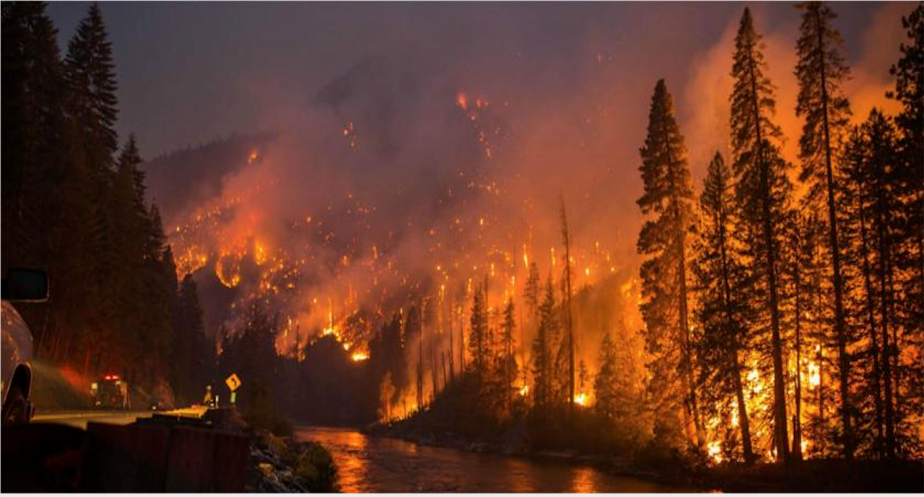
Health Effects of Wildfires
Wayne Cascio, MD, FACC
Director
Center for Public Health and Environmental Assessment
Office of Research and Development
US EPA
Chiwaukum Creek Wildfire 2014
Okanogan-Wenatchee National Forest
Photo Credit: https://ecology.wa.gov/
Case Western University
“Climate Change and Health” MPHP 441
March 31, 2021
Disclaimer: The views expressed do not necessarily reflect the views or policies of the U.S. EPA.

Slide 2
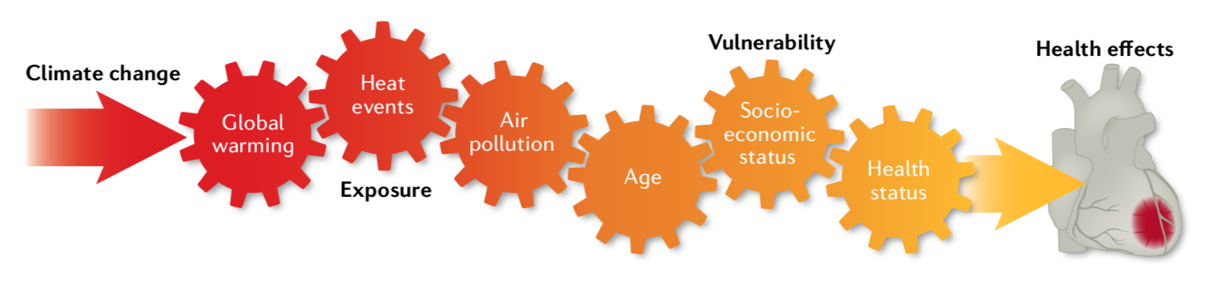
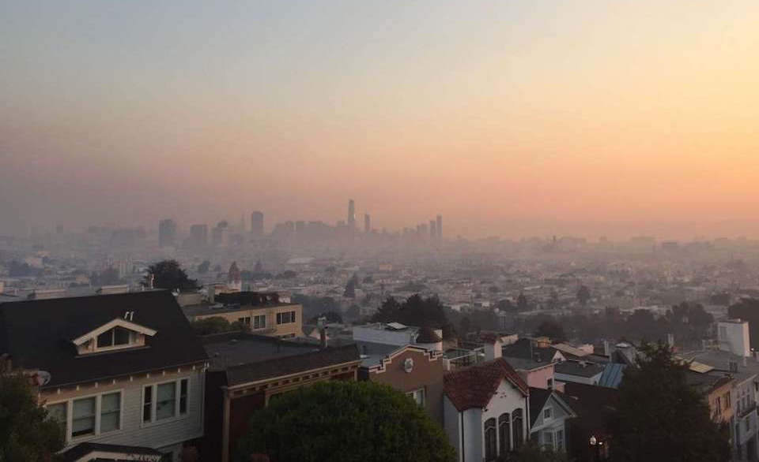
Factors contributing to the
health risks of climate change
Peters A and Schneider A.
Cardiovascular Risks of Climate Change
Nature 18:2, 2021
Wildfire Smoke
2
Credit: SF Gate

Slide 3
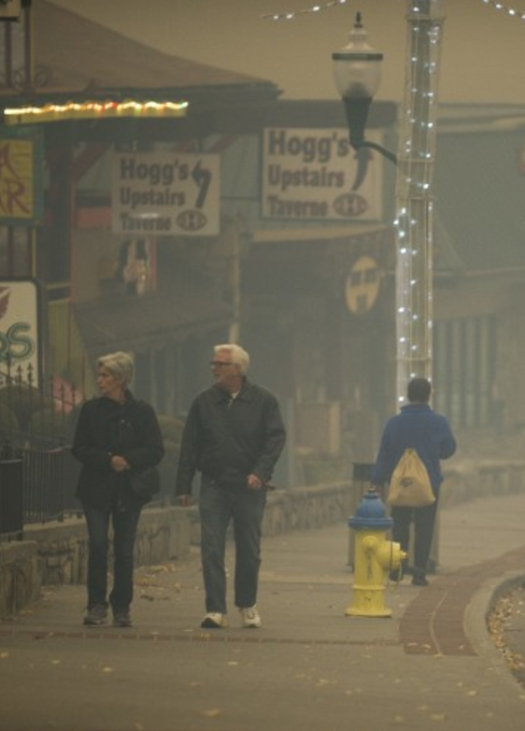
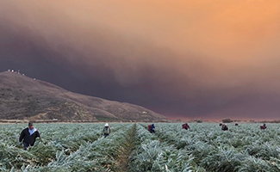
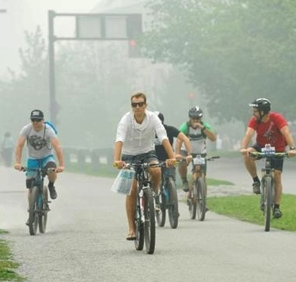
Wildland Fires & Their Emissions
Rural & Urban Community Public Health Concern
Brianna Paciorka, Knoxville News Sentinel
Stephanie Rodriquez, Courtesy of CAUSE

Slide 4
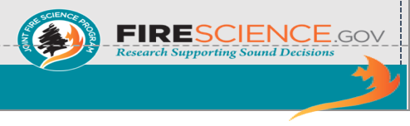
Wildland Fire Definition and Statistics
Current Definitions:
(Fire Executive Council 2009)
Wildland fire — any non-structure fire that occurs in the wildland. Includes both wildfires and prescribed fires.
Wildfire — unplanned ignitions or prescribed fires that are declared wildfires.
Prescribed fires — planned ignitions to meet specific objectives.
Year | Wildfires |  | Prescribed Fires |  | Total Acres (nearest 10,000
 | Number (nearest 100) | Acres (nearest 10,000) | Number (nearest 100) | Acres (nearest 10,000)
2018 | 58,100 | 8,770,000 | 450,300 | 6,360,000 | 15,130,000
2017 | 71,500 | 10,030,000 | 202,400 | 6,430,000 | 16,460,000
2016 | 67,700 | 5,510,000 | 83,000 | 4,020,000 | 9,530,000
2015 | 68,200 | 10,130,000 | 37,300 | 2,960,000 | 13,090,000
2014 | 63,300 | 3,600,000 | 17,000 | 2,390,000 | 5,990,000
2013 | 47,600 | 4,320,000 | 18,800 | 2,000,000 | 6,320,000
2012 | 67,800 | 9,330,000 | 16,600 | 1,970,000 | 11,300,000
2011 | 74,100 | 8,710,000 | 8,700 | 2,110,000 | 10,820,000
2010 | 72,000 | 3,420,000 | 16,900 | 2,420,000 | 5,840,000
2009 | 78,800 | 5,920,000 | 12,400 | 2,530,000 | 8,450,000
10-Year Average | 66,910 | 6,970,000 | 94,200 | 3,320,000 | 10,290,000
Courtesy of John Hall
Table sources: National Interagency Fire Center (raw data); John Hall (rounded values). May get different values for prescribed fire from other sources (e.g., Melvin, MA. 2018. Tech. Rep. 03‒18). Wildfires must exceed a threshold value to be recorded.
4
Notes:
.

Slide 5
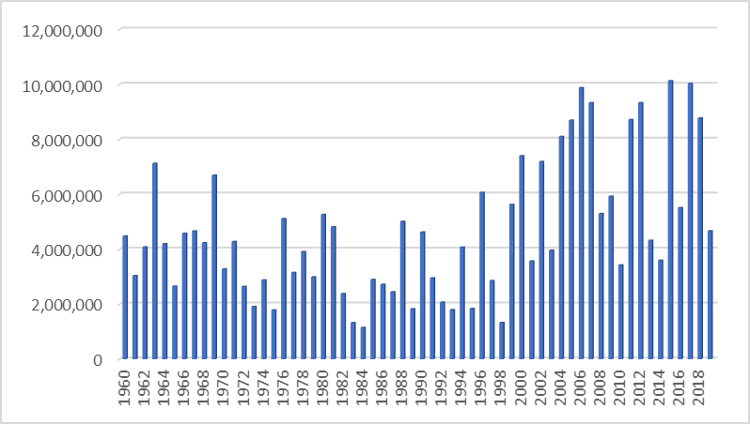
Wildfire in the U.S.
Acreage Burned in the U.S. Annually
Annual Avg. burned
2010 -2020
7.04 million acres
Present Concerns
Increasing acreage burned
Increasing impact on urban areas
  10% of all land with housing are situated in the wildland-urban interface
  Between 1990 and 2010 housing in the Wildland Urban Interface (WUI) grew 41% and land by 33% (Radeloff et al. PNAS 2010)
Increasing vulnerable and sensitive populations
Annual Avg. burned 1960-1999
3.5 million acres
2020
Adapted from https://www.nifc.gov/fireInfo/nfn.htm
5

Slide 6
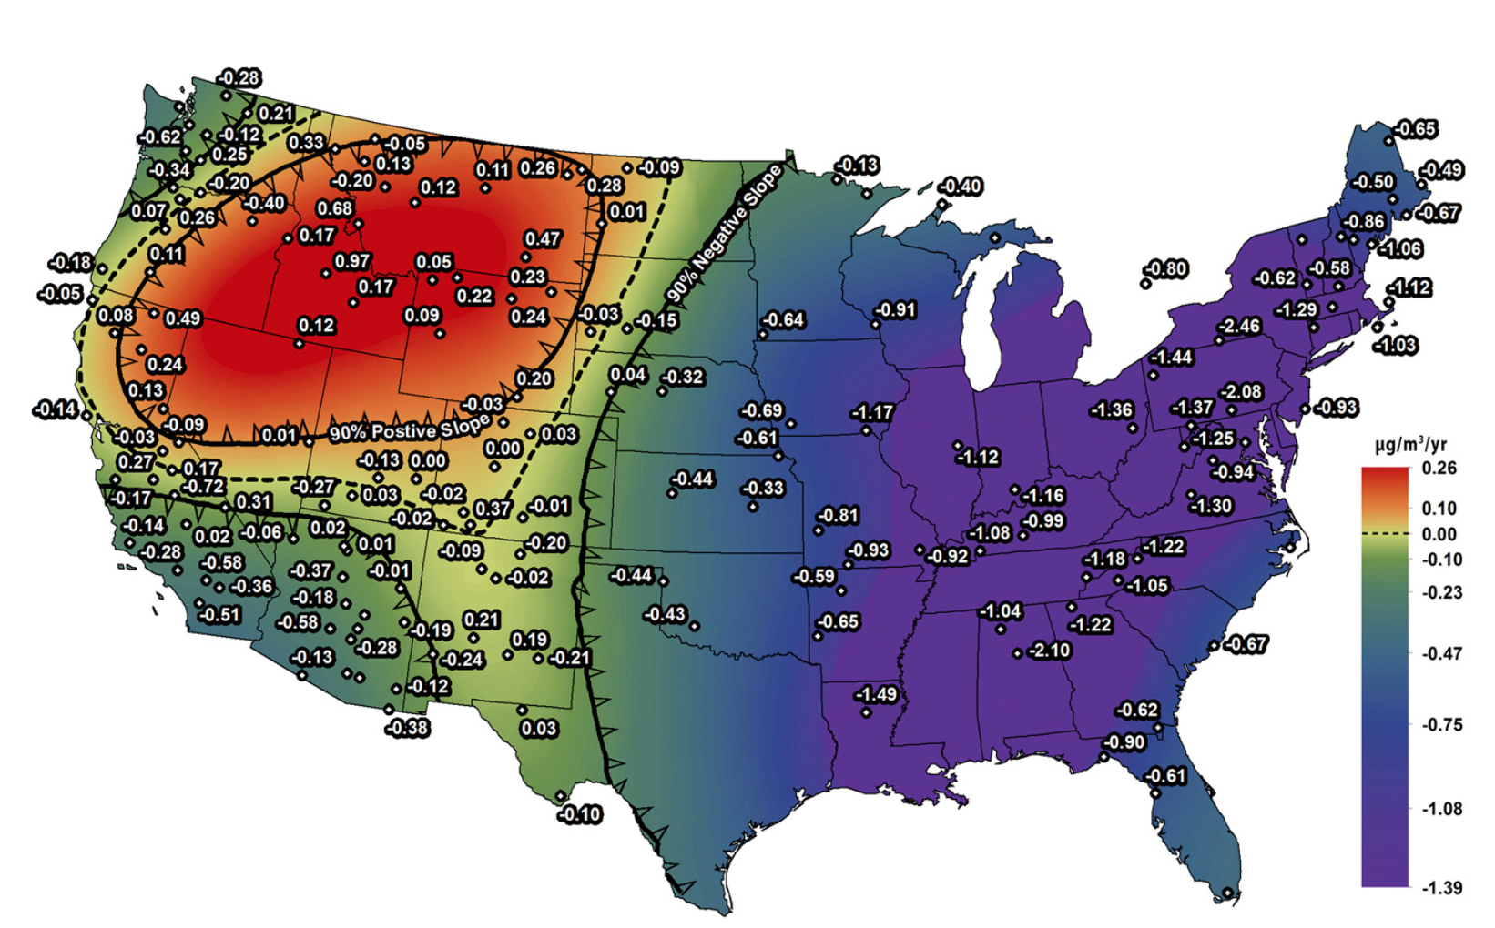
Air Quality Improves in U.S. from 1988-2016
Except in Wildfire-Prone Areas
Worsening Air Quality
Improving Air Quality
Increasing annual ambient air particle pollution
Decreasing annual ambient air particle pollution
Largely due to wildfire-related PM
McClure CD and Jaffe DA. PNAS 115 (31): 7901-7906, 2018
6

Slide 7
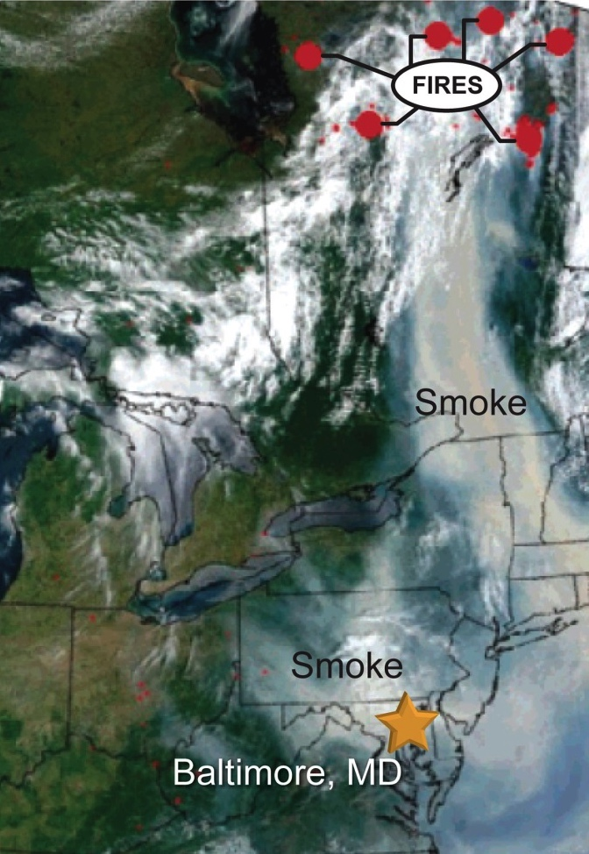
Air-Quality Impacts Extend Long Distances
Affecting Urban Areas & Large Populations
Health Impacts Can Extend Hundreds of Miles
Forest fires in Quebec, Canada, during July 2002 (red circles)
Baltimore, Maryland, a city nearly a thousand miles downwind
30-fold increase in airborne fine particle concentrations
Source: Moderate Resolution Imaging Spectroradiometer (MODIS) instrument on the Terra satellite, Land Rapid Response Team, NASA/GSFC
7

Slide 8
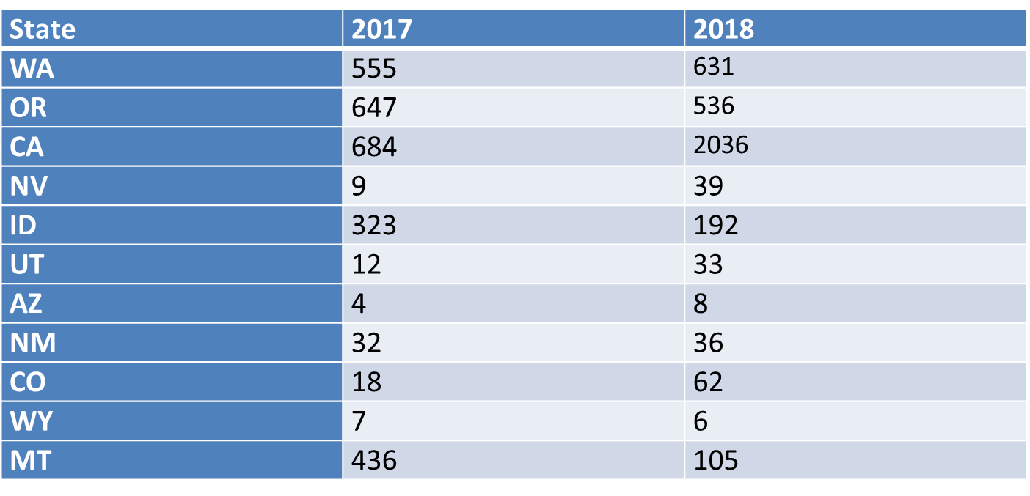
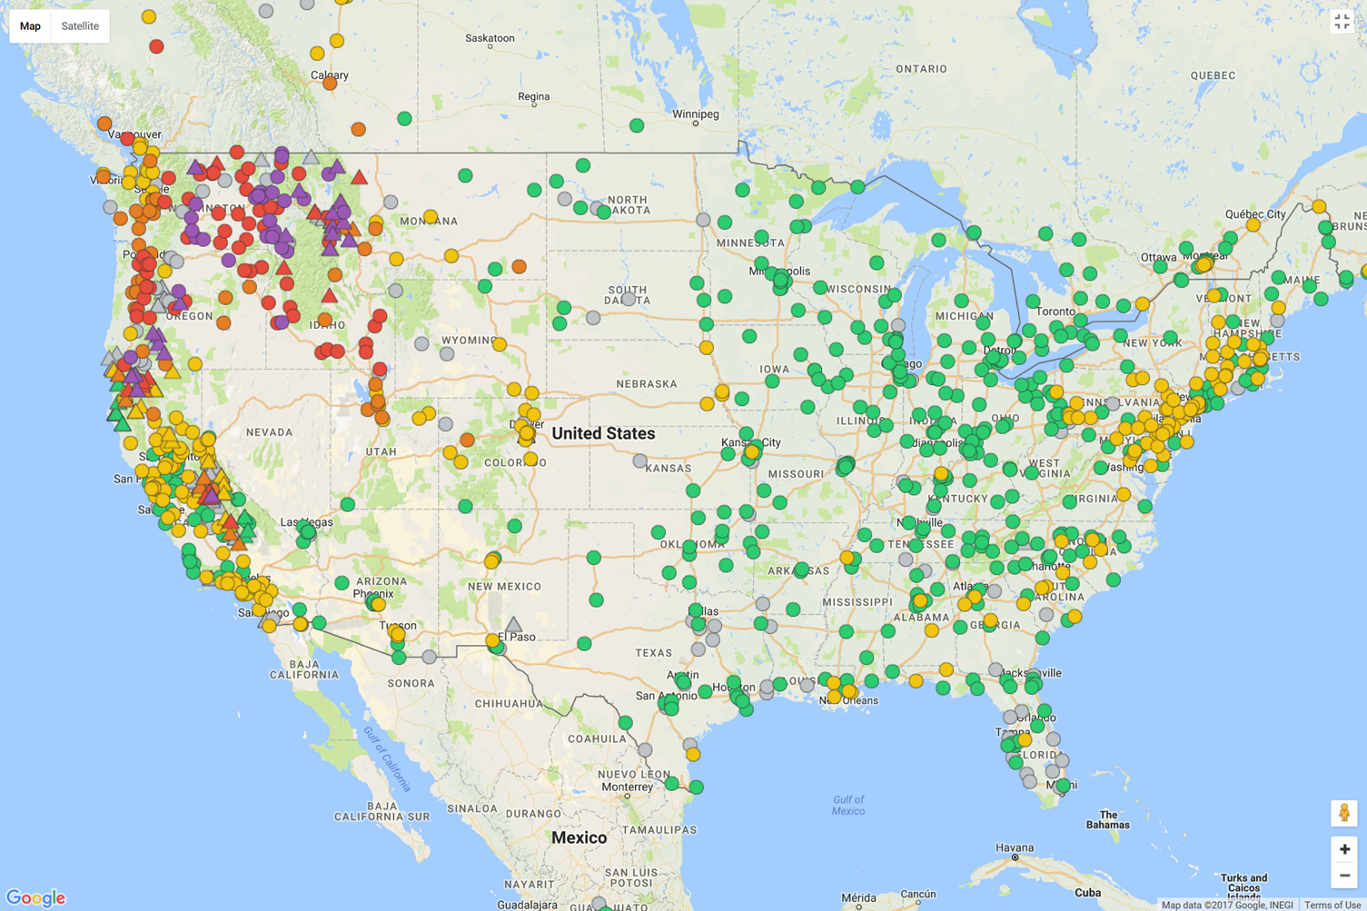
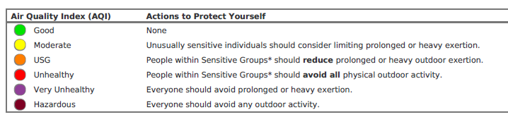

Smoke Impacts from Wildfire are a Concern for Federal, State & Local Officials
Overall days in 2018: 3730 USG, 1995 Unhealthy, 105 Hazardous
95% of all Hazardous days on Temporary Monitors (these monitors are 200x more likely to detect these levels than the permanent monitors)
Number of days across all monitors in a state (fixed and temporary) that the Air Quality Index level for PM_{2.5} exceeds the standard for Unhealthy Sensitive Groups
September 6, 2017 Monitoring of PM2.5, Hourly updated display at:
https://monitoring.airfire.org/monitoring/v3/#/?date=LATEST&productType=plotTable&userProfile=simple
USG = Unhealthy for Sensitive Groups
Courtesy
of John Hall
8

Slide 9
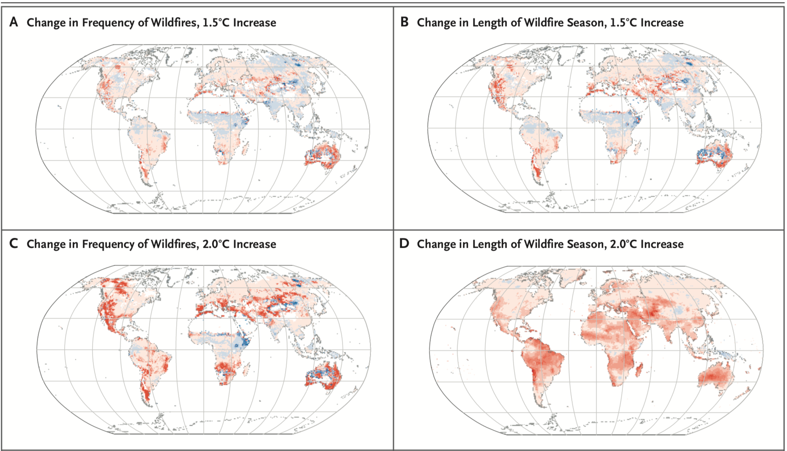
Projected Change in Wildfire from
1981-2000 to 2080-2099
40
20
0
Days
-20
-40
N Engl J Med 2020;
383:2173-2181
9

Slide 10
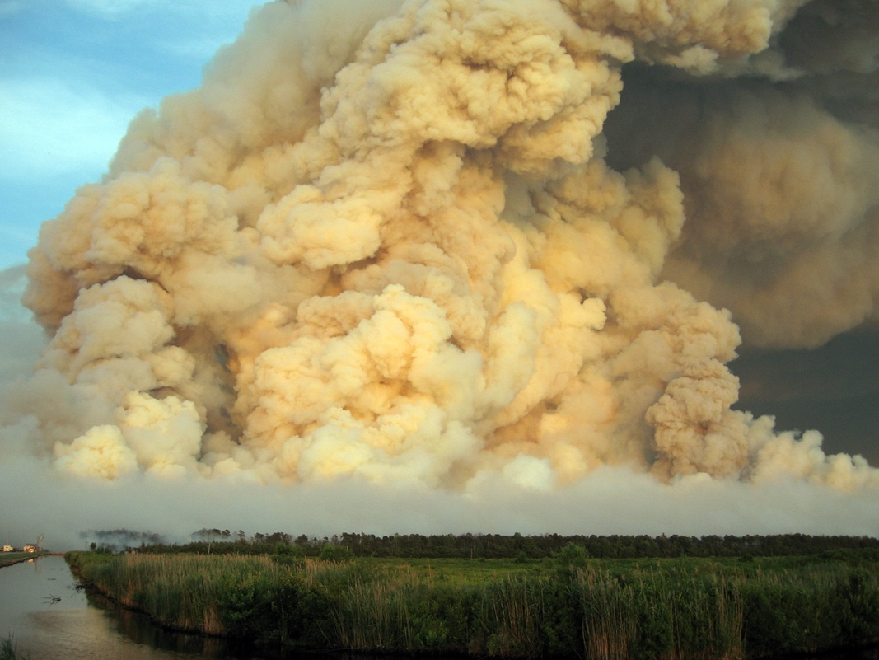
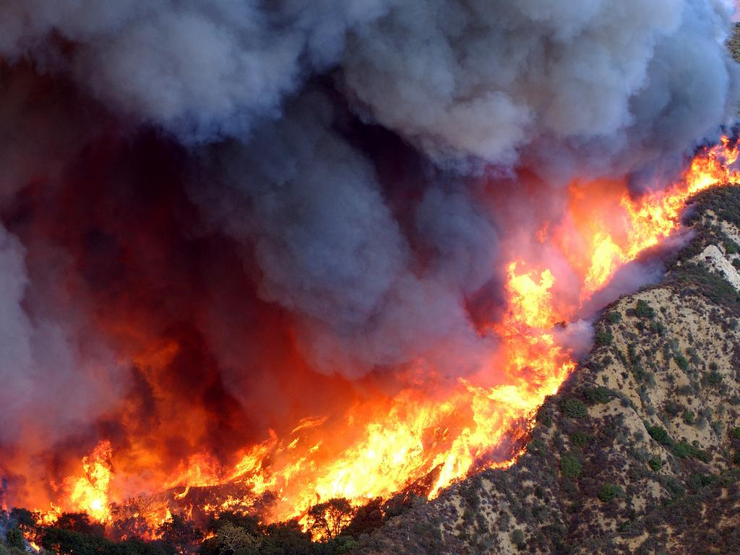

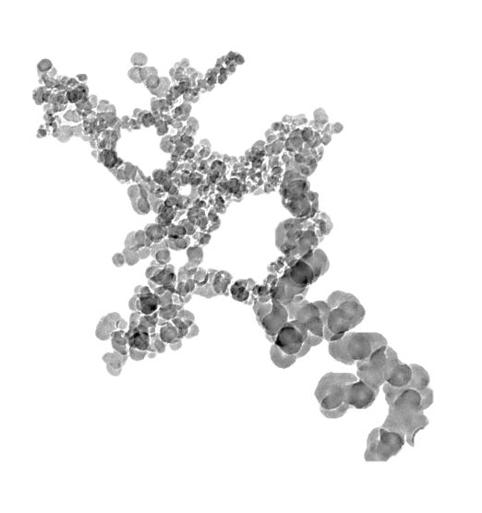
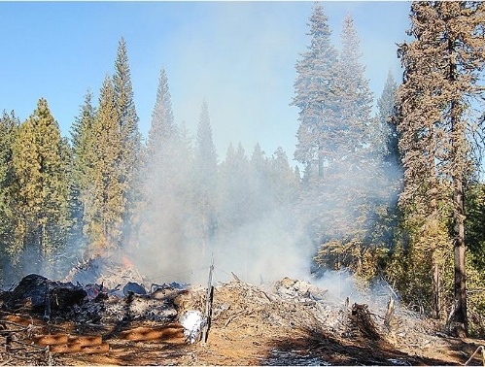
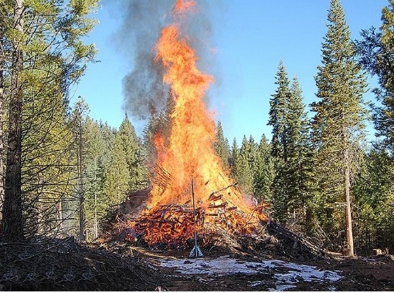
Different Types of Wildfire Smoke
Have Different Toxicological Effects
Fuel type
Forest wildfire
Particulate Matter
(PM)
Ultrafine
Peat wildfire
Fuel type
Fuel type
Fine
Coarse
Combustion phase
Smoldering
Flaming
CPHEA/PHITD/CIB U.S. EPA
10

Slide 11
Mutagenicity of the Biomass Smoke
Condensates Based on Equal Mass
Mutagenicity
Salmonella strain TA98 +S9
Flaming
emissions
Smoldering
emissions
Kim et al EHP (126:1), 2018
CPHEA/PHITD/CIB U.S. EPA
11

Slide 12
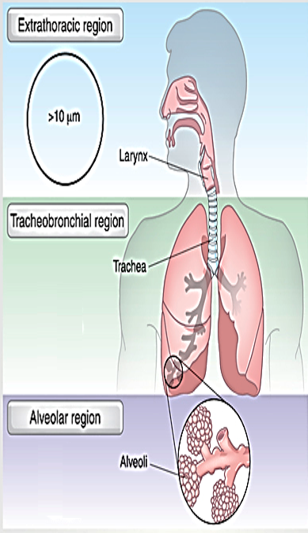
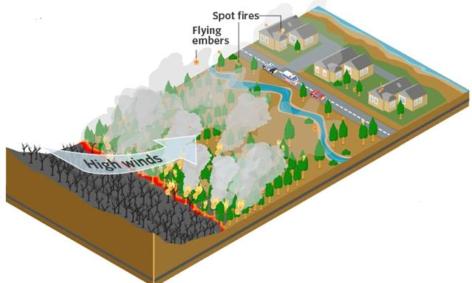
Where There is Smoke There is Illness
Inhaled particle deposition in the lung
Wildfire smoke
Health effects
Gases
Volatile
liquids
>10 µm
Nasal Cavity
Particles
Reactive
metals
Larynx
Organic
species
Trachea
Bronchi
2.5 – 10 µm
(Coarse PM)
Alveoli
Wildfires
< 0.1 µm
0.1 – 2.5 µm
(Ultrafine PM)
(Fine PM)
12

Slide 13
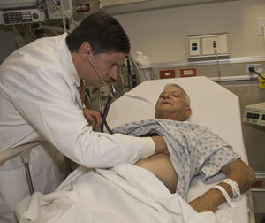
Health Effects of Wildfire Smoke
Known, Suspected and Knowledge Gaps
Known
  All-cause mortality
  Respiratory morbidity
    Asthma & COPD exacerbations
    Bronchitis & pneumonia
    Childhood respiratory disease
Suspected
  Cardiovascular morbidity
  Adverse birth outcomes
  PTSD, anxiety and mood disorders

Slide 14
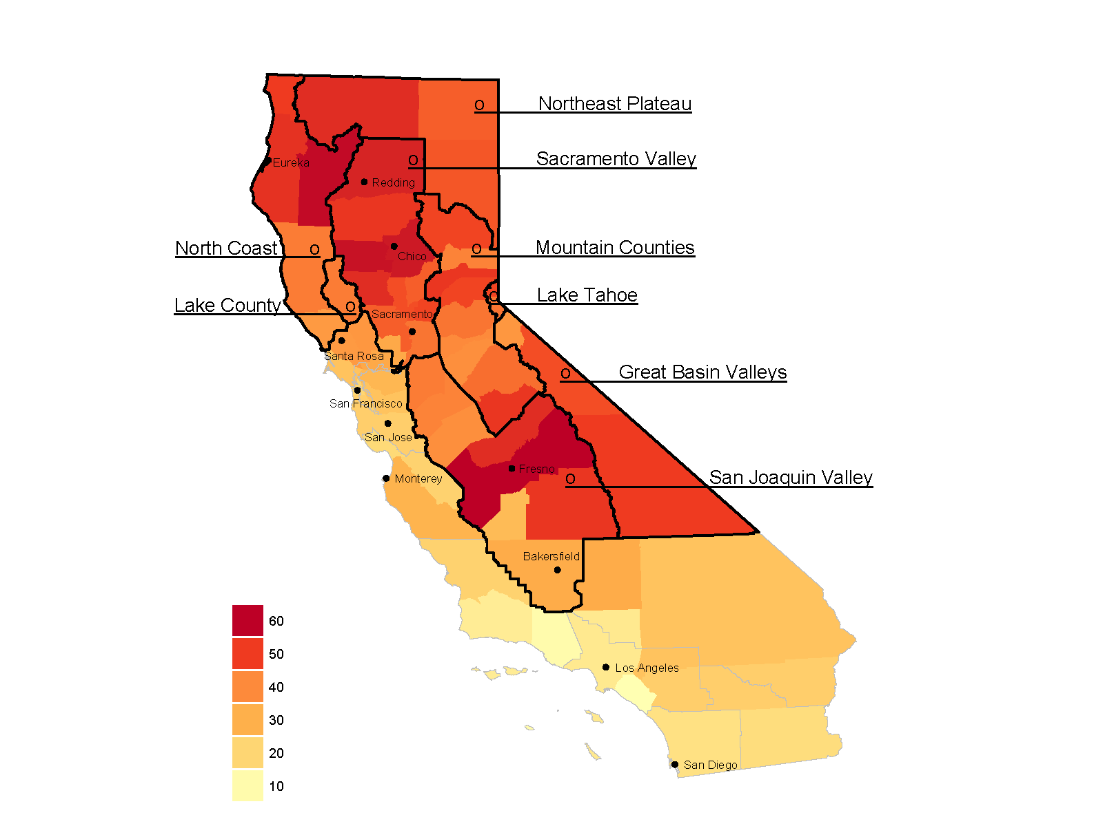
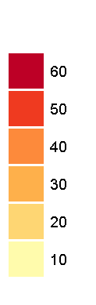
Measuring the Health Effects
of Wildfire Smoke
Smoky days/county during the study: May through September 2015
California 2015 Wildfire Study
Epidemiology study designed to examine respiratory, cardio-vascular, & cerebrovascular health effects of wildfire smoke
Associate wildfire-PM_{2.5} exposure with emergency department visits for cardiovascular and respiratory diagnoses
California air basins included in the study are labeled and outlined in black
Wettstein Z, Hoshiko S, Cascio WE, Rappold AG et al. JAHA 2018
14

Slide 15
Wildfire-PM_{2.5} Increases
Heart Attack & Stroke
All Cardiovascular Causes Lag Day 1
Wildfire-PM_{2.5} associated with heart attacks and strokes for all adults, particularly for those over 65 yrs old
Increase in risk the day after exposure:
  All respiratory causes, 18%
  All cardiovascular, 12%
  Heart attack, 42%
  Stroke, 22%
  Heart rhythm abnormalities, 24%
  (on the same day as exposure)
1.2
Adults 45-64
Adults 65+
All Adults
1.1
Relative Risk
1.0
  Heart failure, 16%
0.9
Light
Medium
Heavy
Wettstein Z, Hoshiko S, Cascio WE, et al. JAHA April 11, 2018
15

Slide 16
Health Effects of Wildfire Smoke
Children and Pregnancy
Respiratory Effects
  Short-term Exposures
    Asthma
      Modified by BMI
      Greatest in infants and children
      <5 years old
  Longer-term Exposures
    Eye irritation
    Upper respiratory effects
      (throat, and nose symptoms)
    Respiratory infections
      (like pneumonia)
Low Birth Weight
California: Administrative Data
2003 San Diego wildfires
Decreased birth weight related to wildfire smoke exposure throughout pregnancy
Small changes in birth weight are important as they can have lifelong cardiovascular implications
Preterm Delivery
Colorado: Vital records data 2007 to 2015
Exposed to wildfire smoke anytime during pregnancy
1.076 times the odds of delivering preterm
S. M. Holm et al. Journal of Exposure Science & Environmental Epidemiology Sept. 2020
16

Slide 17
Who’s at Risk from Wildland Fire Smoke?
At-risk populations include –
Aged adults
Children
People with respiratory disease
People with cardiovascular disease
Pregnant women and fetuses
Populations suspected to be at greater risk –
Women, Non-White and populations with lower socio-economic status*
Populations with chronic inflammatory diseases (e.g., diabetes, obesity)
        ~30% of the
        U.S. population is at-risk
* Liu C et al. Am J Epidemiology 2017

Slide 18
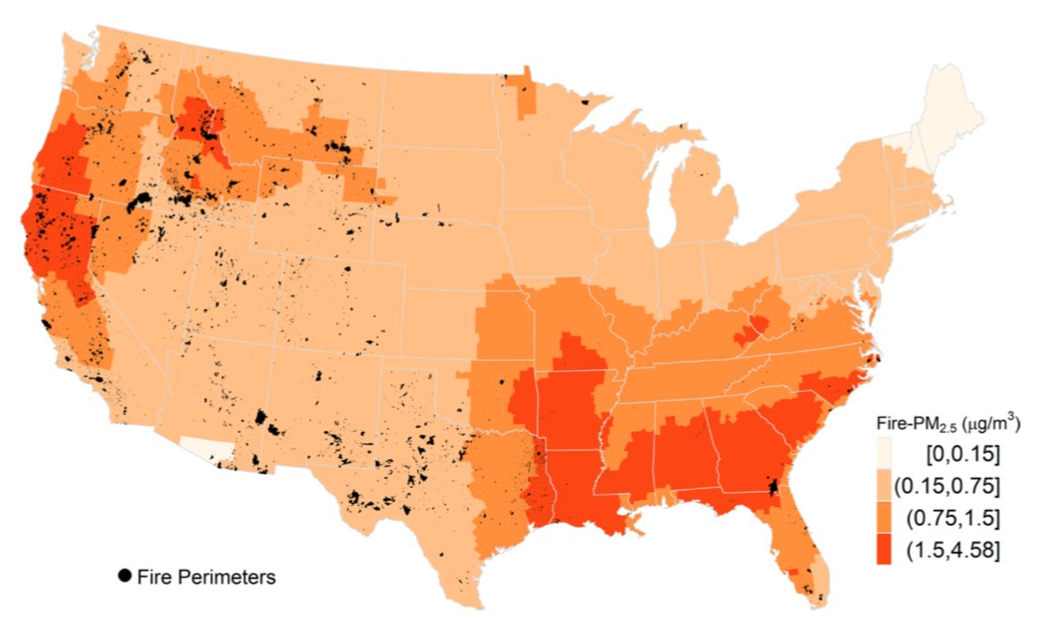
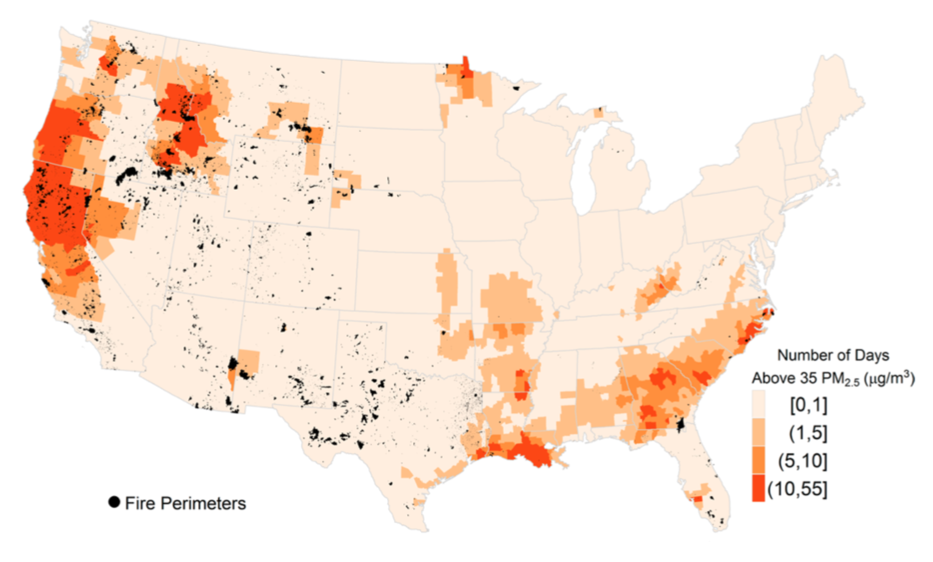
Potential Exposures to Populations to Wildland Fire Smoke
Annual average daily fire- PM_{2.5}
footprint for US counties
How much does smoke contribute to air quality and how often does it exceed the daily standard?
Annual avg. daily fire-PM2.5 footprint by counties
Number of days with fire-PM2.5 above 35 μg/m³
by counties
Areas burned by large fires in black between 2008 - 2012.
18
Rappold A, et al. Environ Sci & Technol 2017

Slide 19
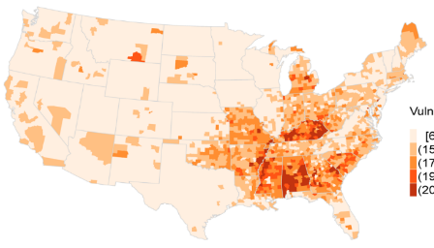
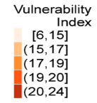
Community Health-Vulnerability Index
EPA tool for public health officials to identify
populations at risk from wildland fire smoke exposure
More smoke in the West, but population is less vulnerable than those in the south
This tool considers factors that define susceptibility to air pollutant-related health effects
Factors of Vulnerability
Peds & Adult Asthma
COPD
Obesity
Diabetes
Hypertension
% population age 65+
Income, education, poverty, unemployment
Rappold AG, et al Environ Sci Technol 2017
19

Slide 20

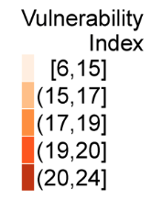
Community Health-Vulnerability
Community-Health Vulnerability Index
National map of Community-Health Vulnerability Index
to Adverse Health Effects from Wildfire Smoke
The Community Health-Vulnerability Index identifies the most vulnerable counties
30.5 million lived in the areas where annual average fire-PM_{2.5} was high (>1.5 μg/m³)
10.3 million people experienced >10 unhealthy air quality days due to smoke
Shows that these communities experience more smoke
exposures in comparison to less vulnerable communities
Rappold AG, et al Environ Sci Technol 2017
20

Slide 21
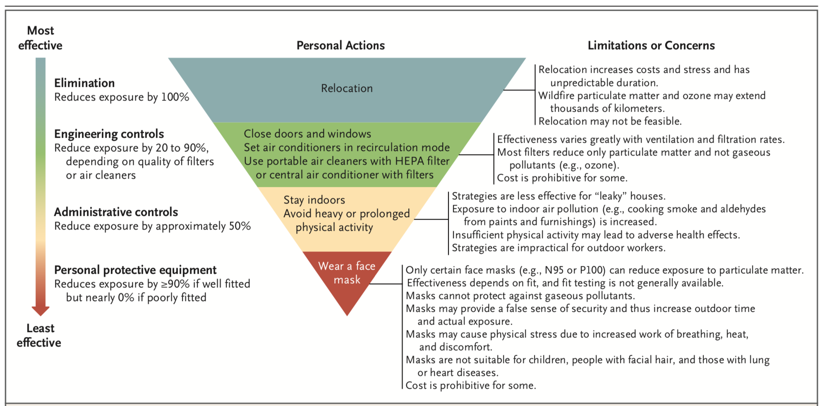
Main Actions that Individual People can Take to Reduce Wildfire Smoke Exposure
Some comments regarding
wearing a Face Mask can be debated.
N Engl J Med 2020; 383:2173-2181
21

Slide 22
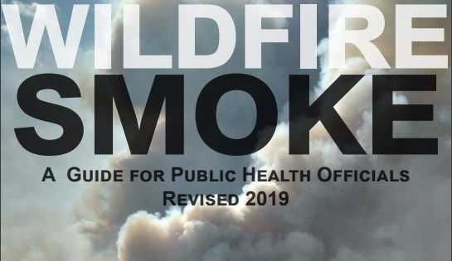
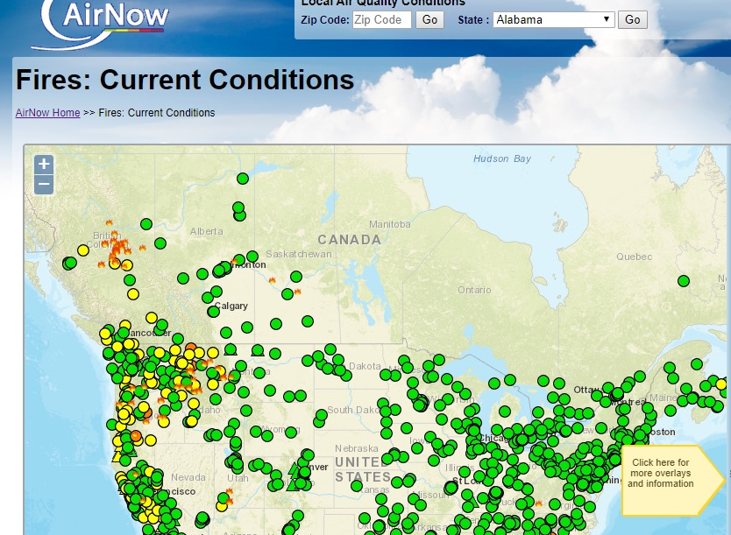
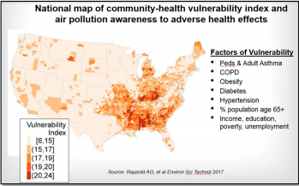
EPA Plays a Supportive Role
Public health outreach: helping the public understand how fires impact their health, including providing real-time information during fire events.
  AirNow
  Health Messaging, e.g., Wildfire Smoke: A Guide for Public Health Officials
  Smoke Sense App
Preparedness resources
  Clean Air Spaces
  Respirator Use
Information Clearinghouse: Smoke Ready Toolbox
Research
  How to improve community capacity and resiliency around smoke events
  Community Health Vulnerability Index
  How fires impact air quality
  Monitoring Needs
Courtesy of Erika Sasser, OAR
22

Slide 23
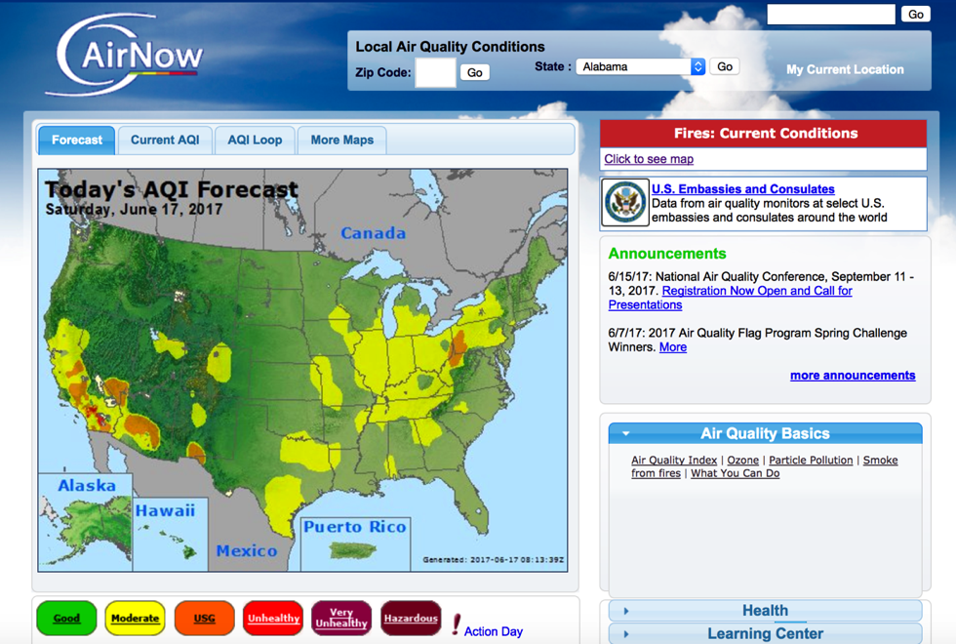
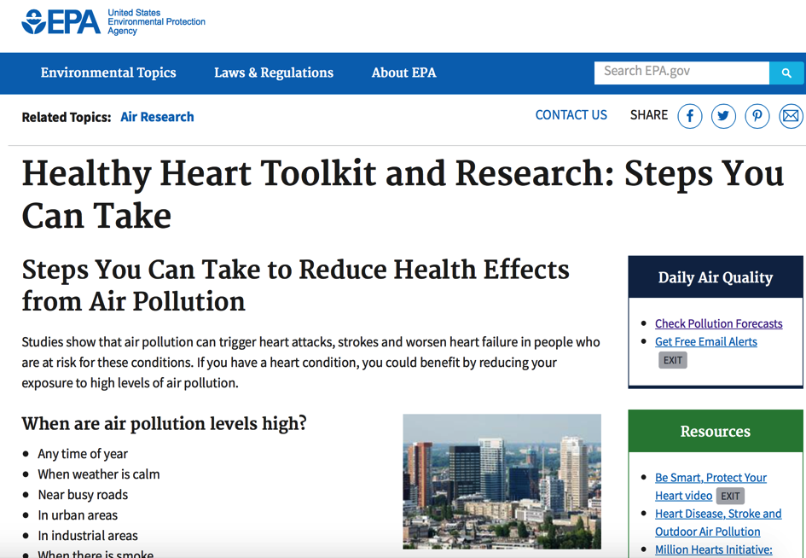
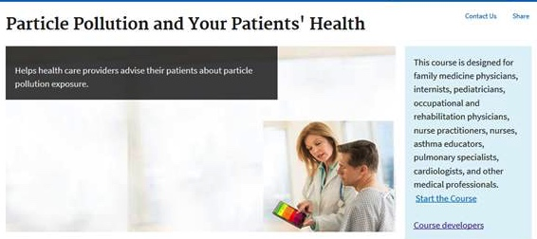
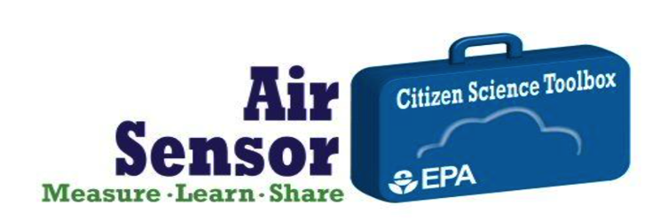

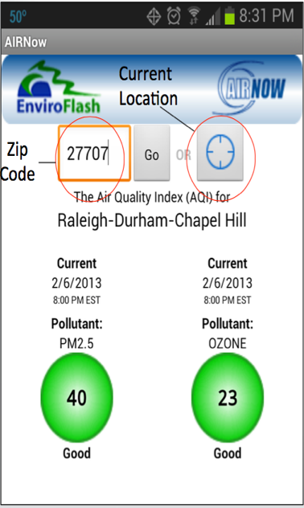
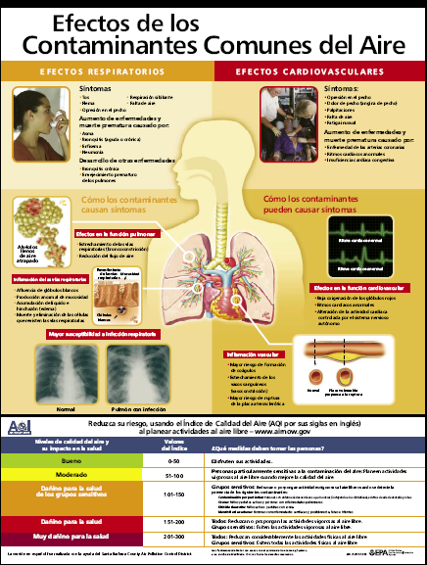
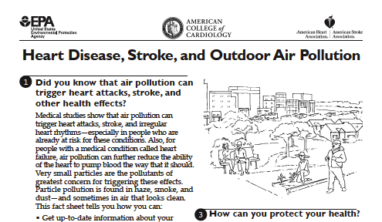

Engaging the Public
Examples of Products
23

Slide 24
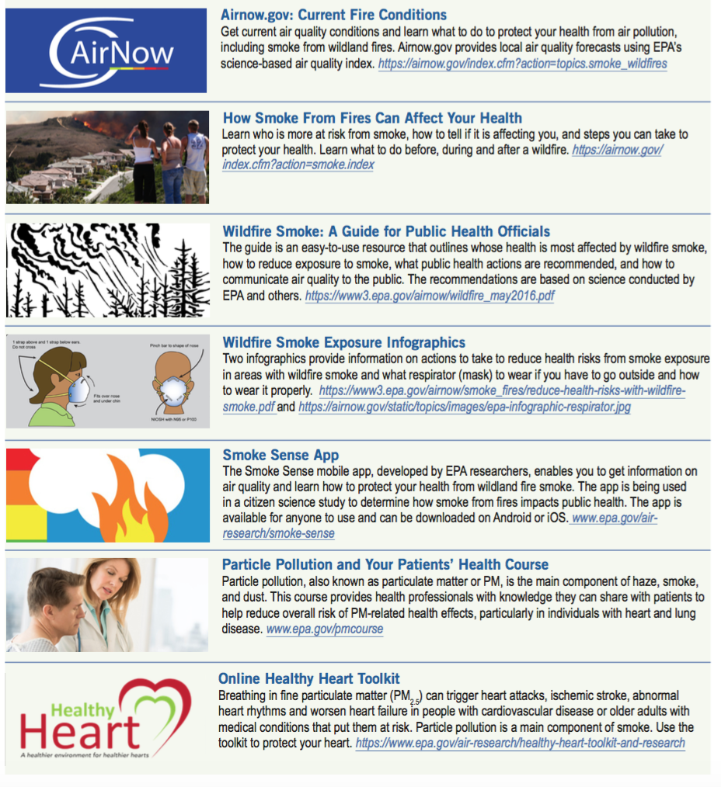
Smoke Ready Toolbox for Wildfires
Smoke Ready Toolbox for Wildfires
Resources health officials can use to educate the public about the risks of smoke exposure and actions people can take to protect their health
https://www.epa.gov/smoke-ready-toolbox-wildfires
24

Slide 25
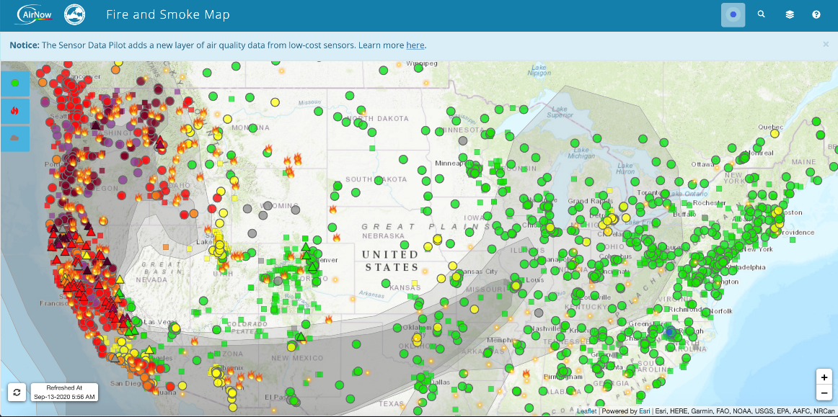
AirNow Fires: Fire and Smoke Map
September 13, 2020
25

Slide 26

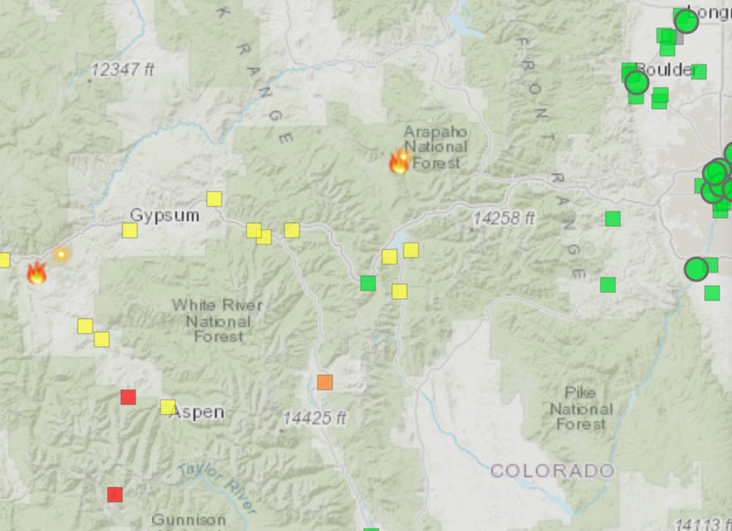
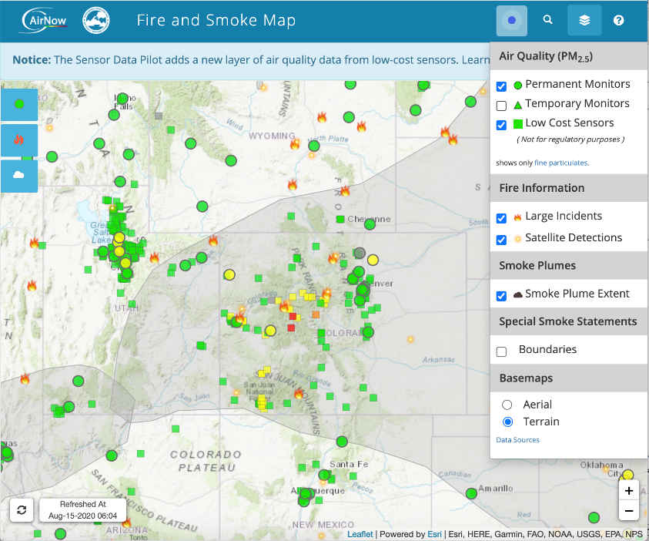
Enhanced Ambient Air Quality (PM_{2.5}) Data
Purple Air Now Displayed on AirNow
Air Quality (PM_{2.5}) Layers: Monitors and sensors reporting PM_{2.5} data
          Permanent Monitors: Federal, State, Tribal
          Temporary Monitors: Typically gov. agencies
          Low Cost Sensors: Currently from Purple Air
Boulder
Gypsum
Denver
Aspen
Colorado
26
https://fire.airnow.gov/
26

Slide 27
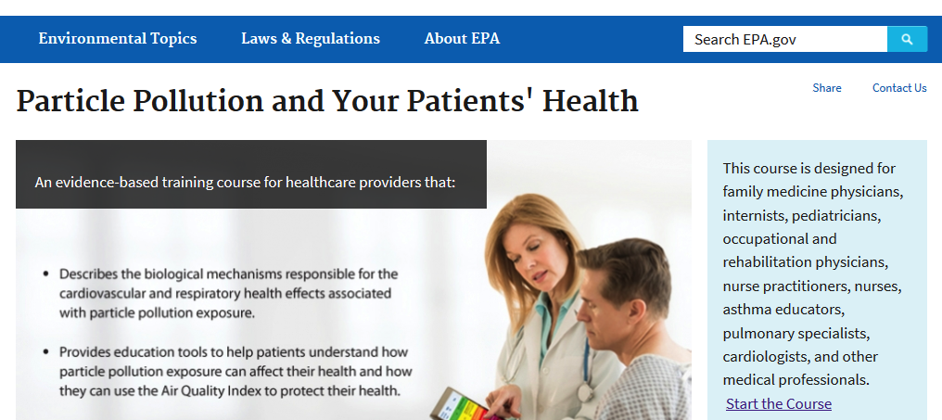
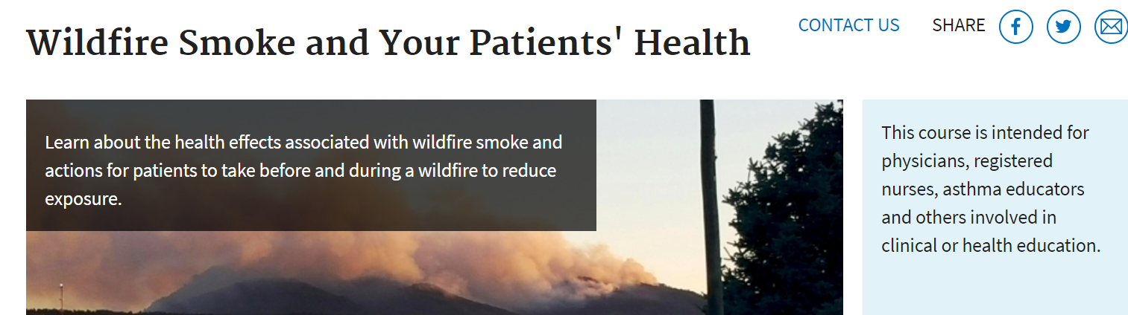
Wildfire Smoke and PM Web CE Courses
For Healthcare Professionals and Educators
In September 2020
Over 40,000 visits were made to the CE courses for:
PM
Wildfire Smoke
CME credit from CDC to physicians, nurses and health educators

Slide 28
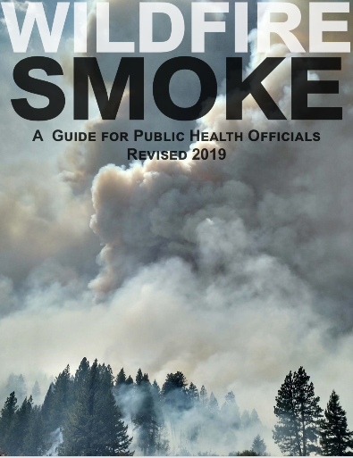
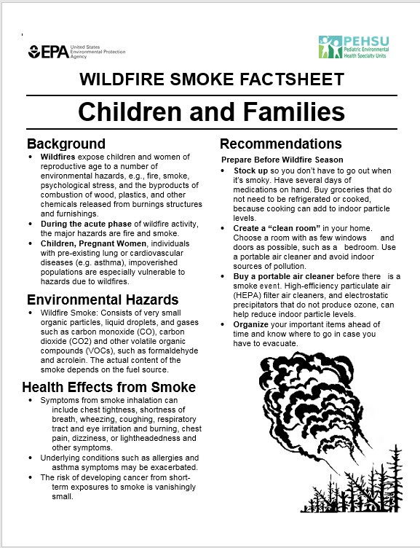
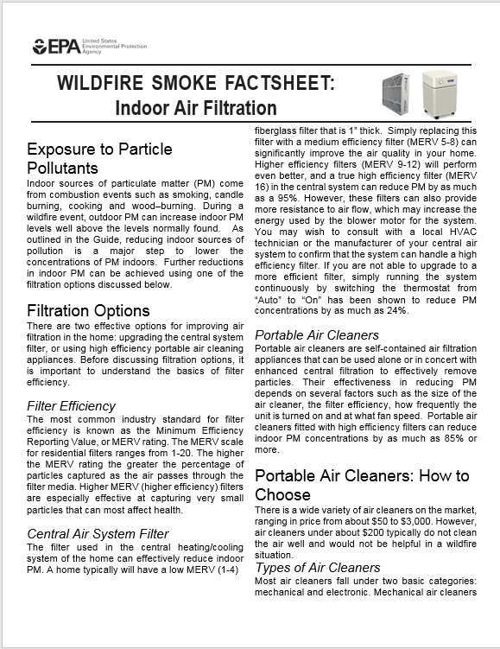
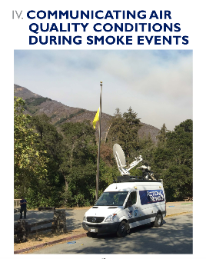

Wildfire Smoke:
A Guide for Public Health Officials
Stand-alone fact sheets
  Prepare for Fire Season
  Protect Yourself from Ash
  Indoor Air Filtration
  Reduce Your Smoke Exposure
  Protect Your Lungs from
  Wildfire Smoke or Ash
  Protecting Children from Wildfire Smoke and Ash
  Protect you Pets and Wildfire Smoke
  Protect Your Large Animals and Livestock from Wildfire Smoke
https://airnow.gov/index.cfm?action=topics.smoke_wildfires_guide_factsheets

Slide 29






Animals Can be Affected
Protecting Pets, Farm Animals and Livestock
Federal and Professional Partners
https://www3.epa.gov/airnow/smoke_fires/protect-your-pets-from-wildfire-smoke.pdf
https://www3.epa.gov/airnow/smoke_fires/protect-your-large-animals-and-livestock-from-wildfire-smoke.pdf
29

Slide 30


Wildfire Smoke Guide
Post-Publication Updates
  CDC has provided important new considerations for protecting health during wildfire attendant to the COVID-19 pandemic.
https://www.airnow.gov/wildfire-guide-post-publication-updates/

Slide 31


N-95 Respirator Use During Wildfire Events
Infographic Available for Download on AirNow
Challenges:
Inconsistent public health messaging across cities and states
Of value only if used correctly
Not designed or recommended for children
Increases work of breathing that might increase risk among those with cardiopulmonary impairment
Research Opportunity:
ORD plans to investigate these issues

Slide 32

Public Health Recommendations
Exposure Reduction Measures
An individual can be advised to:
  Stay indoors
  Reduce outdoor physical activity
  Respirators (e.g., N-95) can help
  in the short-term
  Activate asthma/COPD action plans
  Use a home clean air shelter
A community can be advised to:
  Provide community clean air shelters
  Increase air filtration in institutions
  Cancel outdoor events
  Evacuate

Slide 33
Smoke Sense Citizen Science Research
Smoke Sense provides information about current and future air quality
Forecasted smoke plumes can be visualized
Less time outside during smoke episodes to decrease exposure, & protect health
Smoke Sense helps collect information about who, when, and how frequently people are impacted by smoke
Information about smoke in the air and symptoms experienced in the past week will be logged

Slide 34
What is a Smoke Ready Community
Prepared and empowered to:
  Provide residents with evidence-based, locally information during fire-related smoke events
  Recommend actions to reduce public health impacts from smoke.
Preparedness activities may depend on:
  Forecasted risk for wildfires
  Frequency and severity of smoke impacts
  Nature of the fire event (wildland fire, prescribed fire, residential wood burning
  Underlying vulnerabilities of local populations, and other attributes of the community.
EPA and partners want to provide community will tools and resources to:
  Assess these vulnerabilities in advance
  Plan for appropriate responses
  Take action during a fire
Courtesy of Erika Sasser, OAR

Slide 35
Questions
Thank you
Wayne E. Cascio, MD, FACC
Director, Center for Public Health and Environmental Assessment
Office of Research and Development
U.S. Environmental Protection Agency
Email: cascio.wayne@epa.gov
No conflicts of interest
The presentation represents the opinions of the speaker and does not necessarily represent the policies of the US EPA

Slide 36
Emerging Areas of Health Effects Research
Neurological and Neurodegenerative
Air Pollution & Neurotoxicity in Adults
  Effects on Neurodegenerative Disorders
    Parkinson’s
    (Liu R et al. Environ Health Perspect 2016; Palacios et al. Rev Environ Health 2017)
    Multiple sclerosis
  Non-Specific Neurological Symptoms
    Cognitive Function
    (Tallon et al. Environ Internat 2017)
    Fatigue
    Anxiety and Depression
    (Szyszkowicz M et al. Environ Health insights 2016; Pun EHP 2016; Vert Intern J Hygiene Envir Health 2017)
Air Pollution & Neurotoxicity in Children
  Effects on Child Neurodevelopment
    Prenatal exposure to air pollution
    Childhood exposure to air pollution
  Neurodevelopmental Disorders
    Autism Spectrum Disorder
    Attention-Deficit Hyperactivity Disorder
Accelerated Biological Aging
    Effects on telomeres
      Shortened telomeres measured at birth and in adults an indicator of biological aging
      (Martens DS et al. JAMA Pediatrics 2017; Ward-
      Caviness et al. Octotarget 2016)
36

Slide 37


Solutions-Driven Research Pilot: Creating Cleaner Air Spaces
Focus: Measuring the effectiveness of air cleaning filtration systems in wildfire smoke conditions
Stakeholders identified research priorities, including:
  How effective are portable air cleaners (PACs) or central air filtration systems during smoke events?
  Under what operating and maintenance conditions and in what building types?
Laboratory and field studies
Partnering with:
  Missoula City-County Health Department, Climate Smart Missoula, University of Montana
  Hoopa Valley Tribe, California
Collocation of Purple Air sensors with reference monitors at the USFS Fire Science Lab

Slide 38

Reducing Adverse Health Outcomes of Ambient
and Indoor Exposures to Wildfire Smoke
EPA Science to Achieve Results (STAR) program Request for Application
The Interventions and Communication Strategies to Reduce Health Risks of Wildland Fire Smoke Exposures
Open Date: October 9, 2020 Closed Date: December 15, 2020
URL: https://www.epa.gov/research-grants/interventions-and-communication-strategies-reduce-health-risks-wildland-fire-smoke
Background: EPA is seeking applications proposing research that will address behavioral, technical and practical aspects of interventions and communication strategies to reduce exposures and/or health risks of wildland fire smoke.

Slide 39

Smoke and the Respiratory System
Studies from the global burden of disease have found significant associations between household biomass smoke exposure in developing countries and respiratory infections (Gordon et al, 2014)
A comprehensive meta-analysis assessed associations between air pollution exposure and emergency department visits and hospitalizations for influenza, bacterial pneumonia or culture negative pneumonia
  Interquartile range increases in PM_{2.5} over the previous 7 days were generally associated with increased excess rates of each of these specific respiratory diagnoses (Croft et al 2019).

Slide 40
Smoke and the Respiratory System
Air pollution exposure increases the risk and severity of respiratory infections
  All particles share a common mechanism of biological effect and this supports a common presentation (clinical, physiological, and pathological) following exposure.
  Air pollution affects host defenses and include damage to the muco-ciliary escalator, reduced macrophage number or activity and a general decrease in local and systemic immune function.
Prior observations have not differentiated between type of infection
Most experimental research (in rodents) focused on bacterial pneumonias
  Numerous examples that illustrate the same effects with respiratory viruses
Tobacco smoke is a complex mixture of combustion particles and gases
  Risk of influenza infection, likelihood of severe disease and complication was increased in smokers
  Efficacy of influenza vaccines is reduced in smokers

Slide 41
Smoke and the Respiratory System
Animal Studies
Exposure to air pollutants can increase the severity and course of
bacterial and viral infections
Mice infected with influenza virus and compared the course of infection in animals exposed to diesel exhaust or fresh air
  Viral titers and lung injury were higher in the diesel exposed animals at the peak of infection although all animals recovered to baseline by 14 days Gowdy et al (2010).
Infectivity studies using more potent viral strains have shown that exposure to ozone increased mortality to influenza virus infection under certain exposure conditions (Selgrade et al 1998).

Slide 42

Features of a Smoke Ready Community
Identifies populations at risk
Develops plans for gathering and disseminating information
Develops communications plans and materials in advance
Establishes decision points for community actions
Develops specific strategies to reduce smoke exposures
Educates the community about the importance of being prepared
Develops back-up plans to deal with extreme smoke events and high fire-risk situations
Develops plans for local animals
Courtesy of Erika Sasser, OAR

