Slide 1
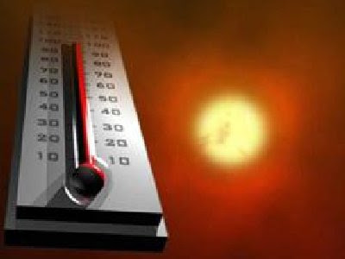
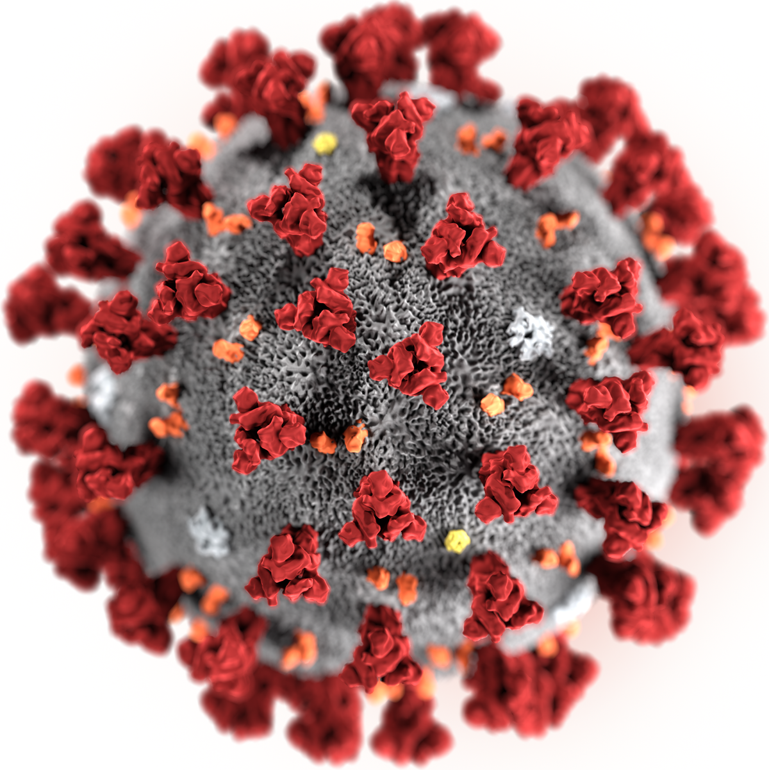
Shared Drivers of COVID19 and Climate Change Challenge and Opportunities Climate Change and Health
MPHP 441
Holly Rosencranz, MD April 2021

Slide 2
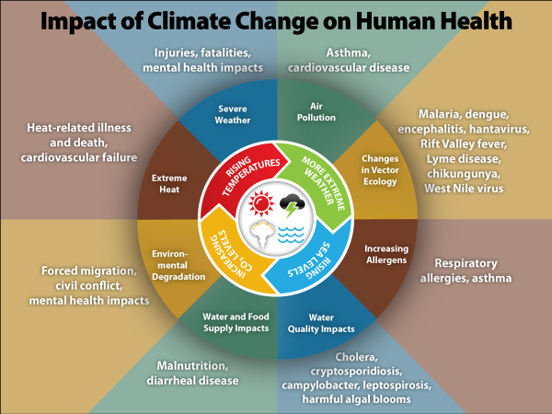
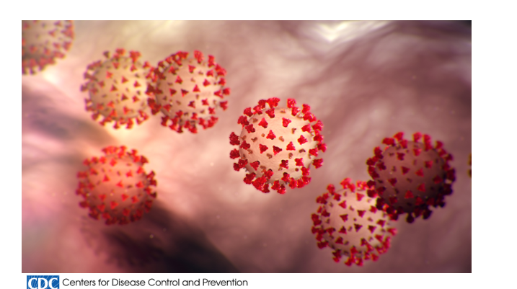
Climate Change Health Impacts
Maternal and reproductive health
Cardiovascular effects of climate change
Climate change and disability
Heat stress and kidney disease
Infectious diseases and climate change
Air degradation, allergies, and pulmonary diseases
Climate change and zoonotic diseases
Worker safety and health
Health effects of wildfires
CDC.gov

Slide 3
Objectives
Understand how drivers of climate change can increase the risk of pandemics
Identify overlapping and disproportionate impacts of climate change and COVID19 on vulnerable communities already suffering from poor health
Recognize challenges in adaptation and mitigation for both climate change and COVID19
Inspire actions that will impact both climate change and COVID19

Slide 4
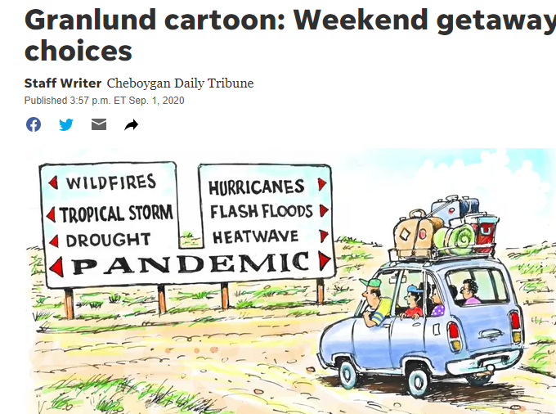
Confluence of the two most pressing global health threats
Notes:
Dave Ganlund . Political cartoonist, over 700 newspapers

Slide 5
SOCIAL DETERMINANTS OF HEALTH
Syndemic of Climate Change and COVID
Syndemic: Synergistic health problems that affect the health of a population within the context of persistent social and economic inequalities.
Mendenhall, 2017
Notes:
The COVID-19 pandemic has highlighted the scale of health inequalities at all levels. disproportionately affected communities already suffering from poor health and living in vulnerable conditions, leading to increases in mortality and disastrous economic damage

Slide 6
Will Climate Change Make COVID19 Worse?
There is no evidence of a direct connection between climate change and the emergence or transmission of COVID-19 disease….
…most emerging infectious diseases, and almost all recent pandemics, originate in wildlife, and there is evidence that increasing human pressure on the natural environment may drive disease emergence.
“If we wish to reduce the risk of future pandemics, we must prioritize action on the climate crisis – one of the most powerful forces driving zoonoses today.”
Dr Richard Horton, editor-in-chief of The Lancet
who.int
thelancet.com
Notes:
Diving into shared drivers

Slide 7
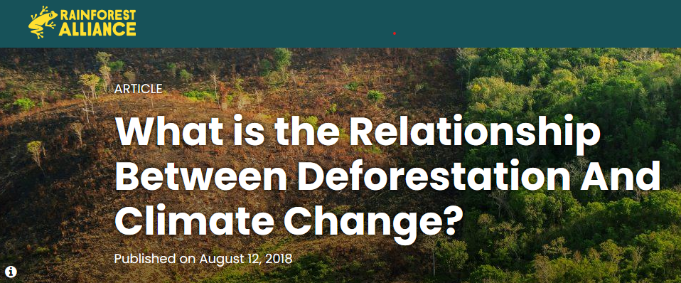
Root Causes of Climate Change Increase the Risk of Pandemics
Loss of Habitat Deforestation for agricultural purposes-largest cause of habitat loss worldwide
Trees capture greenhouse gases (GHGs) like carbon dioxide, preventing them from accumulating in the atmosphere and warming our planet.
Felled trees release stored carbon into the atmosphere
Rainforestalliacne.org
Notes:
Beyond burning fossil fuels. Loss of habitat at forefront
Increasing human pressure on the natural environment Forests:
~80% of remaining terrestrial biodiversity
Absorb/store C02

Slide 8
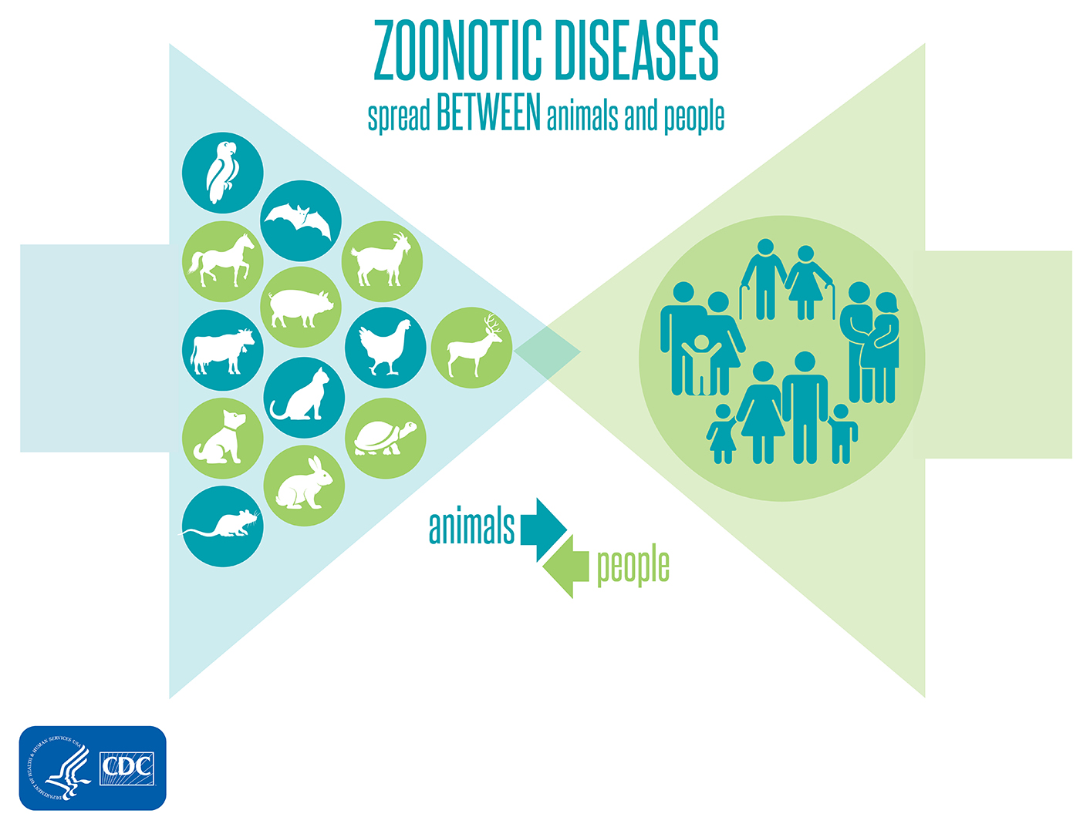
Forest Destruction Increases Climate Change and Risk of Pandemics
Loss of Habitat
Animal movement creates opportunity for pathogens to get into new hosts.
Exploitation and devastation of wildlife and places where animals live put people at risk of encountering new zoonotic diseases like coronavirus
Proximity between people and wildlife carries huge disease risks
West Nile Virus
Palgue
Rabies
Lyme
SPILLOVER
www.biologicaldiversity.com
https://www.hsph.harvard.edu/
Notes:
~80% of remaining terrestrial biodiversity
Absorb/store C02

Slide 9
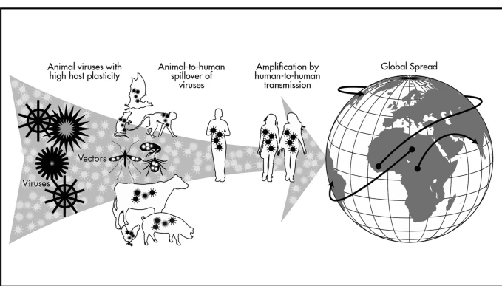
Pandemics
HYPOTHESIS :
Rather than a direct zoonotic spillover from horseshoe bats, the most likely route was through an intermediary animal species. (WHO 2021)
Kreuder Johnson, 2015
COVID19:
“Emerging Infectious disease of probable animal origin.” (Haider, 2020)
Haider, 2020
who.int
Notes:
Reclassify ? Paper in Frontiers of Public Health, authors noted that
The World Health Organization defines a zoonosis as any infection naturally transmissible from vertebrate animals to humans. The pandemic of Coronavirus disease (COVID-19) caused by SARS-CoV-2 has been classified as a zoonotic disease, however, no animal reservoir has yet been found, so this classification is premature.

Slide 10
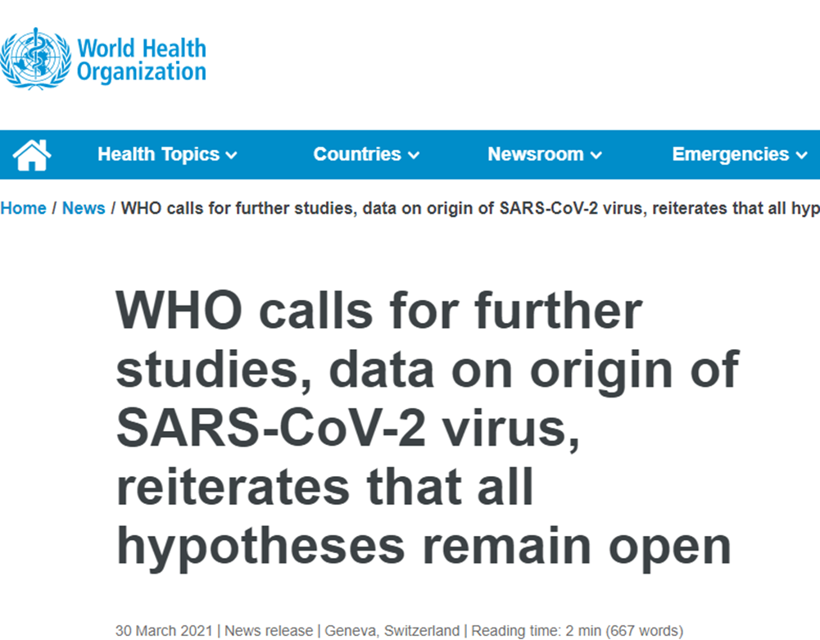
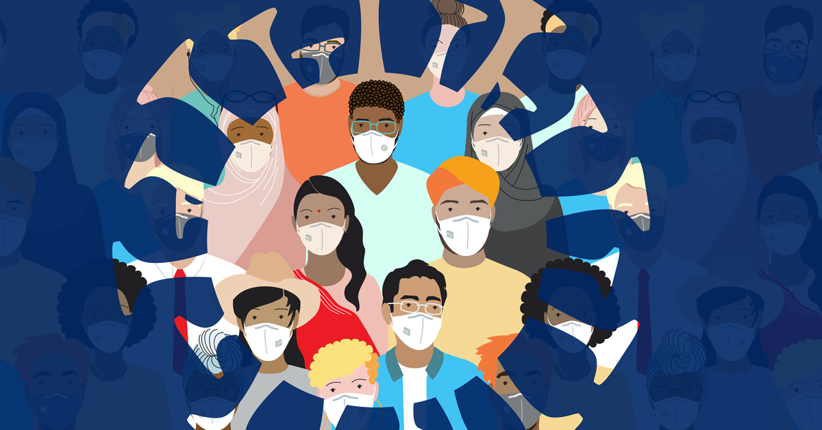
30 March 2021
“our ability to prevent and respond to future pandemics depends on identifying the natural reservoirs and intermediate hosts of SARS-CoV-2 and the natural events that propelled the novel coronavirus onto the world stage” Director-General of WHO
who.int
Notes:
We have not yet found the source of the virus, and we must continue to follow the science and leave no stone unturned as we do,” While the public health priority was, and remains, to mount a rapid, comprehensive and effective response to suppress human-to-human transmission of the virus

Slide 11
Shared Disproportionate Impacts
The COVID-19 pandemic has highlighted the scale of health inequalities at all levels. It has disproportionately affected communities already suffering from poor health and living in vulnerable conditions, leading to increases in mortality and disastrous economic damage
who.int
Notes:
The COVID-19 pandemic has highlighted the scale of health inequalities at all levels. disproportionately affected communities already suffering from poor health and living in vulnerable conditions, leading to increases in mortality and disastrous economic damage

Slide 12
Impacts of COVID19 and Climate Change Shared by Vulnerable Populations
Low income and minority
Air pollution exposure
Chronic diseases
Food insecure/obese
Elderly
Notes:
cWho is at risk? …Everyone but disproportionately affects vulnerable populations
Those with chronic illnesses, economically disadvantaged, socially isolated
The extremes of age Marginalized communities
Persons with existing chronic diseases
Living conditions-no cooling, heat island, exposure to mold
Reflecting social determinants of health
Pandemic has highlighted Communities of color are at increased risk for experiencing serious illness if they become infected with coronavirus due to higher rates of certain underlying health conditions compared to Whites;

Slide 14
Long-term exposure to PM2.5 leads to large increase in COVID19 death rate.
Higher death rates among the poor and people of color reflect existing health and economic inequalities that both contribute to, and result from, greater exposure to air pollution. (Wu,2020)
Wu, 2020
Notes:
One of the most prominent examples of this is in impacts of air pollution.
In places where air pollution is a chronic problem, we have to pay particular attention to individuals who may be more exposed or vulnerable than others to polluted air, such as the homeless and those with chronic medical problems,” says Dr. Bernstein. “These individuals may need more support than they did even before coronavirus came along.”

Slide 15
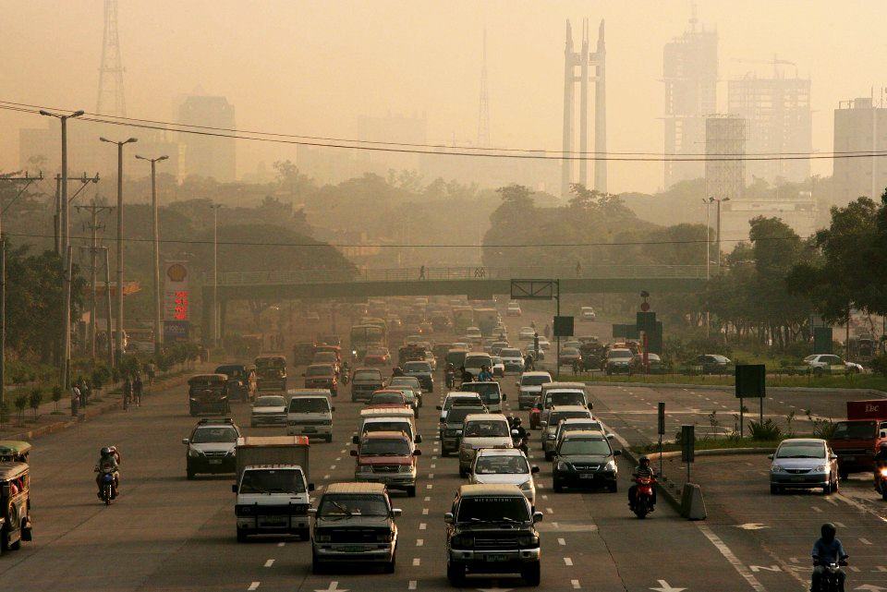
SOCIAL DETERMINANTS OF HEALTH
Overlap: Minorities and Air Pollution
July 2020
Marginalized groups are at higher risk than others for exposure to high levels of air pollution and associated chronic illnesses, as well as for Covid19–related illness and death.
Salas, 2020
Notes:
The COVID-19 pandemic has highlighted the scale of health inequalities at all levels. disproportionately affected communities already suffering from poor health and living in vulnerable conditions, leading to increases in mortality and disastrous economic damage

Slide 16
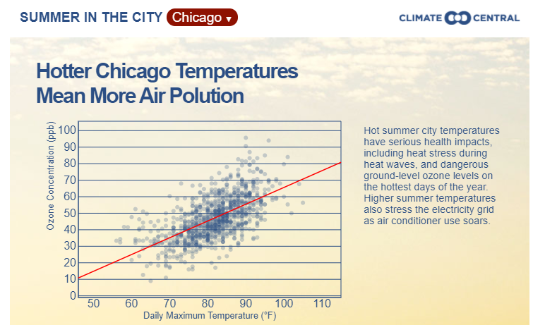
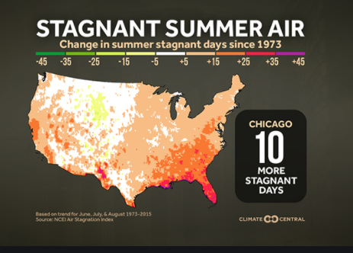
During heat waves, air becomes stagnant, and traps emitted pollutants, often resulting in increases in surface ozone (ncdc.noaa.gov)
Chicagoans in minority neighborhoods on the West and South Sides have the greatest exposure to toxic air pollution and other environmental health hazards in the city. (Chase 2018)
)
ncdc.noaa.gov
Chase, 2018

Slide 17
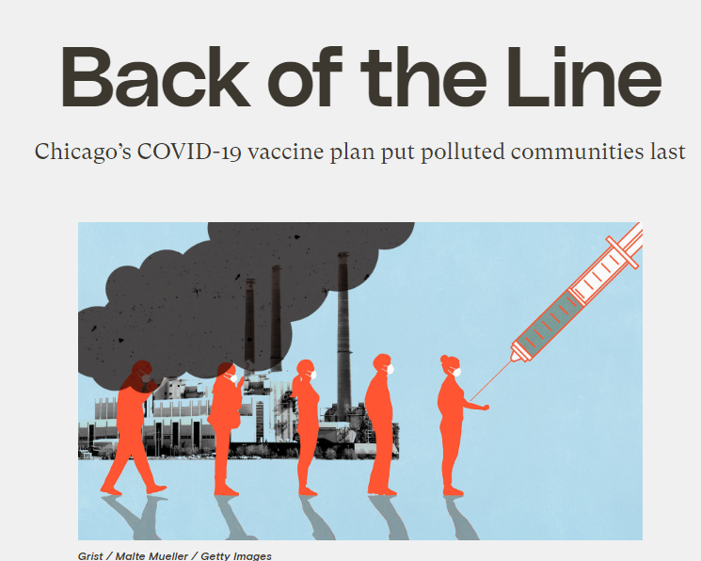
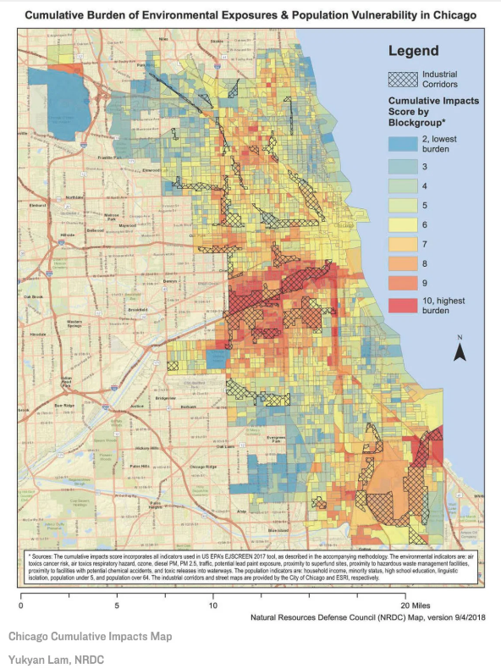
SOCIAL DETERMINANTS OF HEALTH
Minorities and Air Pollution
Residents 15X more likely to die of COVID19
20% fewer vaccines (January 2021)
Mahoney, 2021
Notes:
The COVID-19 pandemic has highlighted the scale of health inequalities at all levels. disproportionately affected communities already suffering from poor health and living in vulnerable conditions, leading to increases in mortality and disastrous economic damage

Slide 18
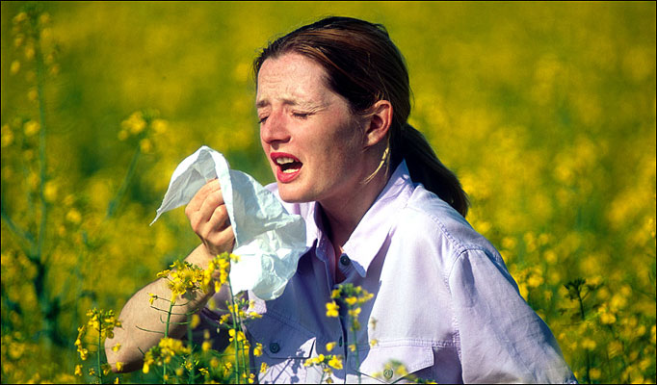
February 2021
Anthropogenic climate change has already exacerbated pollen seasons in the past three decades with attendant deleterious effects on respiratory health.
Anderegg, 2021
Notes:
In addition to air pollution, the Growing season is lengthening. Which means more pollen

Slide 19
(Athanasios, 2021)
Positive association between COVID 10 infection rates and airborne pollen concentrations
Athanasios, 2021
Notes:
Maybe interferon

Slide 20
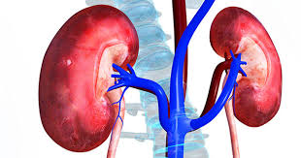
Chronic disease
Having chronic kidney disease of any stage can make you more likely to get severely ill from COVID-19.
CKD more common in older individual and no Hispanic Black adults
Heat Stress Nephropathy
Johnson, 2019
Notes:
Recurrent heat and dehydration may increase risk for kidney diseaseecurrent heat and dehydration can result in chronic kidney disease (CKD) in animals and theoretically plays a role in epidemics of CKD developing in hot regions of the world where workers are exposed to extreme heat. Heat stress and dehydration

Slide 21
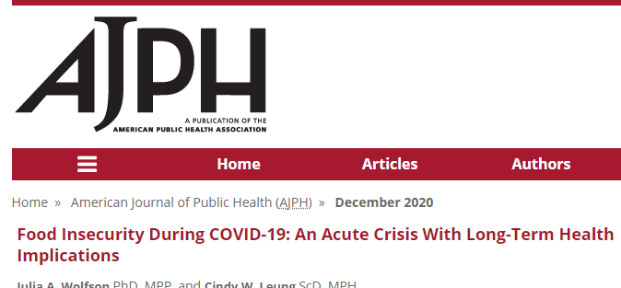
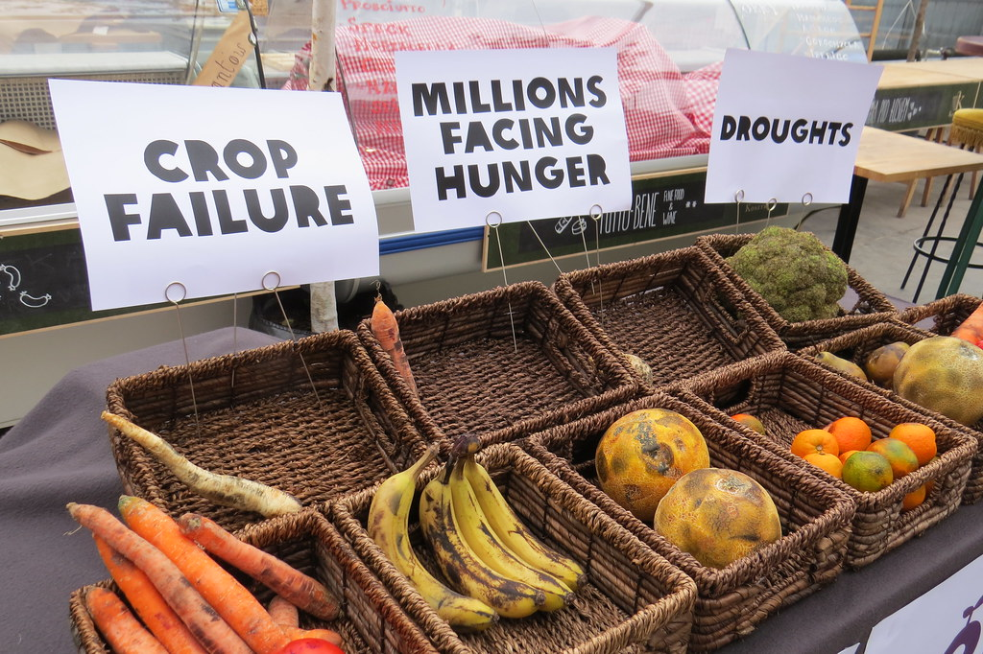
Obesity
(Pan 2012)
Climate change affects crop yields, nutritional value and cost of food and stability of food systems and food security.
Wolfson, 2020
Notes:
The economic downturn caused by the COVID-19 pandemic has already led to devastating consequences for millions of Americans who were struggling to make ends meet and will continue to exert lasting damages disproportionately felt by low-income Americans and communities of color. Since mid-March 2020, numerous surveys have documented unprecedented levels of food insecurity

Slide 22
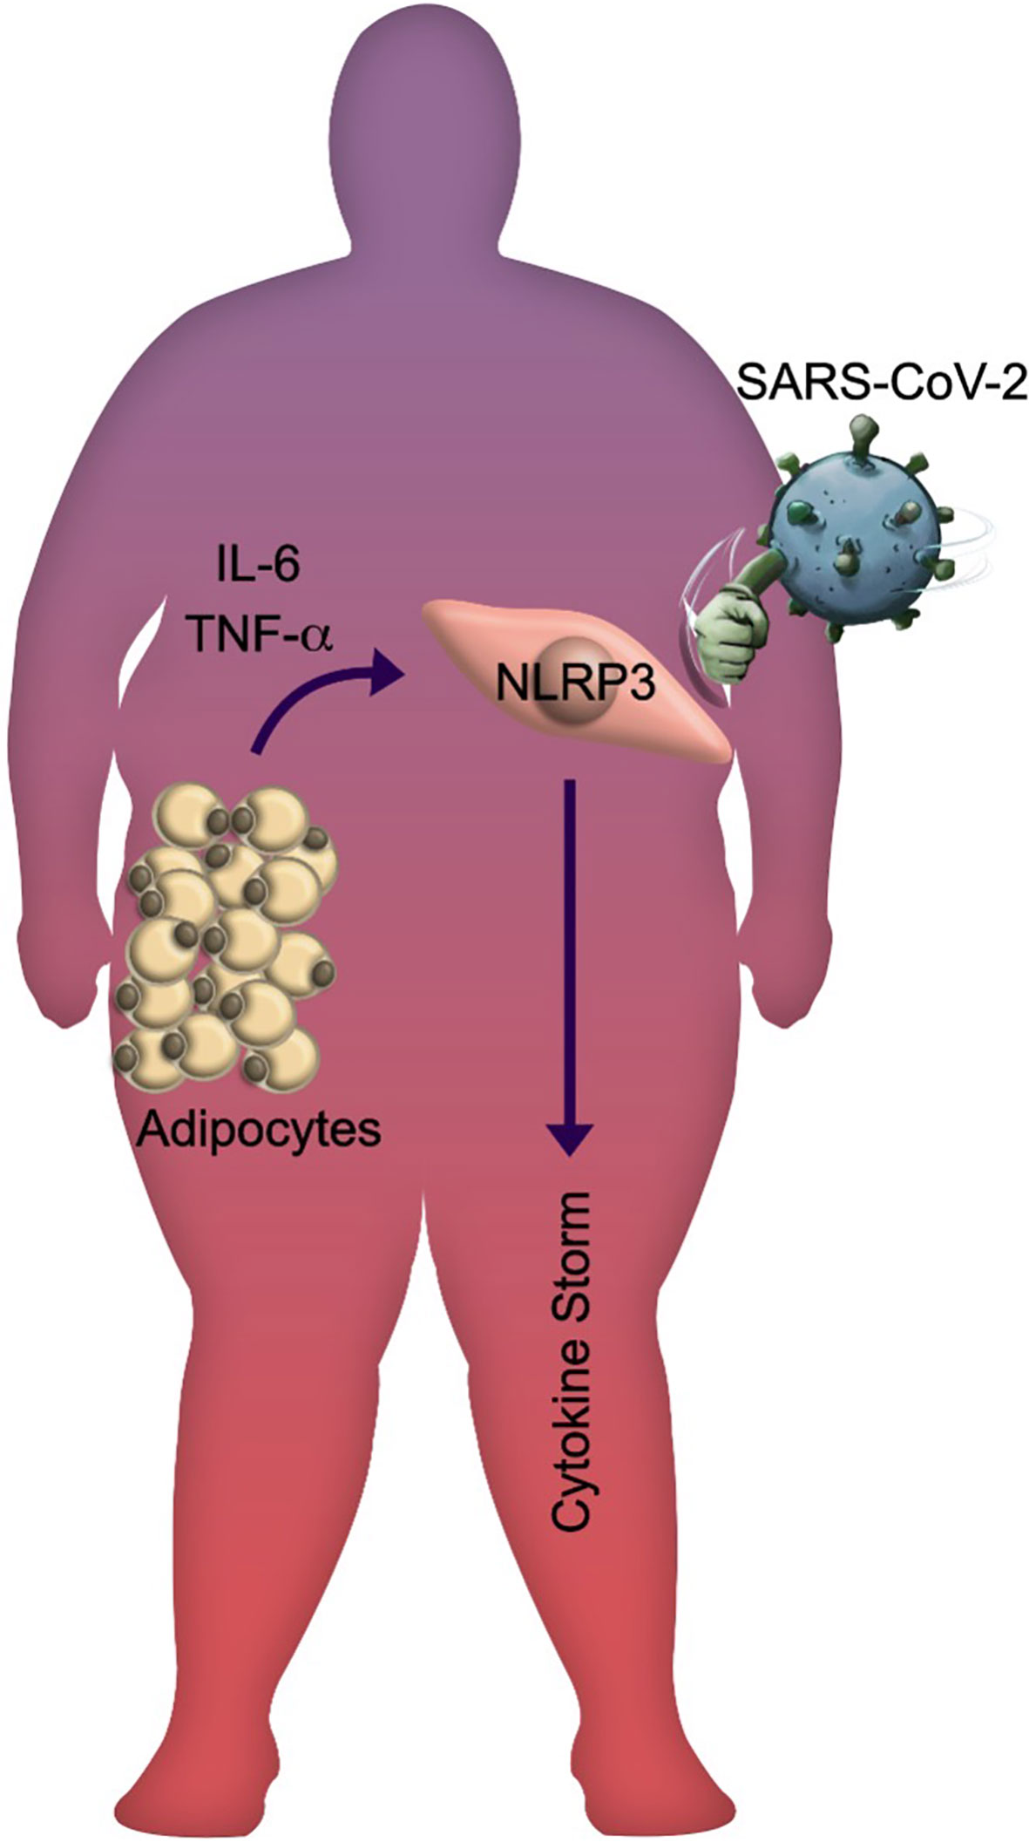
((Kompaniyets 2021)
Obesity increases risk for severe COVID19–associated illness, invasive mechanical ventilation, hospitalization and death, particularly among adults aged <65 years.
Proinflammatory mediators
predispose to worse outcomes in obese patients with COVID19 (Banerjee 2020)
Kompaniyets, 2021

Slide 23
Older adults are vulnerable to climate
change-related health impacts
Heat exposure- increases risk of illness and death in elderly especially those with chronic health conditions
epa.gov

Slide 25
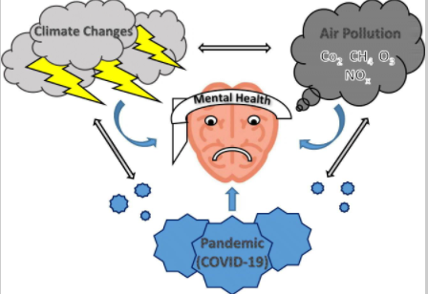
Most Vulnerable
Elderly… people with pre-existing health problems especially mental illnesses…individuals with low socio-economic status, and immigrants.
Mental Health Influences
Mild negative emotional responses to full-blown psychiatric conditions, (anxiety and depression, stress/trauma-related disorders, and substance abuse).
Marazziti , 2021

Slide 26
Climate change threatens efforts to contain COVID19
Shelter in place with destruction of infrastructure
Testing and vaccination access with heatwaves, heavy storms
Social distancing in evacuation or cooling center
Sanitizing hands and surfaces without adequate clean water
Access to health care

Slide 27
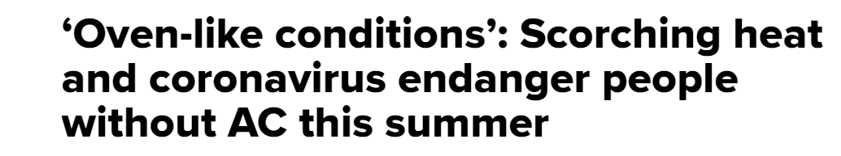
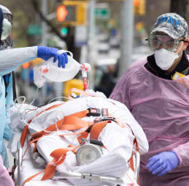
Climate change drove hotter-than-normal temperatures across the U.S. in 2020- putting Americans already vulnerable to coronavirus at heightened risk of heat-related illness and death.
A disproportionate number of people who don’t have AC in their homes are low-income and minority groups.
Many public cooling centers shuttered due to the pandemic, and those that were open could cause disease spread.
Newburger, 2020

Slide 28
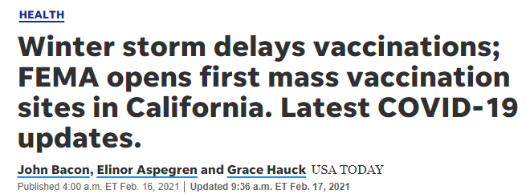
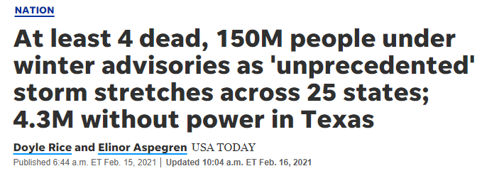
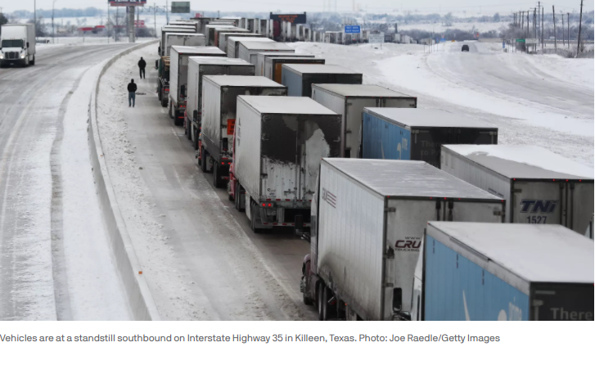
usatoday.com 2021
www.axios ,com 2020

Slide 29
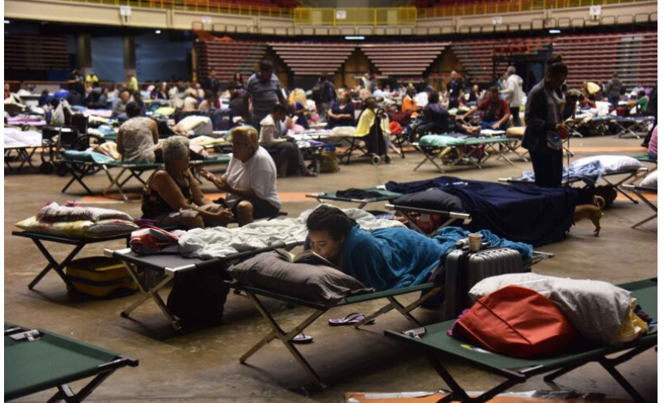
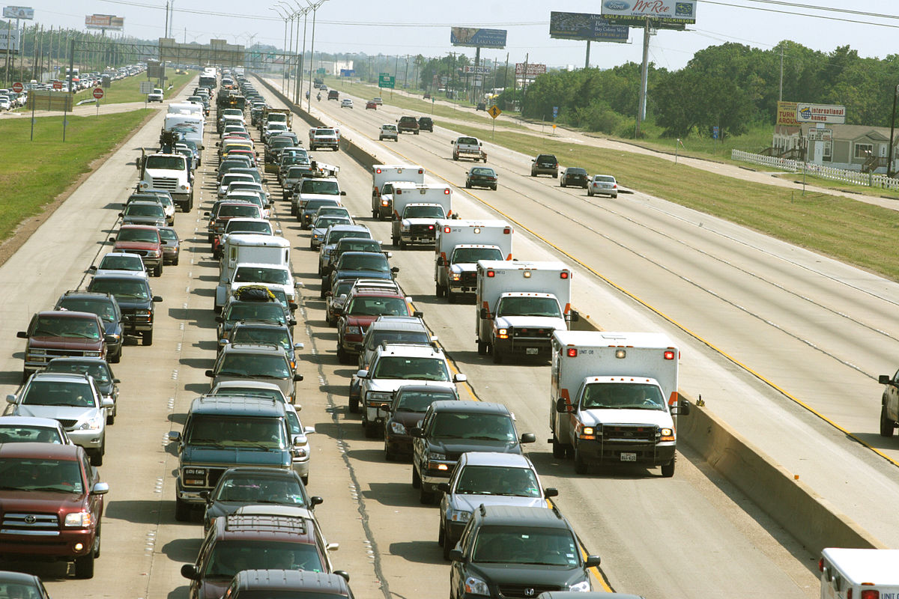
S
Flight from disaster:
April 13, 2020
Large numbers of people evacuate on short notice housed in shelters that are overcrowded, understaffed and undersupplied
Potential for spreading virus to distant locations
propublica.org
Notes:
Looking down the barrel of hurricane season
Large numbers of people may need to flee on short notice and be housed in shelters that are overcrowded, understaffed and undersupplied. In 2017 in Florida Hurricane Irma still forced some 191,000 people into crowded arenas and other shelters.

Slide 30
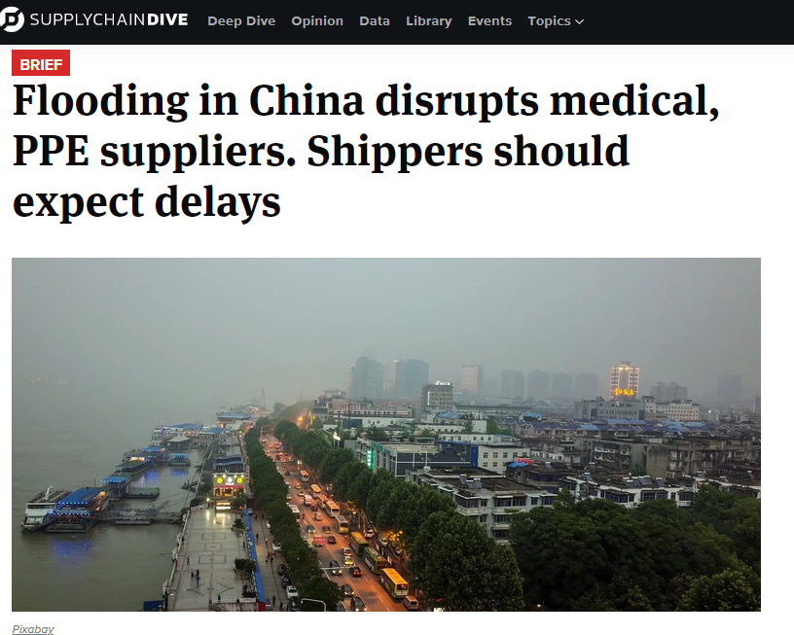
July 23,2020
Leonard,
Flooding impacted supply chains for personal protective equipment, crucial to healthcare workers fighting the pandemic.
Notes:
Flooding in China July 2020

Slide 31
COVID19 threatens efforts to contain climate change
Carbon footprint of PPE manufacture/distribution
Commercial and medical single-use plastic
The average rate of the medical waste generated for coronavirus treatment was …more than tenfold higher than the average generation rate during regular hospital operations. (Abu-Qdais 2020)
(Silva 2021)
Silva, 2021
Abu-Qdais, 2020

Slide 32
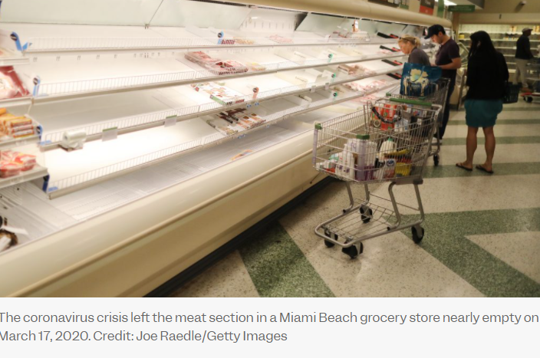
Lessons from COVID for Climate Resilience
The pandemic disrupted global supply chains, induced panic buying and cleared supermarket shelves.
Edible produce rotting in fields.
Livestock because slaughter plants were shut down.
insideclimatenews.org
Notes:
pandemic disrupted global supply chains, induced panic buying and cleared supermarket shelves. It left perfectly edible produce rotting in fields, and left farmers no choice but to gas, shoot and bury their livestock because slaughter plants were shut down
"The disruptions caused by this terrible pandemic have at least awakened the world to the fact that our food systems are far more vulnerable than many realized,"

Slide 33
Develop Strategy for Pandemic Preparedness and Climate Adaptation
“Leveraging COVID19 recovery programs to simultaneously advance the climate agenda presents a strategic opportunity to transition toward a more sustainable post–COVID-19 world.” (Rosenbloom, 2020)
Rosenbloom, 2020

Slide 34
SOCIAL DETERMINANTS OF HEALTH
Syndemic of Climate Change and COVID
Decarbonization
Equity and Environmental Justice
Sustainable Food Systems & Food Security
Health Care Delivery and Access
Proactive public health planning
Notes:
The COVID-19 pandemic has highlighted the scale of health inequalities at all levels. disproportionately affected communities already suffering from poor health and living in vulnerable conditions, leading to increases in mortality and disastrous economic damage

Slide 35
Advocate for Actions by Health Care Systems
Decarbonization and Improved Resilience
Low carbon energy transition in built environment
Minimizing landfill and incineration use for waste disposal
Strategic landscaping
Reduce transport-related emissions through smart procurement
Source clinic or hospital food locally and sustainably
Reduce plastics and single use items
Support telemedicine and remote work
Reimagine health care delivery models
Reduce financial barriers to health care access
Preparation for predictable health crises

Slide 36
Educate Public

Slide 37
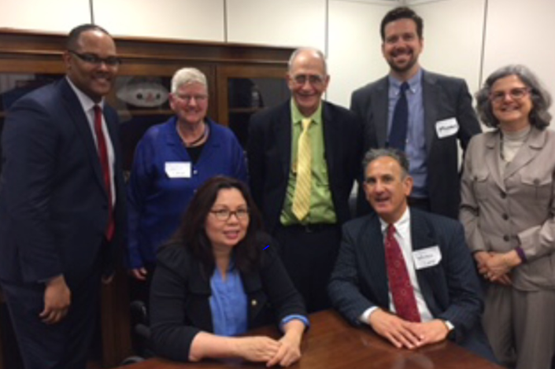
Educate Policy Makers

Slide 38
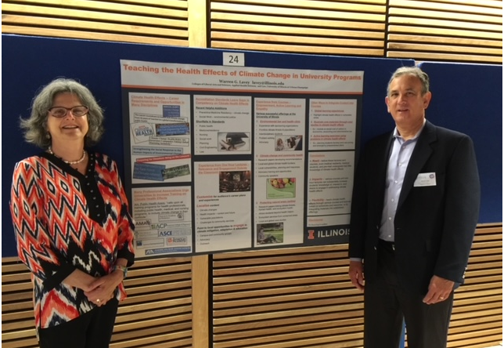
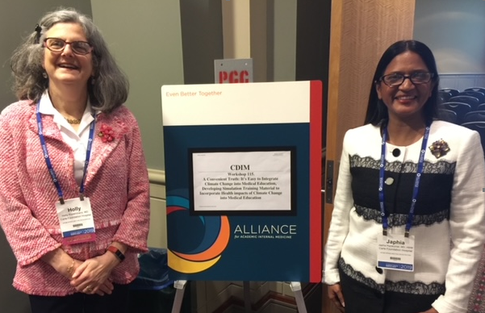
Educate Providers

Slide 39
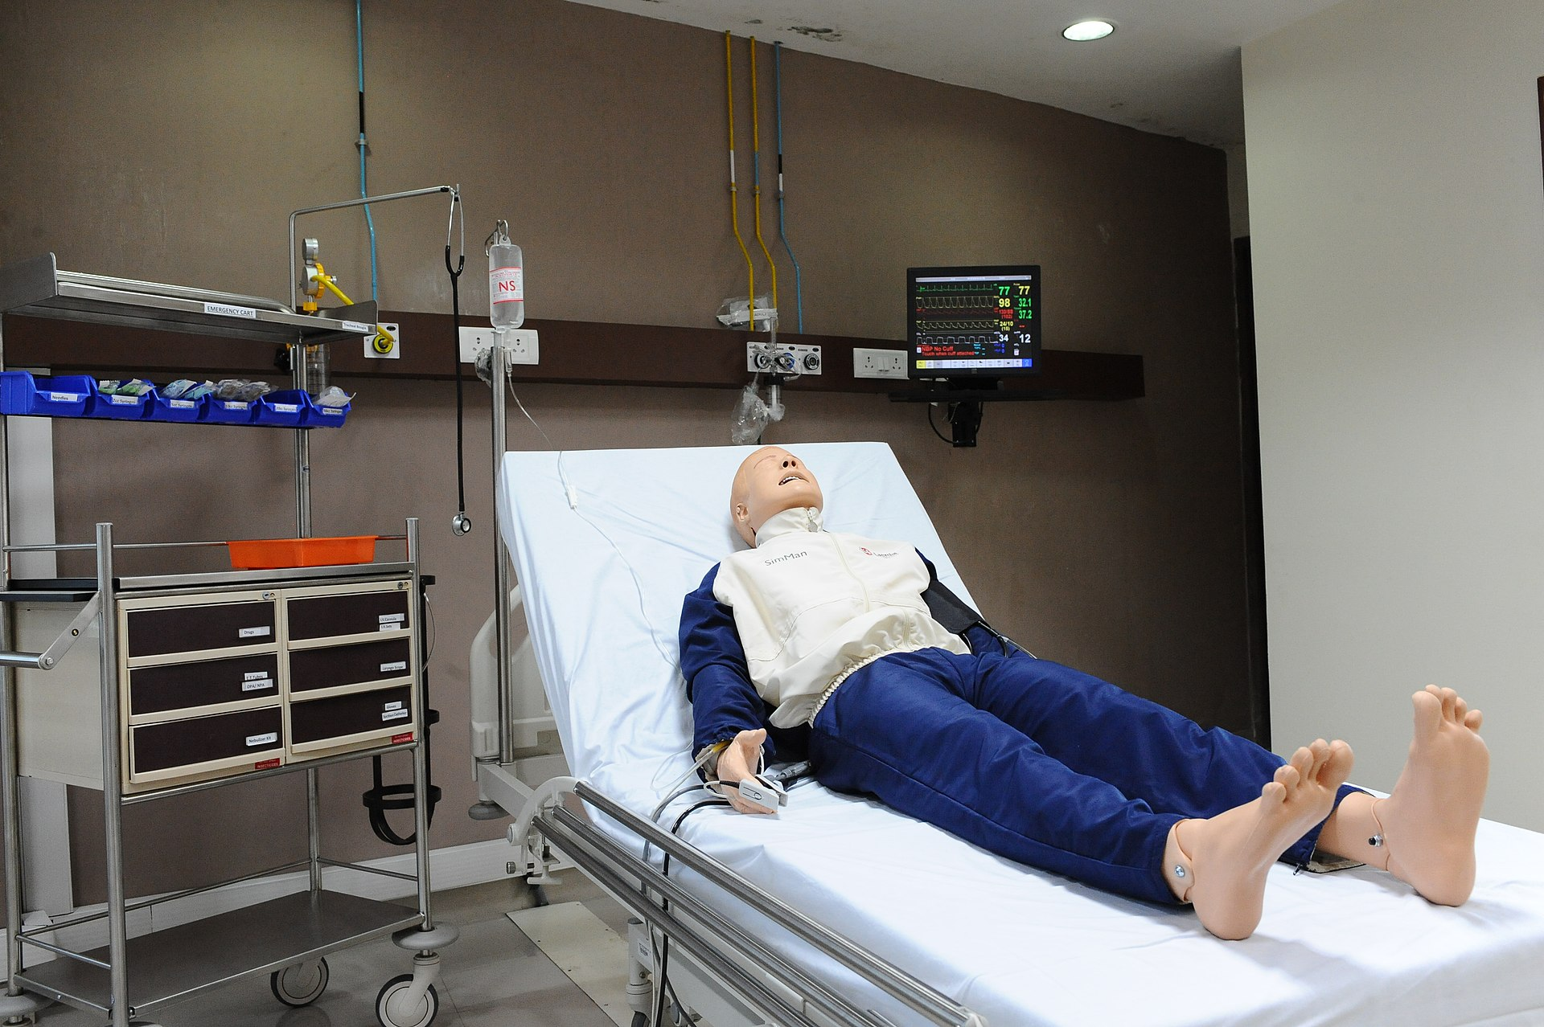
Implement Programs in Health System

Slide 40
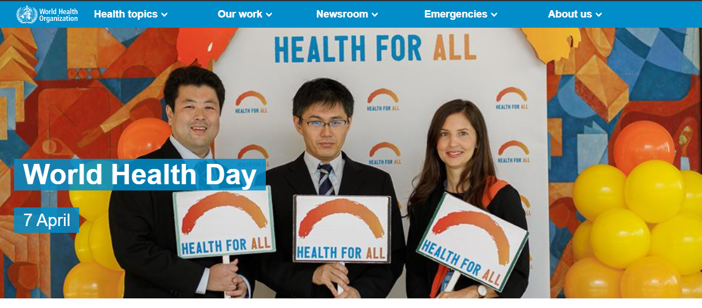
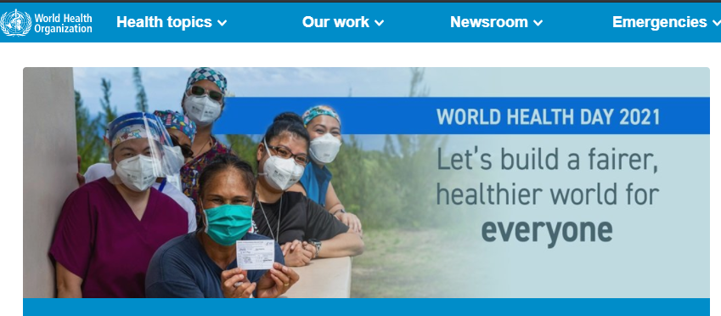
“…calling for action to eliminate health inequities, as part of a year-long global campaign to bring people together to build a fairer, healthier world.”

Slide 41
This Photo by Unknown Author is licensed under CC BY-NC-ND

Slide 42
References
Abu-Qdais, H.A.; Al-Ghazo, M.A.; Al-Ghazo, E.M., (2020). Statistical analysis and characteristics of hospital medical waste under novel Coronavirus outbreak. Global J. Environ. Sci. Manage., 6(SI): 21-30.
Anderegg, W., et al, Anthropogenic climate change is worsening North American pollen seasons, Proceedings of the National Academy of Sciences Feb 2021, 118 (7) e2013284118; DOI: 10.1073/pnas.2013284118
Athanasios Damialis, Stefanie Gilles., et al, COVID-19/POLLEN study group, Higher airborne pollen concentrations correlated with increased SARS-CoV-2 infection rates, as evidenced from 31 countries across the globe. Proceedings of the National Academy of Sciences Mar 2021, 118 (12) e2019034118; DOI: 10.1073/pnas.2019034118
Bambra C, Riordan R, Ford J., et al, The COVID-19 pandemic and health inequalities. J Epidemiol Community Health 2020;74:964-968.
Banerjee M, Gupta S, Obesity and COVID-19: A Fatal Alliance Indian J Clin Biochem. 2020 Oct; 35(4): 410–417.
Chase, B; Judge P. Interactive Map: Pollution hits Chicago’s west, south sides hardest. Better Government Association. 2018, October, https://www.bettergov.org/news/interactive-map-pollution-hits-chicagos-west-south-sides-hardest, accessed April 6,2021
Haider N, Rothman-Ostrow P, Osman AY, et al. COVID-19-Zoonosis or Emerging Infectious Disease?. Front Public Health. 2020;8:596944. Published 2020 Nov 26. doi:10.3389/fpubh.2020.596944
Johnson R, J, Sánchez-Lozada L, G, Newman L, S, Lanaspa M, A, Diaz H, F, Lemery J, Rodriguez-Iturbe B, Tolan D, R, Butler-Dawson J, Sato Y, Garcia G, Hernando A, A, Roncal-Jimenez C, A: Climate Change and the Kidney. Ann Nutr Metab 2019;74(suppl 3):38-44. doi: 10.1159/000500344
Kreuder Johnson, C., Hitchens, P., Smiley Evans, T. et al., Spillover and pandemic properties of zoonotic viruses with high host plasticity. Sci Rep 5, 14830 (2015). https://doi.org
Kompaniyets L, Goodman AB, Belay B, et al. Body Mass Index and Risk for COVID-19–Related Hospitalization, Intensive Care Unit Admission, Invasive Mechanical Ventilation, and Death — United States, March–December 2020. MMWR Morb Mortal Wkly Rep 2021;70:355–361. DOI: http://dx.doi.org/10.15585/mmwr.mm7010e4external icon.

Slide 43
References
Mahoney, A. Back of the Line, Grist. 2021 February 1, t.org/justice/chicagos-covid-19-vaccine-plan-put-polluted-communities-last/accessed April 5, 2021
Marazziti, D, Cianconi,P. Climate change, environment pollution, COVID-19 pandemic and mental health, Sci Total Environ, 2021 Jun15:773,145182 https://www.ncbi.nlm.nih.gov/pmc/articles/PMC7825818/
Mendenhall E, Kohrt BA, Norris SA, Ndetei D, Prabhakaran D. Non-communicable disease syndemics: poverty, depression, and diabetes among low-income populations. Lancet. 2017;389(10072):951-963. doi:10.1016/S0140-6736(17)30402-6
Pan L, Sherry B, Njai R, Blanck HM. Food insecurity is associated with obesity among US adults in 12 states. J Acad Nutr Diet. 2012 Sep;112(9):1403-1409. doi: 10.1016/j.jand.2012.06.011. PMID: 22939441; PMCID: PMC4584410.
Patrício Silva AL, Prata JC, Walker TR, et al. Increased plastic pollution due to COVID-19 pandemic: Challenges and recommendations. Chem Eng J. 2021;405:126683. doi:10.1016/j.cej.2020.126683
Rosenbloom, D, A COVID-19 recovery for climate, Scence, 01 May 2020: Vol. 368, Issue 6490, pp. 447.DOI: 10.1126/science.abc4887
Tsai AC, Venkataramani AS. Syndemics and Health Disparities: A Methodological Note. AIDS Behav. 2016;20(2):423-430. doi:10.1007/s10461-015-1260-2 recommendations. Chem Eng J. 2021;405:126683. doi:10.1016/j.cej.2020.126683
William R. L. Anderegg, John T. Abatzoglou, et al, Proceedings of the National Academy of Sciences, Feb 2021, 118 (7) e2013284118; DOI: 10.1073/pnas.2013284118
Wolfson, J, Leung,C. 2020:Food Insecurity During COVID-19: An Acute Crisis With Long-Term Health Implications, American Journal of Public Health 110, 1763_1765, https://doi.org/10.2105/AJPH.2020.305953
Wu, X., et al., 2020. Air pollution and COVID-19 mortality in the United States: Strengths and limitations of an ecological regression analysis. Science advances, 6(45), p.eabd4049.

Slide 44
References
www.axios.com
www.biologicaldiversity.com
www.cdc.gov
www.climatecentral.org
www.cnbc.com (Newburger, June 27, 2020)
www.epa.gov
www.hsph.harvard.edu/
www.insideclimatenews.org (Gustin, July 7, 2020)
www.thelancet.com
www.lung.org
www.propublica.org (Lustgarten, April 13, 2020)
www.rainforestalliance.org
www.supplychaindive.com (Leonard, July 23, 2020)
www.usatoday.com (Bacon, et al., February 16, 2016)
www.who.int

