Slide 1

Climate Change and Health
Legal and Policy Perspectives
Warren Lavey
April 2021
lavey@illinois.edu

Slide 2


Climate Law and Policy for Healthcare Professionals
Frontlines
Influencers
Local plans
Legislative advocacy

Slide 3
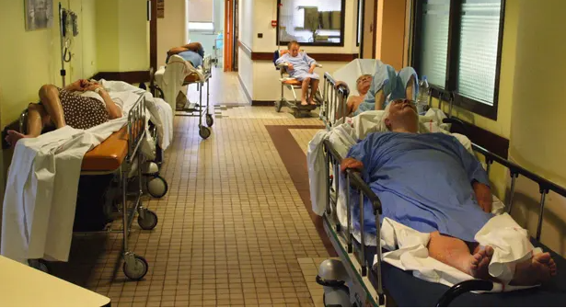
1. Frontlines

Slide 4


Slide 5


Slide 6
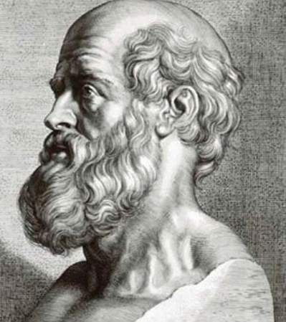
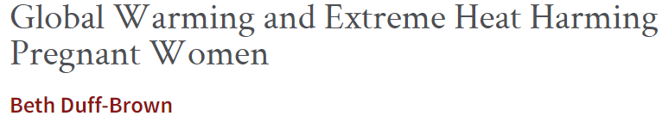
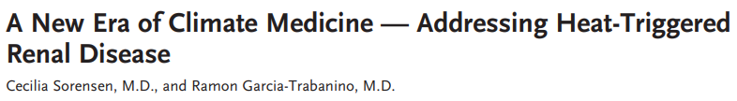

“I will prevent disease whenever I can, for prevention is preferable to cure.”
.

Slide 7

“WHO is committed to engage actively in the UN Framework on Climate Change, with member states, and relevant partners to promote effective climate and health policies which promote health protection.”

Slide 8


“We represent physicians, nurses, health workers, public health professionals, voluntary health organizations, and hospitals and health care systems across the U.S…. We have stepped up to confront the COVID-19 crisis. Now we call for urgent action to address the climate health emergency.”

Slide 9


“Even as our Nation emerges from profound public health and economic crises borne of a pandemic, we face a climate crisis that threatens our people and communities, public health and economy, and, starkly, our ability to live on planet Earth.”
This Photo by Unknown Author is licensed under CC BY-SA

Slide 10
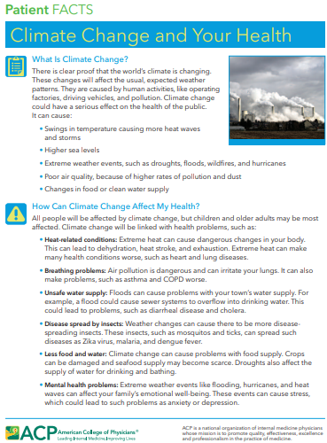
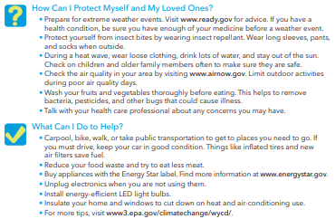

2. Influencers

Slide 11
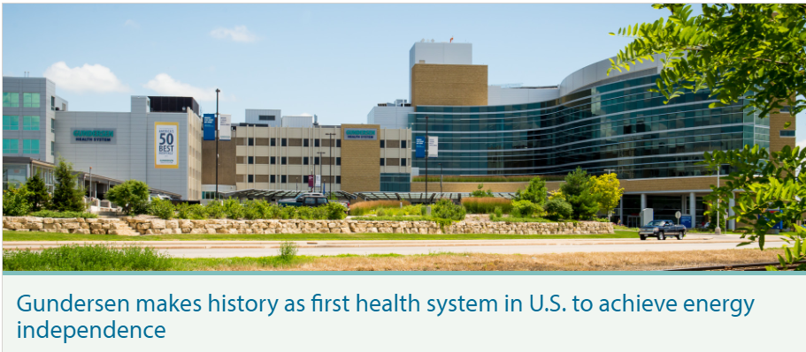


Lead by example

Slide 12

3. Local Plans
Ensuring Environmentally Sustainable Community
“Promoting environmental health requires monitoring conditions, preparing for emergencies, and reducing activities that impair the sustainability of our community’s environment.”

Slide 13

“This CHNA recognizes the need for mitigation strategies (i.e. reducing the human impact on the climate), as well as adaptation and resilience-building strategies (i.e. weatherizing homes of low-income individuals, increasing urban area green spaces, and increasing the capacity of community organizations to respond to climate-related needs).”

Slide 14


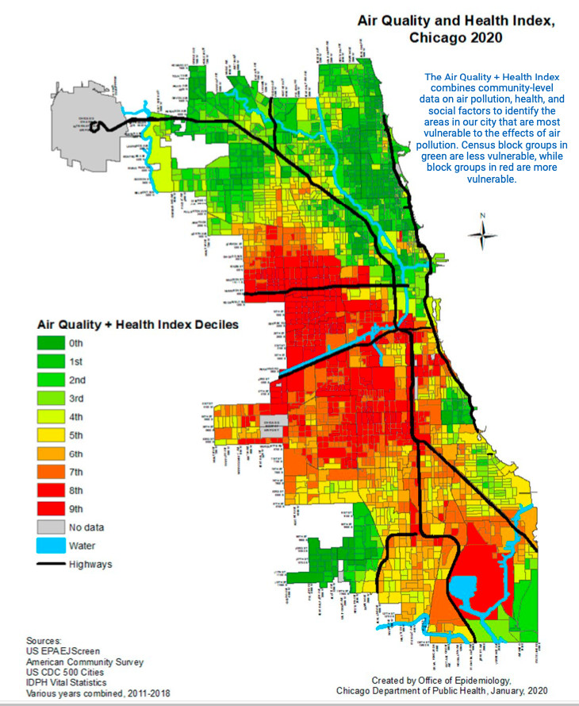


Slide 15
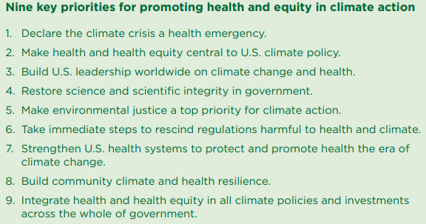
3. Legislative Advocacy
Sign on

Slide 16
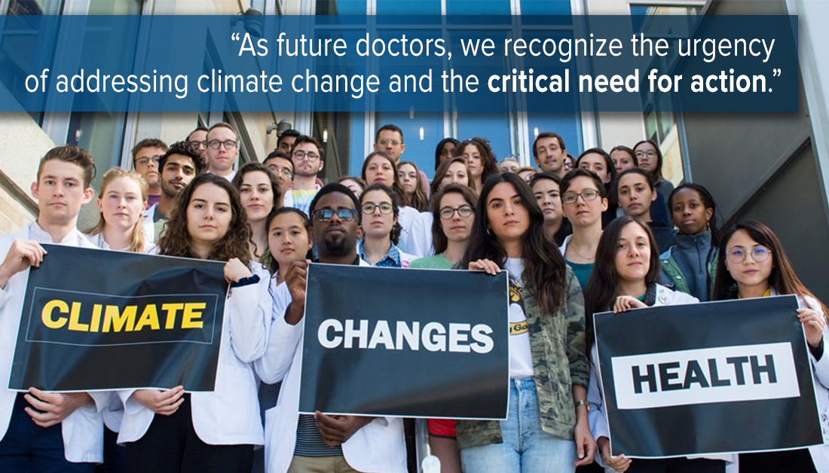


Slide 17
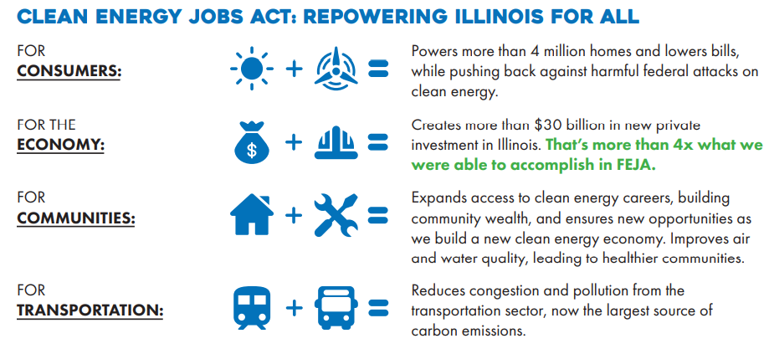



Slide 18
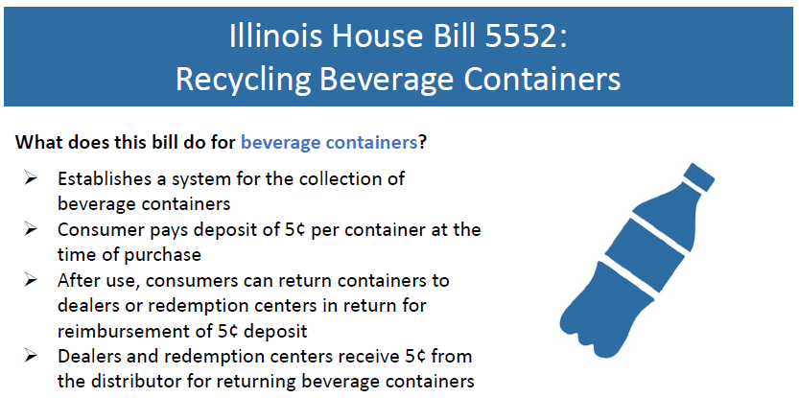
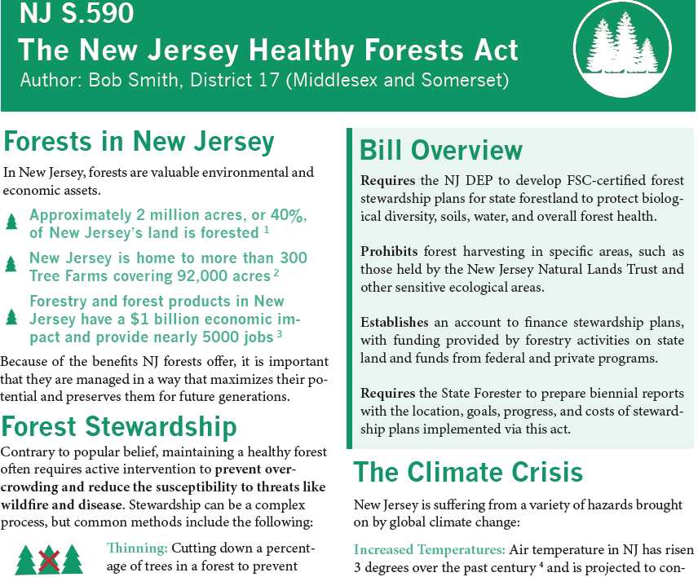
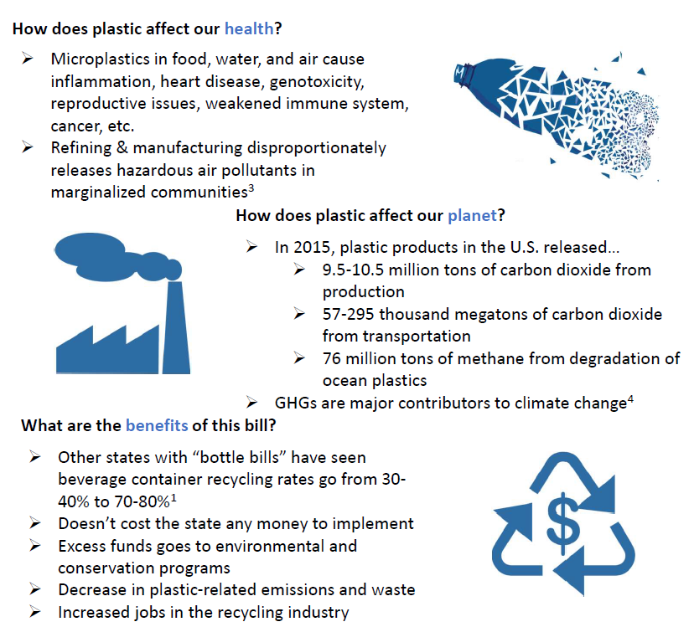
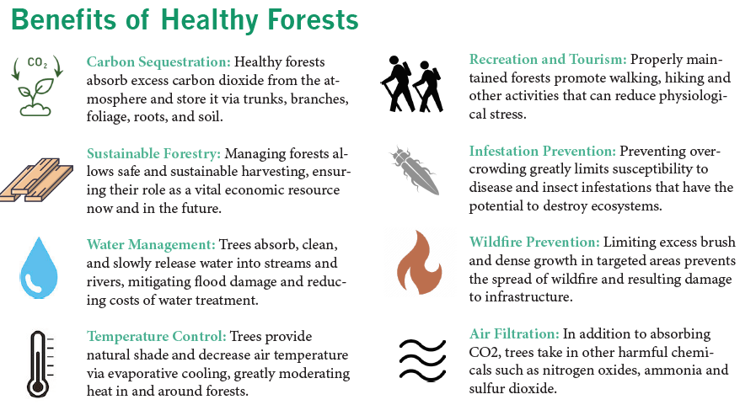





Slide 19
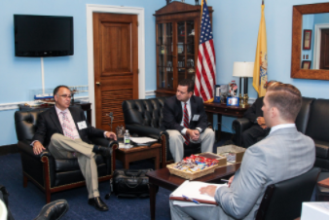

Slide 20
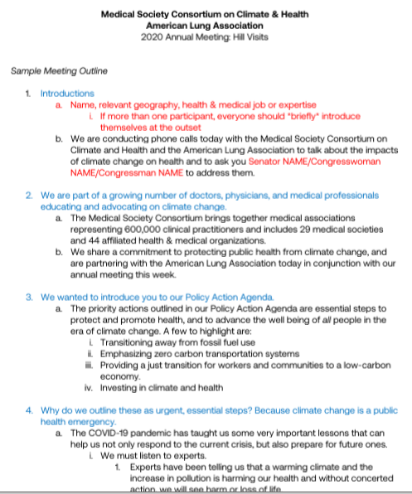
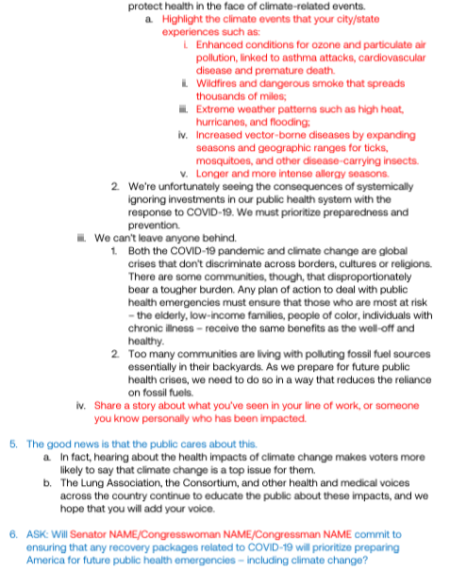
Benefits of actions
Introductions
Physicians’ commitment
Personal stories
Policy action agenda
Ask for action by legislator

Slide 21
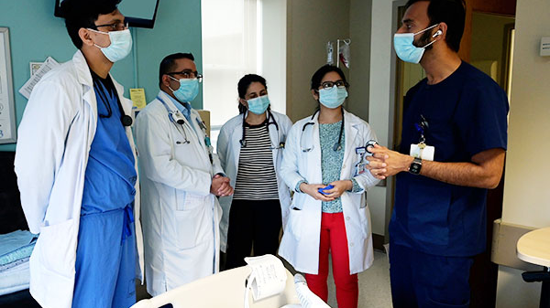
Notes:
Colleagues in clinical settings - limited time , jargon , individual care

Slide 22

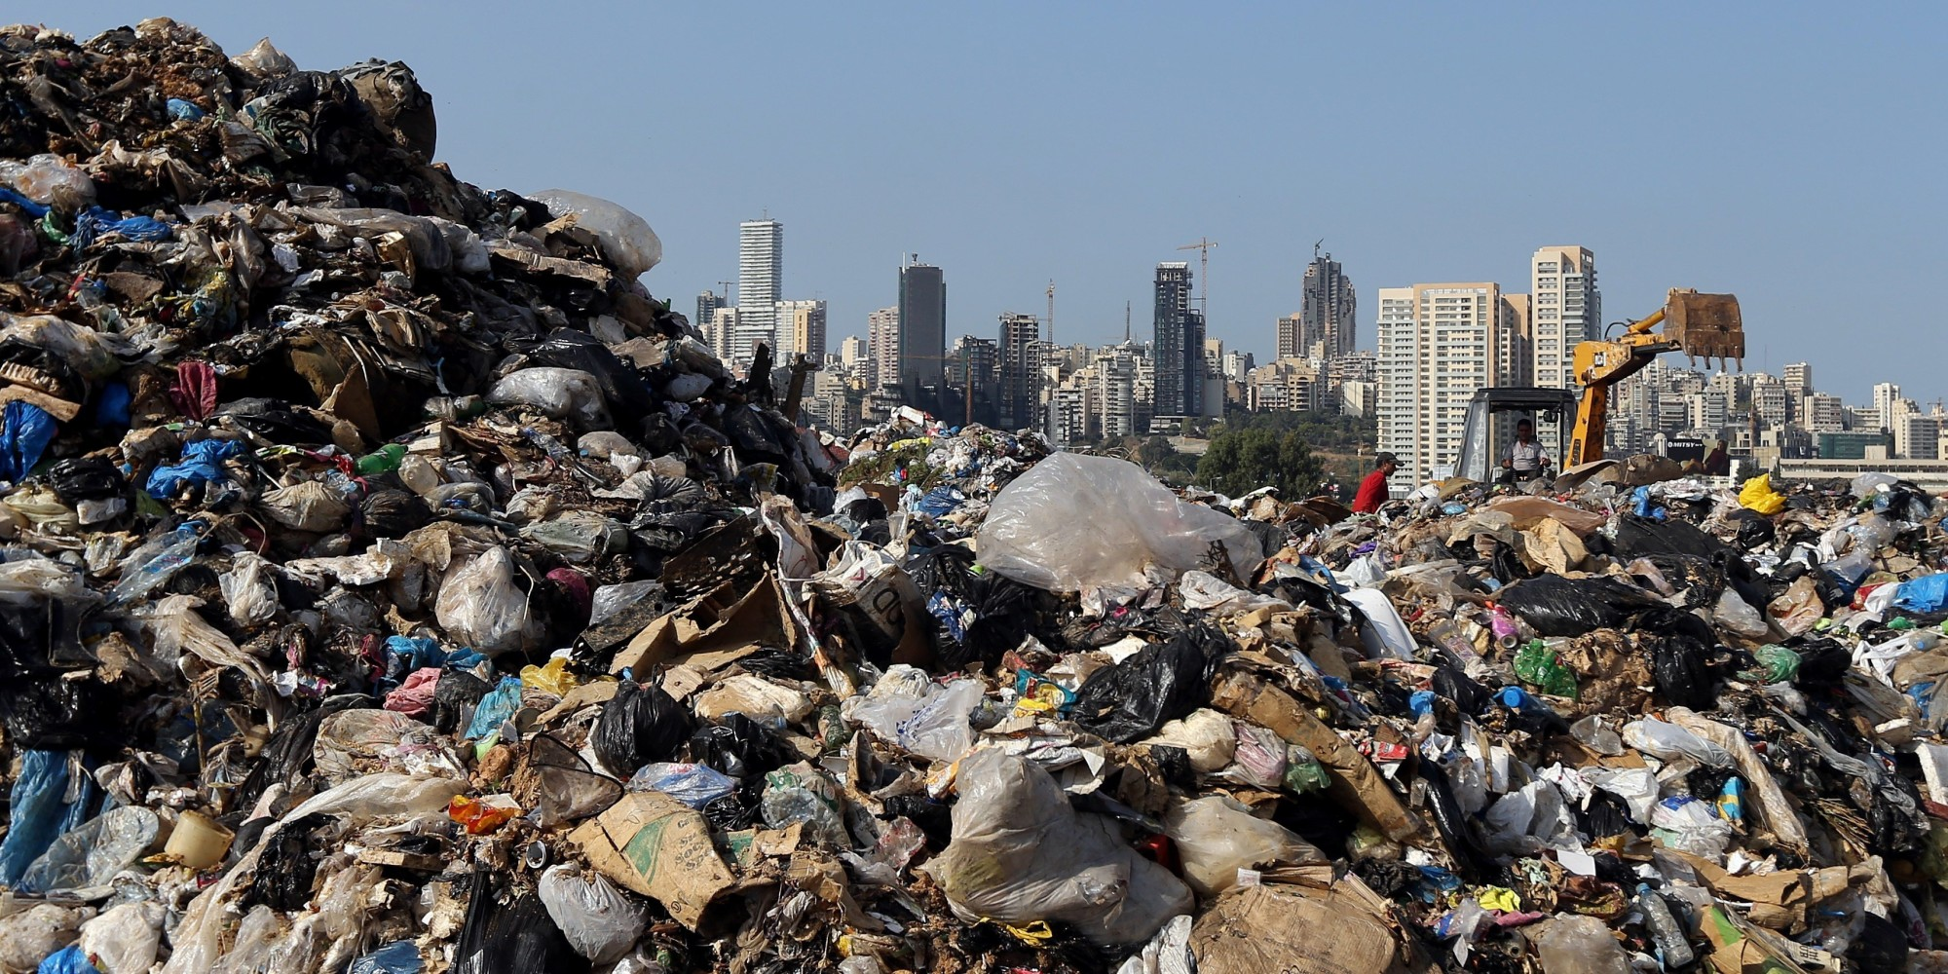

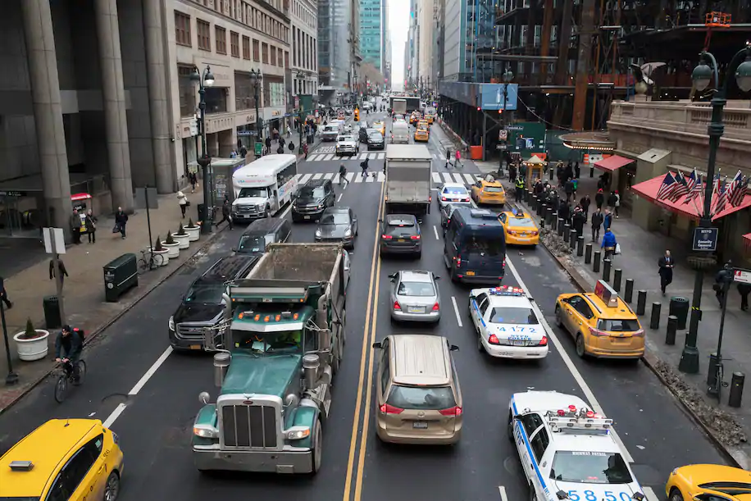
Healthcare professionals cannot save us from our foolishness.

Slide 23
