Slide 1

Climate Change, Plastic Pollution, and Effects on
Ecosystems and Human Health.
Robert F. Brand Ph.D.
Watershed Program Manager
Cell: 216 213 9083
rbrand@ccbh.net

Slide 2
Three Greatest Threats to Health
Nuclear Weapons
Climate Change
Plastic Pollution

Slide 3
What are plastics?
All plastics are synthetic, manufactured, petrochemicals from oil or natural gas.
Thousands of plastic molecules, 2 general classes, with 7 main categories.
Not natural products, Anthropogenic; produced only by humans.
Never existed before. Only 114 years old.
Bakelite, first plastic produced in 1907 by Leo Baekeland in Yonkers, New York.
Nylon in 1929 by DuPont, chemists Wallace Carothers & Elmer Keiser Bolton
Notes:
‘It is a thermosetting phenol formaldehyde resin, formed from a condensation reaction of phenol with formaldehyde’

Slide 4
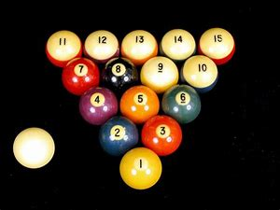
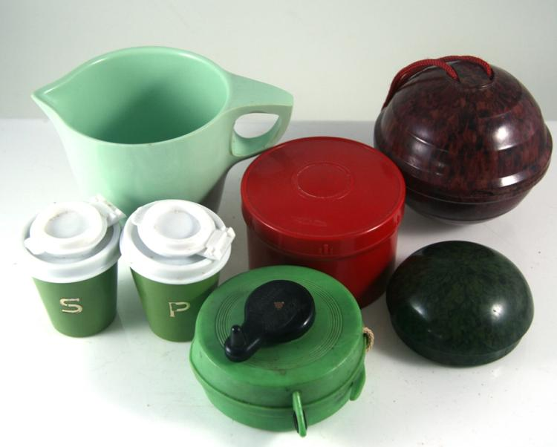
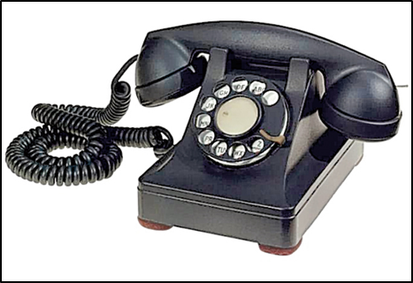
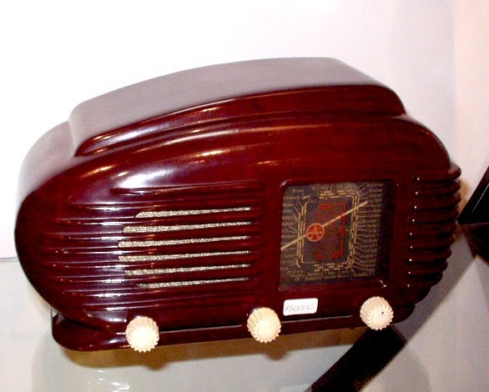

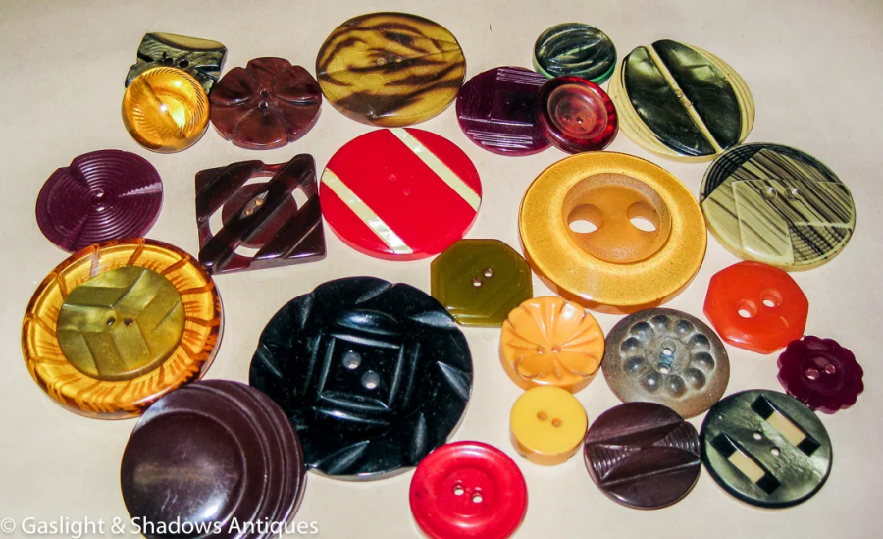
Bakelite Products

Slide 5
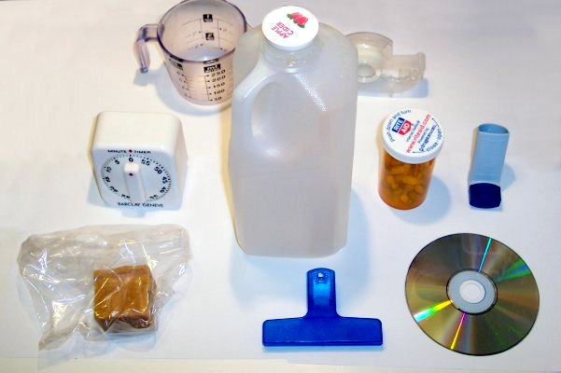
1950’s Plastics: The Wonder Product!
Permeate all Facets of Daily Life and Society, Economics, Water, Soils and Environment.
Polymers are main plastic ingredients, able to be moulded, extruded or pressed into solid objects.
Light weight, durable flexible, and inexpensive to produce; packaging, construction materials, piping, vehicle parts, toys, electronic devices, eye shadow, moisturizer, windows, sidings, doors, boats, bicycles wheels, bullet proof vests, helmets, weapons, clothes, ropes, toys, shoes, medical, kitchen and garden equipment, furniture, tools, backpacks, bags, bottles, lenses, cellphones, computers, diapers.

Slide 6
Plastic Manufacture, Climate and Greenhouse Gases (GHG’s)
Extraction of oil; drilling and fracking, and manufacture of plastics produces GHG’s; CO2 and Methane.
Production of 1 kg of polyethylene (used for bags and bottles) releases 6 kg’s CO2.
Incineration and recycling produces 6 kg’s of CO2.
PVC, PCB’s release GHG’s; Methane and Ethylene, by mechanical size reduction.
Notes:
Royer, S-J, Ferrón, S, Wilson, S.T., Karl, D.M. 2018. Production of methane and ethylene from plastic in the environment, PLoS ONE, 13 (8), https://doi.org/10.1371/journal.pone.0200574⨯
Plastic pollution; http://www.plasticpollutioncoalition.org/.

Slide 7
Tonnes of Plastics Produced
2019 Global production 368 million tonnes. In 1950 it was 1.5 million tonnes.
2018 US produced 35,680 million tonnes. Recycled 13.2 % = 4,71 million tonnes. Landfill solid waste, 26,970 million tonnes.
In 2019 Global plastics market valued at US $ 693.7 billion (2020, $ 711.0 billion).
4% growth projected from 2020 to 2027.
Increasing demand from construction, automotive, electrical and electronics.
Notes:
www.statista.com/statistics/282732/global-production-of-plastics
Ton is used in the imperial system of measurements. One Ton contains 2240 pounds, converted to kilograms equals 910 kilograms.
Tonne is used in metric measurements and equals 1000 kilograms.
US EPA, Office of Resource Conservation and Recovery, 2014. Municipal Solid Waste in the United States Facts and Figures A Methodology Document.
Value of plastics in US markets; www.grandviewresearch.com/industry-analysis/plastic-resins-market
Reference for Plastic production and Municipal Solid Waste (MSW): www.epa.gov/facts-and-figures-about-materials-waste-and-recycling/plastics-material-specific-data

Slide 8
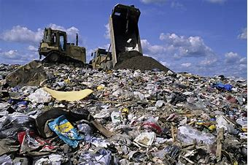
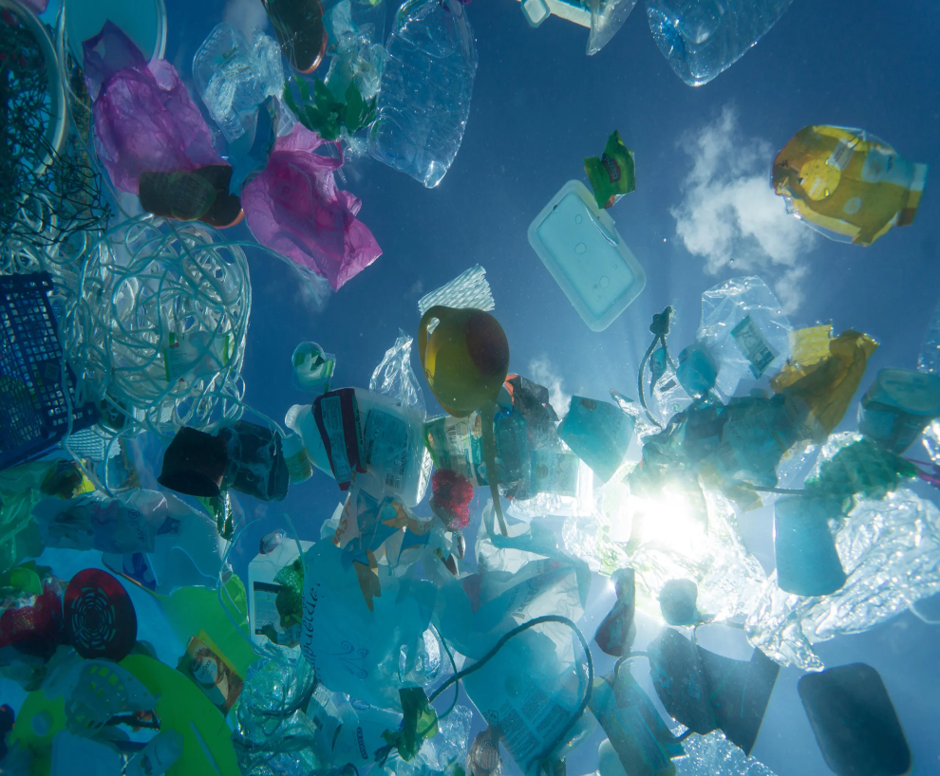
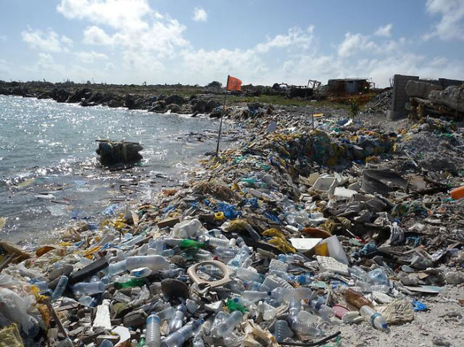
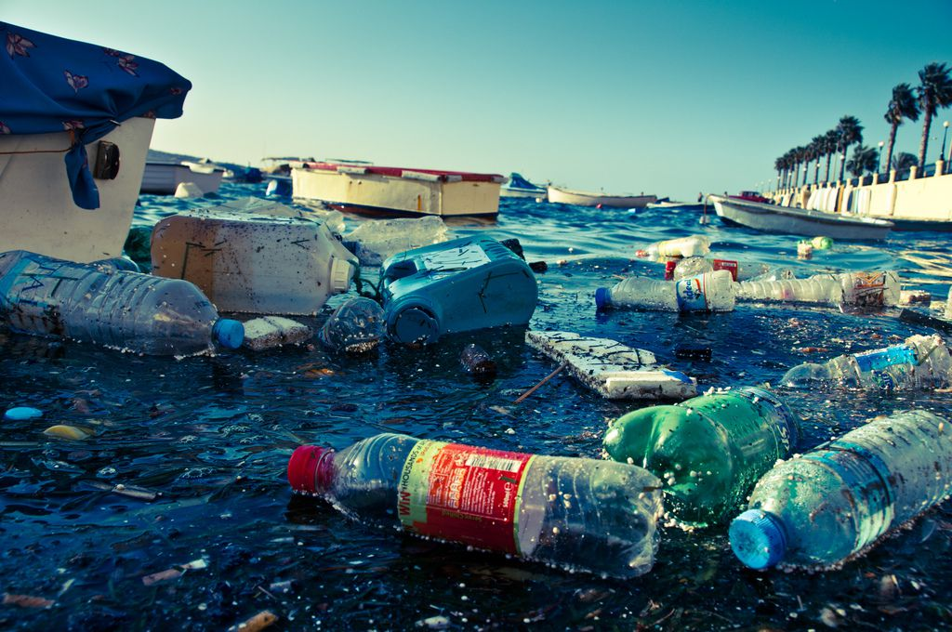
Where does all the plastic go?
Notes:
Images from https://www.bing.com/

Slide 9
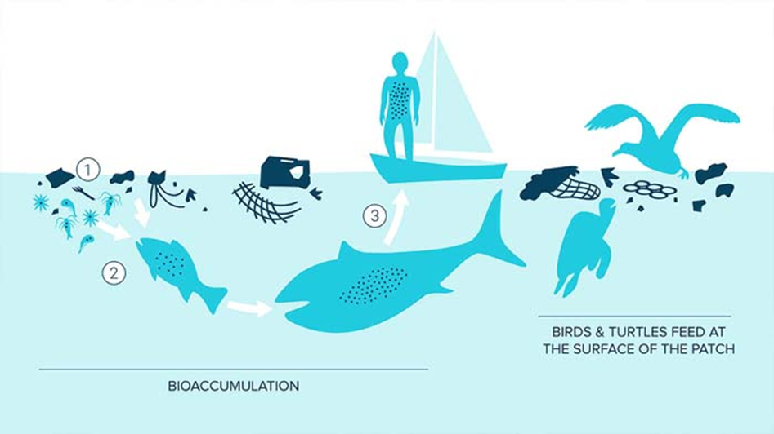
Plastics in Oceans
Cumulative global production 8 Billion tonnes.
Annually 8 million tonnes pollute oceans.
236,000 tonnes are microplastics.
150 million tonnes already in oceans
Concentration by Bioaccumulation
Notes:
UNEP and GRID-Arendal, 2016. Marine Litter Vital Graphics. United Nations Environment Programme and GRID-Arendal. Nairobi and Arendal. www.unep.org, www.grida.no
Valeria Hidalgo-Ruz, Lars Gutow, Richard C. Thompson and Martin Thiel, 2012. Microplastics in the Marine Environment: A Review of the Methods Used for Identification and Quantification. dx.doi.org/10.1021/es2031505 | Environ. Sci. Technol
Jambeck, J. R., et al. “Plastic Waste Inputs from Land into the Ocean.” Science, vol. 347, no. 6223, 13 Feb. 2015, pp. 768–771., doi:10.1126/science.1260352.
Erik van Sebille et al 2015 Environ. Res. Lett. 10 124006
Kershaw, P. J., ed., 2015. (IMO/FAO/UNESCO-IOC/UNIDO/WMO/IAEA/UN/UNEP/UNDP Joint Group of Experts on the Scientific Aspects of Marine Environmental Protection). Rep. Stud. GESAMP No. 90, 96 p.

Slide 10
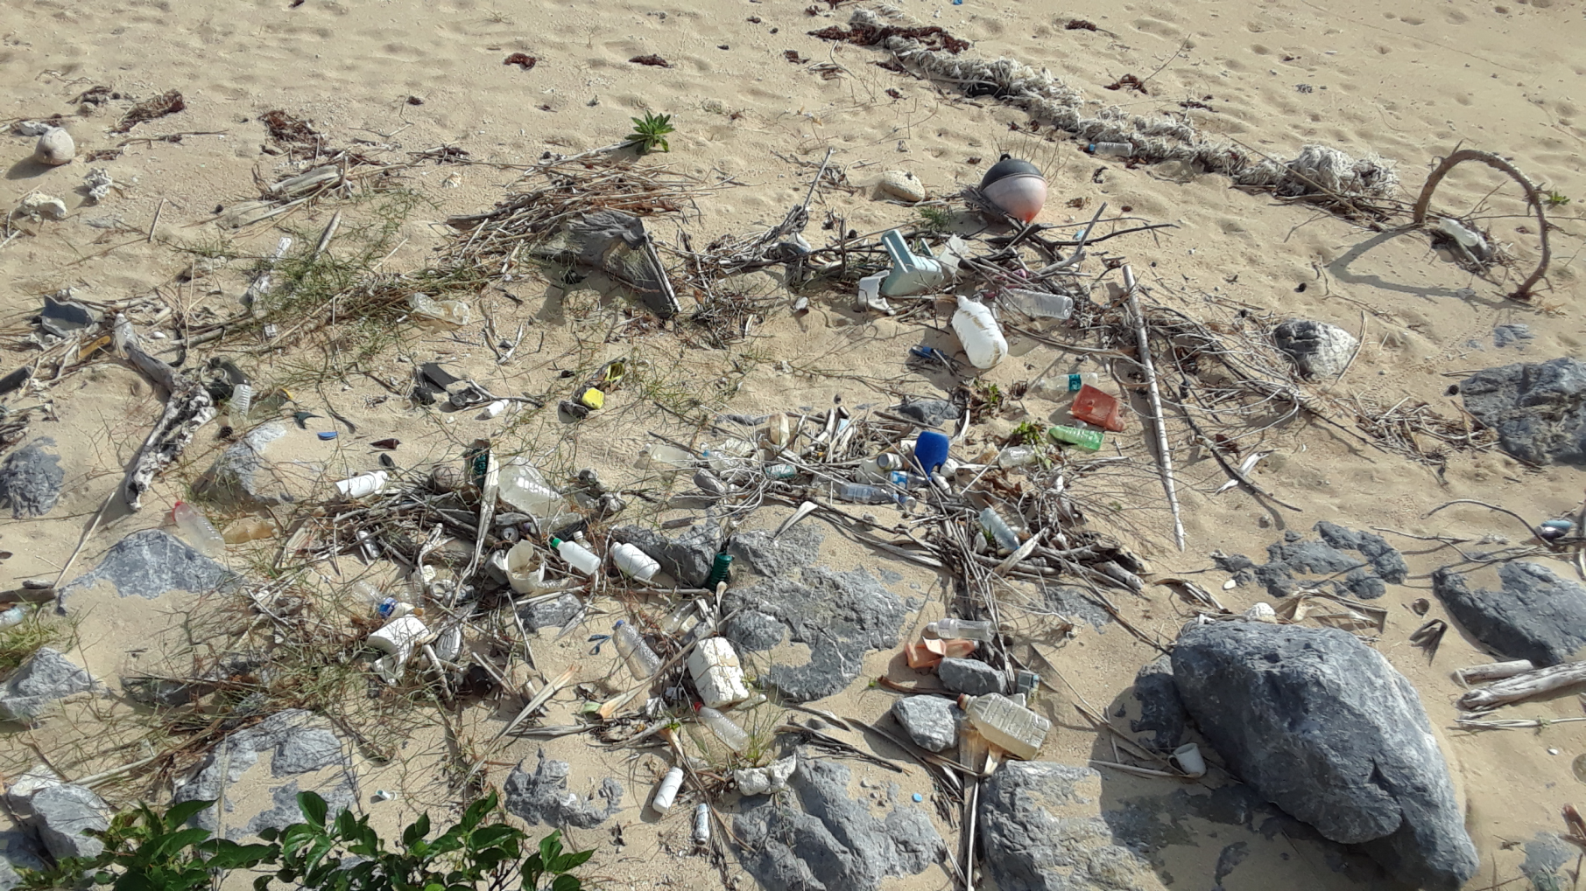
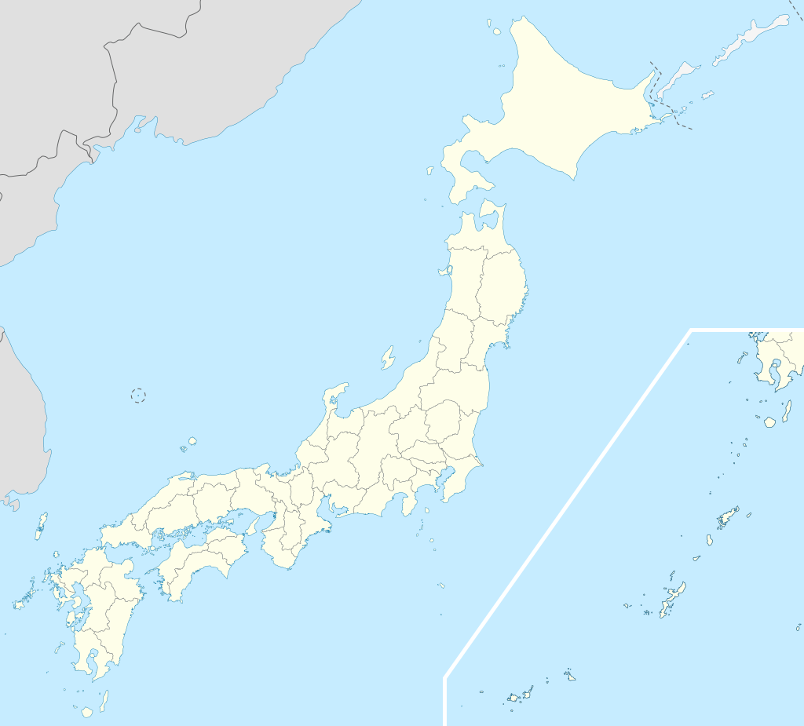
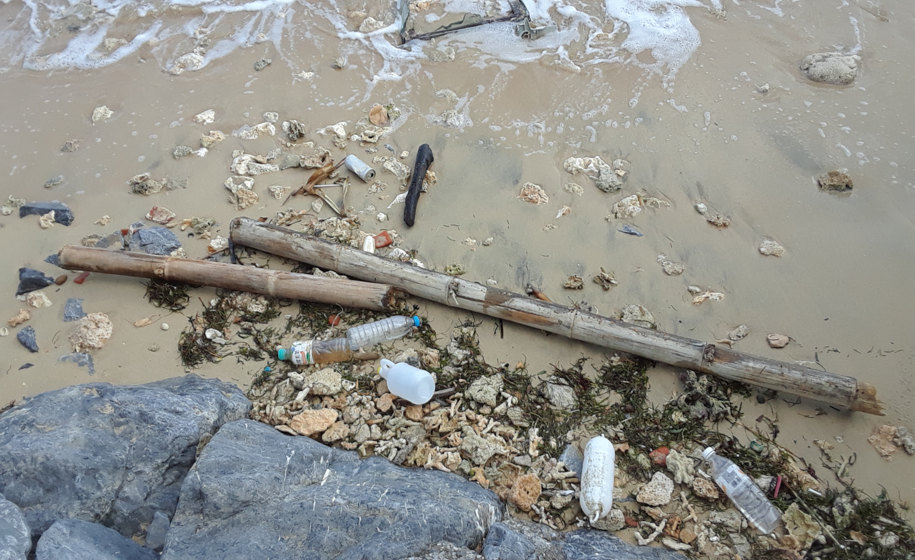
Kumejima 100 km west of Okinawa
Notes:
Map showing Japan, Okinawa and Kumejima by Maximilian Dörrbecker (Chumwa)

Slide 11
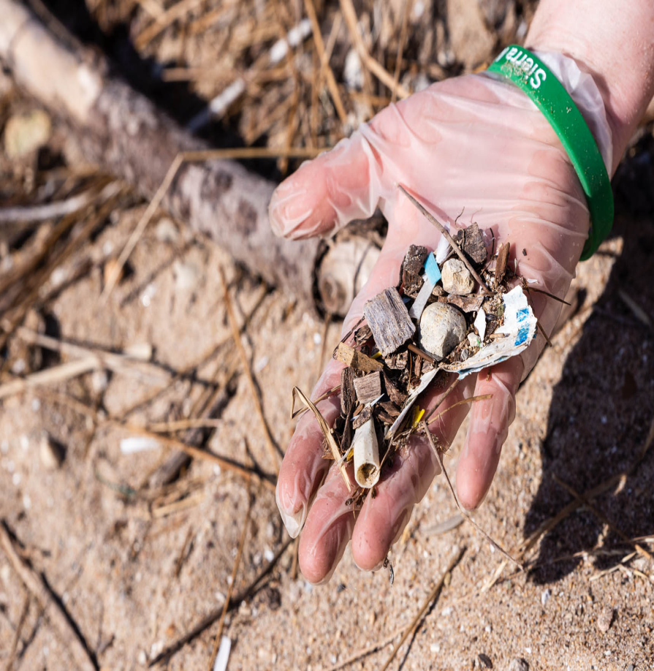
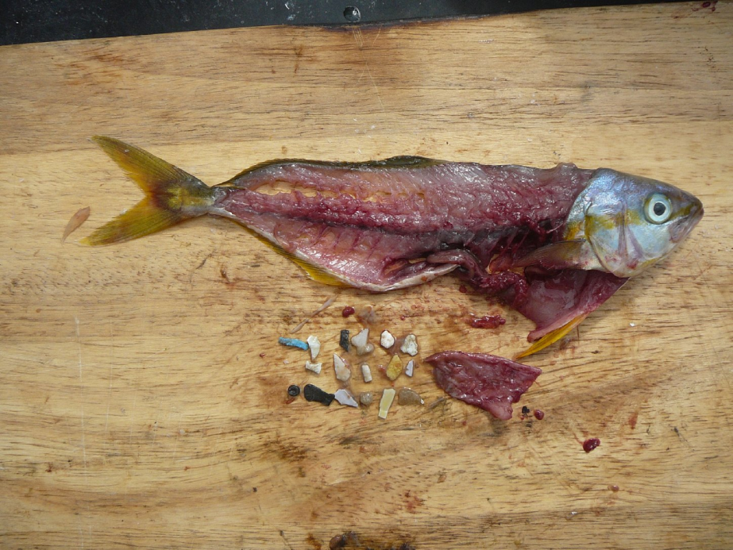
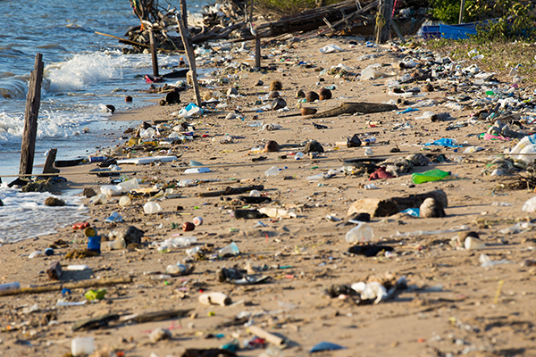
Plastics in Great Lakes
10,000 tonnes annually in Great Lakes.
2,500 tonnes in Lake Erie, second most polluted of 5 Great Lakes.
500 000 objects per km2.
Fish and aquatic animals eating plastics.
Notes:
Image of Fish and plastics copied from KQED 2021.
Image of Beach and plastic pollution, Alliance for the Great Lakes, 2019.
Austin K. Baldwin, Steven R. Corsi, and Sherri A. Mason, 2016. Plastic Debris in 29 Great Lakes Tributaries: Relations to Watershed Attributes and Hydrology. Environ. Sci. Technol. 50, 10377−10385. DOI: 10.1021/acs.est.6b02917
Baldwin, A.K., Corsi, S.R., and S.A., Mason, 2016. Plastic Debris in 29 Great Lakes Tributaries: Relations to Watershed Attributes and Hydrology. Environ. Science.
Technology. 50, 10377-10385
Maciej Zbyszewski, Patricia L. Corcoran, Alexandra Hockin, 2014. Comparison of the distribution and degradation of plastic debris along shorelines of the Great Lakes, North America. Journal of Great Lakes Research, Vol 40 pp 288–299.
Matthew J.Hoffmana, Eric Hittingerb, February 2017. Inventory and transport of plastic debris in the Laurentian Great Lakes. Volume 115, Issues 1–2, 15 Pages 273-281.

Slide 12
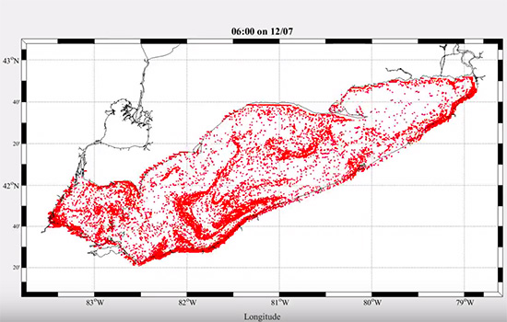
Model of Plastics in Lake Erie
Plastics concentration in Great Lakes from 43,000 particles/km2 to 6.7 million particles/km2, greater than in ocean’s garbage patches.
Model of plastic movement produced by Matthew Hoffman, assistant professor, RIT School of Mathematical Sciences
Notes:
Matthew Hoffman, assistant professor in the Rochester Institute of Technology (RIT). School of Mathematical Sciences, used computer simulations to follow the volume of plastic debris moving across state and international boundaries—from Illinois to Michigan and from Canada to the United States.
Zbyszewski, M., Corcoran, P.L., Hockin, A., 2014. Comparison of the distribution and degradation of plastic debris along shorelines of the Great Lakes,
North America.
Matthew J.Hoffmana, Eric Hittingerb, February 2017. Inventory and transport of plastic debris in the Laurentian Great Lakes. Volume 115, Issues 1–2, 15 Pages 273-281. Marine Pollution Bulletin.

Slide 13
Plastics in Cuyahoga County
Over 319 million grocery shopping plastic bags used annually.
Plastic grocery shopping bags cost 10c.
Used for 12 minutes on average.
Ban introduced in 2020 defuncted by COVID.
Takes 450 to 1000 years to ‘decompose’.
80% of plastics go to landfills.
Toxic plastic leachate pollutes air, soil and water.
Notes:
Source material, visit; http://sustainability.cuyahogacounty.us/

Slide 14
COVID and Plastic Pollution
In 2020 > 1.5 billion masks in the ocean.
More face masks than Jellyfish.
Lifespan of 450 years; an ecological timebomb with lasting environmental consequences.
Hubei Province, China, 2020, daily output of medical waste reached 240 metric tons.
Divert governments attention from green issues.
Notes:
nypost.com/2020/12/28/more-than-1-5b-masks-will-pollute-oceans-this-year-rep
World Economic Forum, 11 Jun 2020. https://www.weforum.org/agenda/2020/06/ppe-masks.
https://www.theverge.com/2020/3/26/21194647.
Medical waste produced during COVID pandemic in 2020.
Shi and W. Zheng. 2020. Coronavirus: China struggling to deal with mountains of medical waste created by epidemic. 5 March. https://www.scmp.com/news/china/society/article/3065049/coronavirus china-struggling-deal-mountain-medical-waste-created.
World Health Organization (WHO). Rolling updates on coronavirus disease (COVID-19). https://www.who.int/emergencies/diseases/novel-coronavirus-2019/events-as-they-happen.
Secretariat of the Basel Convention. 2020. Waste management an essential public service in the fight to beat COVID-19. Basel Convention. 20 March. http://www.basel.int/Implementation/PublicAwareness/PressReleases/WastemanagementandCOVID19/tabid/8376/Default.aspx.
United Nations Environment Programme (UNEP). 2020. Waste Management and essential public service in the fight to beat COVID-19. United Nations Environment Programme. 24 March. https://www.unenvironment.org/news-and-stories/press-release/waste-management-essential-public-service-fight-beat-covid-19.

Slide 15
Plastics Ubiquitous in
Water, Air, Soil and Us!
Single-use, plastic water bottles, major items of litter in waterways and Lake Erie.
Most US residents have phthalates in urine
80% of cellular tissue is water!
Float on surface, in water column, sediments.
Plastics in Mariana Trench at 11 000m depth.
In snow in Alps and Everest summit over 8000 m altitude.
In camels in the deserts.
Notes:
Matthew J.Hoffmana, Eric Hittingerb, February 2017. Inventory and transport of plastic debris in the Laurentian Great Lakes. Volume 115, Issues 1–2, 15 Pages 273-281. Marine Pollution Bulletin.
Baldwin et al., 2016. Phthalates in urine.
Kohn et al., 2000. Plastic water bottles.
Ian A. Kane, Michael A. Clare, Elda Miramontes, Roy Wogelius, James J. Rothwell, Pierre Garreau, Florian Pohl. 05 Jun 2020: Seafloor Microplastic Hotspots Controlled By Deep-Sea Circulation. Science Vol. 368, Issue 6495, pp. 1140-1145. DOI: 10.1126/science.aba5899
esemag.com/water/understanding-plastic-pollution-in-the-great-lakes/

Slide 16
Plastic pollution; Why size matters
Macroplastics; particles > 5mm to 10’s of meters; fishing nets, buoys, weight in grams to kilograms.
Microplastics; particles ≤5 mm,
Nanoplastics; particles 1-1000 nm. Produced by degradation and manufacture of plastics presenting a colloidal behaviour.
Notes:
Julien Gigault, Alexandra ter Halle, Magalie Baudrimont, Pierre-Yves Pascal, Fabienne Gauffre, Thuy-Linh Phi, Hind El Hadri, Bruno Grassl, Stéphanie Reynaud. April 2018. Current opinion: What is a nanoplastic? Environmental Pollution, Volume 235, Pages 1030-1034.

Slide 17
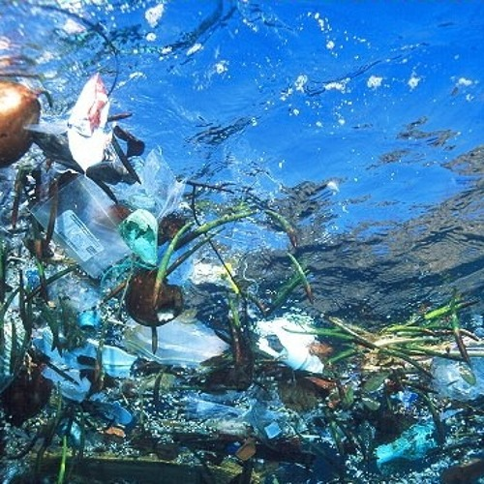
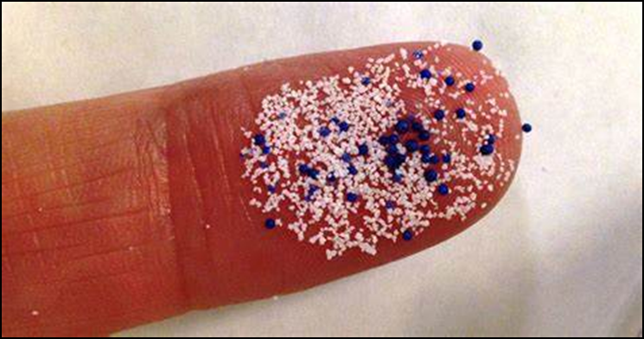
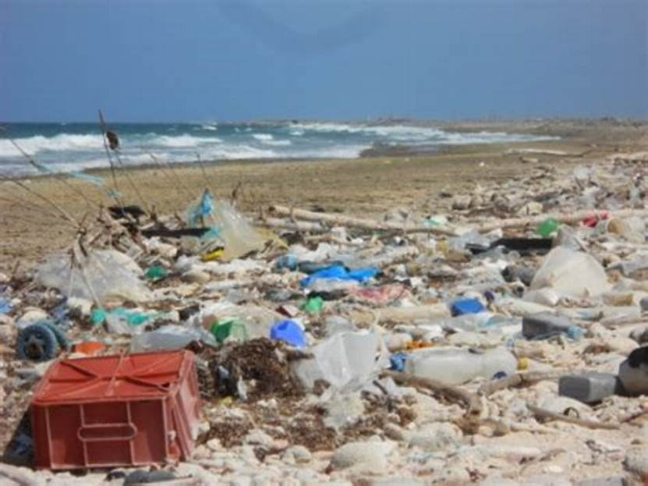
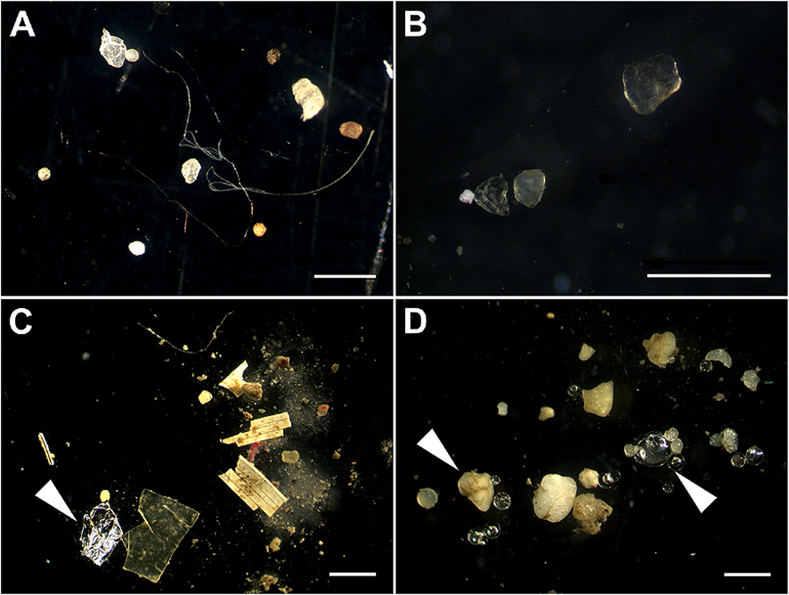
Plastic sizes; macro, micro, nano
Notes:
Image, Macroplastics floating in water; Environmental Protection, 2017.
Image of microplastics on finger; The Times Herald, 2015.
Hidalgo-Ruz, V., Gutow, L., Thompson, R.C., and Theil M., 2012. Microplastics in the Marine Environment: A Review of the Methods Used for Identification and Quantification. Environ. Sci. Technol. Dx.doi.org/10.1021/es2031505
Oluniyi Solomon Ogunola, Palanisami Thavamani, December 2015. Microplastics in the Marine Environment: Current Status, Assessment Methodologies, Impacts and Solutions. Journal of Pollution Effects & Control 04(02). DOI: 10.4172/2375-4397.1000161
Angela Koehler, Alison Anderson, Anthony L Andrady, Kayleigh Wyles et al., April 2015. Projects: Pollution in the Western Indian Ocean: Cellular Effects of microplastics-uptake, fate and pathologies. Joint Group of Experts on the Scientific Aspects of Marine Environmental Protection). Rep. Stud. GESAMP No. 90, 96p.
Kershaw, P. J., ed., 2015. Sources, fate and effects of microplastics in the marine environment: a global assessment. International Maritime Organization, 4 Albert Embankment, London SE1 7SR. www.imo.org Plastic. Joint Group of Experts on the Scientific Aspects of Marine Environmental Protection). DOI: 10.13140/RG.2.1.3803.7925 (IMO/FAO/UNESCO-IOC/UNIDO/WMO/IAEA/UN/UNEP/UNDP

Slide 18
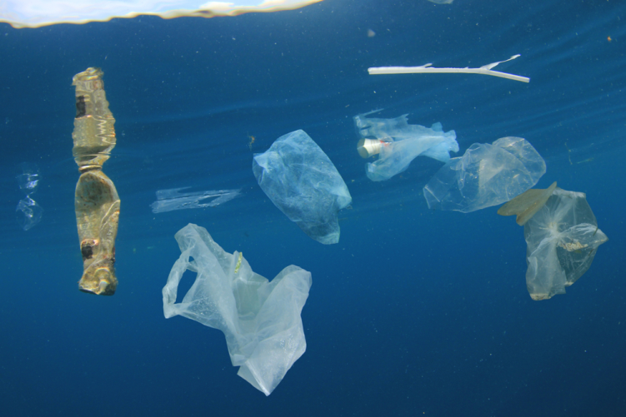
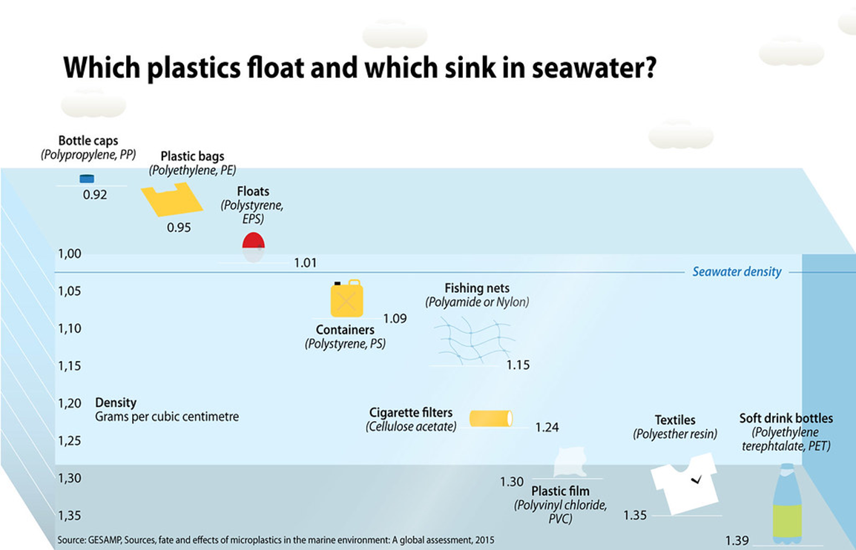
ALL PLASTICS FLOAT: BUT!
Bacteria adhere increases density; Plastics gradually sink accumulating in sediments.
Notes:
Image: Which plastics float? From; https://c1.staticflickr.com/1/696/32211531572_7054f6e303_b.jpg

Slide 19
Why Plastics Differ from Other Pollutants
Effects mediated by physical parameters; shape and size, and chemical toxicity.
Are not oxidize (metals) or weathered (rocks).
Digestion or decay by bacteria, fungi, plants, animals, don’t reduced to original components.
Reduced in size, but retain the same chemical composition.
As size decreases, surface area/volume ratio increases, producing Greenhouse gas; Methane.
Notes:
Shah, A.A., Hasan, F., Hameed, A., and Ahmed, S., 2008. Biological degradation of plastics: a comprehensive review. Biotechnol. Adv. 26, pp. 246-
265.

Slide 20
Two General Classes of Plastics
Thermoplastics and Thermosets.
Thermoplastics: Small pellets, re-melted and returned to original state. Can be recycled, e.g. polyethylene, polypropylene, polyvinyl chloride, polystyrene, nylon, polycarbonate.
Thermosets: Heat-formed into products. Cannot be recycled; vulcanized synthetic rubber, acrylics, polyurethanes, melamine, silicone, epoxies.
Notes:
Reference for Thermoplastics and Thermosets; Canadian Plastics Industry Association; website: https://www.globenewswire.com/en/search/organization/Canadian%2520Plastics%2520Industry%2520Association

Slide 21
Seven Main Types of Plastics
Type 1 – PET (polyethylene terephthalate), plastic bottles, food containers.
Type 2 – HDPE (high-density polyethylene), milk, juice containers, detergent and cleaning products.
Type 3 – PVC (Polyvinyl chloride), pipes, wraps (phthalates), inflatable products, plastic curtains, cooking oil recipients.
Type 4 – LDPE (Low-density polyethylene), bags at grocery stores.
Type 5 – PP (Polypropylene), medicine bottles or ketchup and yogurt recipients.
Type 6 – Polystyrene (Polystyrene), packaging, containers to store and transport food.
Type 7 – All Other plastics (polycarbonate containing BPA), baby bottles, medical and sports equipment, computer parts.

Slide 22
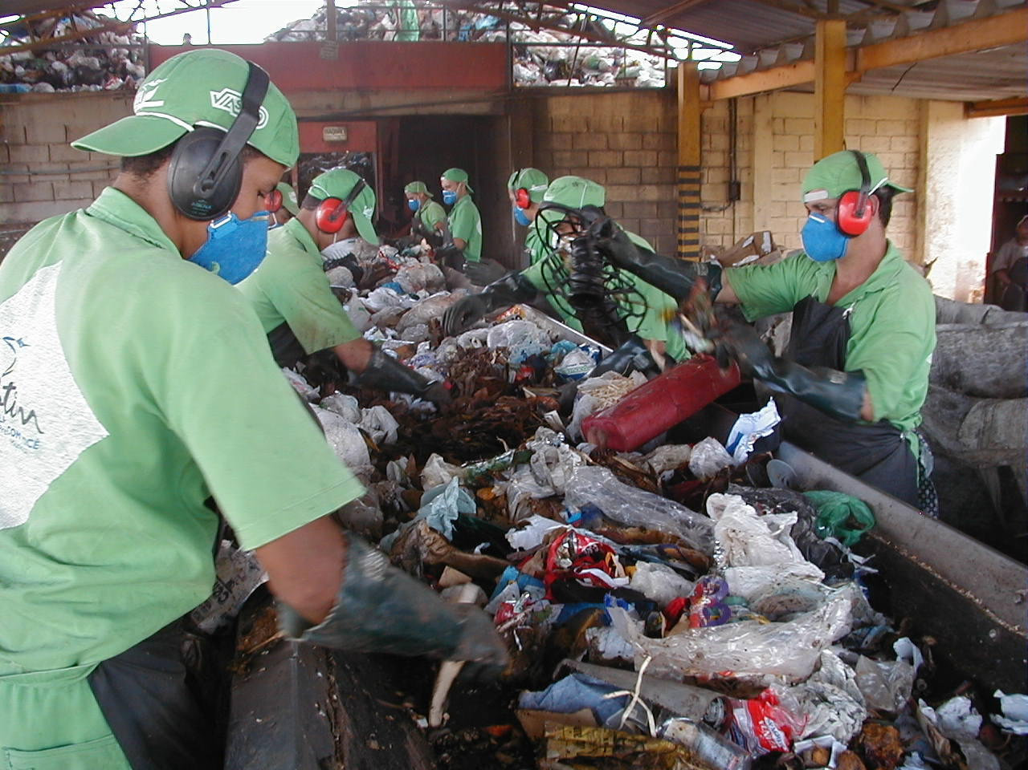
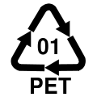
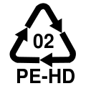
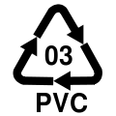
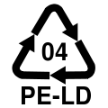
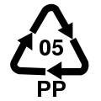
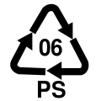
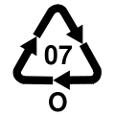
Recycling:
The Plastic Industry Myth!
Thermoplastics CAN be recycled. Thermosets CANNOT be recycled.
Too Expensive To Recycle Most Plastics.
Industry Created Resin Identification Codes: Symbols of all 7 types of plastics.
1, 2, recycled; 3 cannot; 4, 5, 6, 7 sometimes
Notes:
Resin Identification Codes from: https://en.wikipedia.org/wiki/File:Symbol_Resin_Codes.svg

Slide 23
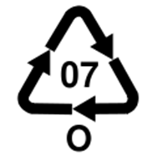
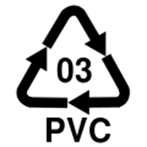
Specifics BPA, Type 7
Type 7 – All Other plastics (polycarbonate containing BPA), baby bottles, medical and sports equipment, computer parts, flame retardants.
BPA = Bisphenol A might disrupt endocrine system – VERY LIMITED recycling.
Phthalates in PVC (Type 3) released and absorbed by fatty foods, meat and cheese, when wrapped or microwaved heated – NOT RECYCLED!
Notes:
https://cancernz.org.nz/

Slide 24
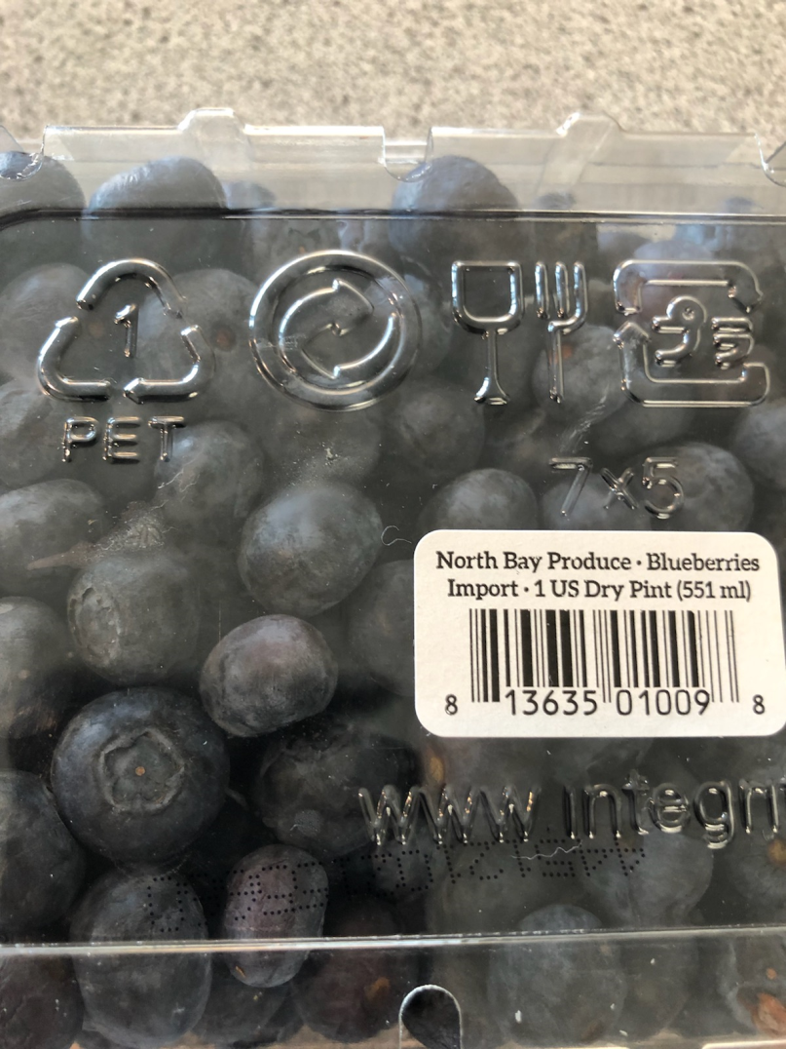
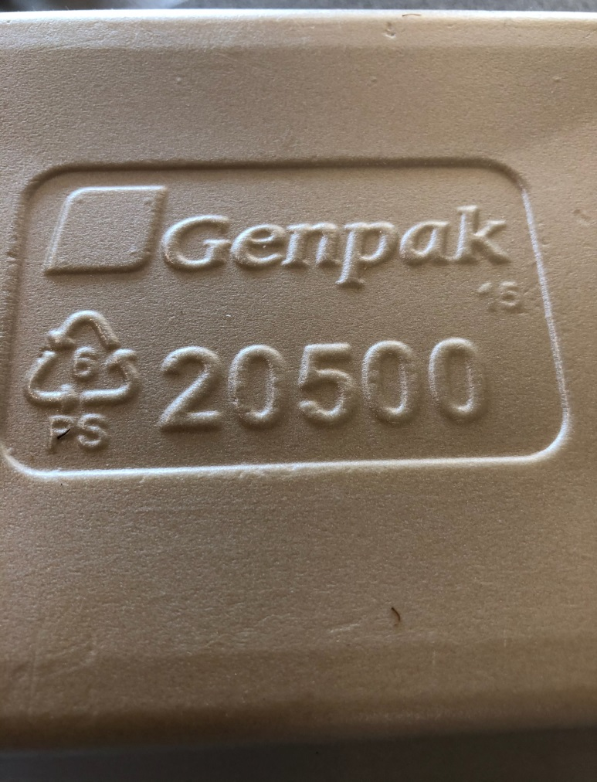
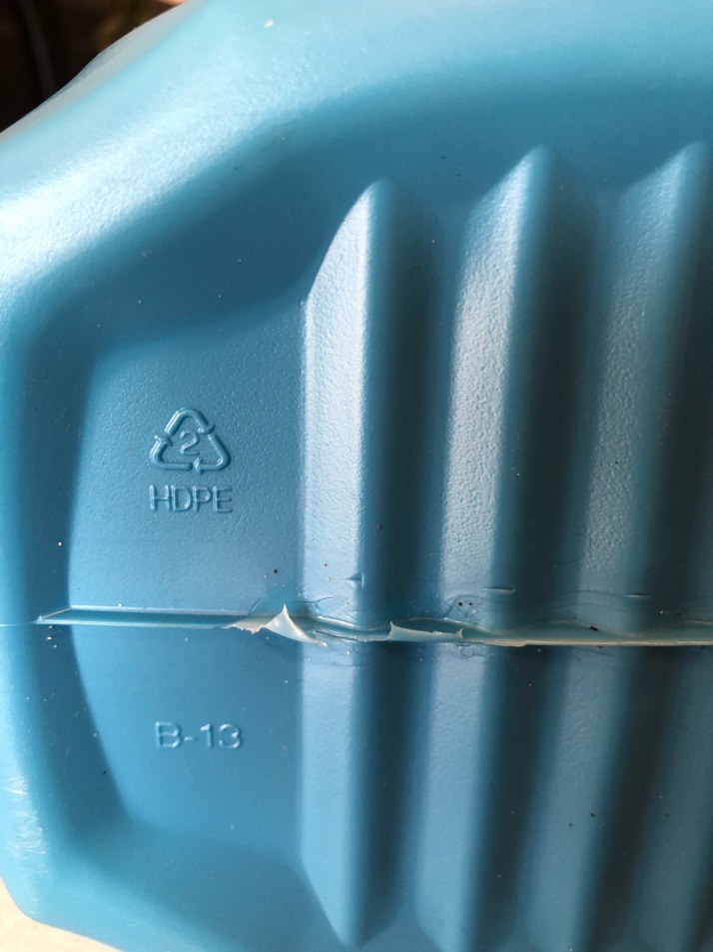
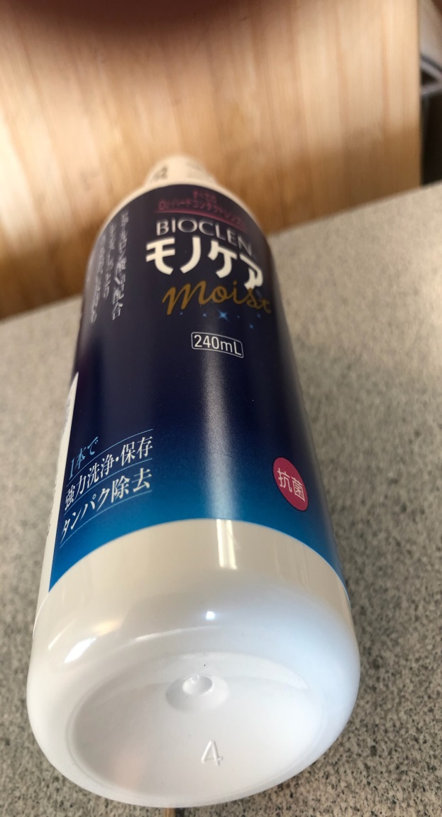
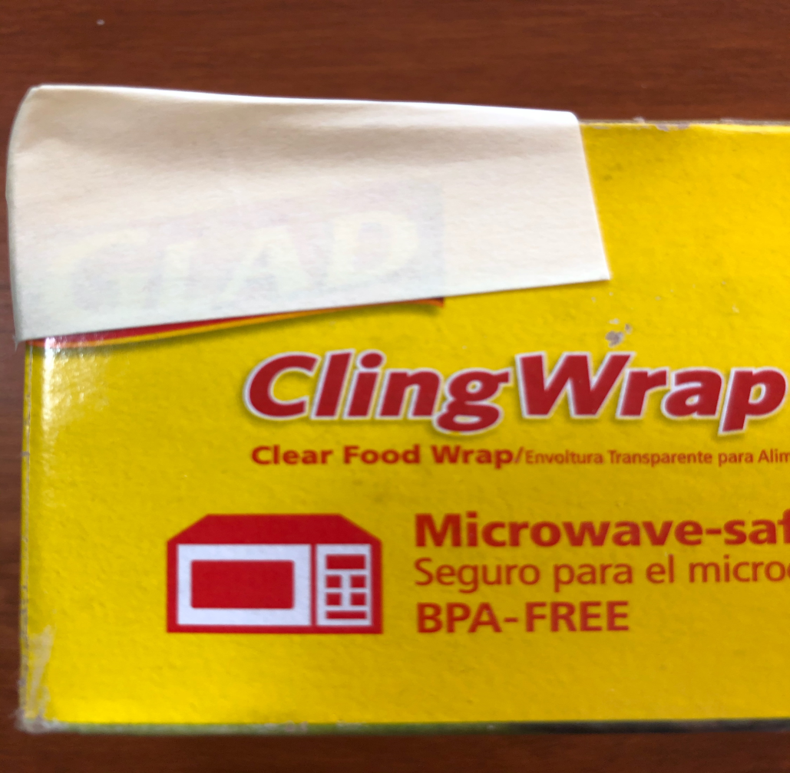
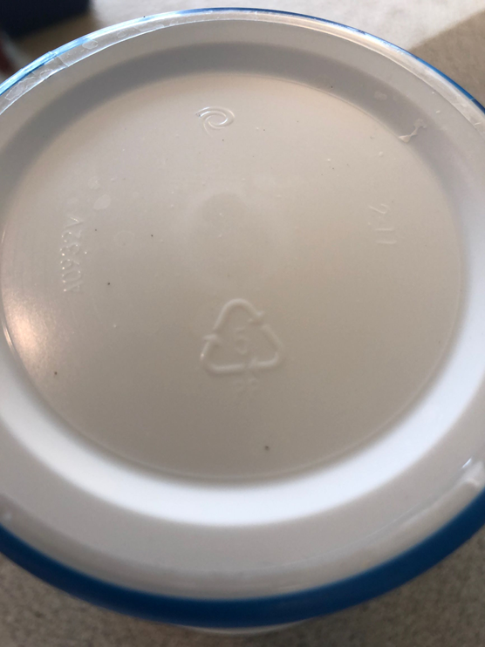
Plastics: What’s in Your House?

Slide 25
Health Impacts of Plastics
Of Two Types;
Chemicals – many are toxic and novel. Toxic effects increase with bioaccumulation.
No plastic is safe to heat in microwaves or hold hot liquids. Volatiles leach into liquids.
Solid Plastics – physical contact; entanglement or ingestion causes injury or death.

Slide 26
Human Health Impacts of
Toxic Plastics Chemical
Four main categories
Carcinogenic – causes cancer.
Mutagenic – mutations in fetus.
Endocrine – disruption in hormones.
Antibiotic resistance – increase in infection.
Notes:
CDC Phthalate Fact Sheet, Human Health Statement for phthalate 2010.
Braun, J.M., Gray, K, 2017. Challenges to studying the health effects of early life environmental chemical exposures on children’s health. PLOS Biology 15(12): e2002800. https://doi.org/10.1371/journal.pbio.2002800
Centers for Disease Control. Phthalate Fact Sheet. Archived from the original on December 29, 2010. Centers for Disease Control. National Report on Human Exposure to Environmental Chemicals. Updated Tables, February 2011. Archived from the original on November 29, 2010.
Kohn, M.C., Parham, F., Masten, S.A., et al., 2000. Human exposure estimates for phthalates. Environ. Health Perspect. 108(10): A440–2. doi:10.2307/3435033. JSTOR 3435033. PMC 1240144 Freely accessible. PMID 11097556.
Mendes, A.J.. 2002. The endocrine disruptors: a major medical challenge. Food and Chemical Toxicology, 40,(6) pp. 781–788. doi:10.1016/S0278-6915(02)00018-2. PMID 11983272.
Tickner, J.A., Schettler, T., Guidotti, T., McCally, M., Rossi, M., 2001. Health risks posed by use of Di-2-ethylhexyl phthalate (DEHP) in PVC medical devices: a critical review. Am. J. Ind. Med. 39 (1), pp. 100–11. doi:10.1002/1097-0274(200101)39:1<100::AID-AJIM10>3.0.CO;2-Q. PMID 11148020.
Microplastic's role in antibiotic resistance, Michael S. Bank, Yong Sik Ok, Peter W. Swarzenski, Science 11 Sep 2020: Vol. 369, Issue 6509, pp. 1315. DOI: 10.1126/science.abd9937

Slide 27
How this happens:
Inhalation, Ingestion, Absorption.
Municipal Solid Waste containing about 12% of plastics which is BURNT, releasing toxic gases; Polychlorinated Biphenyls (cloth flame retardants), Dioxins, Furans, and Mercury.
Poly Vinyl Chloride frees hazardous halogens and pollutes air, exacerbating climate change.
Plastics now in ALL FRESHWATER; beer, soda, bottled water.
Effects on pollinators, insects other animals: unknown? Plastics in honey from pollen!
Notes:
Sudhanshu Kumara, Shankar G. Aggarwala, Prabhat K. Guptaa, Kimitaka Kawamura, 2015. Investigation of the tracers for plastic-enriched waste burning aerosols. Atmospheric Environment, Volume 108, Pages 49-58.
U.S. Environmental Protection Agency (EPA), Office of Resource Conservation and Recovery, 2014. Municipal Solid Waste in the United States Facts and Figures A Methodology Document.
Rinku Verma, Vinoda, K.S., Papireddy, M., Gowda, A.N.S. 2016. Toxic Pollutants from Plastic Waste. Procedia Environmental Sciences, Volume 35, Pages 701-708
Phthalates (Type 3; PVC, Polyvinyl chloride), are plasticizers or plastic softeners.
Plastics in Water: Andrady, A.L., 2003. Plastics in the environment. In: Andrady, A.L. (Ed.), Plastics and the Environment. John Wiley & Sons, Inc., New Jersey.

Slide 28
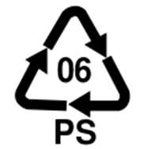
Carcinogens, Mutagens, Endocrine disruptors.
Polystyrene is harmful to the Central Nervous System. Hazardous brominated compounds are carcinogens and mutagens.
Dioxins = Agentorange; cancer, neurological damage, disrupts reproductive thyroid and respiratory systems, aggravates asthma and emphysema, increase risk of heart disease, cause rashes, nausea, headaches.
On crops, in water, enters food chain causing human and ecosystem health problems.
Notes:
Rinku Verma, Vinoda, K.S., Papireddy, M., Gowda, A.N.S. 2016. Toxic Pollutants from Plastic Waste. Procedia Environmental Sciences, Volume 35, Pages 701-708

Slide 29
Antibiotic resistance.
Microplastics from home washing machines enter wastewater plants.
Bacteria attach to microplastics forming bacterial enriched microplastic sludge.
Bacterial sludge contains genes that promote antibacterial resistance.
Impacts on non-human animals unknown.
Notes:
Michael S. Bank, Yong Sik Ok, Peter W. Swarzenski, 11 Sep 2020. Microplastic's role in antibiotic resistance, Science. Vol. 369, Issue 6509, pp. 1315. DOI: 10.1126/science.abd9937
Dung NgocPham, Lerone Clark, Mengyan Li, November, 2021. Microplastics as hubs enriching antibiotic-resistant bacteria and pathogens in municipal activated sludge. Journal of Hazardous Materials Letters, Volume 2. https://doi.org/10.1016/j.hazl.2021.100014
Yiqing Zhu et al., 2012. Study protocol for One Health data collections, analyses and intervention of the Sino-Swedish integrated multisectoral partnership for antibiotic resistance containment (IMPACT). Genome Web.

Slide 30
Health Impacts of Solid Plastic
Ingestion or physical contact cause death or reduces fitness.
Amasses in ecosystems; all effects negative.
Nanoplastics in human and non-human tissue; largely unknown.
Ecosystem effects in Water, Soil, Air, Rain and Plants - largely unknown; >1000 metric tons of plastic deposition by RAIN in western U.S. protected lands annually.
Effects exacerbated by climate change.
Notes:
H. Jesse Smith, 12 Jun 2020: Here, There, And Everywhere. Science
Vol. 368, Issue 6496, pp. 1201-1203, DOI: 10.1126/science.368.6496.1201
Janice Brahney, Margaret Hallerud, Eric Heim, Maura Hahnenberger, Suja Sukumaran. 12 Jun 2020: Plastic rain in protected areas of the United States. Science Vol. 368, Issue 6496, pp. 1257-1260. DOI: 10.1126/science.aaz5819.
Matthias C. Rillig et al., 26 June 2020. Microplastic in terrestrial ecosystems. Science. Vol. 368, Issue 6498, pp. 1430-1431. DOI: 10.1126/science.abb5979

Slide 31
Before we finish:
Plastics Not-So-Trivia!
Which country is the cleanest and has the least plastic?
Rwanda!
Why?
Total ban on ALL polyethylene plastic bags since 2007.
Find more: www.thedeliciousday.com
Notes:
http://www.thedeliciousday.com/environment/rwanda-plastic-bag-ban/

Slide 32
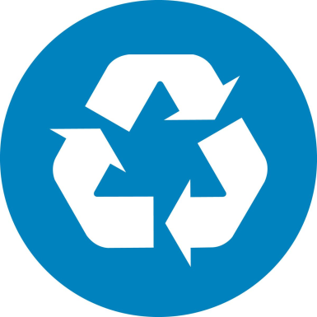
Conclusion: Plastics are here to stay! What to do?
Global society cannot exist without plastics – politics, money & jobs involved.
Extremely useful.
What you can do!!!
Reduce your use of all plastics.
Know the 7 types of plastics.
Recycle the few which can be reused.
This will reduce destructive environmental health effects.

Slide 33
Questions????
Robert F. Brand
Office: 216-201-2001 x 1236
Cell: 216 213 9083
rbrand@ccbh.net

