Slide 1
Climate Change and Vulnerable Populations
Diana Pi, MD

Slide 2
Dry-Run Definition of Vulnerability
Exposure:
  The character of climate change which an individual/population experiences
Sensitivity:
  The susceptibility to damage
Adaptive capacity:
  The ability to adjust to changes, to moderate potential damage, take advantage of opportunities, or cope with consequences.
https://academic.oup.com/gerontologist/article/58/3/567/2967601

Slide 3
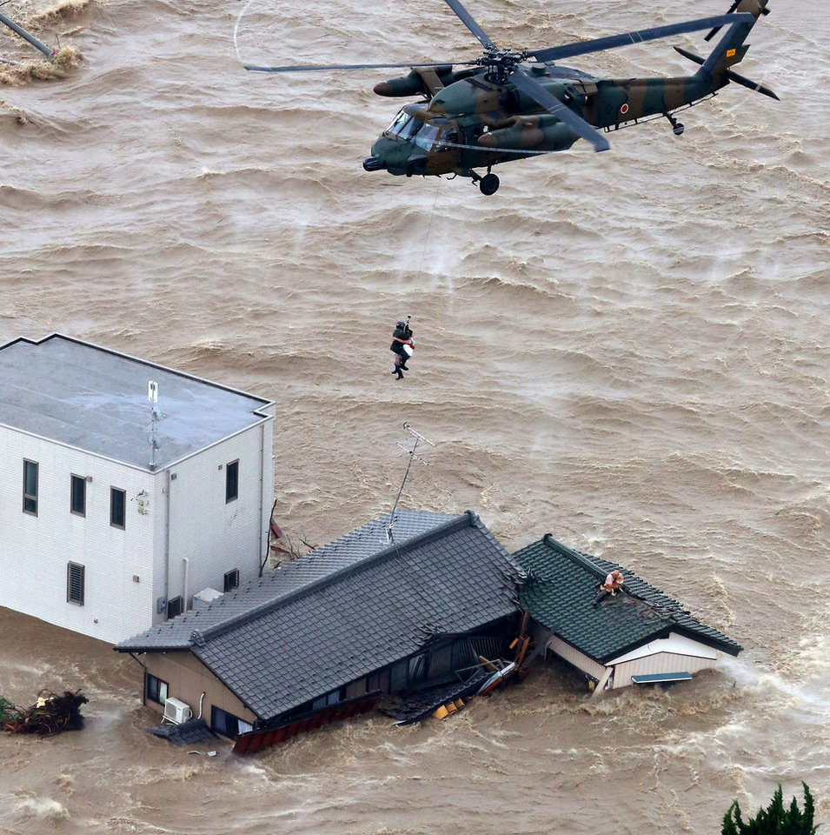
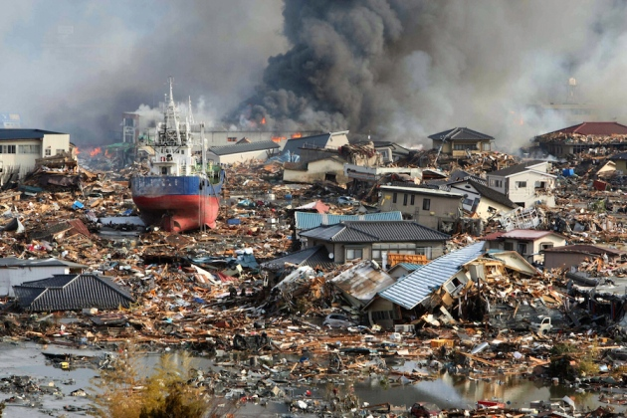
2011, Japan, 9.1 magnitude earthquake followed by 30-foot wave tsunami damaged 6 nuclear reactors. 1/3 million people displaced: 22,000 deaths and missing
2015, Japan, worst flood in 60 yrs. Government mobilized 51 helicopters, 6000 rescuers. 100,000 displaced: 23 people missing,.
Notes:
Helicopters crisscrossed skies over the largely rural city of Osaki, some 350 km (220 miles) north of Tokyo, where the brown waters of the Shibui river inundated rice fields and houses as rescuers in rubber boats ferried people to safety.
Some parts of Japan had received more than twice the usual September amount of rain in 48 hours by noon on Thursday, sparking some of the worst flooding in more than 60 years.
Japan has put heavy emphasis on disaster prevention since a 2011 earthquake and tsunami killed nearly 20,000 people and authorities are keen to avoid the kind of criticism they faced then for what was seen as a sluggish response.
The central government, police, fire officials and military are all working as one," chief cabinet secretary Yoshihide Suga told a news conference.
"We are doing everything in our power to rescue those in need as soon as possible."
Some 51 helicopters and nearly 6,000 rescuers worked into the night on Thursday to pluck stranded people from houses as floodwaters raged below. More than 100 were temporarily trapped on the second floor of a shopping centre in Joso.
Here’s a look at the earthquake and tsunami that struck Japan in March of 2011.
March 11, 2011 - At 2:46 p.m., a 9.1 magnitude earthquake takes place 231 miles northeast of Tokyo at a depth of 15.2 miles.
The earthquake causes a tsunami with 30-foot waves that damage several nuclear reactors in the area.
It is the largest earthquake ever to hit Japan.
Number of people killed and missing
(Source: Japan’s Fire and Disaster Management Agency)
The combined total of confirmed deaths and missing is more than 22,000 (nearly 20,000 deaths and 2,500 missing). Deaths were caused by the initial earthquake and tsunami and by post-disaster health conditions.

Slide 4
Outline
Climate change exacerbates inequality
Complexity of “vulnerability”
Community response
Government policy that helps Earth and vulnerable population

Slide 5
Inequality

Slide 6
Climate Change Worsens Social/Health Inequality
Inequality among nations has narrowed in past 50 yrs
Climate change dampened per capita incomes in the world’s poorest countries up to 30% (India, Nigeria).
  Developing countries are disproportionately in tropics
  Heat increase devastates crops, labor, health
Norway, big oil/gas producer, is 34% richer
The young
  Climate model predicts 88% climate change burden born by children under age 5
https://www.nytimes.com/2019/04/22/climate/climate-change-global-wealth-gap.html
Notes:
Standford paper, 2019, peer review
Having suffered setbacks – such as livelihood losses or deteriorating health – from climate hazards, those who are disadvantaged may have few resources to enable them to cope and recover
Ellen: PVD and air quality
Animals are moving to higher elevations and latitudes to find cooler conditions. And droughts, floods and wildfires have all gotten more extreme.
https://www.nytimes.com/article/climate-change-global-warming-faq.html
Norway is winner, Nigeria is the loser. Exacerbate wealth inequality
Conversely, climate change could bring welcome warming and extended growing seasons to the upper Midwest, Canada, the Nordic countries and Russia. Farther north, however, the loss of snow, ice and permafrost will upend the traditions of Indigenous peoples and threaten infrastructure.
These inequalities will play out on an individual, community, and regional level. A 2017 analysis of the U.S. found that, under business as usual, the poorest one-third of counties, which are concentrated in the South, will experience damages totaling as much as 20 percent of gross domestic product, while others, mostly in the northern part of the country, will see modest economic gains. Solomon Hsiang, an economist at University of California, Berkeley, and the lead author of the study, has said that climate change “may result in the largest transfer of wealth from the poor to the rich in the country’s history.”
On top of that, warmer weather is aiding the spread of infectious diseases and the vectors that transmit them, like ticks and mosquitoes. Research has also identified troubling correlations between rising temperatures and increased interpersonal violence, and climate change is widely recognized as a “threat multiplier” that increases the odds of larger conflicts within and between countries. In other words, climate change will bring many changes that no amount of money can stop. What could help is taking action to limit warming.

Slide 7
Climate change worsens health/economic inequality
In poverty, wealth concentrated in material forms, such as housing or livestock
  Assets are more fragile.
Livelihoods, agriculture and fishing, are climate-sensitive
  Prone to environmental damage
  The erosion of natural assets forces them to shift
    From crop to hybrid crop-livestock agriculture
    Wage labor
    Alternative income may not be available

Slide 8
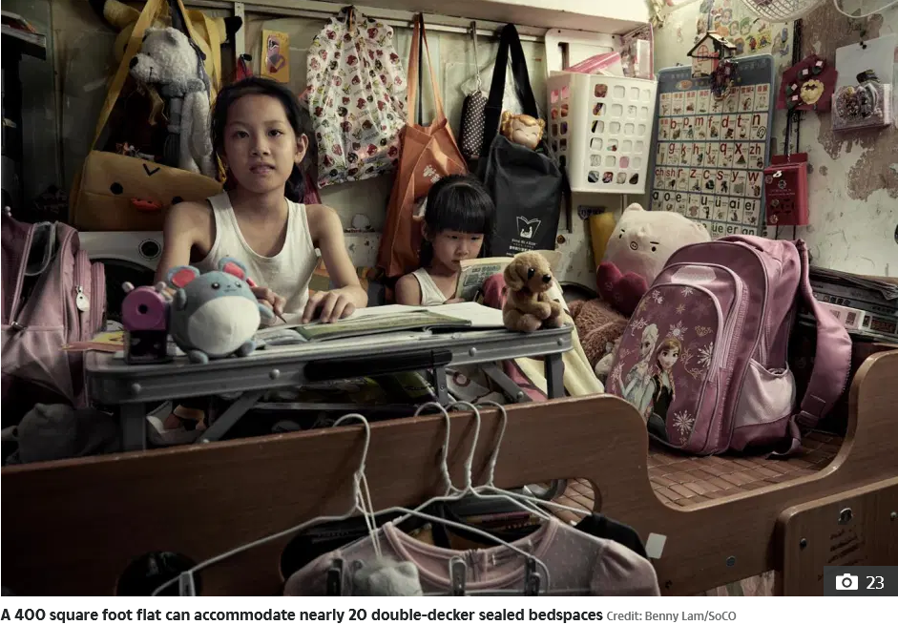
Notes:
Hong Kong rated as the world’s most unaffordable. Ave house price, 21x gross median income
180 sq feet: $390.000
Average dorm size: 200 sq feet
A staggering 200,000 people are living in around 88,000 tiny low income apartments such as these in the city according to the Society for Community Organisation (SoCO).
https://www.thesun.co.uk/news/3743131/hong-kong-coffin-homes-pictures-size/

Slide 9
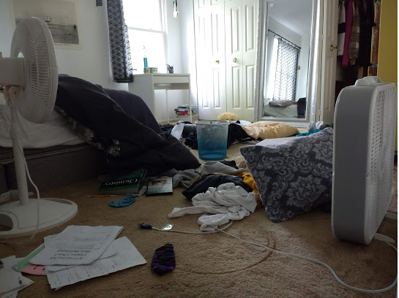
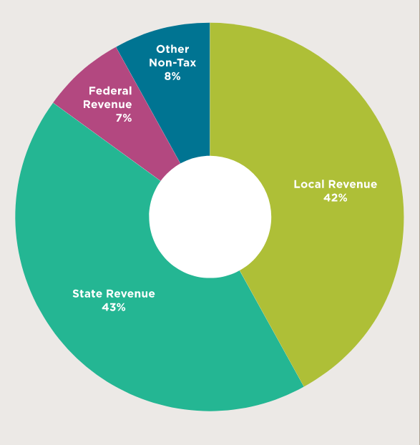
$12,472
Notes:
Said child room.
14 yo girl room from Westlake, OH. Clothes strawn about, closet full of clothes, education focused, paper on the floor, Chemistry textbook, Poster of Wright’s brother, OHIO is birth of aviation, unclear why she has two fans in the room, There are two fans in her room, but house is airconditioned, heated. Serviced twice yearly. What you see is not most what the family owns. House yes. House has insurance. Ohio spent $12,000 yearly on her education, Her parents put money put away for her education.
Backup plan, backup to the backup plan.
Empty waste basket
2020 Fordham Institute Ohio by the number

Slide 10
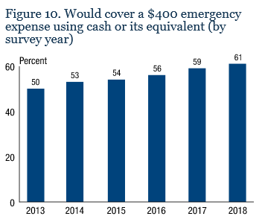
Problems at home:
Fed stat: For a $400 unexpected charge, 40% US population could not pay it w/o borrowing money or selling something.
https://www.federalreserve.gov/publications/2019-economic-well-being-of-us-households-in-2018-dealing-with-unexpected-expenses.htm
Notes:
Ohio: 80% children consider economically disadvantaged, lives below 180% poverty level.
Dental emergency, car breaks down, sudden medical expense.

Slide 11
Biological Susceptibility: It’s Complicated
modulation
Pregnancy Immune suppression
  Rising estradiol/progesterone, pro- alternate with anti-inflammation
Impact on not one but two lives
Safety and efficacy data on drugs and therapy lacking for “fear of the unknown”
Access to clean water and adequate nutrition vital
  Poor nutrition leads to low birth weight, delivery problem, newborn death, poor vaccine response
https://www.ncbi.nlm.nih.gov/pmc/articles/PMC7469740/
Notes:
COVID-19 vaccines not studied in pregnant women initially. Mortality rate is higher than general population….. Now vaccines work: What do we do with the 3.8 million pregnant women.
rising estradiol/progesterone, reducing CD4/CD8 cells, decreasing cytotoxic T cells and a shift from Th1 to Th2 have all been proposed to be important for susceptibility to infections.

Slide 12
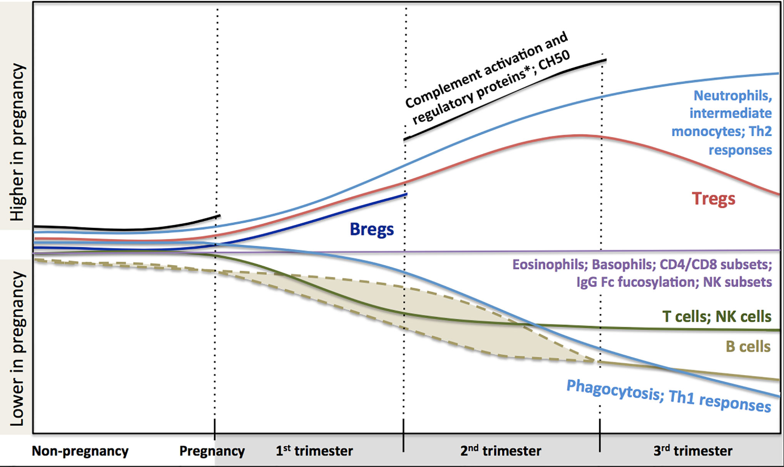
Maternal Immune Modulation
https://www.frontiersin.org/articles/10.3389/fimmu.2020.575197/full#T4
Notes:
Regulatory T cells (Tregs) are a specialized subpopulation of T cells that act to suppress immune response, thereby maintaining homeostasis and self-tolerance
Regulatory B cells (Bregs or B_{reg} cell) represent a small population of B cells which participates in immunomodulations and in suppression of immune responses. These cells regulate the immune system by different mechanisms. The main mechanism is a production of anti-inflammatory cytokine interleukin 10 (IL-10)

Slide 13
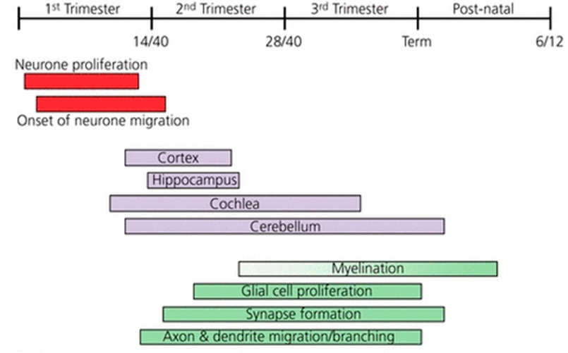
Fetal Neural Development
https://www.mdpi.com/2072-6643/11/10/2378/htm
Notes:
Figure 1. Thyroid hormone action and the development of the brain of the foetus and infant. Relationship between thyroid hormone action and the development of the brain. In the first trimester of pregnancy early neuronal proliferation and migration is dependent on maternal thyroxine (T4). In foetal tissues, inactivating type 3 deiodinase (D3) enzyme expression falls and the development of the thyroid gland commences. By the end of the first trimester, the development of the hypothalamic–pituitary axis has occurred and a surge in thyroid-stimulating hormone (TSH) secretion results in the onset of foetal thyroid hormone production, expression of the activating type 2 iodothyronine deiodinase enzyme (D2) and increasing occupation of thyroid hormone receptors (TRs) by 3,5,3 ¢-L-triiodothyronine (T3). Continuing the development of the brain in the second and third trimesters relies increasingly on T4 produced by both the foetus and mother. Continued post-natal development is entirely dependent on neonatal thyroid hormone production. Apo-TR, unliganded unoccupied thyroid hormone receptor. Reproduced with permission: Williams G.R., Journal of Neuroendocrinology 2008, Vol 20, 784–794, Wiley Publications.

Slide 14
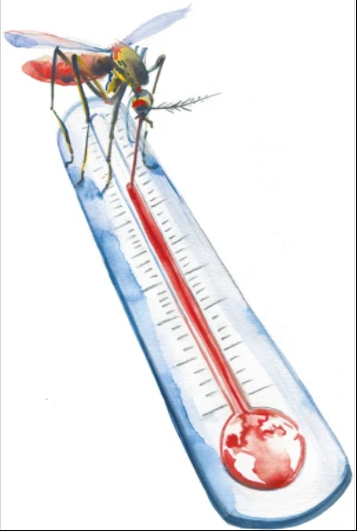
The Viral Hitchhikers of Aedes Mosquito
Single-stranded RNA
  Zika virus
  Chikungunya virus
  Dengue virus
Notes:
Dengue: ¼ will get sick. Rash, N, V, better in one week. Rare complication bleeding. Similar sx of Chinkungunya. (severe cases hemorrhagic, shock syndrome) started 1600.
Chinkungunya: most will develop some sx: joint pain, muscle ache, rash, first time in Americas, last a few days. Joint pain may last months. Mostly in Africa, Asia, 2013 in the Caribbean Island, ‘to become contorted, found Tazania 1952, 50yrs quiet, 2004 outbreak in Kenya, spread to Asia,Europe, America in 2016 heavy burden in Brazil.
Zika: most have no or little sx. Red eye, rash, first discovered Zika forest in Uganda. 1947. Febriel rhesus monkey. First human case 1960, detected in Asia, then 2015 outbreak in Brazil. 60 yrs quiet. Then endemic
explosive and rapid human movement by modern transportation, urbanization, poor water management, and vector control, and facilitated by large immunologically naive human populations and the global spread of the anthropophilic mosquito vector, Ae aegypti. The fundamental basis of ZIKV genetic diversity can be attributed to its error-prone ribonucleic acid (RNA)-dependent RNA polymerase, which does not have proof-reading capacity and is thought to produce approximately 1 mutation per round of genome replication.
Ae. Aegypti: tropic, subtropic
Ae. Albopictus, temporal, cooler weather. Both bite throughout the day. Peak morning/evening
Pictures: https://www.nature.com/articles/s41590-020-0648-y
Larva grows faster in warmer temperature. Cold blooded by nature

Slide 15



Zika
Zika
dengue
Chikungunya
Notes:
Dengue Virus: A Trojan Horse of the Molecular World
There are five antigenically different serotypes of Dengue Virus called DENV-1 to DENV-5. Infection with the virus induces the production of immunoglobulin G (IgG) antibodies, described as homotypic. These provide lifelong immunity, but only against the specific dengue serotype (hence homotypic). If a person is infected a second time with a different dengue serotype, the infection can exhibit an effect known as antibody-dependent enhancement. Antibodies are made that bind to, but do not neutralize, the virus. This allows it to behave as a "trojan horse” as the virus is delivered by the antibodies to cell have ingested the virus for destruction in a still viable state. Upon ingestion the virus is activated by the acid environment of the phagosome and begins to replicate. As a result of the antibody-dependent enhancement, a second infection, even years later, can be much more severe than the initial one, if the two infections are by two different viral serotypes. Dengue virus is an RNA virus that has a genome that encodes only ten proteins. Three of these are structural proteins that both form the outer coat (capsid) of the virus particle (eg PDB entry 3j6 shown above) and have a role in the delivery of the RNA genome into host cells. The remaining seven proteins are involved in the production of new viruses once the virus is inside the host cell.
https://www.ebi.ac.uk/pdbe/about/news/dengue-virus-trojan-horse-molecular-world
Chikungunya virus is a small (about 60–70 nm-diameter), spherical, enveloped, positive-strand RNA virus (see figure 1). Early 2006, the complete sequence of a chikungunya isolate from Reunion Island was made available through NCBI/ GenBank accession no. DQ443544.1. The virion consists of an envelope and a nucleocapsid. The chikungunya virus genome is 11,805 nucleotides long and encodes for two polyproteins – the non structural polyprotein consisting of four proteins (nsP1, nsP2, nsP3 and nsP4) and the structural polyprotein consisting of five proteins (Capsid, E3, E2, 6K and E1) (see figure 2). According to the initial 1955 report about the epidemiology of the disease, the term 'chikungunya' is derived from the Makonde root verb kungunyala, meaning to dry up or become contorted. The Makonde term was more specifically referred to as "that which bends up“n reference to the stooped posture developed as a result of the arthritic symptoms of the disease.

Slide 16
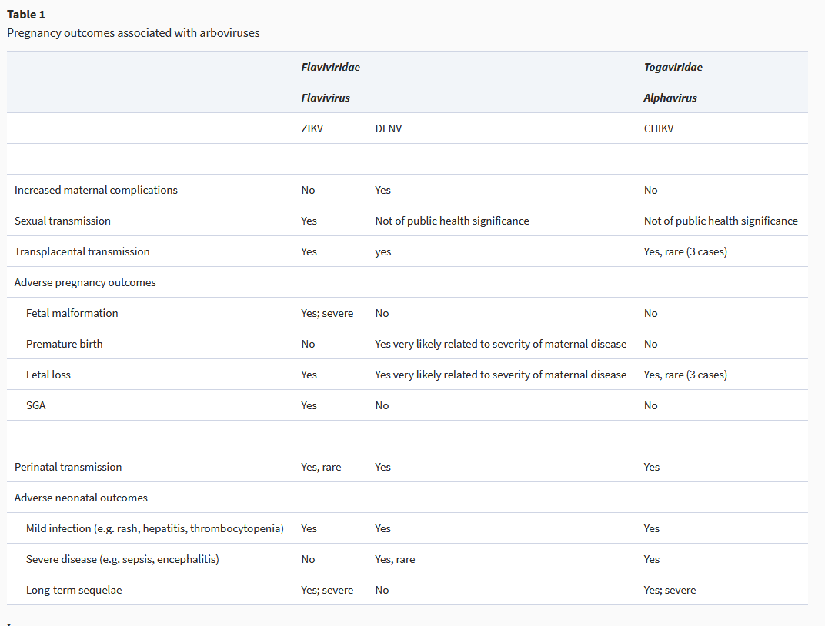
Notes:
SGA, small for gestation age. https://academic.oup.com/jtm/article/26/8/taz077/5588082
WHO: Approximately 17% of all infectious diseases are caused by vector-borne diseases, resulting in over 700,000 deaths annually. Just over 50% of the world’s population are at risk at any time to these vector-borne diseases.²

Slide 17
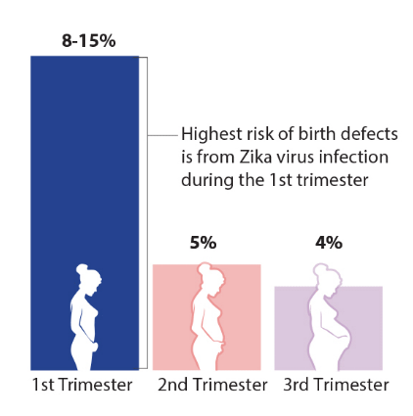
Confirmed Zika Virus Infection During Pregnancy:
5-10 % with Zika-Associated Birth Defects
https://www.cdc.gov/pregnancy/zika/data/index.html
Notes:
The highest number of birth defects occurred 6 months after the peak of the Zika virus outbreakBirth defects potentially linked to Zika virus infection include:
Brain abnormalities and/or microcephaly
Eye abnormalities

Slide 18
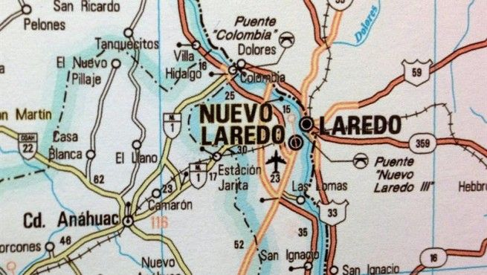
Economic Susceptibility Paradox:
Los Dos Laredos
1999, dengue outbreak
Binational BIDS project
Mexico border cities
  Prosperous
US border cities
  Laredo, TX: 30% below poverty line
Study
  Random clusters of families
  Finger-sticks
  Mosquito survey in yards, patios
  Questions on availability of air-conditioners, quality window screens, etc.
https://wwwnc.cdc.gov/eid/article/9/1/02-0220_article
Notes:
Study of paradox:
In 1997, the Centers for Disease Control and Prevention, the Mexican Secretariat of Health, and border health officials began the development of the Border Infectious Disease Surveillance (BIDS) project, a surveillance system for infectious diseases along the U.S.-Mexico border
The 2,000-mile U.S.-Mexico border is one of the world’s busiest international boundaries. An estimated 320 million people cross the northbound border legally every year
From Mexico’s perspective, the border encompasses some of the country’s most economically prosperous states. In contrast, the U.S. border region is among the poorest areas in the United States, with >30% of families living at or below the poverty level (8). Along the Texas border, an estimated 350,000 or more people live in 1,450 unincorporated areas known as colonias, which lack adequate sanitation infrastructure (8).
1999, dengue outbreaks study
Climate change cause mosquitoes to move north
From 1980 to 1999, the infected mosquito counts in Laredo, Texas, were significantly higher than in three adjoining Mexican states—yet, while there were only 64 cases of dengue fever reported in Texas, more than 62,000 dengue fever cases were reported in the Mexican states.
“Los dose Loredos” are essentially one city
Studies done in random clusters. Finger stick and survey in yard and patio for mosquito breeding sites, questions airconditioning and quality window screens
137 In Texas, socioeconomic factors and adaptive measures, including houses with air conditioning and intact screens, contributed to the significantly lower dengue incidence by reducing human–mosquito contact.137 The adap-tive capacity of a population may augment or limit the impacts of climate change to human vulnerability for vector-borne disease.137 Climate factors are useful b
Results:
Surveys were completed in 622 households (309 in Laredo, 313 in Nuevo Laredo), and 516 persons (228 in Laredo, 288 in Nuevo Laredo) provided blood samples. IgM seropositivity (Table 1) was lower in Laredo (1.3%; 95% confidence interval [CI] 0 to 3%) than in Nuevo Laredo (16%; CI 12% to 20%). IgG seropositivity (Table 1) was also lower in Laredo (23%; CI 17% to 28% vs. 48%; CI 41% to 55%). Conversely, mosquito-infested containers were more abundant on the Texas side of the border: the Breteau Index (the number of infested containers per 100 houses) was 91 in Laredo versus 37 in Nuevo Laredo. Eighty-two percent of homes in Laredo had central or room air-conditioning versus 24% in Nuevo Laredo. In Laredo, evaporative coolers (a low-technology air-conditioning device that cools and humidifies air by drawing it from outdoors through a continually wetted screen) were less prevalent, a greater proportion of houses had intact screens, the average distance between houses was greater, and fewer persons lived in each house (Table 2).
GDP per capita stands for Gross Domestic Product (GDP) per capita (per person). It is derived from a straightforward division of total GDP (see definition of GDP) by the population.

Slide 19
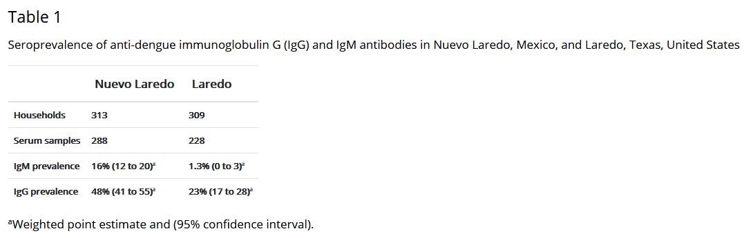
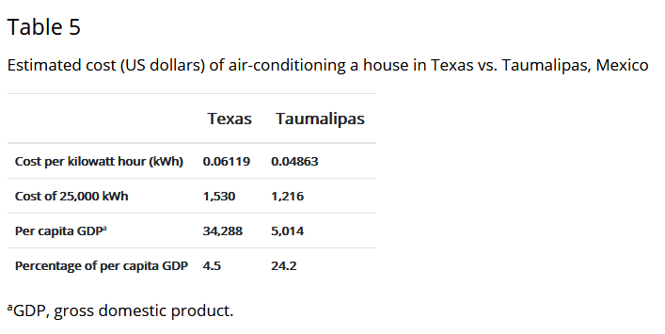
Findings:
1. 622 households studied
2. Breteau Index (the number of infested containers per 100 houses):
91 in Laredo vs 37 in Nuevo Laredo
3. Homes with air-conditioning:
82% in Laredo vs 24% in Nuevo Laredo
Big difference
Notes:
622Study of paradox:
In 1997, the Centers for Disease Control and Prevention, the Mexican Secretariat of Health, and border health officials began the development of the Border Infectious Disease Surveillance (BIDS) project, a surveillance system for infectious diseases along the U.S.-Mexico border
The 2,000-mile U.S.-Mexico border is one of the world’s busiest international boundaries. An estimated 320 million people cross the northbound border legally every year
From Mexico’s perspective, the border encompasses some of the country’s most economically prosperous states. In contrast, the U.S. border region is among the poorest areas in the United States, with >30% of families living at or below the poverty level (8). Along the Texas border, an estimated 350,000 or more people live in 1,450 unincorporated areas known as colonias, which lack adequate sanitation infrastructure (8).
1999, dengue outbreaks study
Climate change cause mosquitoes to move north
From 1980 to 1999, the infected mosquito counts in Laredo, Texas, were significantly higher than in three adjoining Mexican states—yet, while there were only 64 cases of dengue fever reported in Texas, more than 62,000 dengue fever cases were reported in the Mexican states.
“Los dose Loredos” are essentially one city
Studies done in random clusters. Finger stick and survey in yard and patio for mosquito breeding sites, questions airconditioning and quality window screens
137 In Texas, socioeconomic factors and adaptive measures, including houses with air conditioning and intact screens, contributed to the significantly lower dengue incidence by reducing human–mosquito contact.137 The adap-tive capacity of a population may augment or limit the impacts of climate change to human vulnerability for vector-borne disease.137 Climate factors are useful b
Results:
Surveys were completed in 622 households (309 in Laredo, 313 in Nuevo Laredo), and 516 persons (228 in Laredo, 288 in Nuevo Laredo) provided blood samples. IgM seropositivity (Table 1) was lower in Laredo (1.3%; 95% confidence interval [CI] 0 to 3%) than in Nuevo Laredo (16%; CI 12% to 20%). IgG seropositivity (Table 1) was also lower in Laredo (23%; CI 17% to 28% vs. 48%; CI 41% to 55%). Conversely, mosquito-infested containers were more abundant on the Texas side of the border: the In Laredo, evaporative coolers (a low-technology air-conditioning device that cools and humidifies air by drawing it from outdoors through a continually wetted screen) were less prevalent, a greater proportion of houses had intact screens, the average distance between houses was greater, and fewer persons lived in each house (Table 2).
GDP per capita stands for Gross Domestic Product (GDP) per capita (per person). It is derived from a straightforward division of total GDP (see definition of GDP) by the population.

Slide 20
Emergency First-Responders:
See too much, hear too much
Living in the communities they serve, they
  Know the people
  Identify with the victim’s suffering
  Overwhelmed by the number and scope of injuries
  Deal with own loss
  In a study of Coast Guard responders to Hurricanes Katrina and Rita
    Local responders 3x depression compared to non-locals
Off-season
  Feel isolated, away from crew
  No fire, no money
4 yr after large-scale response events: 13% to 18% suffers PTSD
Worse if job includes fire/EMS, 37% contemplated suicide. 10 x rate of US adults (2015)
https://health2016.globalchange.gov/low/ClimateHealth2016_FullReport_small.pdf

Slide 21
Firefighters Mental Health Crisis
In Their Own Words
"Don't call us 'Heroes‘… when divorces, mental health problems and declining wages are the reality, we don't feel like heroes at all."
Without the adrenaline rush, "You just feel flat all the time."
“I have faith that God intervenes…And then it didn't happen."
“You just feel defeated…The things that we used to do that worked ten years ago are no longer working anymore."
https://www.npr.org/2021/02/26/968391523/as-fires-worsen-a-mental-health-crisis-for-those-battling-them
Notes:
https://www.npr.org/2021/02/26/968391523/as-fires-worsen-a-mental-health-crisis-for-those-battling-them
irefighters work the scene as the Glass fire continues to burn in Calistoga, Calif., on Oct. 1, 2020. The United States's west coast experienced a record-breaking fire season in 2020, with five of the state's six biggest blazes in history burning simultaneously, and nearly four million acres scorched.
Josh Edelson/AFP via Getty Images
Hard Work, Low Pay, Miserable Conditions ... and More. California Conservation Corps’s motto:
In 2015, prisoners 2015 made up about 20 percent of California fire crews
Civilian recruits, men and women, age 18 to 25, one-year contract at $10 an hour

Slide 22
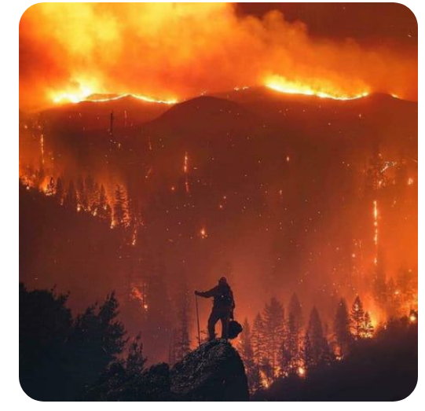

Slide 23
Warming Climate and Firefighting
Longer, harder fire seasons
  Climate change doubled the area burned across the American West 1984-2015
  The west coast’s record-breaking fire season in 2020, 5 of the state's 6 biggest blazes burned simultaneously (nearly four million acres scorched)
California’s forests vulnerable: >147 million drought-killed trees since 2010. Primed to burn.
Days and nights are both warming; but nighttime warming outpaces daytime (2.6 F vs 1.8 F) for the past 125 years
Problems: Firefighters work at night
  Cooler air adds humidity. Fuel breaks.
  Warmer nights keep dead leaves, logs dry
  But flames that calm at night remain aggressively active
https://www.nytimes.com/article/climate-change-global-warming-faq.html
https://www.scientificamerican.com/article/one-climate-change-wildfire-risk-lurks-in-the-dark/
Notes:
From 1997 to 2016, the global mean carbon dioxide emissions from wildfires equated to approximately 22% of the carbon emissions from burning fossil fuels. https://www.nejm.org/doi/full/10.1056/NEJMsr2028985
https://www.scientificamerican.com/article/california-looks-to-battle-mega-wildfires-with-fire/
Fuel breaks: strips of land when flammable vegetations are removed
Firefighters do have some options for adapting tactics to warmer nights—yet they are limited, Bauer says. Many of those battling this year’s intense fires have focused their attacks on the sides of advancing blazes instead of the more aggressive fronts, for example
O night are cool, humidity inc and dry logs absorb the humidity, harder to burnTangled masses of ultra-dry fuel represent a fire hazard of unprecedented size and intensity if left alone
Solution fighting from the sides instead the front. Not ideal solution
Controlled fire in Sierra. https://www.scientificamerican.com/article/california-looks-to-battle-mega-wildfires-with-fire/

Slide 24
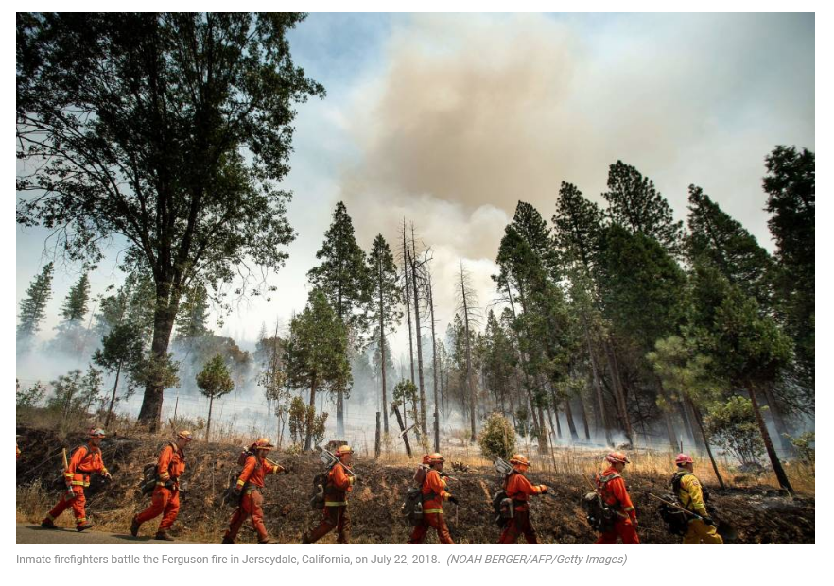
Mitigation:
Newsom: $ 536 million to prevent wildfire
Advance plan and clear protocol for disaster
Training: Aware of personal vulnerability, signs of burnout, compassion fatigue
Committed mental health wellness program
Inmate firefighter program started in 1915. Paid $2-5 per day. Extra $1/hr if actively fighting the fire.
https://www.kqed.org/news/11846622/whats-next-for-incarcerated-firefighters-in-california

Slide 25
Regional Adaptation Plans To Build Resilience
Climate-related impacts most pronounced at local level
In US: 43 adaptation plans
  Average 54 actions/plan: range 14 (Milwaukee) – 447 (Lee County, FL)
Most plans lack details (Ex: 16% discussed cost)
Average 5 out 16 metrics necessary for implementation (0 – 80%)
Mitig Adapt Strateg Glob Change (2017) 22:1249–1279
Notes:
Lee County: Fort Meyer, Sanibel Island, Captiva Islands. Coastal, flat, poor drainage, most live along the coast or estuary. Hurricane, lost 40% of wetland. Losing coastline, inc algae bloom, jellyfish
Mitig Adapt Strateg Glob Change (2017) 22:1249–1279
in a meta-analysis of plan quality
studies, Berke and Godschalk (2009) found that plans consistently Bspecify organi-
zation responsibility and timelines for actions for implementation and monitoring^
but omit other important elements associated with plan implementation, such as
funding source.
. The median number of actions in a plan was 54. Lee County,
FL, included the most actions (447), followed by Lafourche Parish, LA (337), and New York
City, NY (323). Milwaukee, WI, had the fewest actions (14).
While Lee County, FL, had the most actions, the plan’s authors provided little
detail about their proposed actions; many of which were very general (such as Bincrease public
awareness^). Punta Gorda, FL, similarly included many actions that are too general to provide
direction on implementation (e.g., Blimit development,^ Buse flexible planning,^ and
Bstormwater retention^).
Most adaptation plans identified the same climate impacts as discussed in their corresponding
regional chapter of the National Climate Assessment. However, 13 coastal communities
focused exclusively on impacts related to sea level rise, such as inundation, erosion, and storm
surge. For example, Miami-Dade County, FL, Santa Barbara, CA, and Anne Arundel County,
MD, focused exclusively on sea level rise, omitting rising temperatures, extreme heat, and
changing precipitation patterns. While plans that focus on coastal impacts explore the implications
for numerous sectors such as public health, water supply, and infrastructure, ignoring
other changes may leave communities unaware of and unprepared for other projected climate
impacts.
Twenty-eight out of the 43 plans (66%) linked actions to possible future climate impacts or
goals. This connection, however, was often broad, which made it impossible to connect
individual adaptation actions to climate impacts. Fresno County, CA, for example, organizes
adaptation actions into eight sector-based categories: (1) agriculture, (2) freshwater aquatic and
riparian systems, (3) governance and planning, (4) health and emergency preparedness, (5)
infrastructure, (6) valley floor grasslands and semi-desert, (7) water resources and infrastructure,
and (8) woodlands and forests. For each sector, the plan identifies climate impacts;
agriculture, for example, will be affected by rising temperatures, drought, and an increase in
heavy downpours. Because each sector will be affected by multiple climate change impacts, it
can be difficult to connect actions back to climate impacts.
Land use
actions (e.g., transfer of development rights, no-build policies) were also prevalent, having
been identified in 40 of the 43 plans. The least common type of adaptation action found across
all of the plans was advocacy, which was found in only 11 of the 43 plans analyzed. Energy
conservation (found in 19 of the 43 plans), water conservation (22 out of 43), and greenhouse
gas mitigation actions (22 out of 43) were also found in relatively few plans.
Of the 3375 actions identified and categorized, the most common type by count was
practice and behavior (594 actions, ∼18% of actions, Fig. 3), followed by research and
monitoring (498 actions, ∼15% of actions) and physical infrastructure (459 actions, ∼14%
of actions). The least common type of adaptation action was advocacy (∼1% of actions; New
York City had 28 of the 44 advocacy actions identified). Funding, water conservation,
financing, building codes and engineering design standards, and energy conservation were
also infrequent, combined, making up less than 13% of all actions identified across

Slide 26
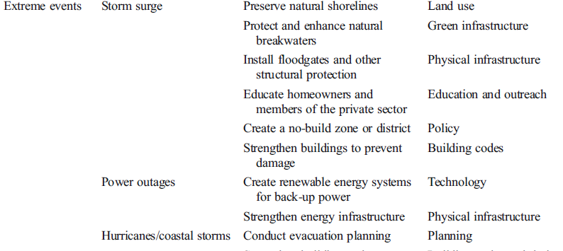
Guideline-Based Climate Adaptation Action

Slide 27
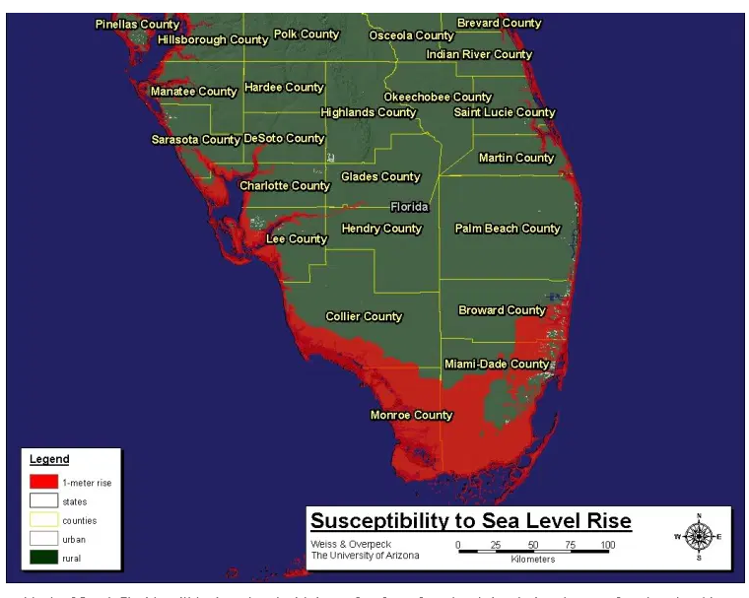
Map U. of Arizona

Slide 28
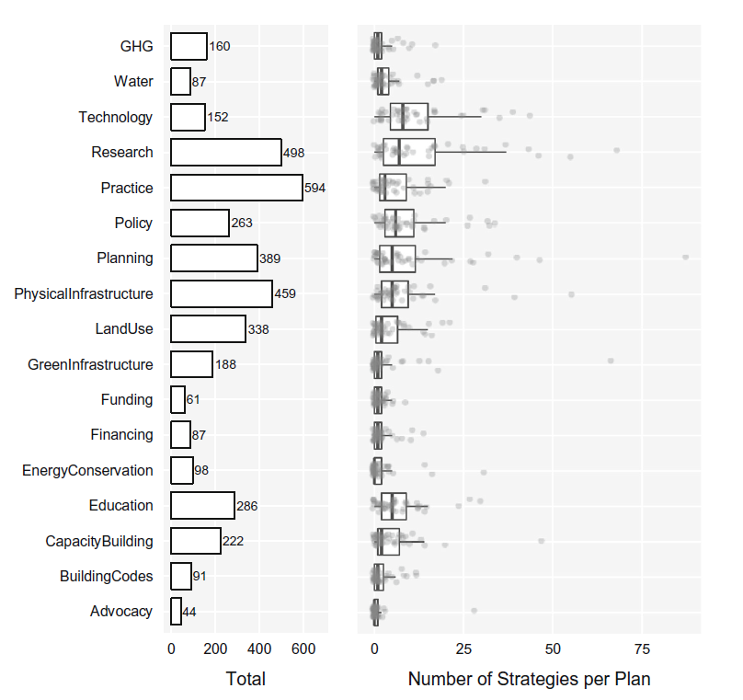

Slide 29
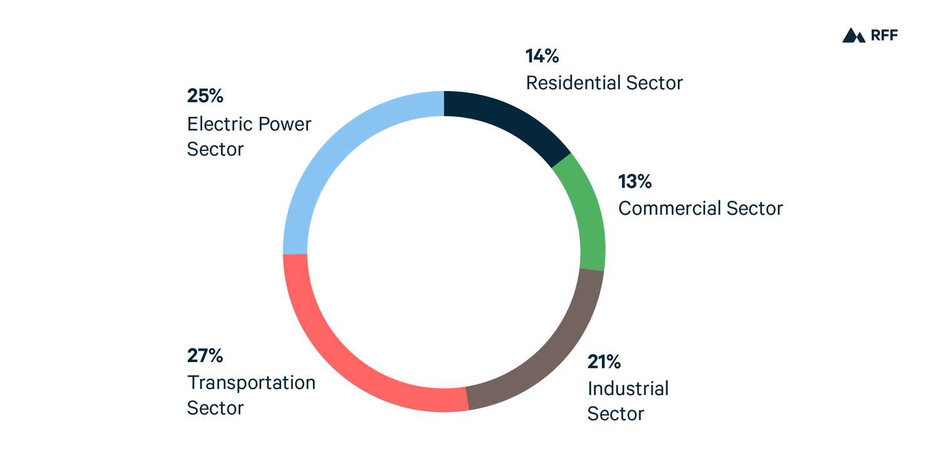
My Vote: Carbon Sin Tax
Carbon pricing: Charge emitters for the carbon dioxide (CO₂)
Generate revenue
  Discourage GHG emission
  Encourage conservation
  Generate funds
  Nobody asked but this is
  how I’d spend the money:
    Plastic regulation/recycling
    Education in climate change
    Universal healthcare
2018 United States Carbon Dioxide Emissions from Energy Consumption by Sector
https://www.rff.org/publications/explainers/carbon-pricing-101/
Notes:
If you don’t like something, tax it.
Sin tax: cigarettes and alcohol
Tax of gasoline over $4 per gallon, people use less gasoline.
American “allergic” to tax.
Not well received 56%. Money went to high-income family,
It worked for many countries
Canada: BC. 2008. B.C. used the revenues to cut income taxes and, more recently, to cut health premiums and invest in green technologies. It has some of the lowest income tax rates in Canada.
reduced the use of gasoline and natural gas by seven per cent per person. Nearly all is produced by hydro and biomass
2. NE US In 2009, 11 states, including New York and Massachusetts, worked together to put a price on carbon. They used the other type of carbon pricing: cap-and-trade. Their system is known as RGGI (Regional Greenhouse Gas Initiative), or “Reggi
Eleven states that are home to over a quarter of the U.S. population and account for a third of U.S. GDP have active carbon-pricing programs and are successfully reducing emissions. Those states are California and the ten Northeast states — Connecticut, Delaware, Maine, Maryland, Massachusetts, New Hampshire, New Jersey, New York, Rhode Island, and Vermont — that make up the Regional Greenhouse Gas Initiative (RGGI). RGGI is the first mandatory cap-and-trade program in the United States to limit carbon dioxide emissions from the power sector.
3. Sweden: Sweden has had a carbon tax since 1991. It started at €25 per tonne of greenhouse gases and is now €120 per tonne, the highest carbon tax in the world. Since implementing carbon pricing, Sweden’s economy has grown well above the European average.
Businesses and homes started using less coal, gas and oil for heating, and started using biofuels instead. Sweden has reduced its greenhouse gas emissions by 25 per cent since 1995.
https://www.nationalobserver.com/2019/07/22/opinion/six-places-where-carbon-pricing-working
Cap and trade vs carbon tax
https://www.brookings.edu/blog/planetpolicy/2014/08/12/pricing-carbon-a-carbon-tax-or-cap-and-trade/

Slide 30
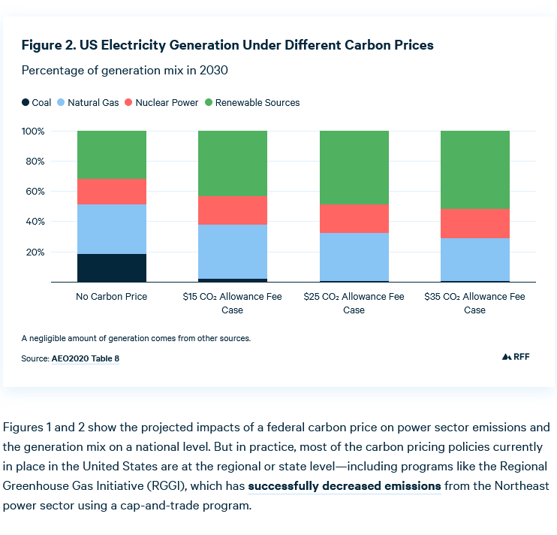

Slide 31
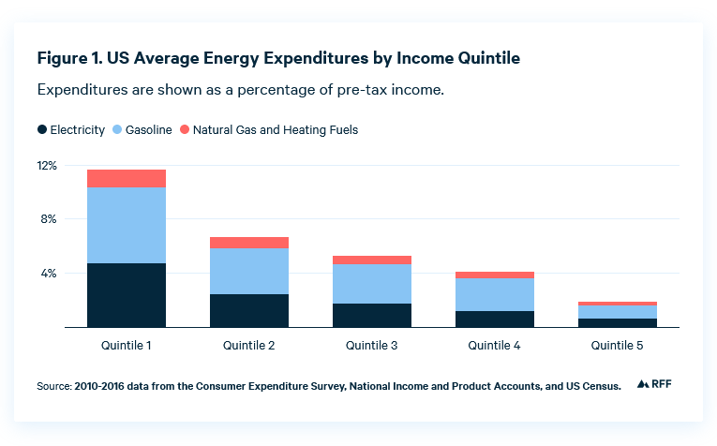
Utility takes higher percentage of income in low-income family.
Notes:
The amount of energy a household consumes directly or indirectly is associated with income. Higher income households tend to consume more of everything, including energy, so they would likely see a greater increase in expenditures. However, low-income households may be more vulnerable to changes in energy prices; although low-income households consume less energy, it accounts for a larger share of their budgets (Figure 1). Consequently, it would at first appear that carbon pricing would be regressive, because the costs to low-income households would represent a greater share of their income.

Slide 32
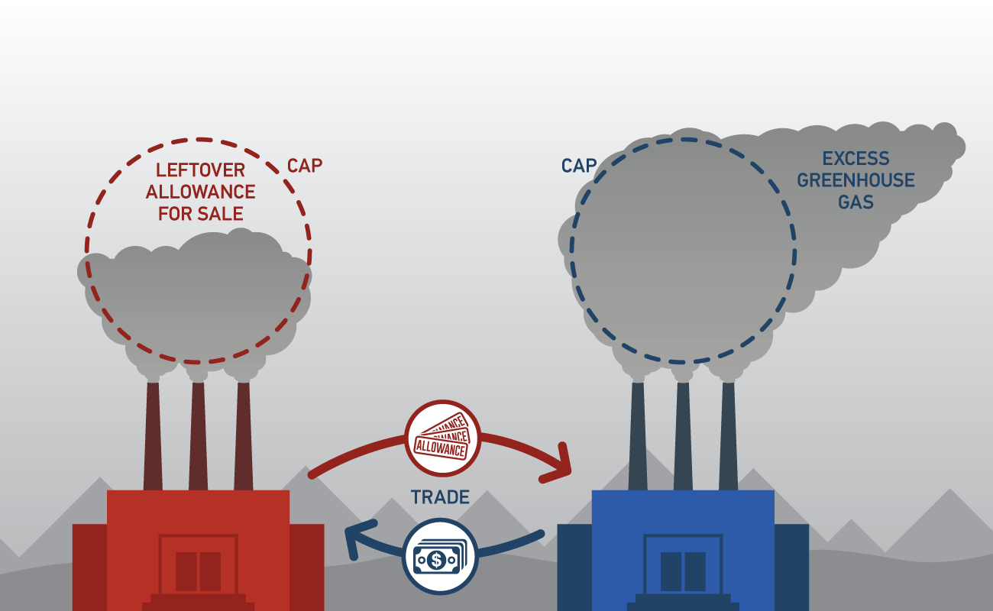
Carbon Cap-and-Trade
Notes:
Trade and Cap: market driven. 11 states: California and East coast, Midwest. states of Connecticut, Delaware, Maine, Maryland, Massachusetts, New Hampshire, New Jersey, New York, Rhode Island, Vermont, and Virginia
30% reduction by 2030
Pronounce: Reggie
Save billions for consumer
M50% dec in CO2
Half comes from clean or renewable energy sources
Saved hundreds of lives, thousands of asthma attacks. Columbia: reduce asthma, premature births. Low birth rate
Save hundred of millions in energy
Create tens of thousands of jobs
https://www.rggi.org/auctions/auction-materials

Slide 33
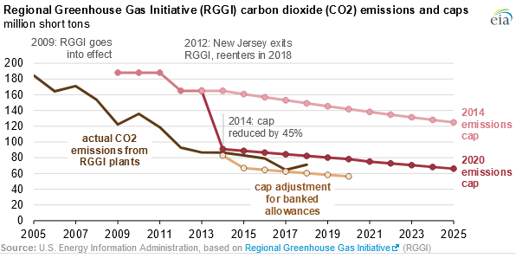
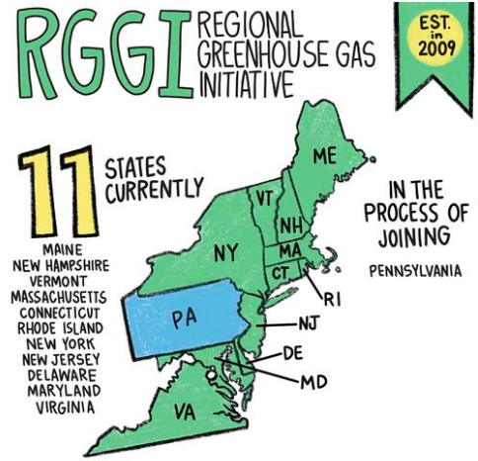
11 states
Initial 2009 cap higher than emission b/c projected CO2 inc
CO2 emissions down 50%
Net benefit: $4.7 billion, 40,000 jobs-years from 2009-2017
Funding: 50% energy efficiency, 19% bill assistance, 4% renewable energy
Health economic benefit of $5.7 billion
  Hundreds lives save
  Thousands fewer asthma hospitalization
  Lower rate pregnancy complications
RGGI: Congressional Research Service 2018
Notes:
RGGI: pollution down 50%, economy grows by 8%. 11 years old start 2009
https://www.eia.gov/todayinenergy/detail.php?id=42255
29states, 3U.S. territories, and the District of Columbia are implementing mandatory renewable portfolio standards, which generally require a specific percentage of electricity to be generated from renewable energy sources.2
https://fas.org/sgp/crs/misc/R41836.pdf
RGGI is a sector-specific cap-and-trade system that applies to carbon dioxide (CO2) emissions from electric power plants16with capacities to generate 25 megawatts or more17—165facilitiesin the nine RGGI states.
CO2emissionsaccount for approximately 99% of all GHG emissions from power plants.In 2014, emissions from the electricity power sector accounted for 28% of all U.S. GHG emissions.
Perhaps the most successful U.S. market-based program in the environmental policy arena is the sulfur dioxide emissions trading system (known as the Acid Rain Program) established by the1990 amendments to the Clean Air Act.24
energy efficiency (50%);•bill assistance (19%);•GHG abatement (7%);•renewable energy (4%);•state budget reduction (6%); and•administration (4%).44

Slide 34
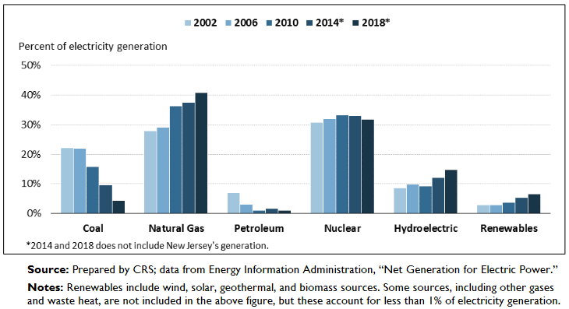
RGGI States Electricity Generation by Energy Source
Notes:
Note that the combination of the nine RGGI states and California CO2emissions (740 million metric tons) would rank above eighth, behind South Korea (Table 1).8
https://fas.org/sgp/crs/misc/R41836.pdf

Slide 35
Conclusion
Climate change can make a bad situation so much worse for the vulnerable population
Susceptibility for each individual/population is unique, complex, compounded
Carbon tax brings cost to pollution—done right—can help vulnerable population

Slide 36
References
https://health2016.globalchange.gov/low/ClimateHealth2016_FullReport_small.pdf

Slide 37
Resilience
Mitig Adapt Strateg Glob Change (2017) 22:1249–1279

Slide 38
Vulnerable population
https://health2016.globalchange.gov/low/ClimateHealth2016_FullReport_small.pdf (p. 247-264)
https://www.nytimes.com/2021/02/13/opinion/sunday/working-class-dignity.html?referringSource=articleShare (help lumber, eat an owl; NYT opinion piece on homeless)

Slide 39
Elderly
https://agingconnected.org/report/
https://www.nytimes.com/2021/02/28/technology/seniors-vaccines-technology.html?action=click&module=Top%20Stories&pgtype=Homepage

Slide 40
Maternal-fetal Virus Transmission
https://www.cdc.gov/pregnancy/zika/data/index.html
https://www.ncbi.nlm.nih.gov/pmc/articles/PMC5214529/#R64
https://www.ncbi.nlm.nih.gov/pmc/articles/PMC7469740/

