Slide 1

The Room Where It Happens:
Economics’ Predictions for Climate Change
MPHP 441 Climate Change and Health
April 21, 2021
Mark E. Stewart, Ph.D.

Slide 2

Three People Walk into a Room…
Who? Electric company president, a US senator, and a scientist
What? Committing to a new electric power plant
  A plant built now, will likely be running in 2040
Can they consider wind power? Solar power?
Why not keep existing plants?
What will government subsidize or tax?
Risks? Technology, government policy, …
Secret Sauce: LCOE Levelized Cost of Energy,
  Estimate of life cycle cost of electricity
  Cost of equipment, capital, operation & maintenance, fuel…

Slide 3
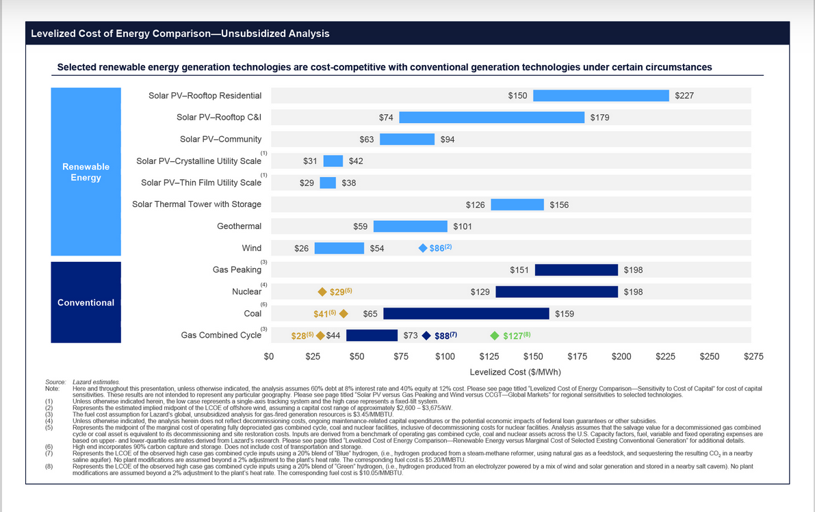
Profitable
Not Profitable
Profit
$2/MWh on 680MW plant up to a $million/month
Offshore
Wind
Hydroelectric
$38
$65
Cost of
Running
Existing
Plants
(Marginal)
Cost of Building
a New Plant
Better←→Worse
High Tech
Natural Gas
to Electricity
Commercial rate 4.79¢/kWh $48
Lazard Levelized Cost of Energy V14.0 2020

Slide 4

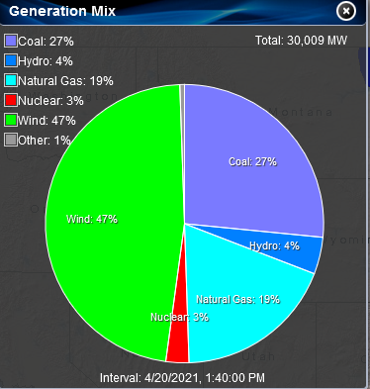

US– Annual Average Wind Speed at 100 m
SPP (Southwest Power Pool)
Generation Mix
m/s

Slide 5

Average WindSpeed—Global Wind Atlas
10+ m/s
<6 m/s

Slide 6
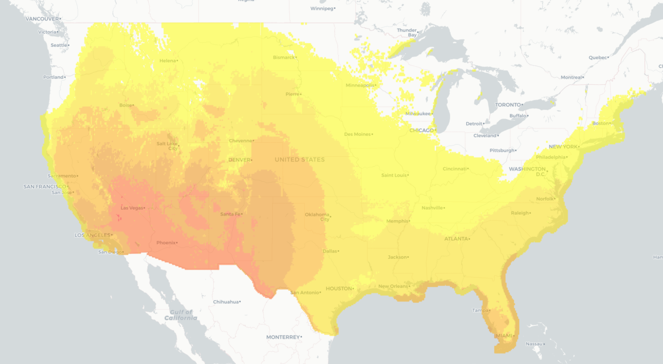
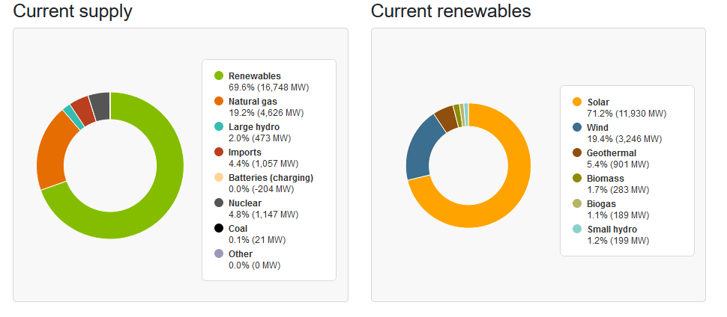
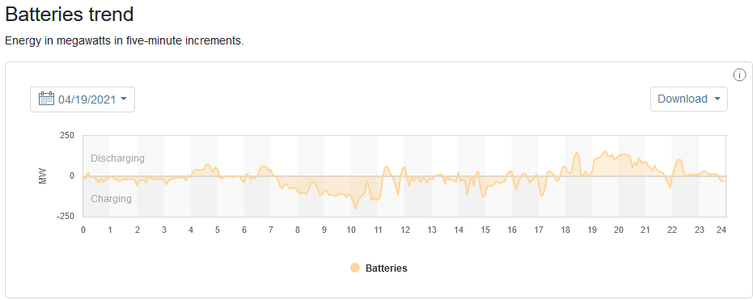

US – Solar Photovoltaic Potential
California ISO April 20, 9:40 PST
California ISO April 19, 2021
kWh/m²/Day

Slide 7
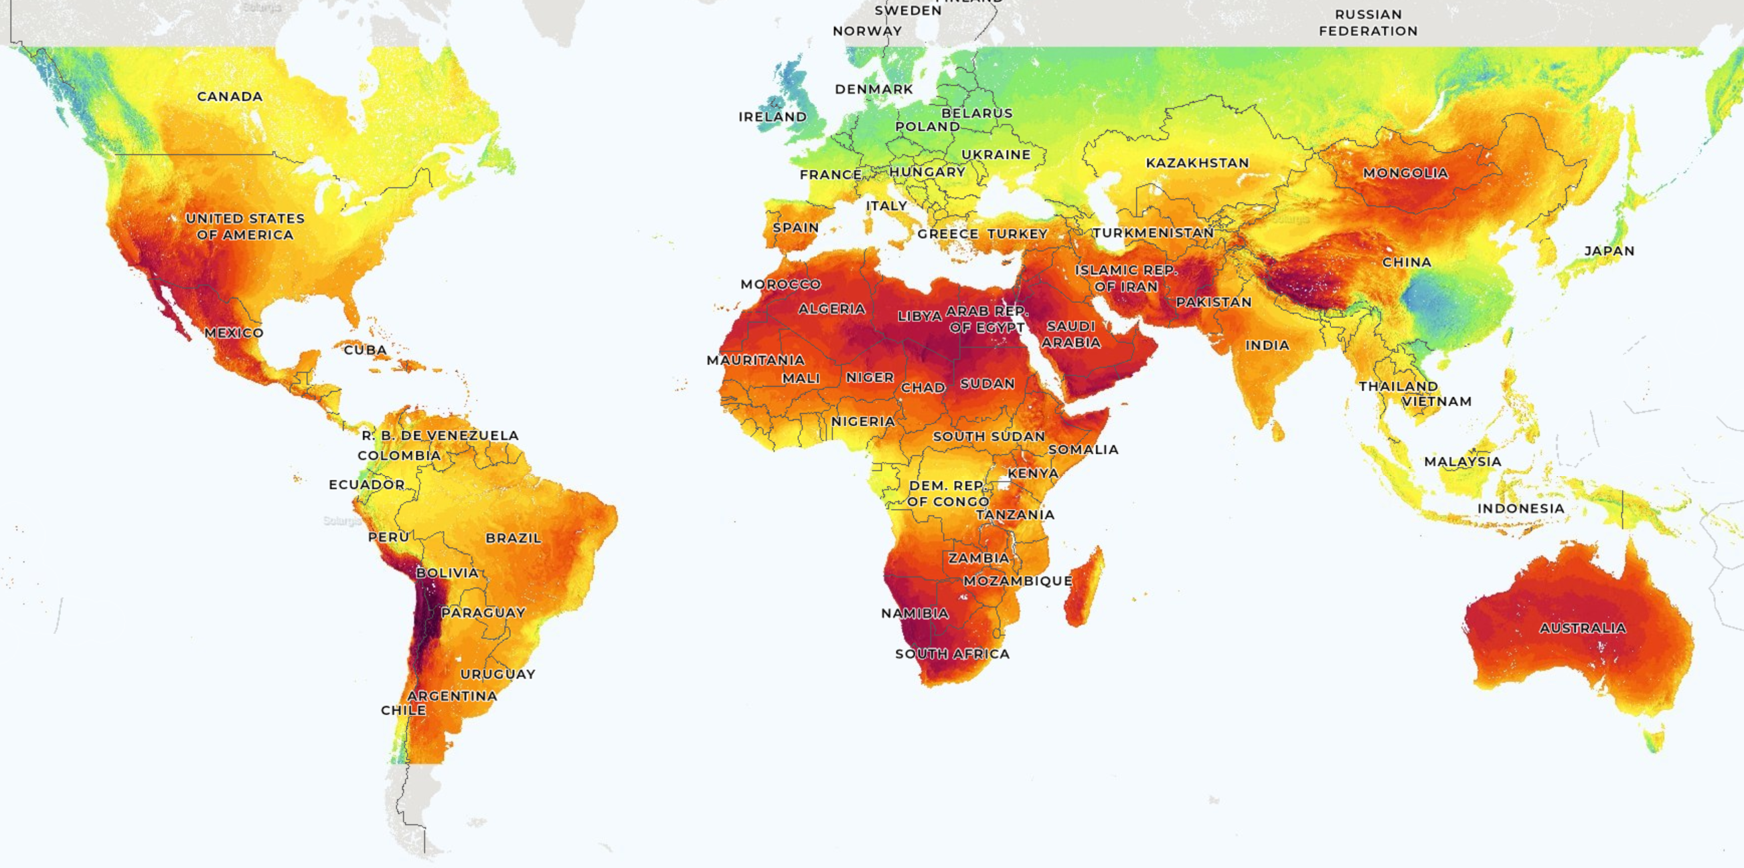
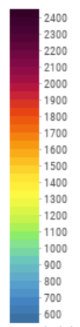
World – Solar Photovoltaic Potential
kWh/kWp

Slide 8
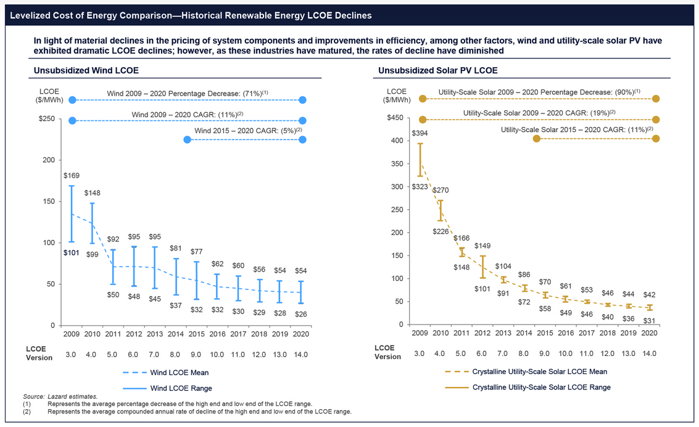
Lazard Levelized Cost of Energy V14.0 2020

Slide 9
Profitable
Not Profitable
$24
Hydroelectric
$38
$65
$9
$62
$86
$165
$20-40/Ton Carbon Tax
$37
$53
$92
$20-40/Ton Carbon Tax
Commercial rate 4.79¢/kWh $48
Lazard Levelized Cost of Energy V14.0 2020

Slide 10


Slide 11
Conclusions…
Economics helps predict the progression of climate change
Government policy can hasten these changes

Slide 12
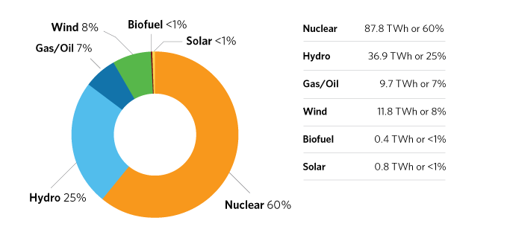
Ontario ISO Year 2020 Output

Slide 13
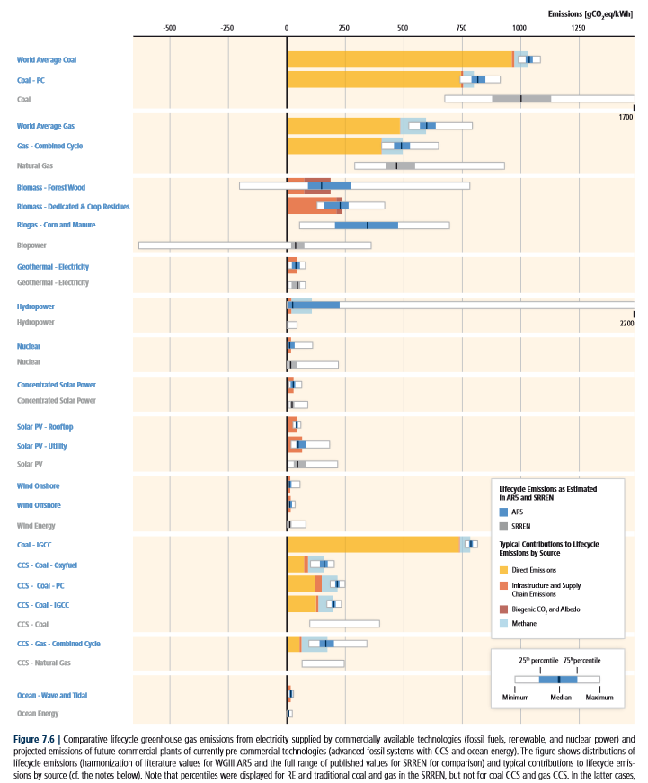
World Coal: 50X
1000 gCO₂eq/kWh
World Gas: 25X
500
Nuclear: 1X
Solar PV: 3X
50
Wind: 1X
15
IPCC AR5 WG3 chap. 7, p. 539

