Slide 1

So, Is our goose (civilization) cooked?

Slide 2
What is the Green New Deal and how would it work?
Pat Murray, MD, MS
Dept of Physical Medicine and Rehabilitation

Slide 3
Questions to be able to intelligently discuss after this talk
What is a carbon budget and how does it set the end line at mid-century (~2005)?
What are the components of the Green New Deal?
Is the Green New Deal technically feasible?
Can we afford the Green New Deal?
What are the easy parts of the Green New Deal?
What are the hard parts of the Green New Deal?
What role can we play in avoiding catastrophic climate change?

Slide 4
What is a carbon budget?
Actually a bit of a misnomer
Usually think about budgets annually.
But in this situation there is a finite amount total dose of green house gas (GNG) that the world can tolerate while maintaining its temperature.
The natural elimination rate of CO2 is very slow
Think about a chemotherapy drug like adriamycin that has a maximum cumulative lifetime dose
The total dose of CO2 is dependent on what temperature rise that is tolerable
Most scientists now think that 1.5 degrees C is the most we can tolerate.

Slide 5
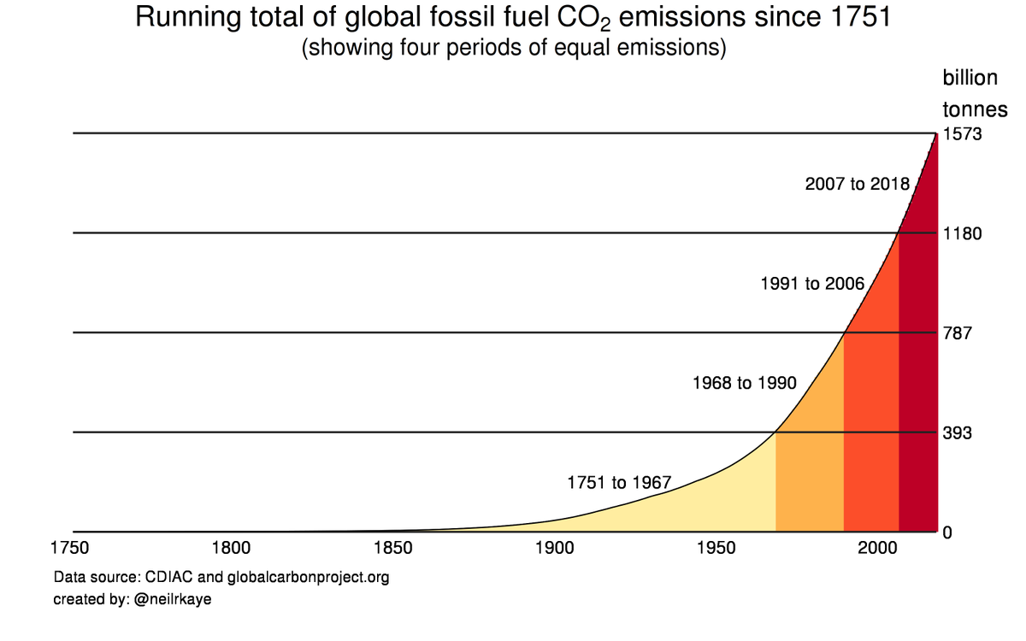

Slide 6
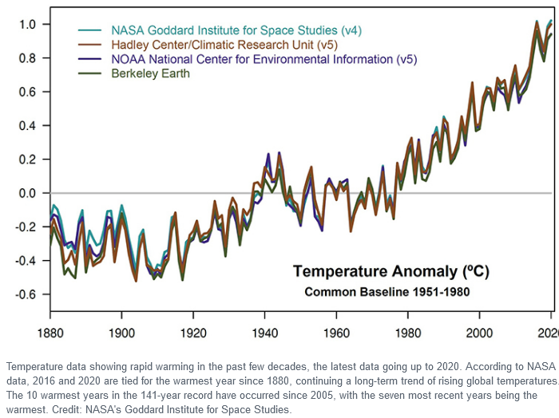
Where are we on the road to 1.5 Degrees C?

Slide 7
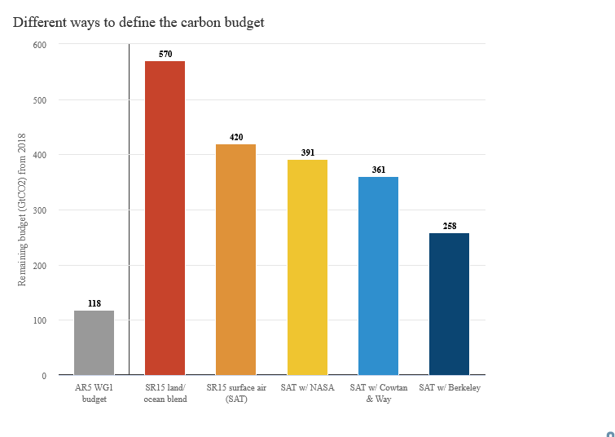

Slide 8
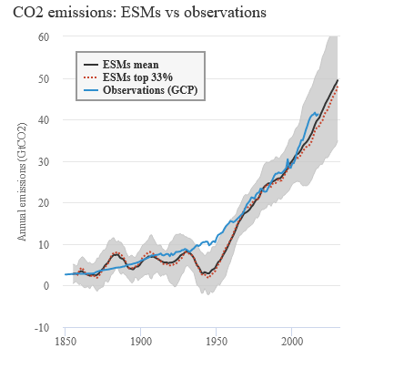

Slide 9
The most largest (most optimistic) estimate of cumulative carbon is 2300 gigatons (We are at about 1650 now)
At 45 gigatons per year, we will reach our Maximum cumulative dose in 13 years if we continue with business as usual (BAU).
If we spread the carbon budget over 29 years then we need to decrease carbon emissions about 6% each year to reach this goal
If we set 6% as the target for decline, we have 11 years to cut global GHG emissions by half

Slide 10
The magnitude and the urgency of the change that caused the Green New Deal to be proposed
What the resolution proposed:
Appointment of a Select Committee to develop a plan for a Green New Deal and draft legislation for a national 10-year mobilization
There was nothing in it about hamburger or air travel!

Slide 11
Five Goals of the Green New Deal
Achieve net-zero greenhouse gas emissions through a fair and just transition for all communities and workers;
Create millions of good, high-wage jobs
Invest in the infrastructure and industry of the United States
Sustainable environment for all;
Promote justice and equity in historically oppressed frontline and vulnerable communities.

Slide 12
Focus today: high level view technical aspects of reaching goal one: net zero greenhouse gas emissions by 2050
Five Pillars of Decarbonization
Zero carbon electricity and doubling of electricity production
  Doubling is probably a significant underestimate
Electrification of end uses
Green synthetic fuels
Smart grid creation implementation
Energy and Material efficiency
Sixth Issue: Agriculture

Slide 13
Getting to zero carbon electricity is pretty easy
Capital cost of new infrastructure for wind, solar--
Levelized costs are now the same as fossil fuels
(Unaddressed issue is obsolete capital investment in fossil fuels infrastructure)
Intermittency of the renewables and limited dispatchability
Energy storage (batteries, hydrogen, and pumped storage)
Grid expansion and diversification

Slide 14
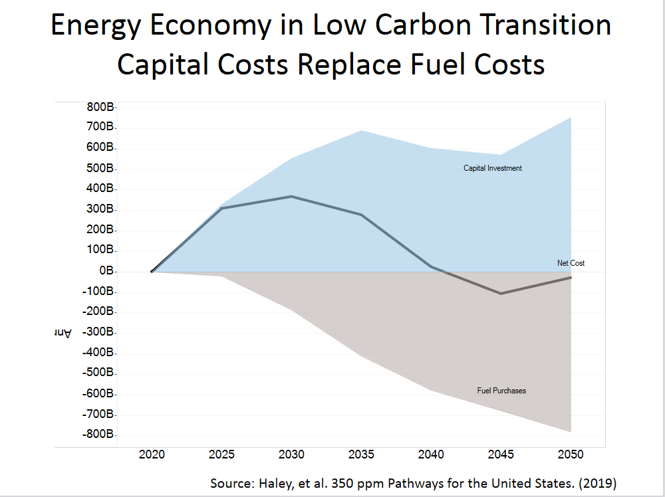

Slide 15
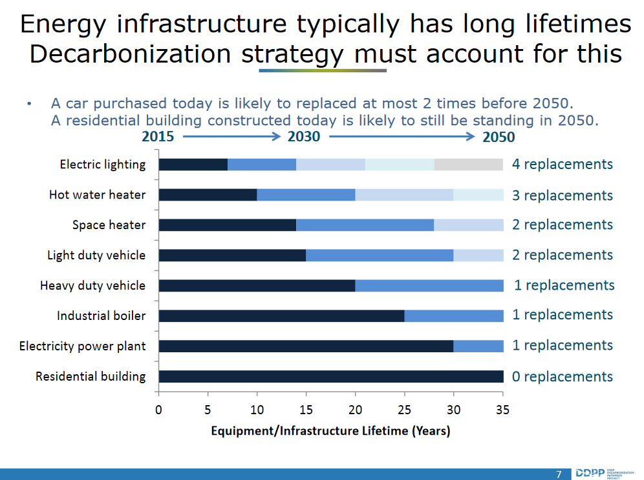

Slide 16
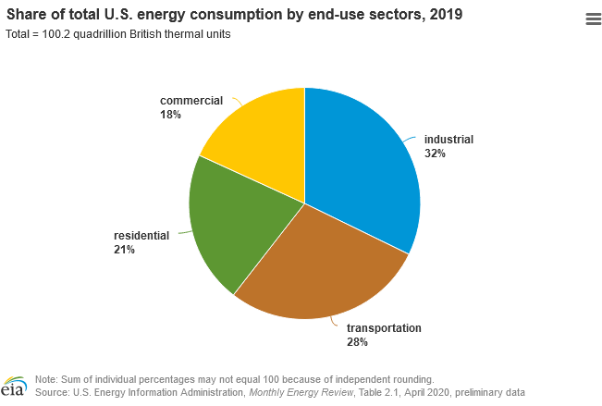
How energy use is divided by sector today

Slide 17
2nd pillar is electrification of end use
Some of these sectors are relatively easy and not requiring a lot of new capital expense
Personal and Local transportation: EVs and charging stations
Heating and cooling of new residential properties: Heat pumps
New commercial buildings: Heat pumps
Industrial
Light manufacturing
Much of agricultural production

Slide 18
Some sectors are technically not hard, but expensive
Relatively hard or costly
Retrofitting existing residential properties
Retrofitting existing commercial facilities
Primary issue is heating as old buildings are expensive to upgrade
Energy efficiency
Heat production
Large investment by owner

Slide 19
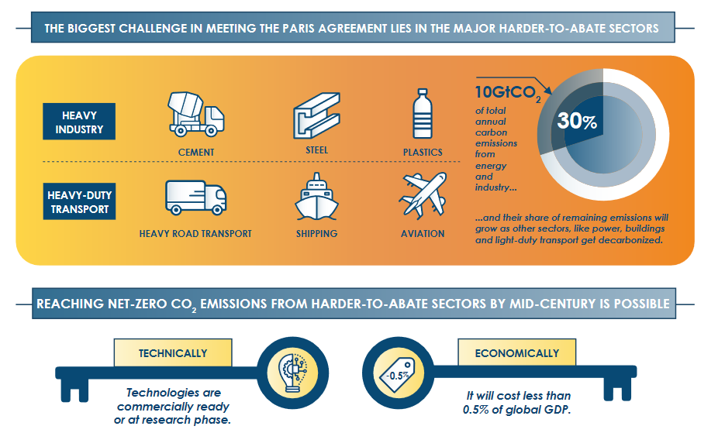

Slide 20
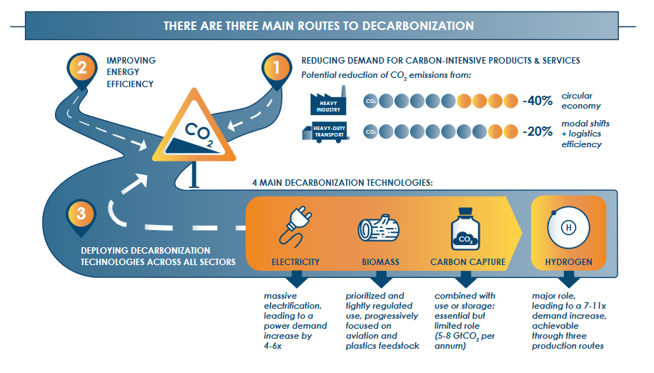

Slide 21
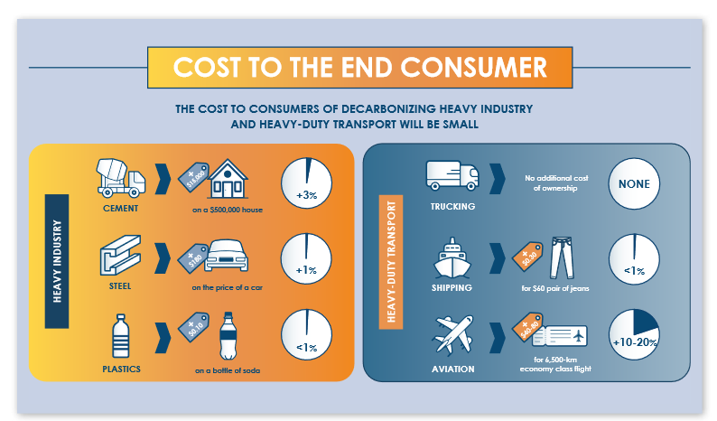

Slide 22
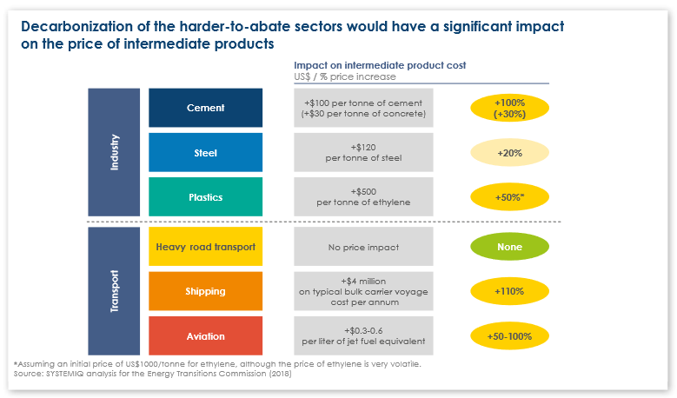

Slide 23
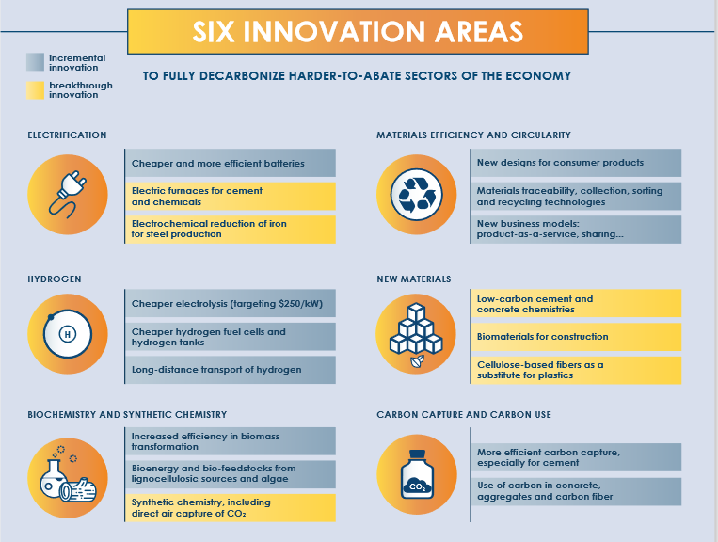

Slide 24
Timeline of the change will influence the cost of the transition
How to deal fairly with capital investments made now obsolete property
Least-cost solution in each case is to retire the existing capital at the end of its normal life

Slide 25
National Policy Framework
Timelines for phasing out fossil fuel–related capital stocks
  Natural gas, coal, and oil
R&D outlays for the hard technologies
  Focused on plastics, cement, steel
  Aviation, ocean shipping
  Carbon sequestration
Public investments
  Interstate transmission of electricity, charging stations, catenary lines
  government fleets and buildings, and other public infrastructure
Financing for a fair transition for those displaced
  Job retraining, income supplements, regional development
Public financing for building retrofits
  Housing
  Industry

Slide 26
Up for discussion
Allocations of responsibilities among federal, state, and local governments
Carbon pricing, including carbon taxes, feed-in tariffs
How to incentivize/pay for transition
  Carbon price management (tax carbon or incentivize carbon free alternatives)
    For difficult sectors where solutions aren’t clear
    Phase in carbon pricing on future costs to avoid social disruption
  Manage quantities
    For sectors where solutions are clear and already cost effective, e.g., Electric cars, new building standards for heating, cooking

Slide 27
Some caveats
I have talked today as though all greenhouse gases are carbon dioxide
They aren’t-- methane, nitrous oxide, and refrigerants are important and management of these is needed as well.
I have not discussed the carbon impact of our present food system
What most scientists suggest is that after we reach these goals we begin a period of development where we drawdown greenhouse gases. There is an excellent book on this topic, called Drawdown, edited by Paul Hawken that points the path to do this. Good place to learn about food issues among other things.

Slide 28
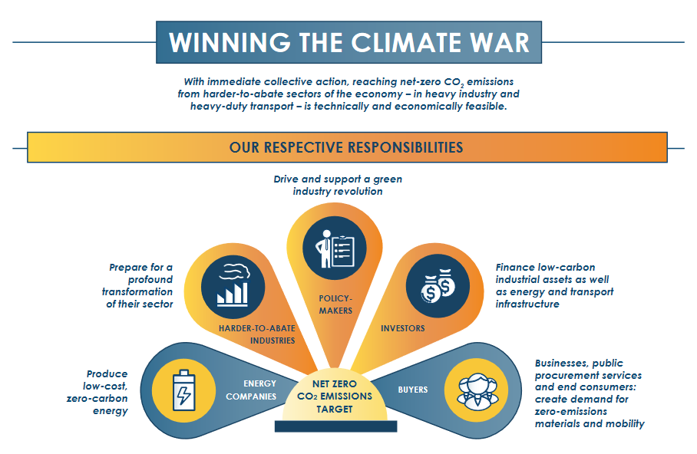

Slide 29
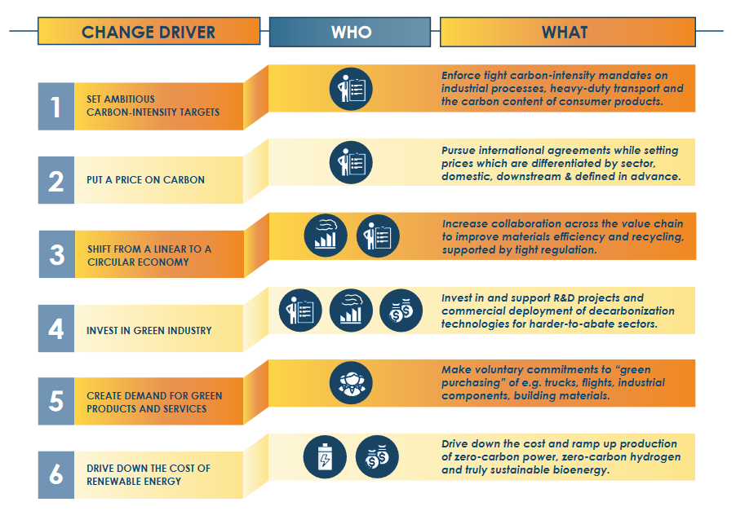

Slide 30
The problem is primarily political
How to sell these ideas to the American people?
Things to avoid--
Emphasis on raising taxes (carbon)
Emphasis on personal sacrifice
Things to emphasize
Benefits to all (Interstate highway example)
Emphasize concrete plans and their method of implementation
Importance for the nation and future generations

Slide 31
Every congressman, indeed every voter, should have a specific idea of what a Green New Deal would mean for their district and region. Without such a plan, climate activists will continue to win the battle over climate science but still lose the war over climate action.

