Slide 1
Communicating with the Public About Climate Change and Health
Diana Pi, MD

Slide 2
Outline
Dissect the psychology of a doubter
Protect your own sanity
Communicate concerns and solutions
Exercise
Notes:
20% Americans don’t believe human activities cause climate change (PEW 2019). Those who do, many don’t do much about it. My goal: Simple ways to communicate problem and, more importantly, the solutions. It’s important to protect you from frustration, endanger relationship, burnt out. Know what work and don’t.

Slide 3
Outline
Dissecting the psychology of a doubter

Slide 4
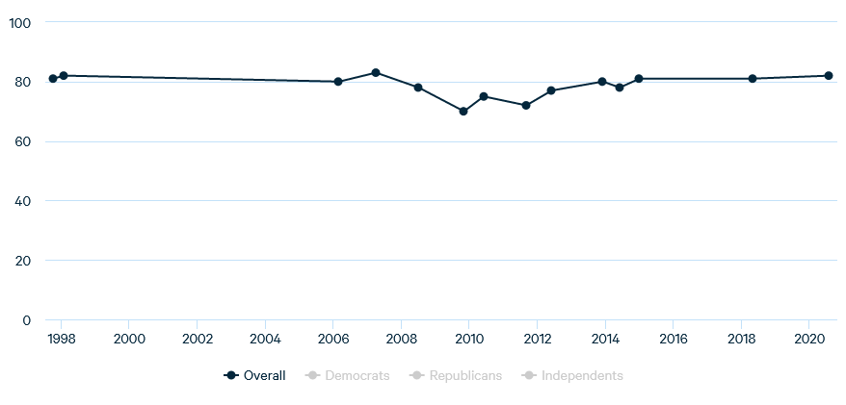
Percentage of Americans who believe human action has least partly caused global warming
https://www.rff.org/publications/reports/climateinsights2020/
Notes:
Number is static. Two ways to look at it: Lack of better public information. Survive bipartisan politics

Slide 5
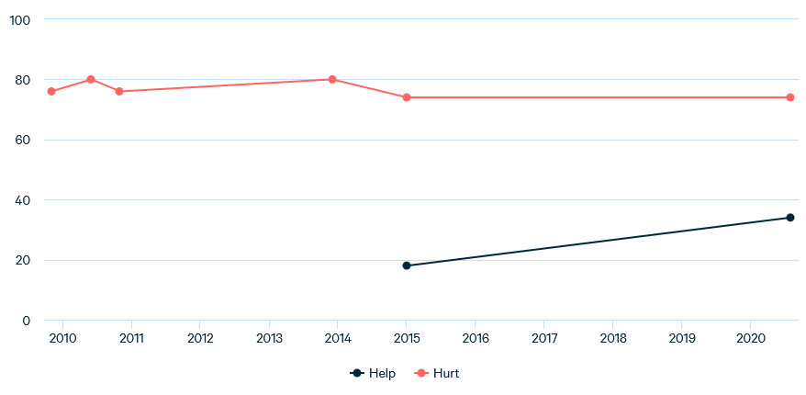
Percentage of Americans who believe global warming will hurt or help future generations
https://www.rff.org/publications/reports/climateinsights2020/

Slide 6
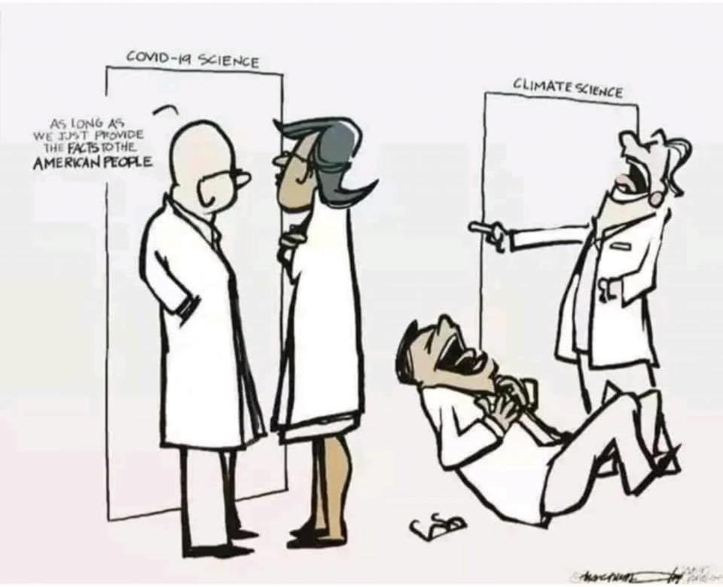

Slide 7
Why don’t you believe in climate change?
Science illiteracy
  In 2015 assessment of 11,000 12th-graders
    22% proficient or better in science
    40% below basic knowledge
  9,654 US adults who believe COVID-19 is planted
    15% with some postgraduate training
    48% with high school education or less
Facts don’t always work
  4 out 6 don’t accept
https://www.pbs.org/video/its-okay-be-smart-climate-science/

Slide 8
Why don’t you believe in climate change?
Media hyperbole numbness
  Framing: Apocalypse
  Intense helplessness, uncertainty, high cost
Inconsistent message
  “97% scientists” in agreement
  Nuance in scientific error is lost
Optimism bias
  Bad things only happen to other people
Notes:
Hyperbole numbness, a later slide. Inconsistent message: No masks in the beginning of COVID-19 pandemic, than masks. Fauci on increasing herd immunity. Many blames him for manipulating data. “When polls said only about half of all Americans would take a vaccine, I was saying herd immunity would take 70 to 75 percent,” Fauci, who turned 80 on Thursday, told the Times. “Then, when newer surveys said 60 percent or more would take it, I thought, ‘I can nudge this up a bit,’ so I went to 80, 85.’”
Optimism bias: hurricane will not hit here.

Slide 9
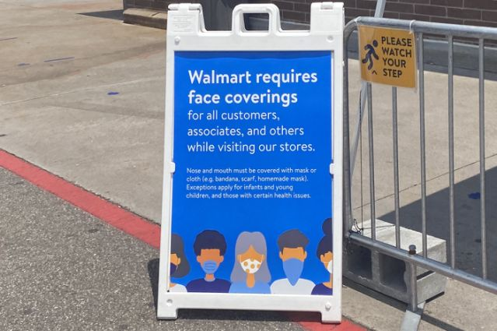

Notes:
Monday, Oct 5, Donald Trump leaves Walter Reed after 3-day hospitalization, still contagious. Monday, July 20, Walmart mandated face mask wearing. “No mask, no service.” Flurry of stores followed.

Slide 10
Why don’t you believe in climate change?
Political party
  Strongest predictor
  Conservatism has been linked through neuroscience to correlate with increased need to “to reduce uncertainty, ambiguity, threat, and disgust”
  Accept (or reject) views of people who you believe (or disbelieve)
Demographics
  Inclined toward hierarchy
  Against changes to the status quo
  “Smart idiot” effect: Conservatives with higher education and general scientific knowledge are often more wrong about climate change
  Sex and income have a smaller effect
Sunken Cost
  Conflicting aspiration, goals
    Ex: People whose livelihood depends on the oil industry
  Don’t rock the boat to our comfortable lifestyle
Notes:
Idiot effect: better-educated Republicans were more skeptical of modern climate science than their less educated brethren. Only 19 percent of college-educated Republicans agreed that the planet is warming due to human actions, versus 31 percent of non-college-educated Republicans. Opposite true for liberals by 23%. Messengers matter: Pope, church group, social group.

Slide 11
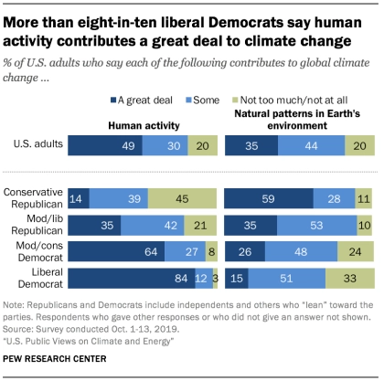
Political affiliation as a predictor
https://www.pewresearch.org/science/2019/11/25/u-s-public-views-on-climate-and-energy/ps_11-25-19_climate-energy-00-05/

Slide 12
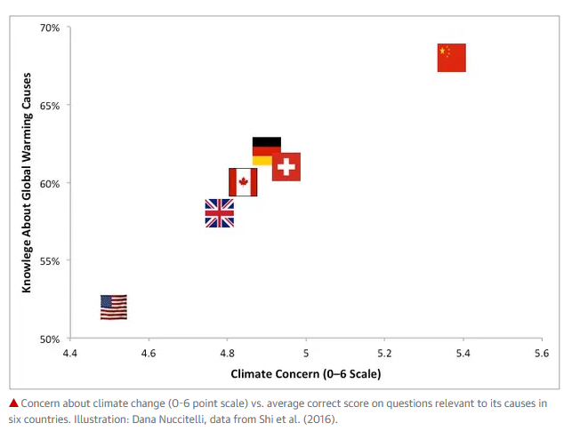
https://www.theguardian.com/environment/climate-consensus-97-per-cent/2016/may/04/scientists-are-figuring-out-the-keys-to-convincing-people-about-global-warming
Notes:
In Shi’s survey, the Chinese respondents had the most knowledge about the causes of global warming, with the German and Swiss participants most accurately answering the questions about its consequences. These nationalities also expressed the greatest concern about climate change. Americans showed the least climate knowledge and the least concern. The Chinese and Swiss participants were also the most altruistic (caring about the welfare of others), and the most concerned about environmental health. Americans cared least about the welfare of others and the environment.

Slide 13
Why don’t you believe in climate change?
Finish pool of worry
  Climate change low on the list of daily concerns
Stone-age mind
  Not good at thinking about the future and caring about what's happening outside of their bubble
    Respond better to PAIN (personal, abrupt, immoral/indecent, that impacts now).
    Climate change impact is slow, distant, in the future
    In an air-conditioned room, heat is an abstract
https://www.pbs.org/video/its-okay-be-smart-climate-science/
Notes:
Nice PBS video.

Slide 14
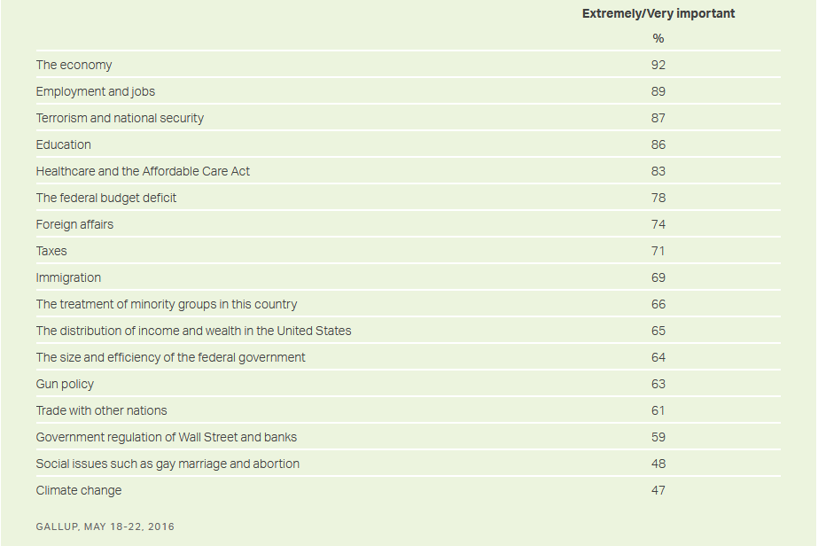
Importance of presidential issues

Slide 15
Psychology behind climate denial
Motivated interference
  We hold a specific bias to ignore evidence
  Ex: Livelihood depends on the oil/coal industry”
  Ex: Resent government takes our money and spend on carbon mitigation efforts
Confirmation bias
  The tendency for us to seek out information that affirms our beliefs and disregard information that goes against them
  Stubborn
    It's efficient and easy to be due to confirmation bias
Denial
  Primitive defense mechanism
  Refusing uncomfortable truths protects us
Enormity
  Problem too large to believe
  Human race faces extinction
https://www.psychologytoday.com/us/blog/denying-the-grave/201901/climate-change-denial
Notes:
To put in psychological terms.

Slide 16
Immaturity of the Society
We as scientists make mistakes.
Science will self-correct overtime.
General level of science knowledge is low.
Anti-elitism
  What does the expert know?
  Enable by social media: Everybody is an expert.
Political polarization: across all kinds of topics
  You’re with me or against me.
  Mask-wearing.
Lack of nuance in our society.
https://www.youtube.com/watch?v=tMtsWAFUhpY
Notes:
Conversation on COVID-19 with Nicholas Christakis, Yale Sterling Professor. Antimask-wearing is matter of control, mixed message in the beginning, has yet to see a family member to get COVID-19, make me look weak, violate my constitutional right. Political leaders not wearing one. Low level of science, knowledge in school, science is facts and number, binary; not a method of understanding the world (filled with uncertainty)

Slide 17
Rationalization
Why blame me? Climate change is natural. By sun, volcano.
Life will find a way.
It’s not that bad, takes another 15 years right?
Hotter? We just had a snowstorm.
Models are unreliable; not all scientists agree.
A hoax?
Limiting carbon emission halts progress, loses job, hurts economy.
What can I do?
Later...
https://www.hull.ac.uk/special/blog/why-people-still-believe-climate-change-is-fake-and-why-we-know-theyre-wrong

Slide 18
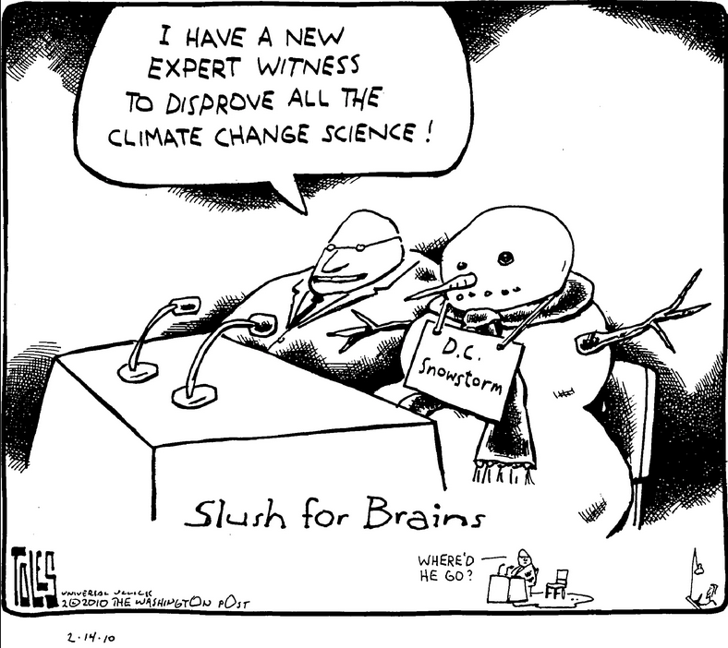

Slide 19
We believe what we want to believe

Slide 20
Outline
Dissecting the psychology of a doubter
Protect your own sanity

Slide 21
Pick your fight wisely
Roll with it when strong doubts are expressed,
Resist the impulse to convince
Confirm respect for their views. “I hear you.”
Conclude with your commitment to their health and mutual interest
Stick with simple messages that educate and empower
Need government action
https://www.acpjournals.org/doi/10.7326/M20-6443

Slide 22
Past the time for convincing…Change policy
“Climate change is a problem less of individual belief than of collective action. The most efficient route…lies not in convincing deniers to believe in climate change but in galvanizing those who already do.”
What should you do when your uncle calls climate change a liberal hoax over the Thanksgiving dinner table?
Estimate how many minutes you would likely invest in this “discussion.” Then — don’t…use the time to call your legislator or write a letter to the editor.
Better yet, mobilize a friend who already believes climate change is a problem. Set up an in- person meeting with their representative, join a protest or a local environmental nonprofit.
https://ensia.com/voices/climate-change-deniers/
Notes:
Laalitha Surapaneni an assistant professor in the General Internal Medicine Department at the University of Minnesota, talks about it’s past the time for convincing, It’s time to act.

Slide 23
Outline
Dissecting the psychology of a doubter
Protecting your own sanity
Communicating concerns and solutions

Slide 24
Numbers numb, stories sell
“Scientists need to tell their stories — stories about why they became scientists and what science has done and is doing for humanity. Remember, science is an abstract, intellectual process for most people. It is very hard for people to gain an emotional connection to science. That’s what narrative is for.”
https://archive.thinkprogress.org/numbers-numb-stories-sell-the-key-messaging-lesson-from-trump-s-win-c1bff0a79bea
Notes:
Ed Maibach, director of George Mason’s Center for Climate Change Communication, summed it up at a 2015 White House panel on climate communications. I agree to some degree. How good a story teller are you? And your listeners?

Slide 25
How to convince Uncle Ed?
Be calm, patient, respectful
Listen
  Goodall: While you’re talking, your opposite is thinking counter argument
    Grow trust
    Plant seed of doubt
  Understand whom you’re talking to.
  Moral Foundation Theory
    Liberals and conservatives prioritize different ethics, values
    Liberal: compassion, fairness and liberty
      Polar bear, deforestation
    Conservative: purity, loyalty and obedience to authority
      Environmental stewardship and respect for God’s creation
      Protecting the environment means obeying authority
      Values come from the ingroup
Notes:
Like Goodall’s (Chimp lady) message: Somebody don’t believe climate change. Take them to artic, sit them on ice and see how “quickly they vanish under the water.” She’s so damn calm and funny. I need to look like her at 86-7. Altruism improves longevity. Don’t spend time discredit source or shame them: “You’re wrong, uneducated, there’s a right/wrong way.” Correcting others may make them double down on their misconception.

Slide 26
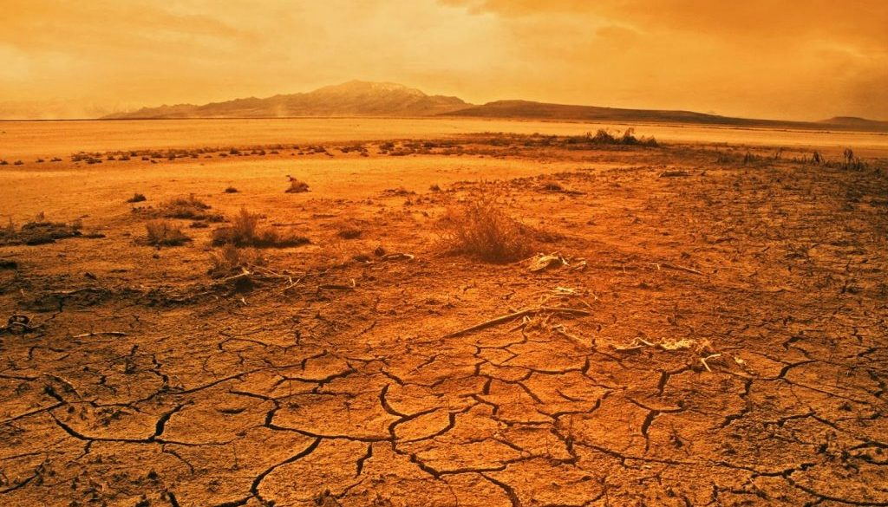
Facts overload: Pick your facts
2020 has been disastrous.
Hurricanes in the Atlantic are so numerous that there are not enough letters in the Latin alphabet to name them all. Fires in California torched more than 4 million acres, smashing the state’s record for land burned in a single season. In the first nine months of this year, at least 188 people have been killed in a record-tying 16 weather disasters that cost $1 billion or more. The nation now spends almost 10 times as much responding to and recovering from natural events as it did in the 1980s. And that’s just the United States. Don’t forget the bush fires in Australia, floods in Central Africa and the powerful Cyclone Amphan, which killed dozens of people in India and Bangladesh.
2020 has also been hot.
During one of the Northern Hemisphere’s warmest winters on record, the Great Lakes never froze, Russian officials in Moscow had to import fake snow for the holidays, and the fire season in parched California began months ahead of schedule. Temperatures soared in the Siberian Arctic, melting permafrost and fueling devastating, carbon-spewing fires. In Baghdad, where the mercury hit an unprecedented 125 degrees Fahrenheit in July, vegetation withered and metal door handles burned to the touch. Heat waves have smashed records from Phoenix to Hong Kong. Earth overall is on track to have its second-hottest year on record.
https://www.washingtonpost.com/climate-solutions/2020/10/22/climate-curious-disasters-climate-change/
Notes:
Facts are important, emphasis on risk also. But careful not to overwhelm.

Slide 27
Pick your facts
Projections less trusted
  By 2050, sea level will rise by 30 centimeters
  Livestock account for 36% of drought-related losses (crops account for 49%)
  An estimated additional 175 million people could have zinc deficiencies and an additional 122 million people could be protein deficient…
Distance may make climate change victim less relatable
  California wildfire
  Australia bushfire
Notes:
Stick to simple facts that are relevant.

Slide 28
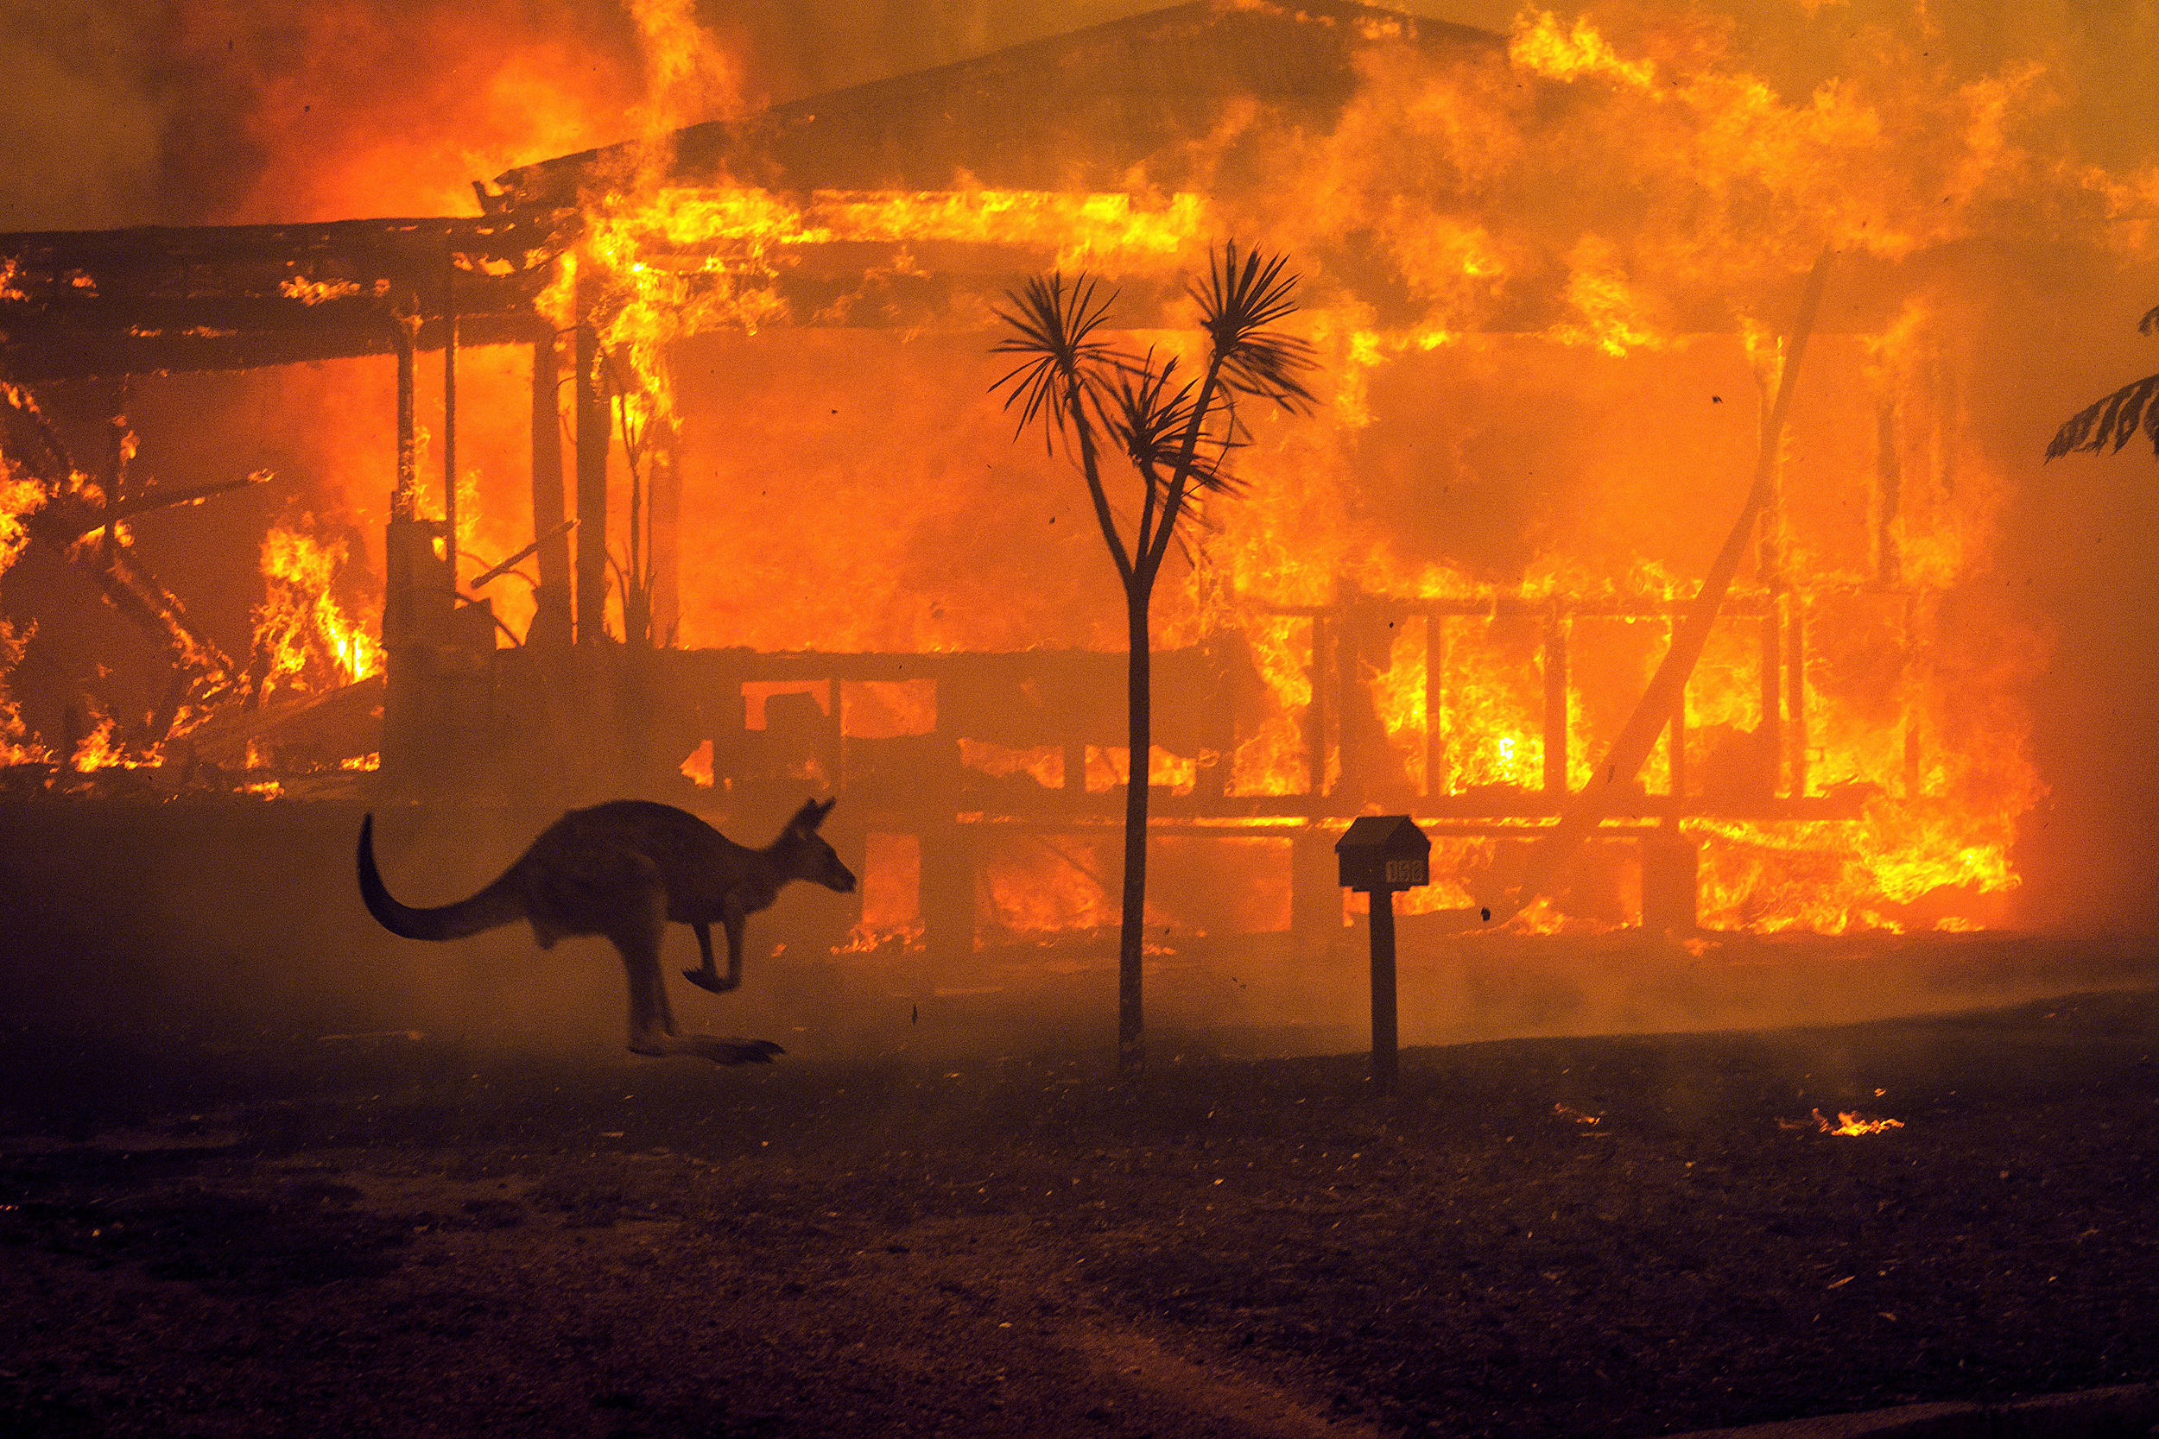
A kangaroo rushes past a burning house in Lake Conjola, Australia, on Dec. 31, 2019.

Slide 29
Share facts of public values, local interests
Pick facts from the past, local data
In Ohio: Warmer
  Longer growing season
  Inc CO2 may help growth in certain crops
  Increased ground-level ozone can damage crop
  Increase in vector-borne and tropical diseases
More precipitation
  More rain in spring, fall (less time to plant and harvest), winter
  More drought in summer (stunt plant growth)
  More 24-hr or multi-day rain: flash flood
  Warmer lake, severe storm runoff increase algae bloom
Notes:
Pick simple facts that are relevant. Example: Tell my patients who come in with pneumonia, prolonged cough to quit smoking. Arthritis to lose weight.

Slide 30
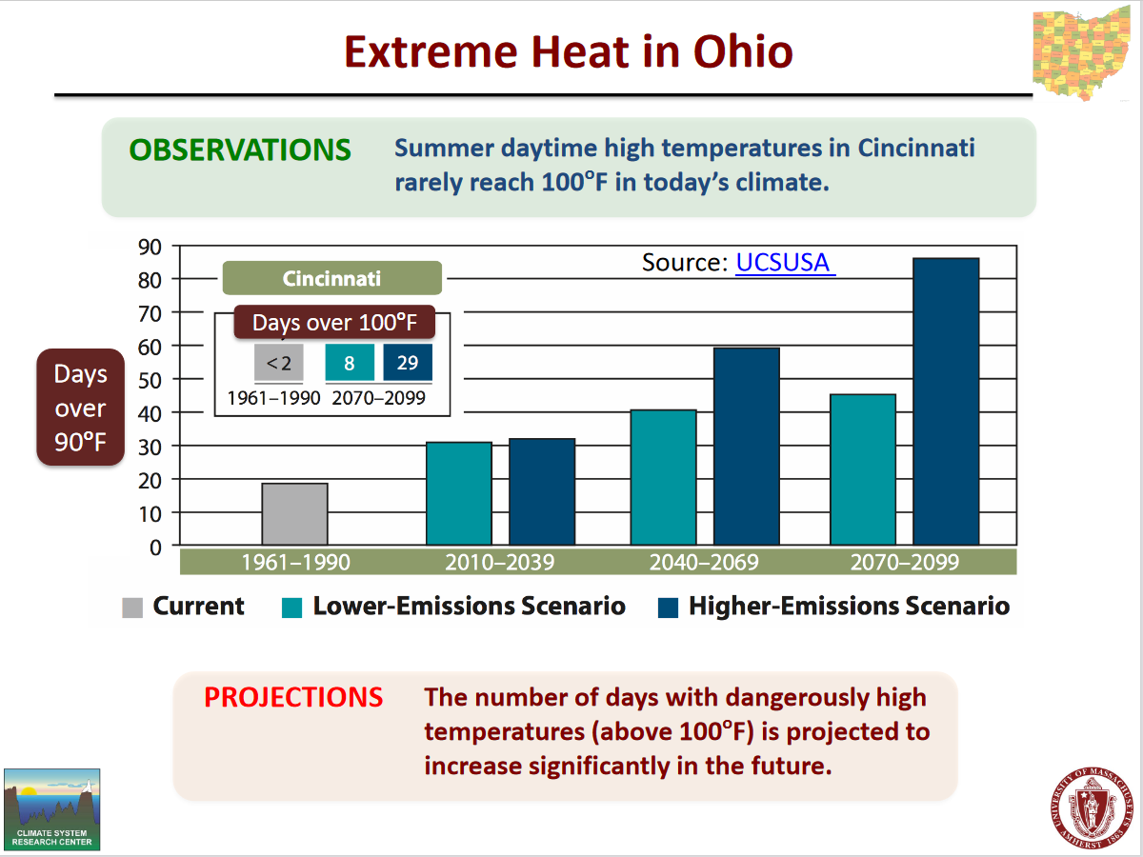
Notes:
Data from U Mass. Historically, there have been 17 days per year on average with a heat index above 90 degrees Fahrenheit, the worker safety threshold. This would increase to 60 days per year on average by midcentury and 93 by the century’s end. heat index above 100 degrees Fahrenheit. This would increase to 22 days per year on average by midcentury and 49 by the century’s end. Of the cities with a population of 50,000 or more in the state, Cincinnati, Dayton and Middletown would experience the highest frequency of these days.

Slide 31
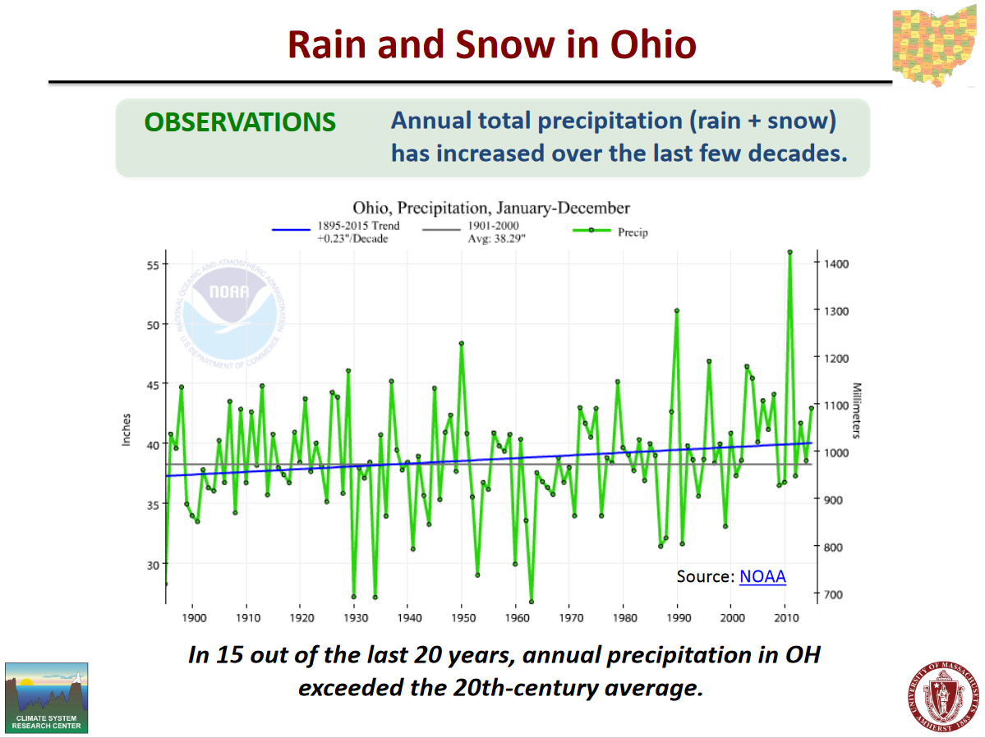

Slide 32
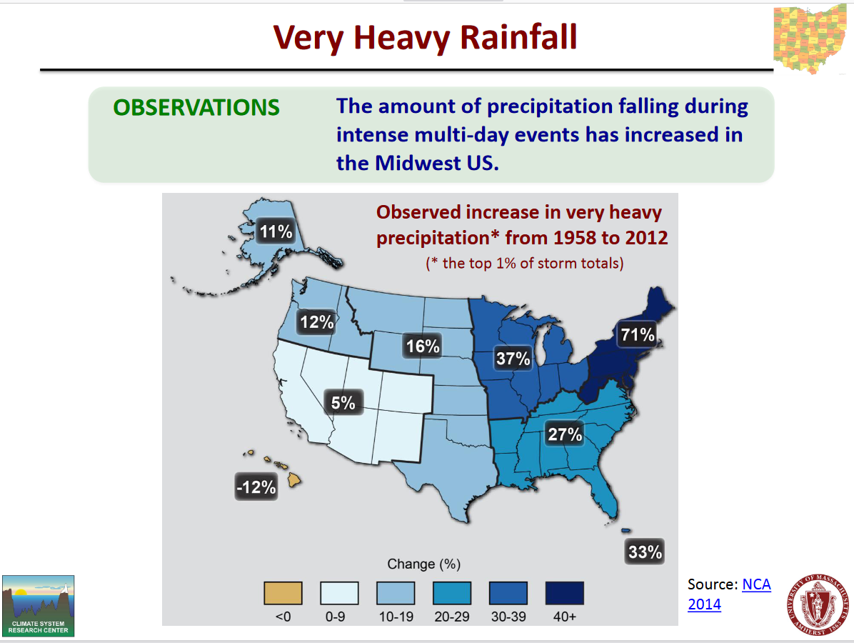

Slide 33
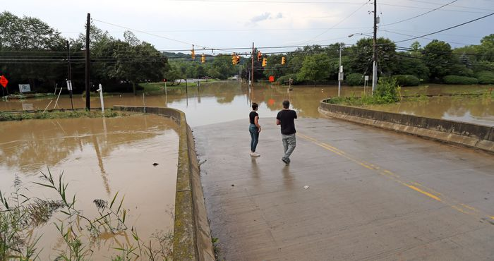
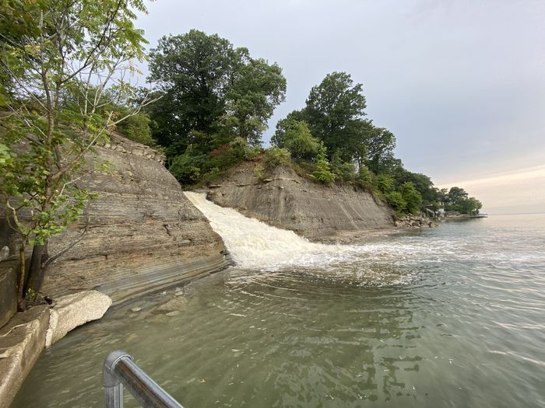
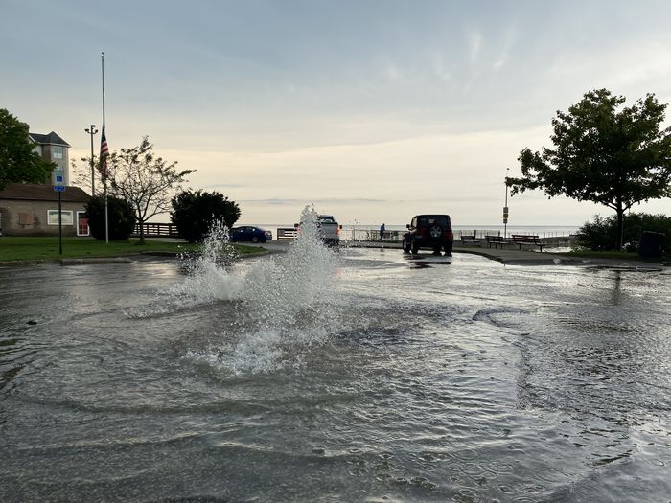
Columbia Road Beach in Rocky River
Flooded Canal Road in Valley View, September 17, 2020, Cleveland.com
Bradstreet’s Landing in Rocky River

Slide 34
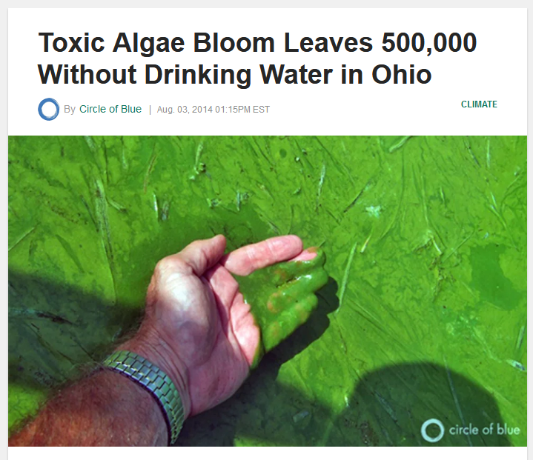

Slide 35
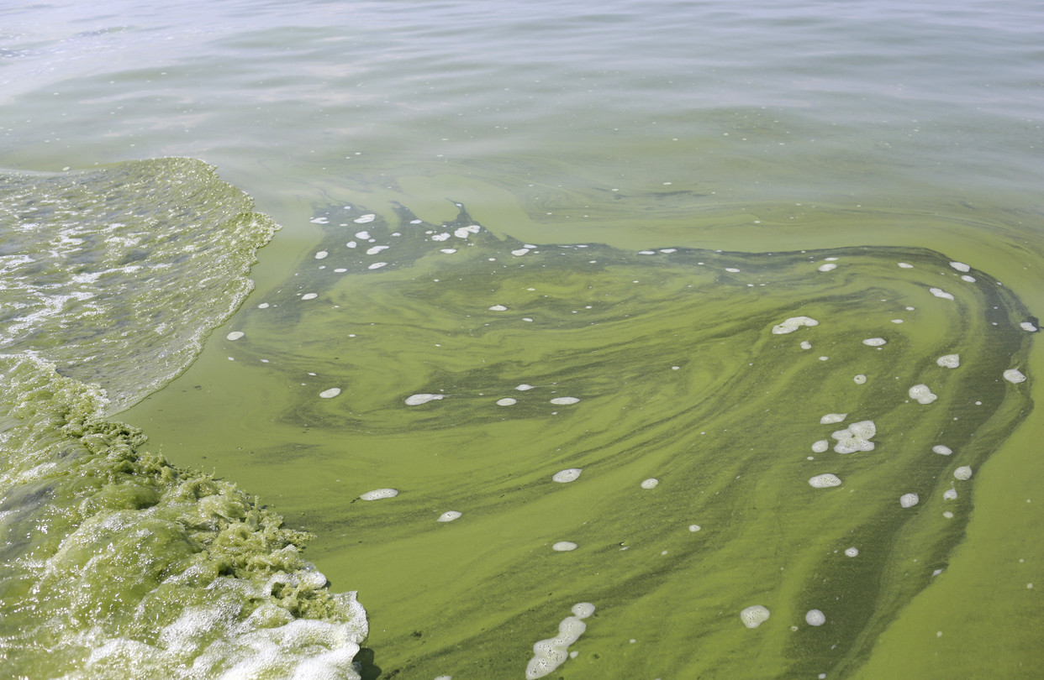
Notes:
The harmful blue-green algae feast on nutrients such as phosphorus and nitrogen, which have been entering Lake Erie en masse recently from farm runoff and sewage-treatment plants. The buildup causes algal blooms, and leads to water that can cause rashes, kidney and liver problems, as well as throw off the ecosystem. Biggest runoff is Maumee River. Done it 1960/70 before a big cleanup.

Slide 36
Solutions are sexy, saving, simple, and healthy
Take the bus/train, bike, walk to work one day a week (exercise)
Reduce red meat intake (healthier)
Eat peanuts instead of almonds (cheaper, similar protein/fiber content)
Buy phosphate-free detergent
Switching to LED (save $1000 over 10 yrs in an average household)
Solar panel (free-market business)
Don’t idle your cars (good for lungs, esp. children)
Notes:
Idling for more than 10 seconds uses more fuel and produces more emissions that contribute to smog and climate change than stopping and restarting your engine does. Researchers estimate that idling from heavy-duty and light-duty vehicles combined wastes about 6 billion gallons of fuel annually. About half of that is attributable to personal vehicles, which generate around 30 million tons of CO2 every year just by idling. While the impact of idling may be small on a per-car basis, the impact of the 250 million personal vehicles in the U.S. adds up. eliminating the unnecessary idling of personal vehicles would be the same as taking 5 million vehicles off the roads (Department of Energy)

Slide 37
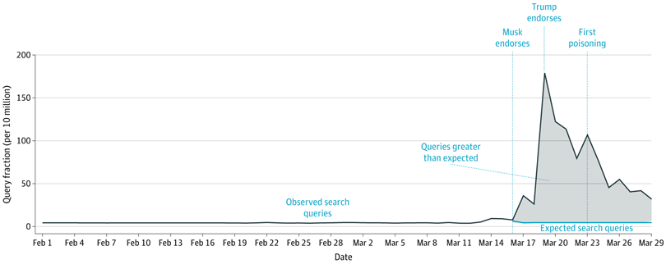
Celebrity endorsement:
Internet search for purchasing hydroxychloroquine
JAMA Intern Med. 2020;180(8):1116-1118. doi:10.1001/jamainternmed.2020.1764
Notes:
Celebrity is a brand: sell perfume to dog food. Can work in our favor. How effective celerity endorsement is not clear. Can backfire. Prince William and younger members of the royal family have come under fire in recent years for alleged hypocrisy for their backing of environmental campaigns while simultaneously using private jets to fly around the world.

Slide 38
The biggest celebrity is…

Slide 39
You
Notes:
The biggest celebrity: You

Slide 40
Welcome to Team ME: Do as I do
Speak up
  Tell your family and friends what’s the single biggest way you can make an impact on global climate change?
  Focus on what they’re already doing right
Drive electrical car
Run or bike to library, post office
Power my home with green energy
Weatherize
  Heating and air-conditioning account for almost half of home energy use
  New windows
Invest in energy-efficient appliances
Reduce water waste
Own two 60-gallon rain barrels
Eat less red meat. Try not to waste food
Switch to LED light bulbs

Slide 41
Health-related scientists are frontline soldiers to communicate climate change in health
Climate change is the greatest threat to public health in 21th century
Trust in doctors have gone down
Health is a shared concern for all Americans
Help patients make the link among emissions, climate instability, and their own health
80-90% physician believe anthropogenic influence on climate change
Barriers: Lack of knowledge, limited time, low reimbursement, fear of igniting political resentment
Example: Parents concerned about vaccine safety credit a warm rapport with a pediatrician as the most important factor in deciding to immunize their children
https://www.acpjournals.org/doi/10.7326/M20-6443
Notes:
Two studies: One 51 to 97% vaccination rate based on individual provider (Sep 1, 1997 Pediatric), 50% vs 74% vaccination rate if parents who believe in pediatrician twice as likely to vaccinate their children. (2006, Pediatrics).

Slide 42
When Science wins, everybody wins

Slide 43
Outline
Dissecting the psychology of a doubter
Protecting your own sanity
Communicating concerns and solution
Exercise

Slide 44
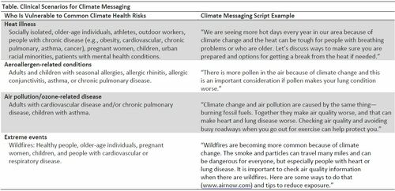
Clinical setting

Slide 45
Child-parent intergenerational learning
Notes:
Example: How the children influence the parents in our family.

Slide 46
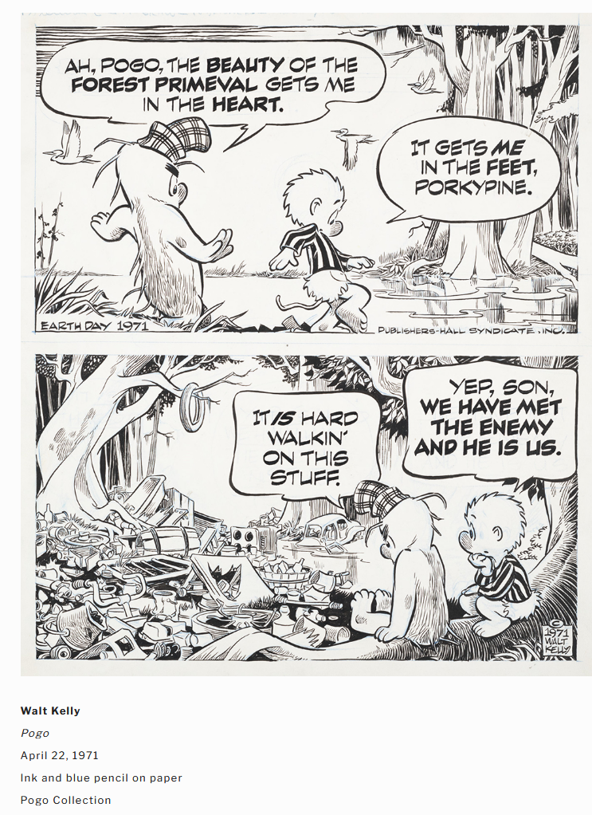

Slide 47
References: Understanding Climate Change Denial
https://www.rff.org/publications/reports/climateinsights2020/
https://www.pewresearch.org/science/2019/11/25/u-s-public-views-on-climate-and-energy/
https://www.pewresearch.org/science/2019/11/25/u-s-public-views-on-climate-and-energy/ps_11-25-19_climate-energy-00-01/
https://www.pbs.org/video/its-okay-be-smart-climate-science/
https://www.salon.com/2012/02/24/the_ugly_delusions_of_the_educated_conservative/
https://www.theguardian.com/environment/climate-consensus-97-per-cent/2016/may/04/scientists-are-figuring-out-the-keys-to-convincing-people-about-global-warming
https://www.vice.com/en/article/a3d35a/how-to-sway-a-climate-change-skeptic
https://digitalrepository.trincoll.edu/cgi/viewcontent.cgi?article=1687&context=theses

Slide 48
References: Communication
https://www.nytimes.com/2020/01/02/opinion/climate-change-deniers.html
https://www.vice.com/en/article/a3d35a/how-to-sway-a-climate-change-skeptic
https://www.acpjournals.org/doi/10.7326/M20-6443
https://www.washingtonpost.com/news/monkey-cage/wp/2017/11/28/how-to-persuade-people-that-climate-change-is-real/
https://www.ipcc.ch/site/assets/uploads/2017/08/Climate-Outreach-IPCC-communications-handbook.pdf

Slide 49
References: Ohio Climate Change
https://www.geo.umass.edu/climate/stateClimateReports/OH_ClimateReport_CSRC.pdf
https://www.cleveland.com/news/2020/09/labor-day-spoiled-by-flash-flooding-across-northeast-ohio.html
https://artsandsciences.osu.edu/news/climate-change-ohio
https://www.ucsusa.org/about/news/midwest-region-areas-temperature-exceeds-100-degrees

