Slide 1
Climate Change and the Well-Being of People with Disabilities
February 17, 2021
Kristen A. Berg, PhD, CRC

Slide 2
This session’s agenda
Explore concepts and current research that examine and explain:
  Mechanisms linking disability and climate change
  Possible interventions or solutions

Slide 3
“…any condition of the body or mind (impairment) that makes it more difficult for the person with the condition to do certain activities (activity limitation) and interact with the world around them (participation restrictions).”
Centers for Disease Control, 2020
Notes:
Estimated 1 billion persons worldwide have a disability

Slide 4
“… results from the interaction between persons with impairments and attitudinal barriers, such as stereotypes, stigma and prejudices, and environmental barriers. That hinders their full and effective participation in society on an equal basis with others.”
Office of the United Nations High Commissioner for Human Rights, 2020

Slide 5
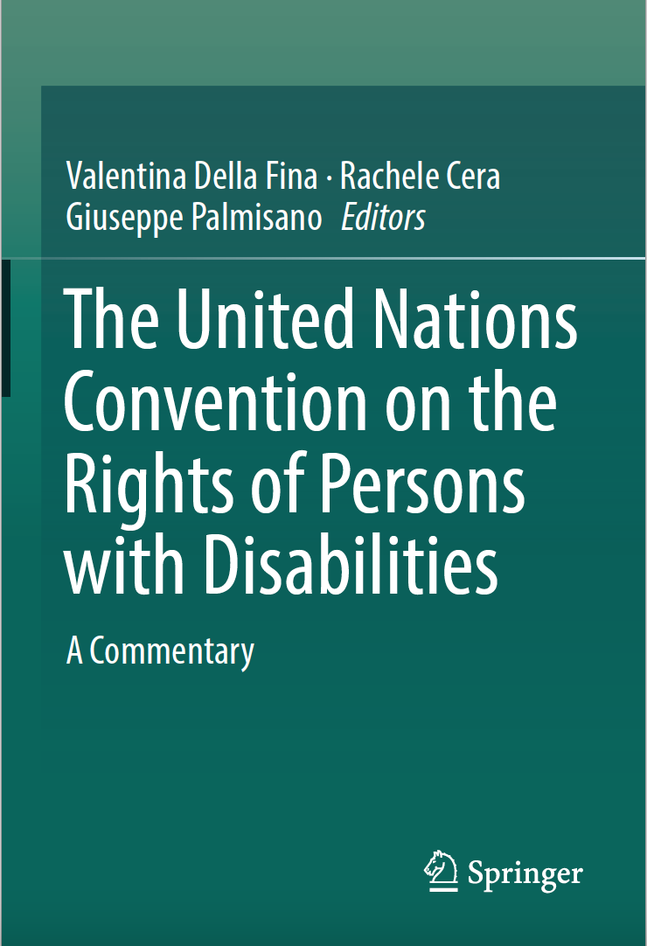
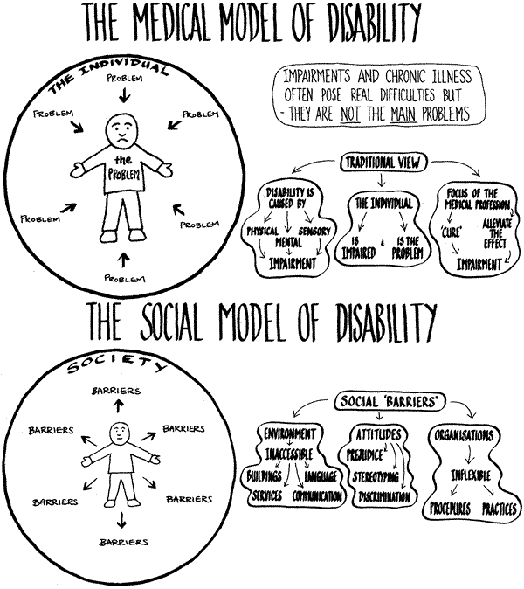
Human Rights Model of Disability
(National Conference for Community and Justice, 2019)
Notes:
U.N. Convention on the Rights of Persons with Disabilities, Dec. 13, 2006

Slide 6
Climate change, and its associated disasters and emergencies, is one of the most profound environmental barriers now faced by persons with disabilities.
(Office of the United Nations High Commissioner for Human Rights, 2020)
Notes:
Climate change is one of the most profound environmental barriers now faced by persons with disabilities, both immediately and in the long-term destabilization of key, interconnected systems of support PWD must access for well-being.

Slide 7
1) Climate change brings more natural disasters, thus increasing the prevalence of disabling injuries or diseases;
2) Climate change compounds the vulnerability of people with disabilities and the existing health and resource inequalities they face.
(Office of the United Nations High Commissioner for Human Rights, 2020)
Core mechanisms:

Slide 8
- Greater heat waves, fires;
- Impaired food production → under-nutrition;
- Food- and water-borne diseases
(U.N. Environment Program, Climate Change and Human Rights, 2015)
Climate change predicts higher prevalence of disabling conditions
World Health organization estimates 250,000 deaths between 2030 and 2050 from malaria, malnutrition, dengue, heat stress, and diarrhea (Simon Hales et al., 2014)

Slide 9
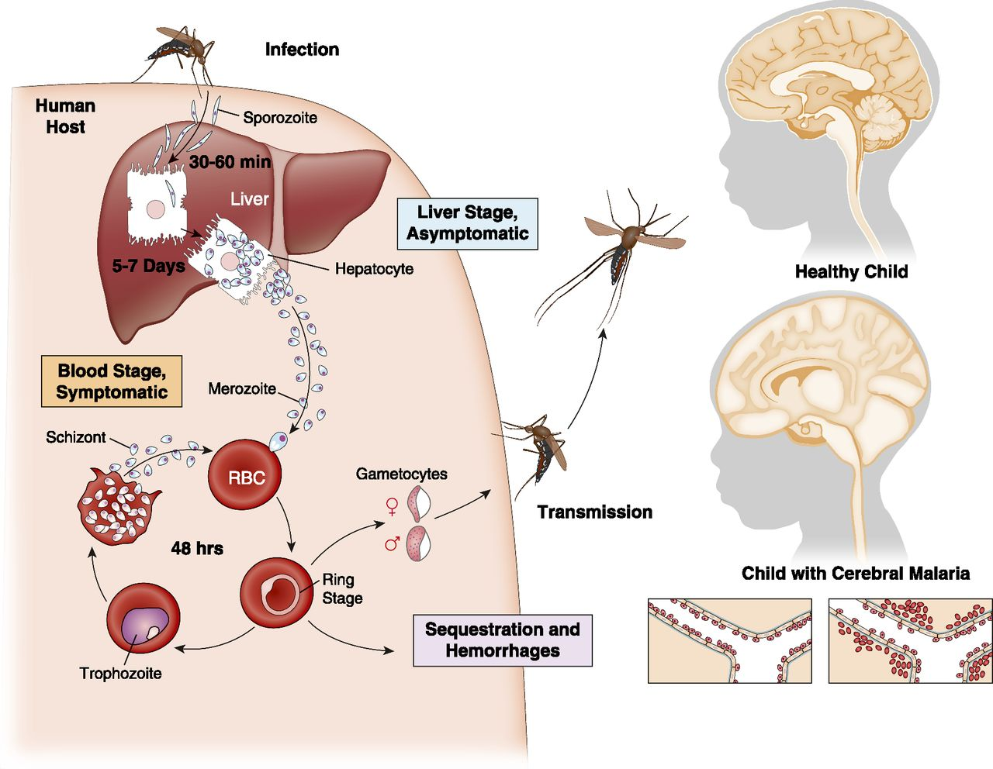
Climate change predicts higher prevalence of disabling conditions
1 in 10 children experience neurological impairment (epilepsy, behavior changes, learning disabilities, motor/coordination/speech problems) after cerebral malaria
(Riggle et al., 2010)

Slide 10
Climate change predicts higher prevalence of disabling conditions
Climate change disasters linked with higher levels of stress-related psychiatric disability (Padhy et al., 2015)
Compared to general population, persons with psychiatric disability have over 3 times higher likelihood of death during heat waves (Bouchama et al., 2007)
Compounded injury or illness for persons with spinal cord injury with abnormal body temperature regulation (Alexander, 2019; Khan et al., 2007)

Slide 11
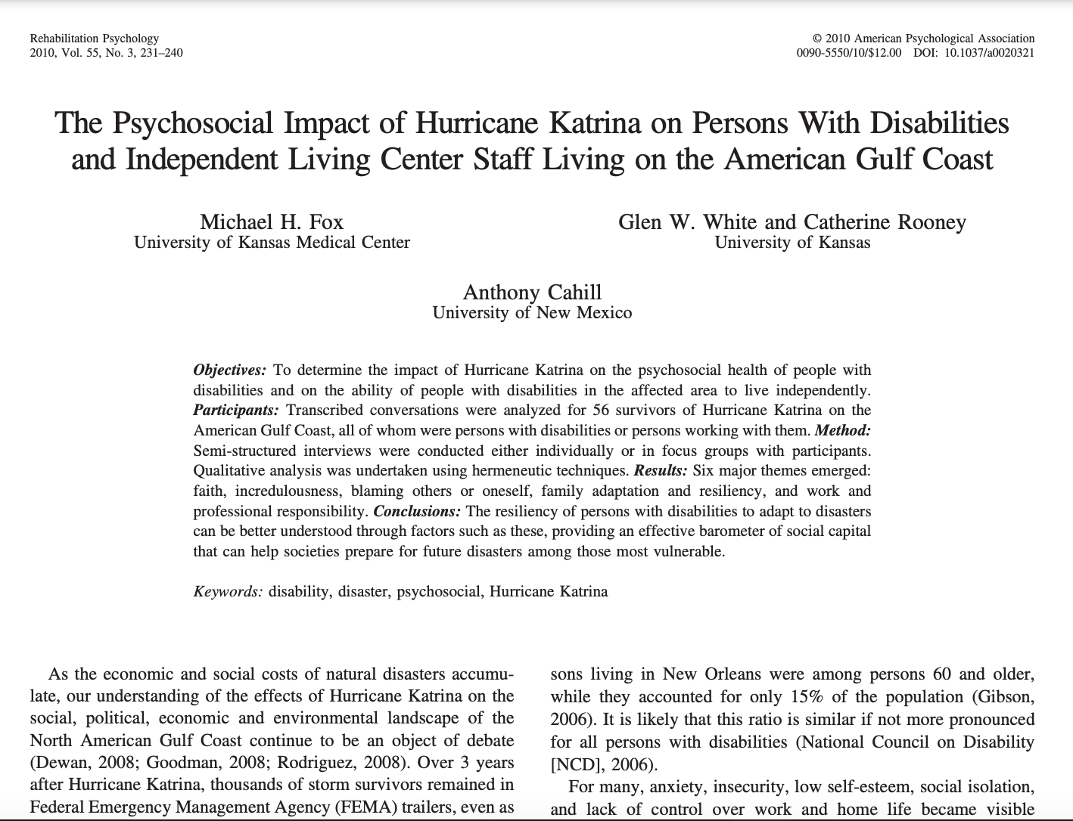
Notes:
Fox, M. H., White, G. W., Rooney, C., & Cahill, A. (2010). The psychosocial impact of Hurricane Katrina on persons with disabilities and independent living center staff living on the American Gulf Coast. Rehabilitation Psychology, 55(3), 231.

Slide 12
“I turned around and by that time I was out of water. As a quadriplegic,
I don’t sweat like normal people and my temperature gauge was broken, so I get overheated and there wasn’t any air that day and I got stuck on a highway with marsh on either side. No trees, no breeze, nothing but the heat. If somebody that I knew from the fire department had not been volunteering to help out, I probably would have died that day from heat stroke.
I started feeling better and they iced me up and sent me back to my friends and family.
So, I got sick then and terribly ill with the infection that I got because of the wheelchair and having to live with it I wound up with what’s called a void, where the bone rubs on the muscle tissue and the muscle tissue doesn’t spring back like normal people and it gets infected and then the infection tries to eat its way out of the body and you wind up with these huge wounds that take a lot longer than the average to heal up after surgery. I’m going to finally get my skin flap this March the 30th and I’ll get out of bed and be released, to go back and try to find a home probably in the middle of May.”
(Fox et al., 2010)
Notes:
Fox, M. H., White, G. W., Rooney, C., & Cahill, A. (2010). The psychosocial impact of Hurricane Katrina on persons with disabilities and independent living center staff living on the American Gulf Coast. Rehabilitation Psychology, 55(3), 231.

Slide 13
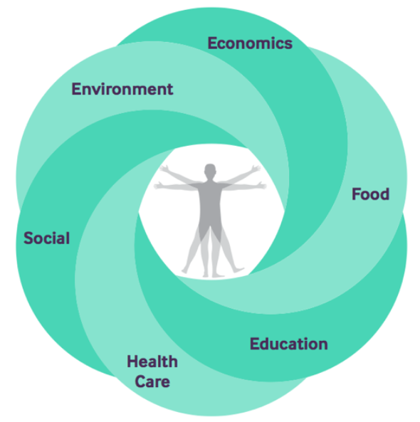
Conceptual Model of Social Determinants of Health

Slide 14

Climate change compounds existing vulnerabilities and inequalities

Slide 15
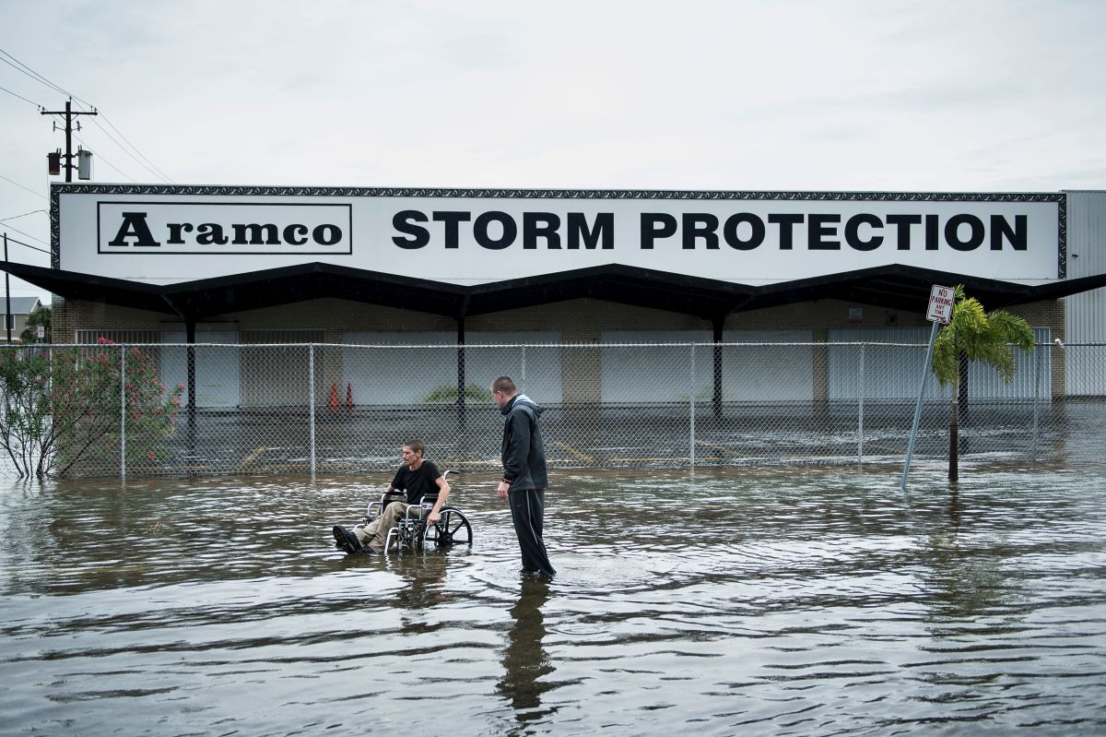
(Photo: Brendan Smialowski/AFP/Getty Images)
(Perry, 2017)
Climate change compounds existing vulnerabilities and inequalities

Slide 16
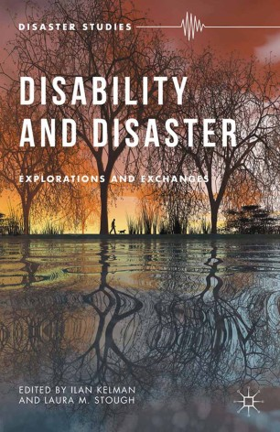
Climate change compounds existing vulnerabilities and inequalities
The Water is Rushing In
“The following narrative comes from the transcript of a statement by Marcie Roth given on June 15, 2010 before the US House of Representatives Subcommittee on Emergency Communications, Preparedness, and Response. In her statement, Ms. Roth recounted the experiences of Benilda Caixeta during the days following Hurricane Katrina. Benilda Caixeta’s story transfixed US Representatives and other government officials and, sadly, served as an appalling illustration of how the nation’s lack of disaster planning for the needs of people with disabilities brought about deadly consequences. Ms. Roth retold the story of Benilda Caixeta in public venues numerous times as an example of the importance of changing laws, policies, and practices used in the emergency management field in the US. Benilda Caixeta’s experiences also personally and professionally galvanized Ms. Roth to become a nationally recognized expert on the needs of people with disabilities in disaster.” (Roth, 2015)

Slide 17
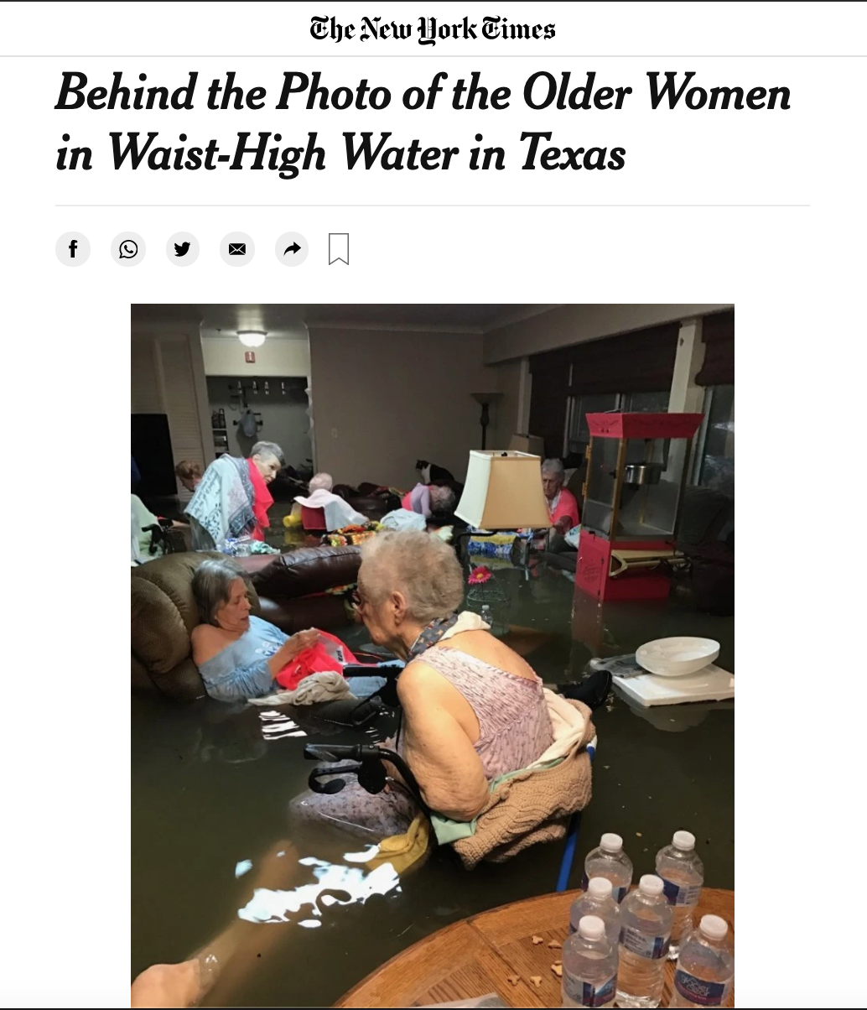
(New York Times, 2017)

Slide 18
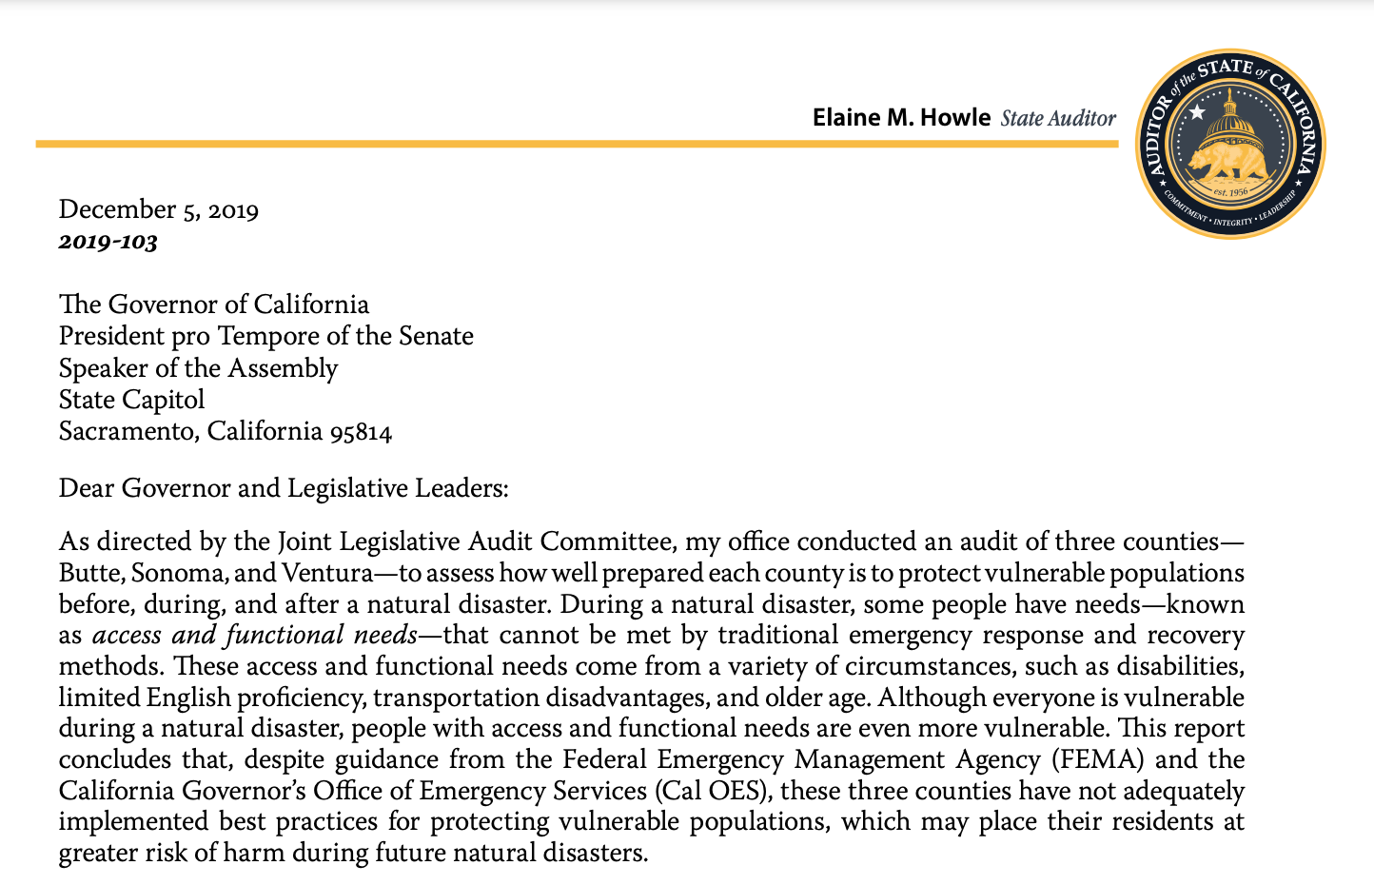
Climate change compounds existing vulnerabilities and inequalities

Slide 19
Climate change compounds existing vulnerabilities and inequalities
People with disabilities comprise one of the most vulnerable groups to climate change:
Impaired capacity to adapt to changes in the environment
Exclusion from disaster planning and preparedness
(Wolbring, 2009)
Notes:
Wolbring, G. (2009). A culture of neglect: Climate discourse and disabled people. M/C Journal, 12(4). https://doi.org/10.5204/mcj.173

Slide 20
Resilience for individuals and communities in the face of climate change is critically shaped by:
1) Natural resources
2) Human resources
3) Social resources
4) Physical resources
5) Financial resources
(Care International, 2009)

Slide 21
… and many people with disabilities rely, every day, on numerous complex systems:
Health maintenance (medicine, electricity, medical care)
Ability to move in and through physical areas
Effective communication access
“Program access"

Slide 22
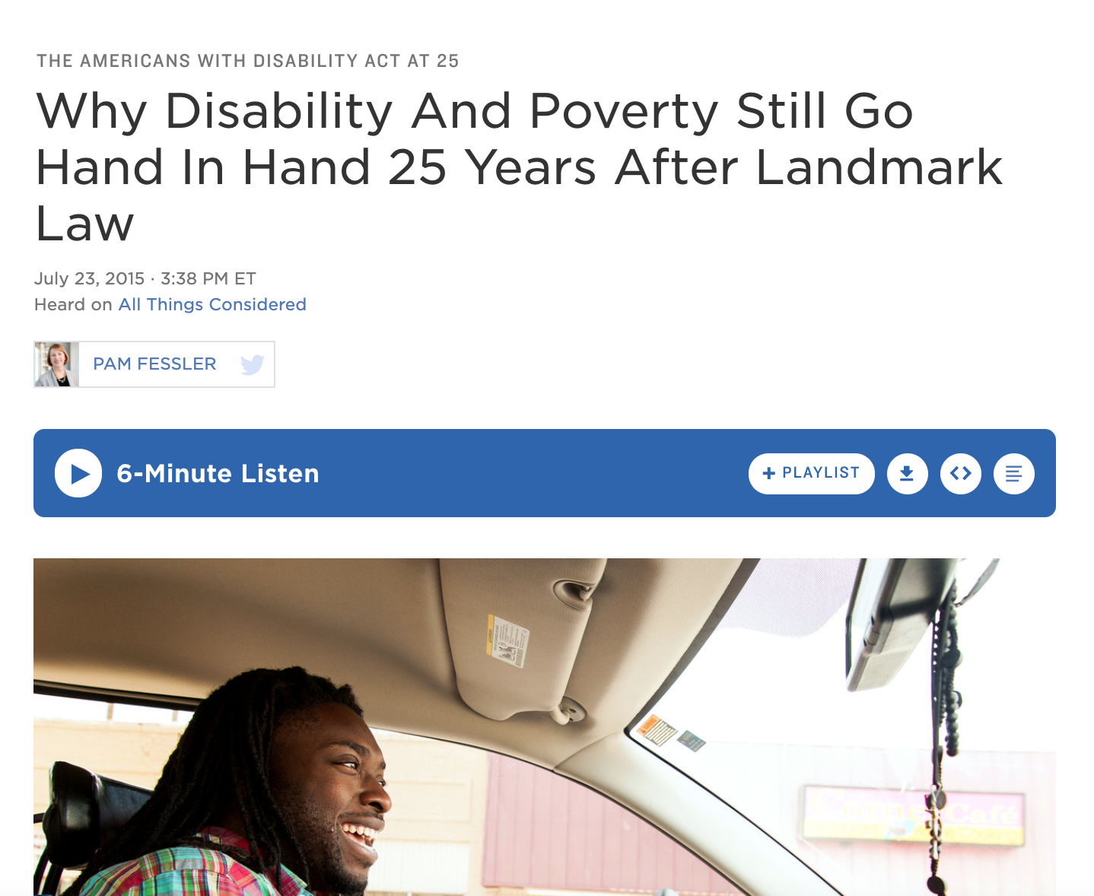
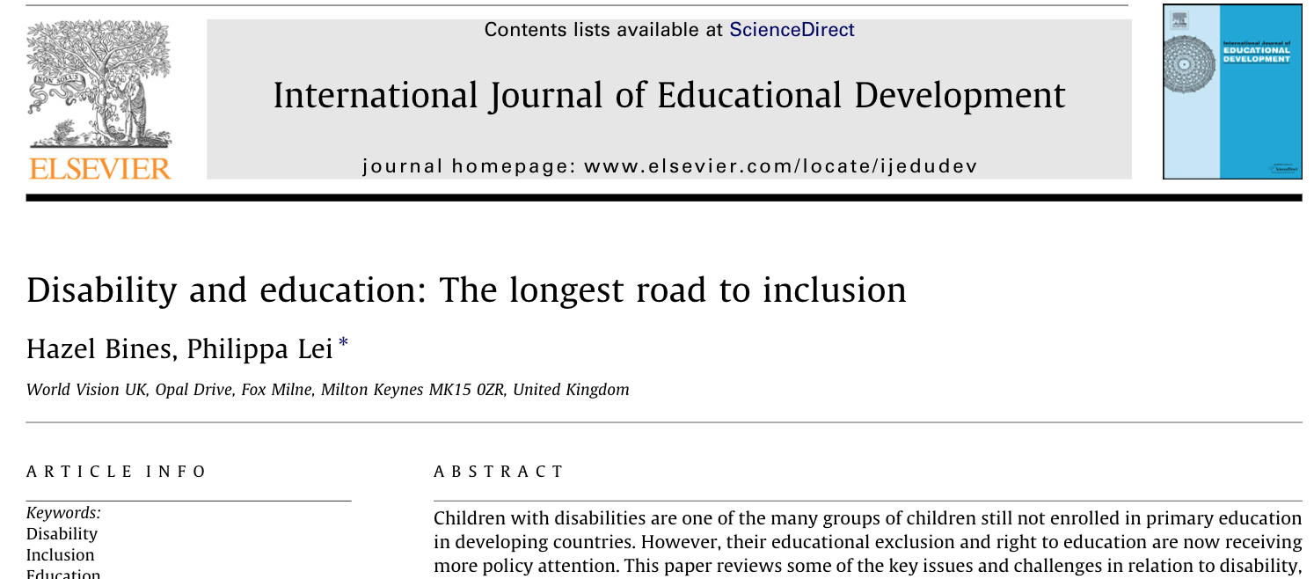
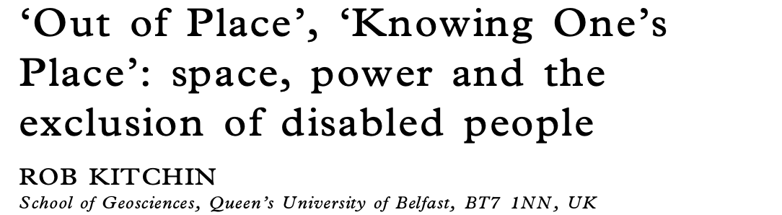
… but societal structures tend to position people with disabilities, at baseline, as resource-deprived.

Slide 23
“Working for climate justice requires challenging the root causes of vulnerability, rather than treating disabled people as the inevitable casualties of climate change. It also means interrogating the realities that keep some of us farther from the storm.” (Watts Belser, 2019)
Key Solutions:

Slide 24
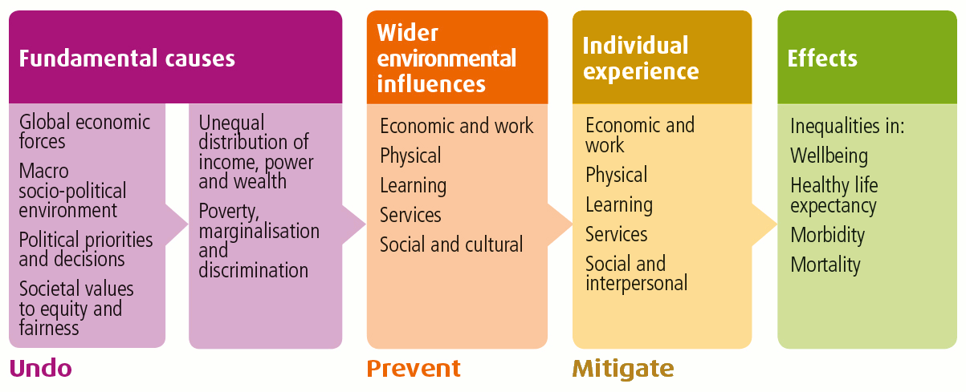
Key Solutions:
From National Health Service, Scotland

Slide 25
*Most current social determinants of health and climate justice efforts focus here
Key Solutions:
From National Health Service, Scotland

Slide 26
- Sendai Framework for Disaster Risk Reduction
(2015–2030)
- Inclusive disaster response and climate change solutions benefit everyone, not just persons with disabilities
- Include people with disabilities in drafting climate change solutions; standards/indicators to ensure inclusion
- Apply accessibility standards to construction and repair of infrastructure (“Build Back Better”)
Key Solutions:

Slide 27
1) Climate change drives up prevalence of disability through both injury and disease
2) Climate change also exacerbates existing disabilities and health and resource inequalities through structural ableism and privilege
3) Inclusive disaster response benefits everyone; persons with disabilities must be key stakeholders in disaster preparedness and response planning
Key Takeaways:

Slide 28
Thank you!
Questions? kab185@case.edu

