Slide 1
MPHP 441: Climate Change and Health Heat Stress and Kidney Disease
Anne Huml, MD, MS
ahuml@metrohealth.org

Slide 2
Objectives
Part I: Understand how heat affects human health- heat stress and the cascade of heat related illness
Part II: Describe the intersection of climate change, kidney health, and kidney disease
Part III: Review other climate-related threats to kidney health
Part IV: Think about the resources we use to treat kidney disease impacts our climate

Slide 3
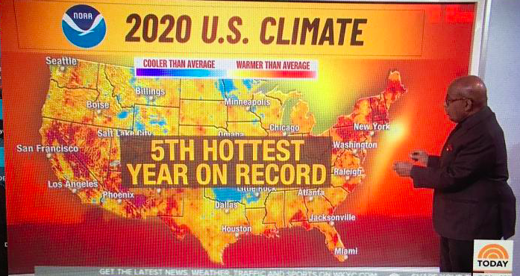
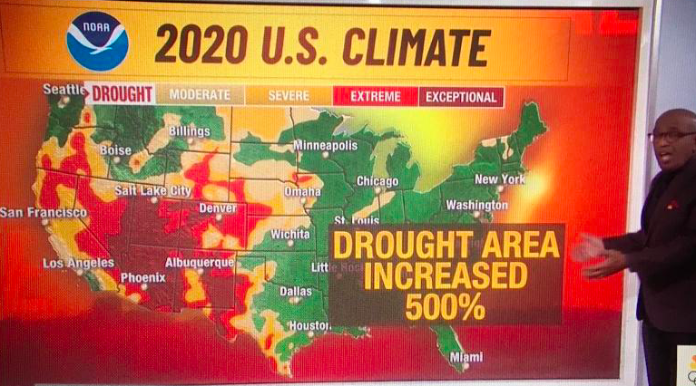
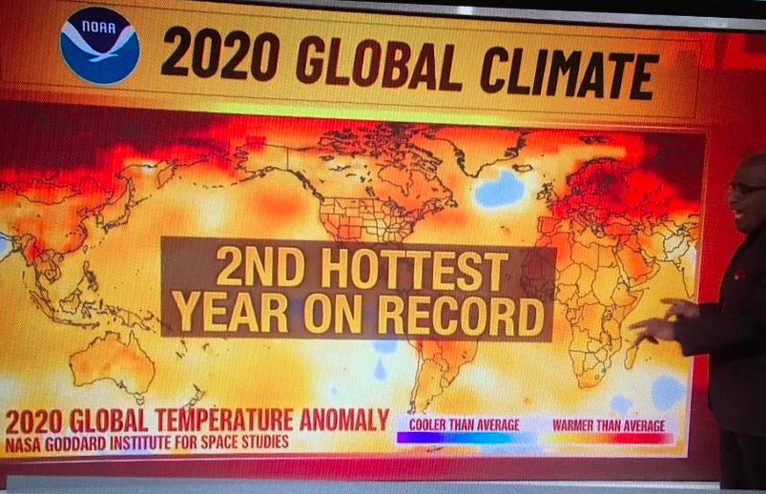

Slide 4
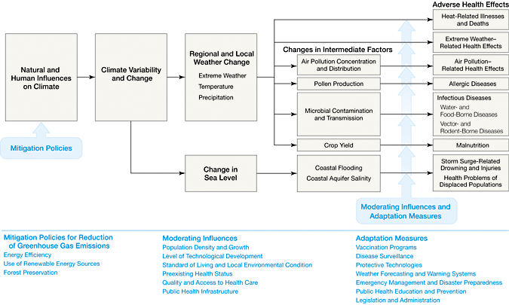
Cascade of Illnesses Triggered by Climate Change
Haines A, Patz JA. Health effects of climate change. JAMA. 2004 Jan 7;291(1):99-103.
Notes:
These climate changes are not expected to lighten-up; temperatures increase btwn 1.8-5.8 deg C in next centruy, and sea levels rise by 9-88cm.
Economies largely depend on fossil fuels that is accompanied by greenhouse gases- including Co2 and methane.
The consequences of these changes in our ecosystems include:
Thermal Stress== heat waves that affect our most vulnerable- elderly and chronically ill
Floods/drought== leading to physical facility loss, higher rates of diarrheal diseases and other environmental molds anxiety/depression
Earlier start to spring== more pollen, allergic rhinitis
Air pollution== through emissions or forest fires
Infectious disease==vector borne diseases, rodent borne diseases, including malaria and dengue, hantavirus (lung infection), cholera
Tick borne diseases like Lyme
Malnutrition==due to things like increasing in drought
I think that many other talks in this class will focus on the specifics of these disease entities and disease: including CVD, infectious diseases, zoonotic disease, and occupational health

Slide 5
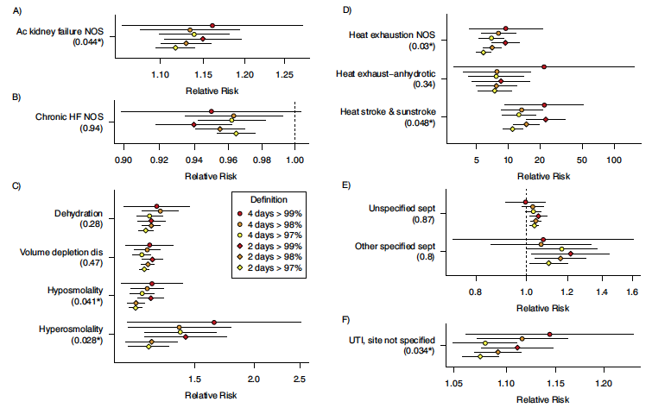
Heat Related Illnesses Leading to Hospitalization
Hopp, S, et al. Preventive Medicine 110 (2019) 81-85.
Notes:
Hopp et al. analyzed daily admissions for nearly 24 mil mediare enrollees in 1943 counties over a 10-year period. Characterized reasons for hospitalization for patients during 2-4 day heat wave days compared to non heat wave days.
Noted 11 diagnoses with increased relative risk for hospitalization on heat wave days vs non-heat wave days.
These include aki, dehydration, heat exhaustion/stroke, sepsis, and UTI – less RR for CHF

Slide 6
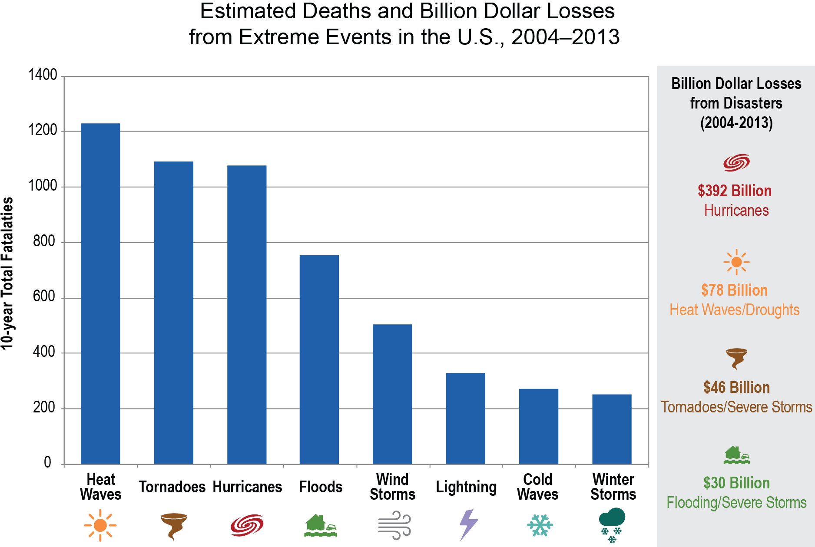

Slide 7
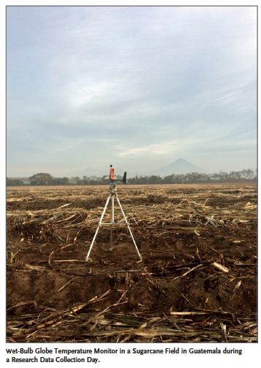
Climate Change & Kidney Disease: One piece of the puzzle
Heat stress nephropathy
CKDu
Mesoamerican nephropathy
Sri Lankan nephropathy
Uddanam nephropathy
Notes:
During early 1990s, case reports of young, agricultural workers in sugar cane fields (Sri Lanka) reported with chronic kidney disease of “unknown” etiology, or CKDu-- individuals did not have the typical risk factors for CKD/ESKD including DM and HTN. Within years, higher than expected numbers of cases of CKD among agricultural sugar can workers throughout the Pacific coast of Central America from Guatamala to Panema were recognized- giving rise to the name Mesoamerican nephropathy. Also noted to develop among cotton and corn workers as well as shrimp farmers.

Slide 8
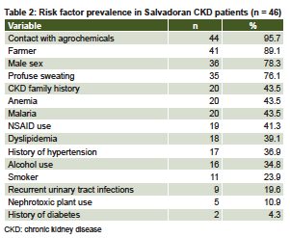
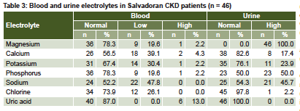
Characteristics of Affected Workers
MEDICC Review, April 2014, Vol 16, No 2
Notes:
Workers noted to have elevated Cr when undergo screening before seasonal harvest, usually have worked harvest prior
Ages 20-50 yr
Asymptomatic
Nml BP, nml glucose
No proteinura
No PVD
+hearing loss, +myoclonus
Herrera, et al- studied 46 workers, 36 M, 10 F to characterize renal and extra renal causes of CKD in El Salvador. Mean age 45 yr,
Examinations included social determinants; psychological
assessment; clinical exam of organs and systems; hematological
and biochemical parameters in blood and urine; urine sediment
analysis; markers of renal damage; glomerular and tubular function;
and liver, pancreas and lung functions. Renal, prostate and gynecological
ultrasound; and Doppler echocardiography and peripheral vascular
and renal Doppler ultrasound were performed.

Slide 9
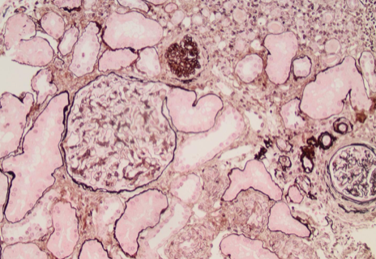
Histology of a Patient with Mesoamerican Nephropathy
Johnson RJ, et al. N Engl J Med. 2019 May 9;380(19):1843-1852.
Notes:
PAS stain showing focal inflammation, tubular atrophy and glomerulosclerosis.

Slide 10
Location and Crop Type Matter
Prevalence of Elevated SCr
Region | Crop | Male | Female
Coastal Lowland
 | Sugarcane | 37.0% | 17.5%
 | Cotton | 29.4% | 18.6%
Coastal Highland
 | Sugarcane | 3.5% | 0%
Coffee or subsistence |  | 3.5% | 0%
Males
Females
Am J Kidney Dis. 2012;59(4):531-540
Notes:
Peraza, et al studied 256 M and 408 W ages 20-60 yr old in El Salvador and stratified kidney function by type of work. Collected other characteristics as well.
Of the men in the coastal communities, 30% had elevated SCr levels and 18% had eGFR 60
mL/min/1.73m2 compared with4%and 1%, respectively, in the communities above 500 m. For agricultural workers,
prevalences of elevated SCr levels and eGFR 60 mL/min/1.73 m2 were highest for coastal sugarcane and cotton
plantation workers, but were not increased in sugarcane workers at 500mor subsistence farmers. Women followed
a weaker but similar pattern. Proteinuria was infrequent, of low grade, and not different among communities,
occupations, or sexes. The adjusted ORs of decreased kidney function for 10-year increments of coastal sugarcane
or cotton plantation work were 3.1 (95% CI, 2.0-5.0) in men and 2.3 (95% CI, 1.4-3.7) in women

Slide 11
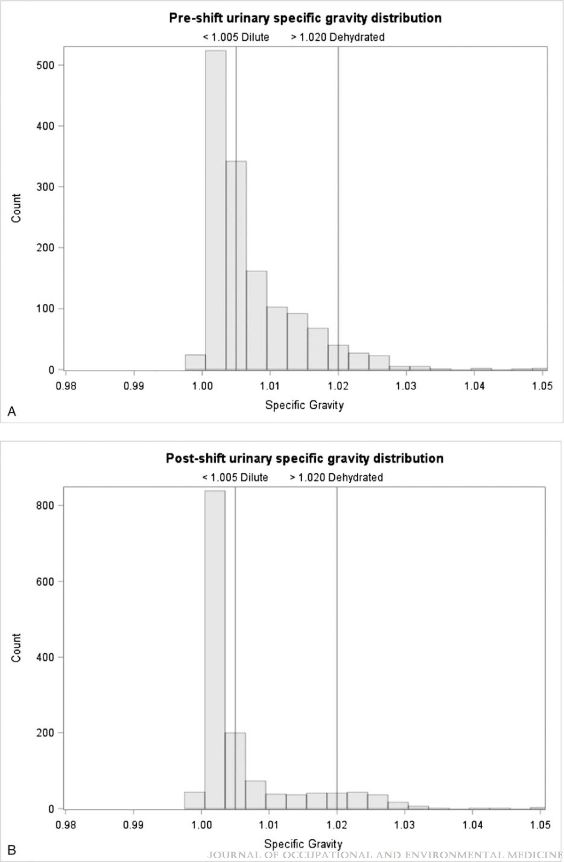
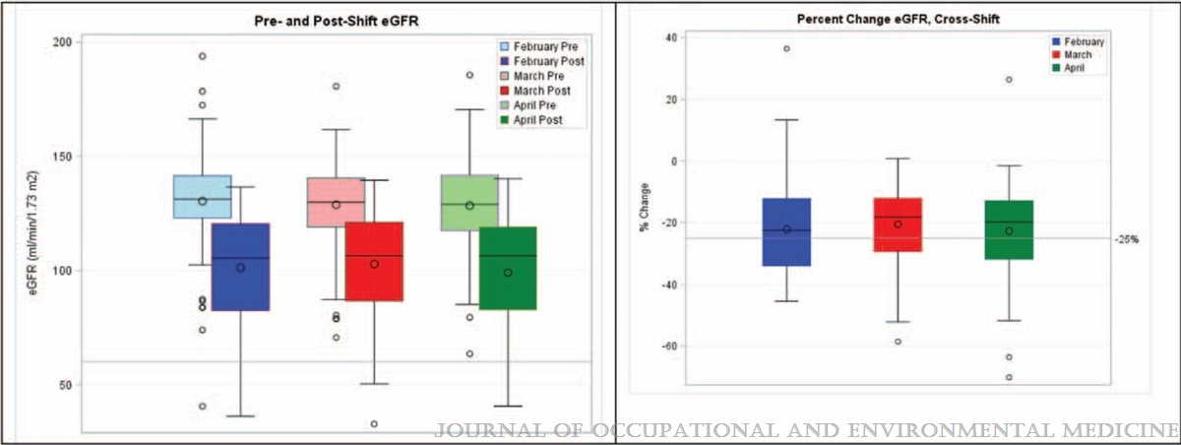
Mechanisms of Kidney Injury
Sorensen CJ, et al. J Occup Environ Med. 2019 Mar;61(3):239-50
Notes:
Serum cr increases during work shift, as does other biochemical markers- e.g. CK
This asymptomatic decline in kidney function is a signal for dehydration related reduction in kidney perfusion
These recurring changes accumulate to place workers at risk of CKD
Or, between seasons, kidney function does not return to its prior baseline
Graph of 105 healthy sugarcane workers with nml kidney functions. Measure biomarkers of injury pre-harvest, daily. Observe unfavorable trends in kidney function across shifts.

Slide 12
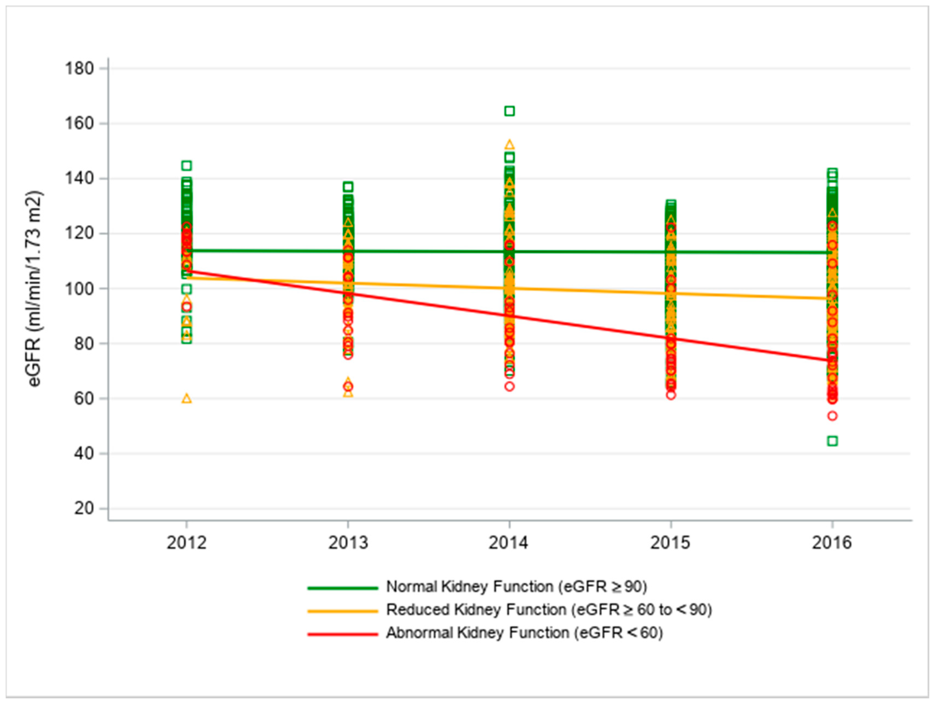
Screening and Intervention to Slow Progression of Kidney Disease
Sorensen, C.J. et al. Int. J. Environ. Res. Public Health 2020, 17, 8552.
Notes:
Feb 2017, split Guatemalan sugarcane workers into three groups:
AKF (abnormal kidney function eGFR < 60), RKF (reduced kidney function, eGFR 60-89), and NKF (normal kidney function eGFR >=90)
A health promotion, behavioral and educational intervention centered on water electrolytes, rest and shade was provided to all participants.
Prospectively analyzed their renal funciton. All groups stabilized or improved trjectory of decline during the intervention. Supports screening and intervention as a promise to slow progression of kidney disease among workers.

Slide 13
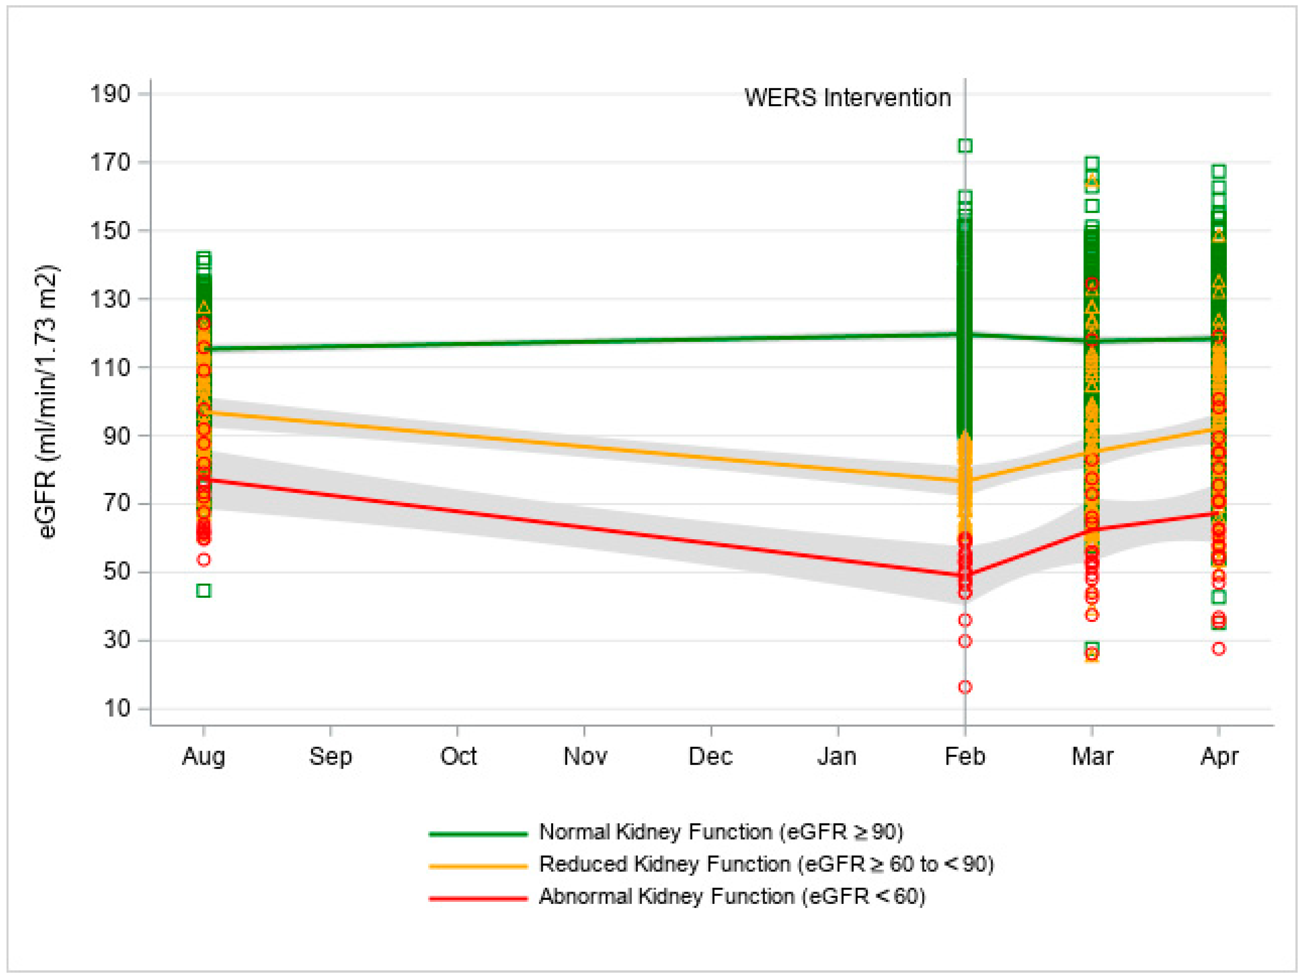

Slide 14
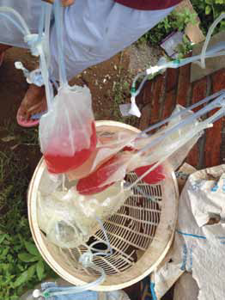
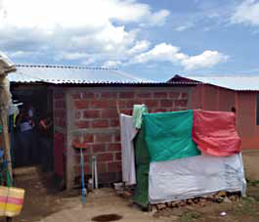
Clinical Implications
Krinsky and Levine. Kidney International (2014) 86, 221–223.
Notes:
Under resourced areas affecting socially and economically vulnerable populations, access to healthcare is limited and difficult
Families suffer from economic consequences of not being able to work and many other devistating consequences.
Paper published in 2014 by 2, 2nd year medical students at MtSiani School of Medicine in NY- summer long experience in Nicaragua; 25 patient PD program. Rounded with the 2 PD nurses. Describe the first hand account of the strife of a single pt on PD x 6 mo in hospital. Construction and cost of clean room. Conditions of home dialysis.

Slide 15
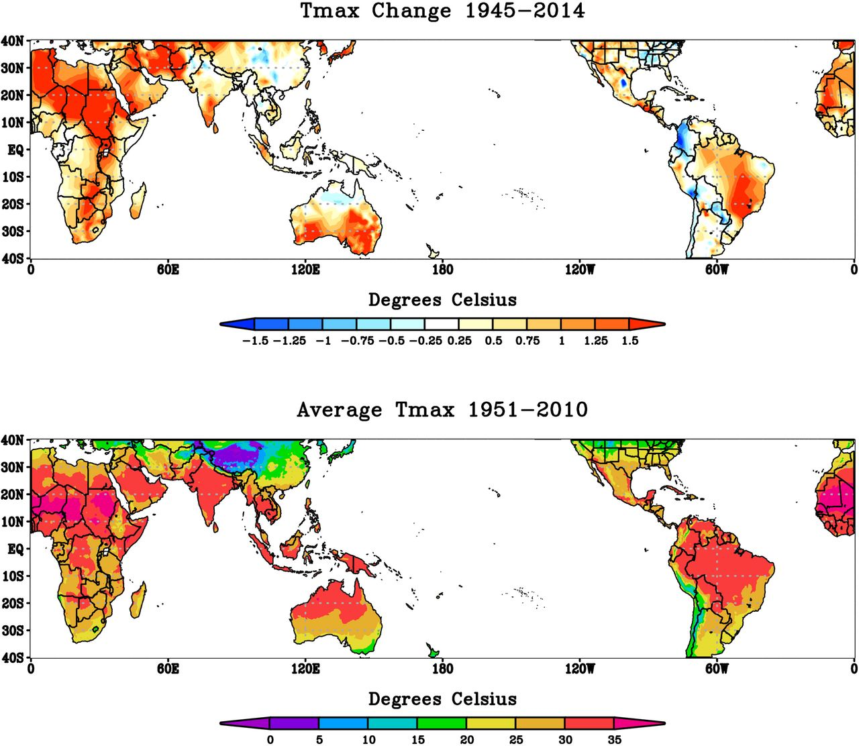
Kidney Disease Epidemics Occurring Elsewhere
Jason Glaser et al. CJASN 2016;11:1472-1483
Notes:
CKD in rural farmers of Andhra Pradesh, India. In a study of 1500 villagers in the Prakasham district, 60% had eGFR <60, hemodialysis rates are higher in the Nellore District (southern India ~ 10x higher than in other regions). Primary occurpation of rice, coconut and cashew farming.
In the northern proviences of Sri Lanka an epidemia has been increasing since the 1980s affecting more than 100,000 people. Young, middle aged- rice farmers. ? Agrochemicals and well water may contribute.

Slide 16
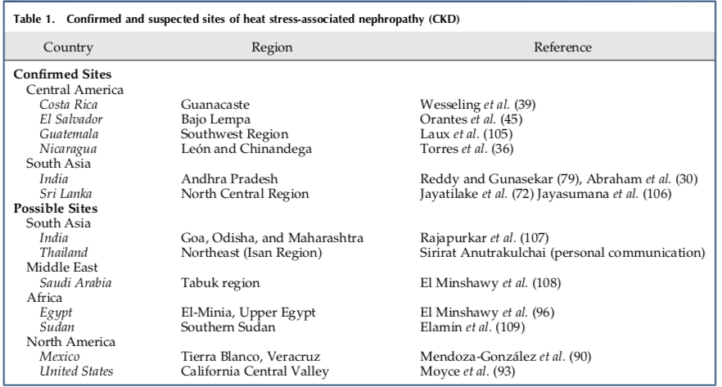
Jason Glaser et al. CJASN 2016;11:1472-1483

Slide 17
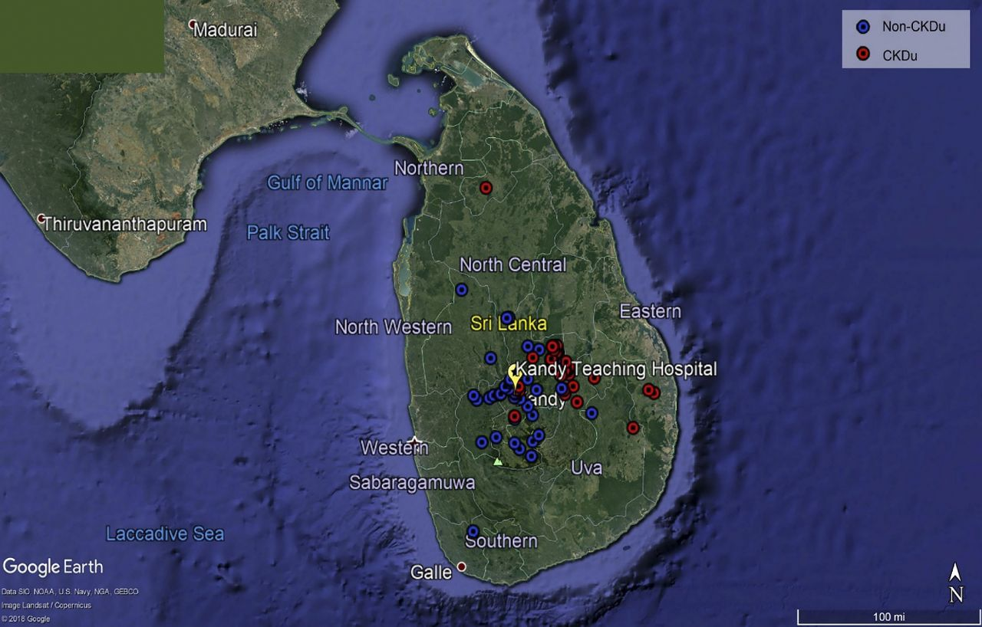
Sri Lankan Nephropathy
1990s, rice paddies in rural region
Men > Women
Ages 40-50 yrs
Asymptomatic rise in creatinine
Electrolyte changes (hypoNa, K, Mg; hyperuricemia)
Shuchi Anand et al. CJASN 2019;14:224-232
Notes:
SLN: 600 pts over course of 1 yr going to tertiary nephrology clinic, 87 had biosy, 49% of thse dx== primary T-I kidney disease (30% chronic, 15% active)
RF For tubulointerstitial disease was born in endemic province, male, farmers (OR 2.0), used tobacco (OR 1.7), drink well water (OR 1.5). ** Pt referred for biopsy despite co-morbid DM or HTN did not experience lower odds of TI disease.

Slide 18
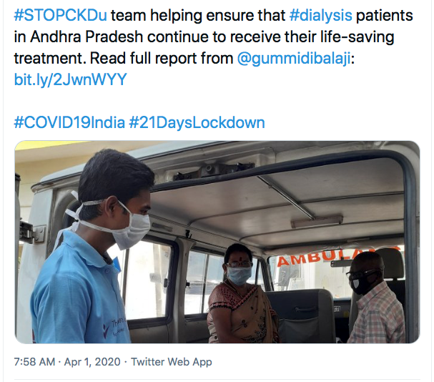
Uddanam Nephropathy
Noted in 1990s
Coconut, cashew and rice farming
Asymptomatic, bland urine
Biopsy shows interstital nephritis
Notes:
CKD epidemic has been noted in central India- Andhra Pradesh, Odisha, Chhattisgarh, and Maharashtra
Uddanam== comes from a village in Andhra Pradesh

Slide 19
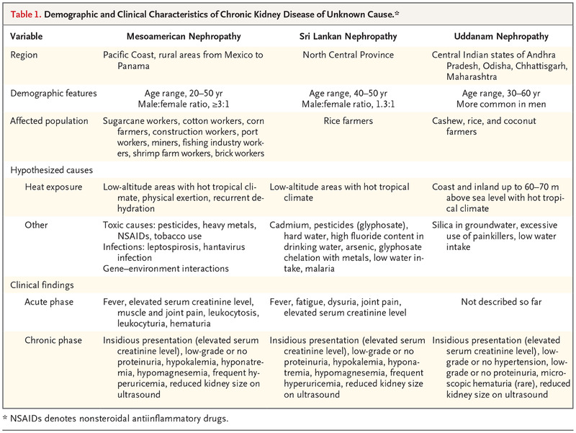
Notes:
Unlikely. More likely represents a multifaceted/multifactorial condition explained by interplay of many factors. A variety of other possible causes of CKDu are under investigation. Other common links in CKDu is its presence in agricultural communities, so, environmental and occupational factors are likely to contribute.

Slide 20
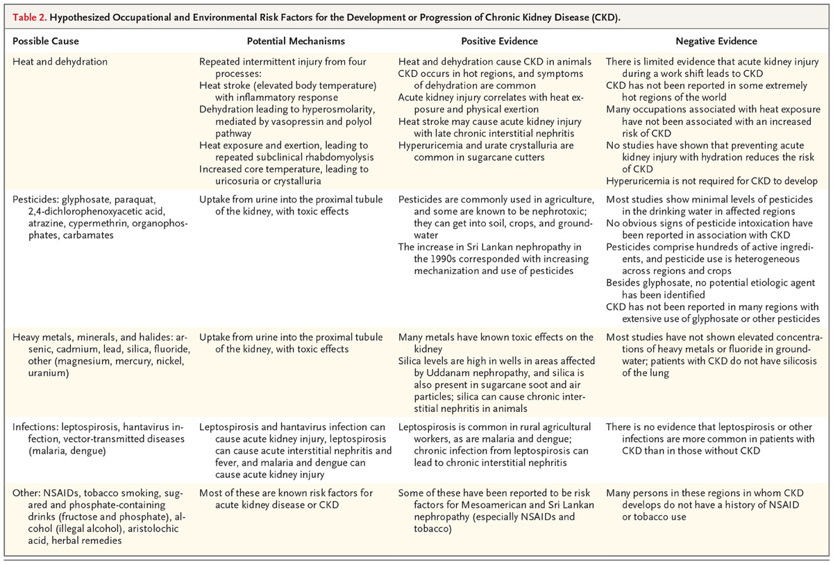
RJ Johnson et al. N Engl J Med 2019;380:1843-1852.
Can It Be the Heat Alone?
Hypothesized Occupational and Environmental Risk Factors for the Development or Progression of Chronic Kidney Disease (CKD).
Notes:
Table 2. Hypothesized Occupational and Environmental Risk Factors for the Development or Progression of Chronic Kidney Disease (CKD).

Slide 21
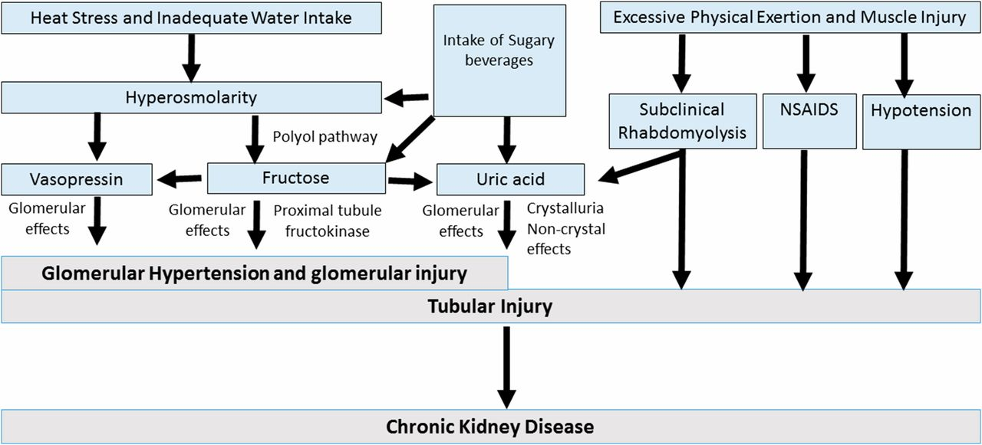
Metabolic Changes Contribute to Kidney Disease
J Am Soc Nephrol 27: 2247–2256, 2016
Johnson RJ, et al. J Am Soc Nephrol. 2016 Aug;27(8):2247-56
Notes:
Potential mechanisms involved in heat stress–associated CKD. CKD occurring in response to recurrent dehydration may involve a variety of mechanisms. Central to the loss of water is the development of hyperosmolarity, which stimulates the release of vasopressin, and the generation of fructose in the kidney from activation of the polyol (aldose reductase-sorbitol dehydrogenase) pathway.⁵⁰ Vasopressin acts to increase glomerular hydrostatic pressure and increases the risk for progression of kidney disease.^{91,123,124} Endogenous fructose production is also metabolized by fructokinase in the proximal tubule, resulting in tubular injury and the release of oxidants, uric acid, and chemokines.⁹⁰ Fructose may also increase vasopressin levels,¹²⁵ and likewise, rehydration with sugar beverages may provide additional fructose, with an amplification of the vasopressin and uric acid levels.⁴⁷ Furthermore, other factors that may be involved include low–grade muscle injury associated with excessive physical exertion leading to subclinical rhabdomyolysis,¹²⁶ an increased risk for nonsteroidal anti–inflammatory drug (NSAID) use, and rarely, hypotension from volume depletion. Volume depletion may also be associated with activation of the renin-angiotensin system and development of hypokalemia, which may also play a role in kidney disease.

Slide 22
Climate Related Threats to Kidney Health
Air Pollution
Heavy Metals
Natural Disasters

Slide 23
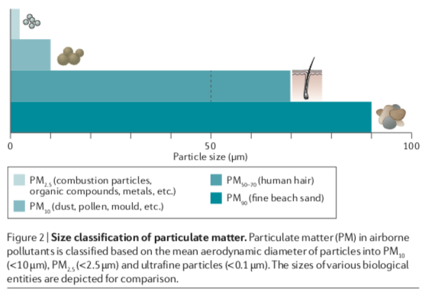
Environmental Pollution and Kidney Disease
Xu X, Nie S, Ding H, Hou FF. Nat Rev Nephrol. 2018 May;14(5):313-324
Notes:
Kidney is vulnerable to environmental pollutants- 20% of CO of blood filtered through kidneys and toxins can be concentrated.
Particulate matter is described by size. Composition is gaseous compounds, solid, and liquid particles. Come from road traffic and industrial burning of fossil fuels. Desribed as amount present, e.g. 1-yr average of PM 2.5 in China and India ? 50 ug/m3 while in US 10-14 ug/m3. Inhaled particles > 5 um are trapped in upper airways and coughed out or swallowed, < 5 um go into the terminal bronchioles and taken up by macrophages.

Slide 24
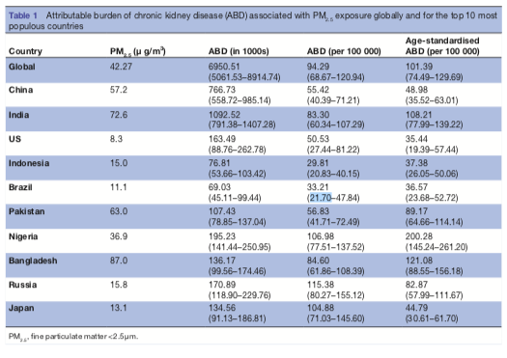
Kidney Disease Can be Attributed to Air Pollution
Bowe B, Xie Y, Li T, et al. BMJ Open 2019;9:e022450. doi:10.1136/ bmjopen-2018-022450
Notes:
Estimates of the global burden of CKD attributable to fine particulate matter air pollution in 194 countries
ABD: attributable burden of disease, YLD: years living with disability, YLL: years of life lost, DALY: disability adjusted life years.
This table depicts the 10 most populated countries in the world. Shows that the global attributed burden of [kidney disease] to pollution is 101.4 per 100,000 people (age adjusted).

Slide 25
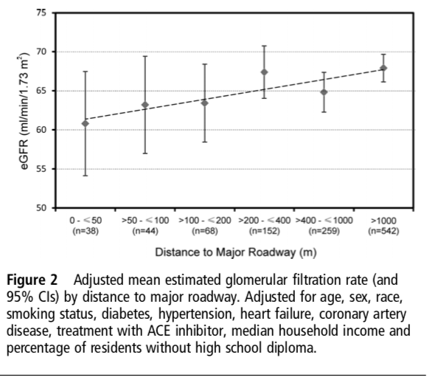
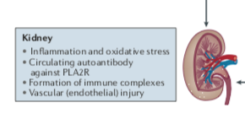
Epidemiological Evidence of Air Pollution and Kidney Disease
Xu X, et al. Nat Rev Nephrol. 2018 May;14(5):313-324
Lue S, Wellenius GA, Wilker EH, et al. J Epidemiol Community Health 2013;67:629-634.
Notes:
Approximately 1100 pt admitted to BIDMC in Boston for ischemic stroke over 5- years. They categorized these pts into residential distance form major roadway ( in meters). After controlling for several important characteristics that may contribute to kidney disease, found tha tpts living closer to a major roadway had lower kidney function (eGFR) than patients living farther away. E.g. within 50 m v. >1000 m➔ eGFR lower by 3.9 ml/min/1.73 m2. This is comparable to the loss of eGFR observed for a 4-yr age increase in population based studies.
Mechanisms by which pollution causes kidney disease is not fully ascertained. However, postulated that increased oxidative stress and inflammation may lead to detrimental effects in kidney health. Moreover, a specific disease has been characterized in patients in China- called Membranous Nephropathy. One type of MN Is mediated by antibodies that attack kideny (PLA2R antibodies interacte on glomerular podocytes creating complexes that damage kidney). M type PLA2R is found in pulmonary macrophages as well as podocytes. Pollution may alter PLA2R antigen in lung, trigger formation of antibodies to it and then circulating antibodies also deposit in kidney.

Slide 26
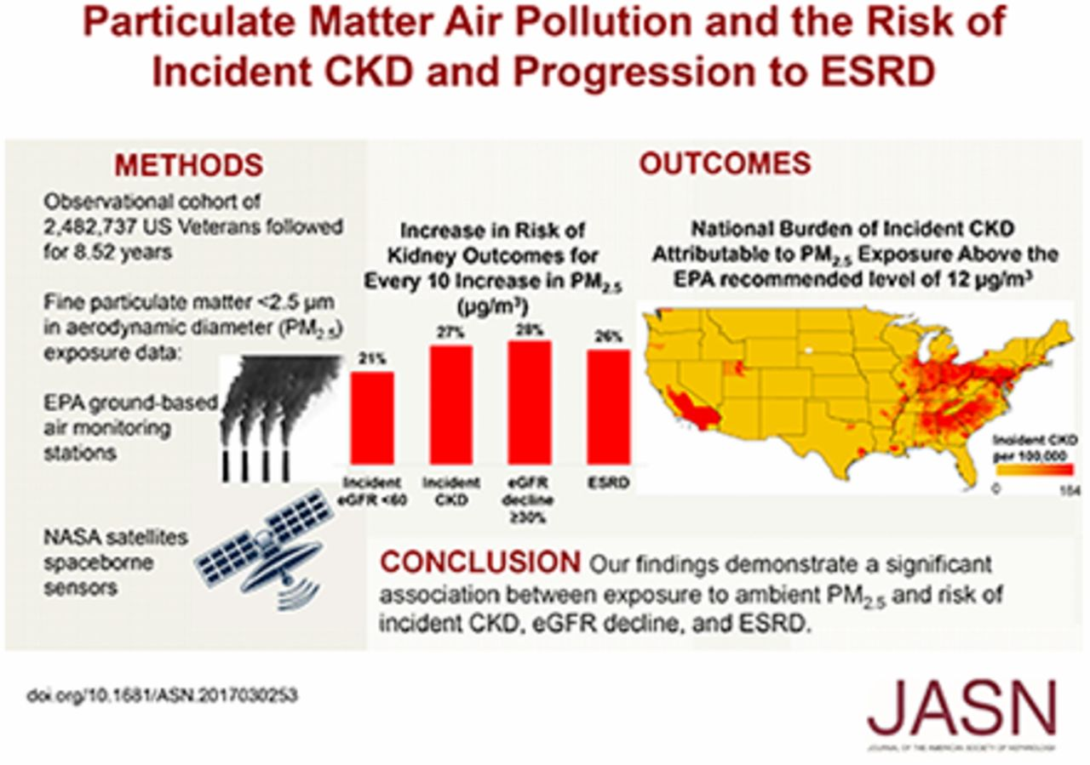
Benjamin Bowe et al. JASN 2018;29:218-230
©2018 by American Society of Nephrology
Notes:
2 mil US Veterans treated with time 0 kidney measurement and at least 1 after that. Used EPA and NASA systems to estimate exposure to PM 2.5.
Each 10 ug/m3 increase in PM 2.5 concentration was associated with a 26-28% increase risk of incident CKD, CKD progression or development of ESRD

Slide 27
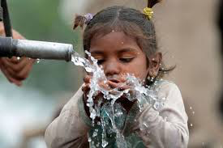
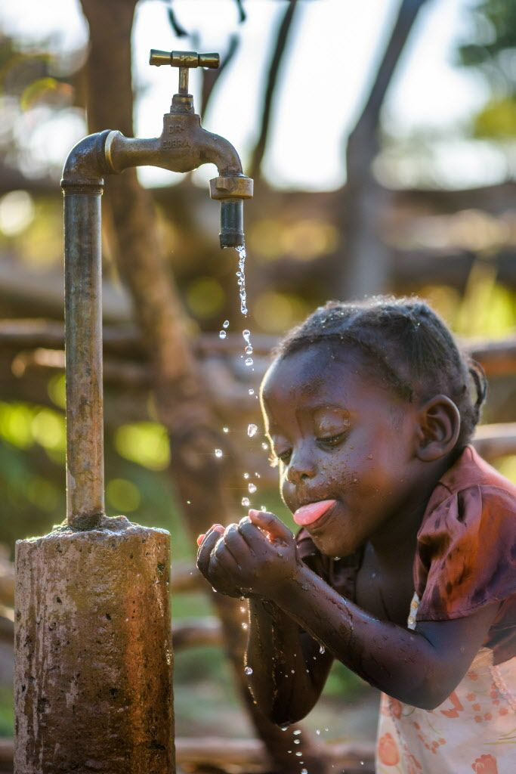
Heavy Metals and Kidney Disease
Mining
Industry
Urban expansion
Fertilizers
Notes:
Pollute drinking water
Heavey metals persistence, bioaccessiblity, absorbption, and dermal contact
Soil is contaminated through irrigation
Crops are contaminated by soil
Animals are contaminated by eating crops
1.8 billion people worldwide don’t have access to clean drinking water

Slide 28
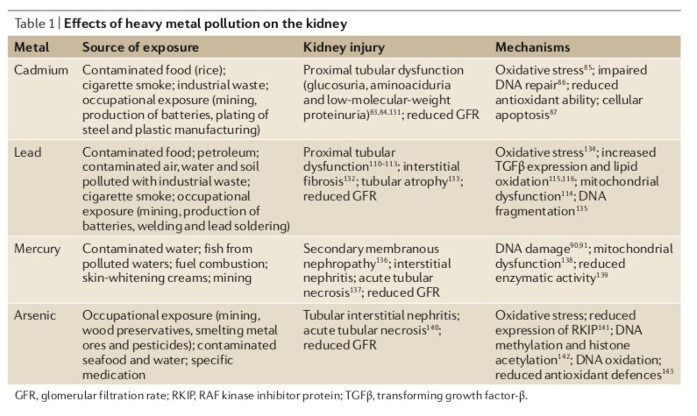
Xu X, Nie S, Ding H, Hou FF. Environmental pollution and kidney diseases. Nat Rev Nephrol. 2018 May;14(5):313-324

Slide 29
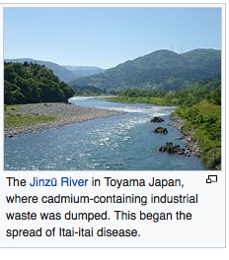
Heavy Metals and Kidney Health
Itai-Itai disease from cadmium nephrotoxicity
Anemia, severe bone pain, osteomalacia, and kidney failure
Kobayashi E, et al.. Environ Toxicol. 2009 Oct;24(5):421-8.
https://en.wikipedia.org/wiki/Itai-itai_disease
Notes:
Mining in mountains of Japan– first reported in 1912, took 55 yr to undergo epidemiologic investiation
Mining polluted river, toxic levels in fish, water was used in rice farming and then consumed by people
Cadmium accumulated in toxic doses in renal cortex, activated calmodulin that has a role in smooth muscle contraction and ca sensing, disruption of calcium homeostasis and causes musculoskeletal symptoms

Slide 30
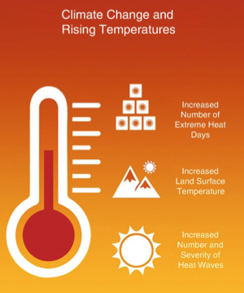
Dialysis
Heat Stress Nephropathy
Natural Disasters

Slide 31
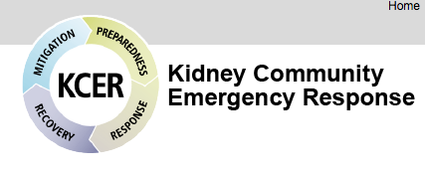
Healthcare Delivery in Climate Change
Natural Disasters
https://www.kcercoalition.com/en/esrd-networks/
Notes:
Natural disasters interrupt healthcare delivery in multiple ways:
Including care infrastructure, power outages, facility damage, transportation, supply chains
Since Hurricane Katrina, healthcare resiliency has been built around delivering dialysis to patients who rely on this modality to treat kidney disease:

Slide 32
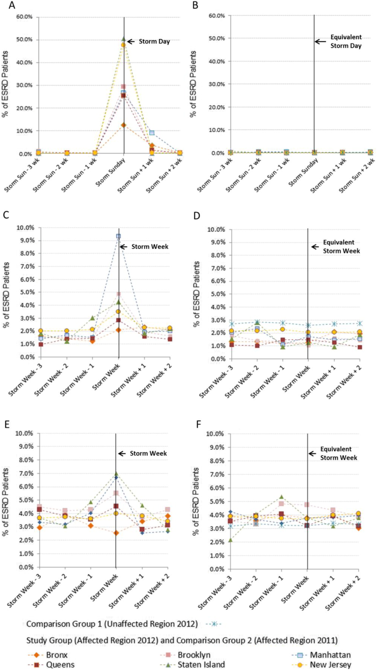
Impact of Hurricane Sandy on Dialysis Patients in the NE
Identified 221 dialysis units affected by storm, representing approximately 15,000 dialysis patients
4.5% hospitalized (3.2-3.8%), 4.1% with ED visit (1.7-2.6%), 1.8% with 30-d mortality (1.5-1.6%)
Kelman J, et al. Am J Kidney Dis 2015;65(1):109-115.
Notes:
Study that looked at Hurricane Sandy that made landfall in US on 10/29/12
Evaluated impact on dialysis patients – including frequency of early dialysis, ED visits, hospitalization rates and 30-d mortality
Compared this to rates of each of these outcomes in 1) ESRD patients living outside the affected areas in same time period, and 2) ESRD patients in the same area 1 year prior
Found: nearly ½ of study group rec’d early dialysis, post storm increases in ED visits, hospitalizations, 30-day mortality

Slide 33
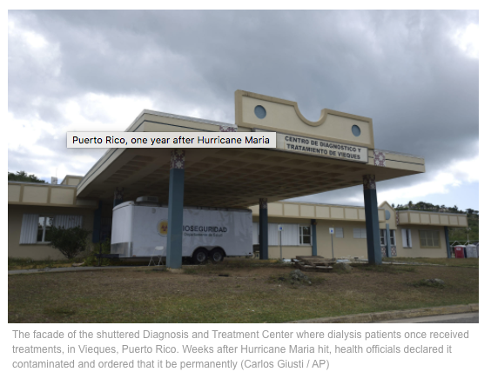
Care for Dialysis Patients During and After Hurricane Maria
https://www.baltimoresun.com/photos/darkroom/bs-dk-puerto-rico-maria-ap-20180919-htmlstory.html
Notes:
Compounded issues to emergency medical care in the wake of Hurricane Maria- PR
Enroll in mainland medicare and medicaid systems
6,000 dialysis patients in 48 dialysis facilities
80% of power grid out
In total 4,600 + deaths

Slide 34
Kidney Disease Threatens Climate Health
Resource utilization in dialysis– “Green Nephrology”
WATER
POWER
SUPPLIES/WASTE
Dialysis
Notes:
The provision for treatment of kidney failure is enormous worldwide. In 2010, 2.6 million people worldwide receive dialysis for kidney failure and this is expected to double by 2030. In 2018, over 3.3 mil people worldwide receiving hemodialysis (89% hemo, 11% PD) > 2 million people die each year because of lack of access to kidney replacement therapy, this is set to increase to 9 mil by 2030.

Slide 35
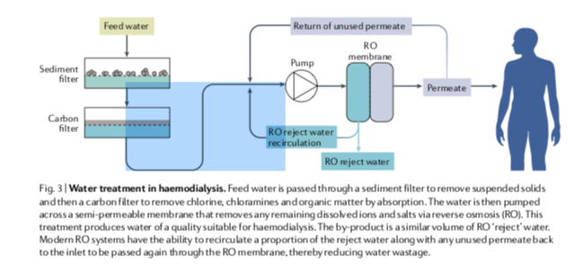
Water
Barraclough KA, Agar JWM. Green nephrology. Nat Rev Nephrol. 2020 May;16(5):257-268.
Notes:
RO systems help to clean water
Many of inefficity, reject btwn ½- 2/3 of the source water
DFR of 500 ml/min results in 120 L of water use over 4 hr treatment for each patient, 18,720L of water used annually for pt dialyzing 3x per week
Settings of low recovery ratio

Slide 36
Power/Waste
Electricity use per dialysis treatment (at 2 Australian centers) was 12.0kWh- 19.6 kWh
Ref: Australian household uses 18.7kWh per day
1.5-8 kg of waste per treatment reported. Less than 1/3 of the non-hazardous waste recyclable.
Very large carbon footprint; difficult to estimate pharmaceutical carbon footprint

Slide 37
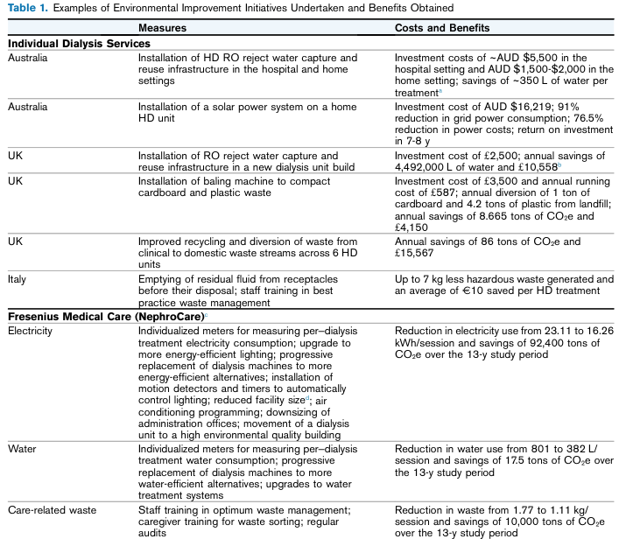
Yau A, Agar JWM, Barraclough KA. Am J Kidney Dis. 2020 Nov 7:S0272-6386(20)31075-1.

Slide 38
Summary
Climate change confers multiple adverse health effects in humans
CKDu is an epidemic consequence of heat stress nephropathy manifesting in vulnerable populations throughout the globe
There are many other climate-related threats to kidney health including air pollution and natural disasters
Many opportunities and challenges exist to deal with these climate related health effects

