Slide 1
Serving the Community Through the Lens of
Inclusion, Diversity, and Health Equity
Margarita Diaz, MSN, RN
Director, Inclusion, Diversity and Health Equity
The Office of Inclusion & Diversity/Human Resources

Slide 2

“We must be embracing to all, treat all, employ all, and see value in all.”
Akram Boutros, MD, FACHE
President and Chief Executive Officer

Slide 3
METROHEALTH GOALS FOR RACIAL EQUITY & INCLUSION
BUILDING SUSTAINABLE EQUITY
Improve Black and other minority representation at senior levels of the organization
Improve leadership representation of underrepresented groups
Focus on hiring, retention, and promotion at all levels for Black and other minorities
Enhance hiring, retention, and promotion of diverse candidates for Medical Staff
Create a stronger sense of inclusion and belonging for our Black and other minority staff in particular, and all employees in general
Eliminate or substantially reduce health disparities among our patients
Support regional efforts to reduce mental and physical health disparities
Promote economic equity and participation in all our activities
Establish a range of anti-bias and anti-racism educational programs for all employees

Slide 4

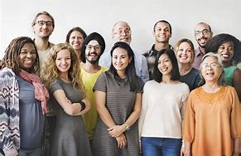
Who Are We and Who Do We Serve
To continually improve the health of our community and its diverse populations by fostering an inclusive and engaging workforce, which delivers the highest quality of care to people representing all dimensions of diversity.
In the Employee population we work with:
70%-White
19%- African American
5%- Asian/ Native Hawaiian/ Pacific Islander
4%- Hispanic/ Latino
2%- Other
In the Patient populations we serve:
44% White
37% African American
10% Hispanic / Latino
1% Asian
8% Other
Notes:
It is important to not only be diverse…….but to be inclusive which means we engage all people as partners in care…..
We should be reflecting the communities we serve ……..WHY>>>>>>because it builds credibility wit the community, trust grows, mutual understanding is present and we can increase our cultural encounters which then make us more inclusive………..
On the other side, the more “diverse” people we serve the more critical to have a cultural awareness or the better understanding of who we serve
Why is this important? 53% of our patients are underrepresented groups
So where we may not always represent or look like the patients we serve we can become more proficient effective safe increase quality and equity by understanding where they come from and who they are throu

Slide 5

Culture Matters
Culture in Society
Culture is the sum total of the way people live and guides decisions and actions of a group through time.
Culture Includes: Values, beliefs, language, ways of thinking, communication styles, behavioral norms, and so on…
Culture in Healthcare
Influences:
Patients’ healthcare beliefs,
Practices and attitudes toward care
Trust in the system and in the individual providers
Cultural differences impact how people receive, understand and act upon health information and healthcare services.
The culture we create is empathetic to the many dimensions of any individual

Slide 6

Cultural Competence
Is the ongoing capacity of healthcare systems, organizations and professionals to provide for diverse patient populations and high quality care that is safe, patient and family-centered, evidence-based and equitable, The National Quality Forum.
Why Cultural Competence in Health Care
End misunderstandings in diagnosis or in treatment planning that may arise from differences in culture
Improve patient adherences with treatments
End health care disparities

Slide 7
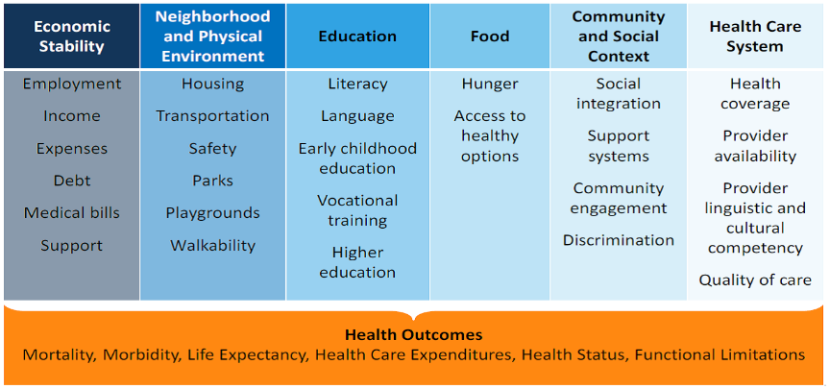

What Drives Health?
There are many factors that influence how long and how well we live--- from the quality of our homes and the safety of our neighborhoods to the opportunities we have for good jobs and education.

Slide 8
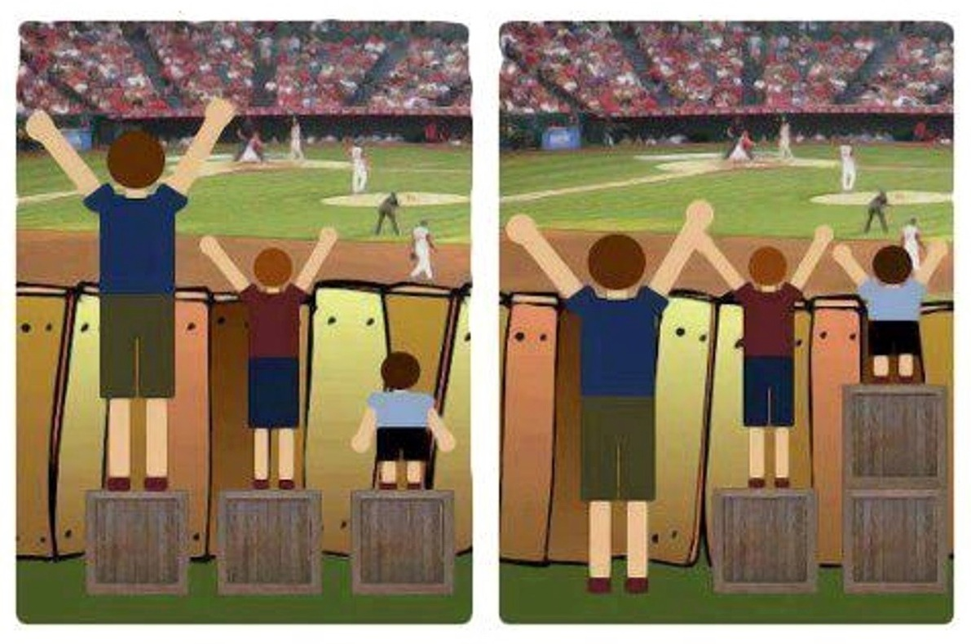
Health equity is achieved when every person has opportunity to “attain his or her full health potential” and no one is “disadvantaged from achieving this potential because of social position or other socially determined circumstances.” Health inequities are reflected in differences in length of life; quality of life; rates of disease, disability, and death; severity of disease; and access to treatment.
https://www.cdc.gov/chronicdisease/healthequity/index.htm
Equality Vs Health Equity

Slide 9

Culturally Competent Model for Care Delivery at MetroHealth
Culturally competent health care systems acknowledge and incorporate:
  Importance of culture
  Assessment of cross-cultural relations
  Recognition of potential impact of cultural differences
  Expansions of cultural knowledge
  Adaption of services to meet culturally unique needs
  Increased diversity of workforce and leadership
  Strategies to promote diversity in all hiring and recruitment
  Assessment of bias, stereotypes and prejudice in organizational and leaders’ behaviors

Slide 10
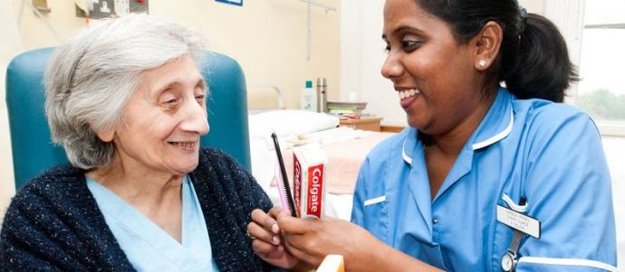
Health Equity Is……….
Create a safe space for patients
Attitude of inclusivity where patients feel welcomed
Working together with your patient for a common goal
Recognize differences are okay
Empathy by recognizing challenges
Ongoing conversations
Culture of acceptance/compassion
Listen to the patient
Build trusting relationships

Slide 11

At MetroHealth
Health Equity Looks Like…….

Slide 12
Inclusion, Diversity, and Equity Foundations
National CLAS Standards
Equity of Care
Equity of Care Pledge to Act Framework
The Joint Commission
Standards that address:
-Language
-Culture
-Health Literacy
-Cross-cultural Communication
-Cultural Competence
-Patient and Family-Centered Care
Standards for “Culturally and Linguistically Appropriate Services: these are 15 National Standards acknowledged and integrated by The Joint Commission that include:
-Fostering Cultural Competence
-Ensuring Language Access-
-Reflecting and Respecting Diversity
-Collecting Diversity Data
-Building Community Partnerships
-Benchmarking, Planning and Evaluating
Increasing the collection and use of race, ethnicity, language preference and other socio-demographic data to inform programming and outcomes
Increasing cultural competency training to increase culturally competent care
Increasing diversity in leadership and governance to reflect the communities we serve

Slide 13


Health Care Disparities
Health disparities adversely affect groups of people who have systematically experienced greater obstacles to health based on their racial or ethnic group; religion; socioeconomic status; gender; age; mental health; cognitive, sensory, or physical disability; sexual orientation or gender identity; geographic location; or other characteristics historically linked to discrimination or exclusion. Healthy People 20/20
Many LGBT people feel unwelcome in health care settings and avoid care in order to avoid uncomfortable or stigmatizing experiences.
Makadon, HJ, Mayer, KH, Potter, J, Goldhammer, H, 2015
Notes:
Pride and Kidsz Pride Networks 12 years of service
Economic opportunities such as the annual Transgender Job Fair
PFA LGBT Community Council
Preferred Name and Pronoun initiative
SOGI documentation in EPIC
Safe Zone Trainings

Slide 14
Locations and options for listing for Preferred Name
SOGI- (Sexual Orientation and Gender Identity) & Preferred Name
To improve the patient experience and better support patient-centered care it is easier to see a patient's preferred name.
Patient Lists or the patient header, shows the patient's preferred name if a preferred name has been documented.
This is especially important for transgender or nonbinary patients, but also helps improve the patient experience for any patient with a preferred name that differs from their legal name.
Location | Name | Gender
Inpatient Labels | Legal Name Only | Legal Sex
Lab Labels | Legal Name Only | Legal Sex
Prescriptions | Legal Name Only | Legal Sex
Pharmacy Labels | Legal Name Only | Legal Sex
Patient Headers | Legal Name w/Preferred Name | Gender(if data is on record) Legal(if no gender filled in) Birth Sex(if data is on record)
Patient Workspace Tab | Legal Name w/Preferred Name in Quotes | N/A
After Visit Summaries/Discharge Instructions | Legal Name w/Preferred Name | N/A
Patient Lists | Legal Name w/Preferred Name in Quotes | N/A
Unit Manager | Legal Name w/Preferred Name in Quotes | N/A

Slide 15
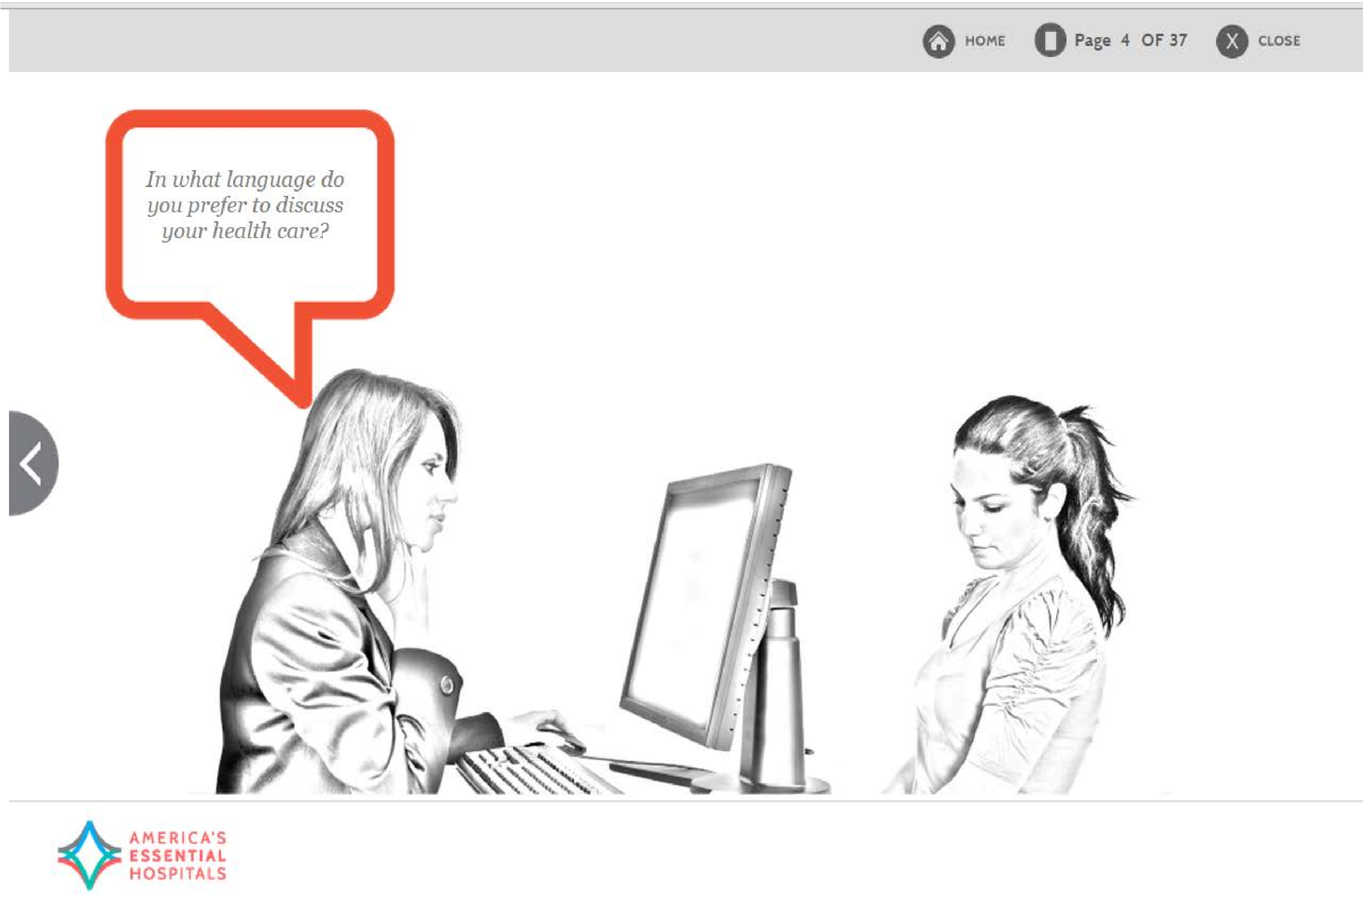
Collection of Race, Ethnicity and Language
REaL Data
To train hospital staff on accurate collection of REAL
Accurate data reduces health disparities
To measure is to know: if you cannot measure it, you cannot improve it
Provide insight into population health

Slide 16
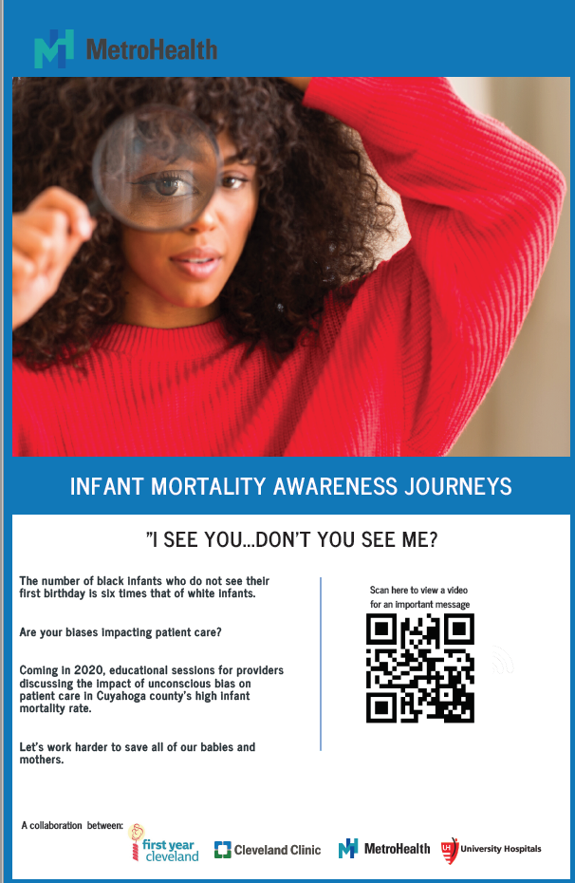

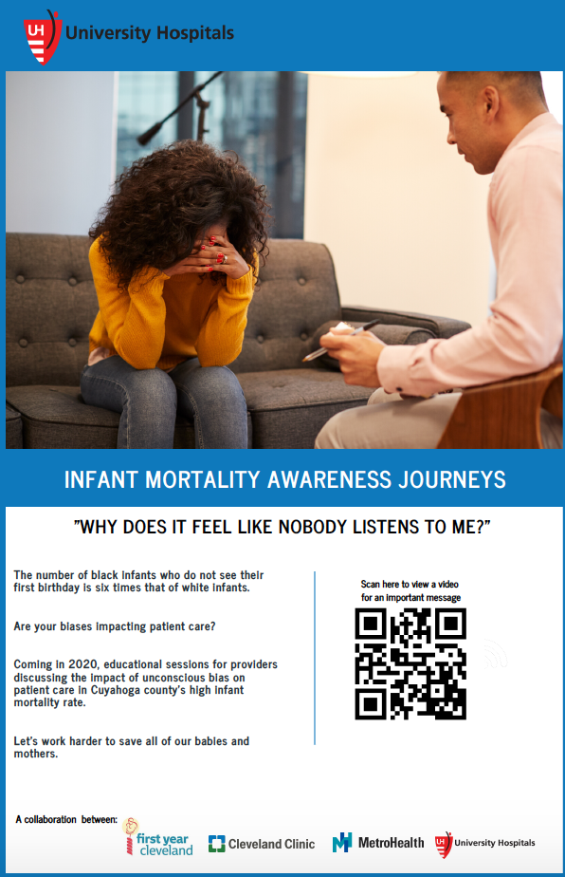
First Year Cleveland awareness campaign

Slide 17
Through Programming Our Teams Become IDE Aware and Prepare
•Co-creating a Culturally Competent MetroHealth
•Unconscious Bias in the Workplace
•SafeZone Training ( LGBTQ)
•Best in Class (BIC) Leadership Program- Inclusive Leadership
•Engaging a Diverse Workforce
•Strengths Finders- “Team of Me; All of Us”
•Cultural Competence Series (4 short sessions)
•“Ask Every Patient REaL” in EPIC Cadence
•Nurse Education / Competency Days- Nurse Education
•New Employee Orientation
•Online educational modules for all staff
•Customized training, orientation or coaching sessions
•Values Orientations
•Schwartz Rounds- I&D cases
•“Creating Space” for Critical Dialogue Series
•Nursing and I&D partnership
•Graduate Medical Education (GME) and I&D partnership for new resident orientation
•TeamSTEPPS- integration of Inclusion and Diversity and language access resources

Slide 18
Wellness goes beyond medical care.
We must expand our reach because…
Health happens in communities
Imagine a community where we see the full picture of our patients and their lives beyond the walls of MetroHealth or any health system
Imagine a community without barriers between health and social services where people can be e-connected to the services they need with closed-loop communication
Imagine a community where we can identify and eliminate potential barriers to health and well-being based on evidence to better allocate time and resources

Slide 19


Improved Health through Opportunity, Partnership and Empowerment
Improve the health of populations by leading efforts to address social and economic barriers to good health
Identify and promote opportunities for change in practice, learning and policy
Develop and nurture partnerships to make the greatest impact for individuals, neighborhoods and communities
Co-create a self-sustaining community where everyone is empowered to live their healthiest life

Slide 20



1. Starts with Awareness/ Self-Awareness
2. Grows with Knowledge
3. Is enhanced with specific Skills
4. Sharpened with Cross-Cultural Encounters
Notes:
We understand that this is a journey that will continue

Slide 21
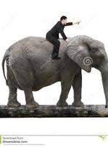
We consciously and unconsciously bring the elephant with us…

Slide 22

Seven Steps to Identify and Address Unconscious Bias
1. Recognize that YOU have biases.
2. Identify what those biases are.
3. Explore and unpack your biases.
4. Systematically address your biases.
5. Look for areas of common interest.
6. Get rid of your biases.
7. Be mindful of “bias kickback.”
(Based on the work of Howard Ross, Cook Ross, Inc.).

Slide 23

Keys to Success
Collect race, ethnicity and language preference data
Identify and report disparities
Provide culturally and linguistically competent care
Develop culturally competent disease management programs
Increase diversity and minority workforce pipelines
Involve the community
Make cultural competency an institutional priority

Slide 24

Leads to Health Equity
Culturally Competent Patient Centered Care
Notes:
WITH PATIENTS AND WITH EACH OTHER
We all remember the slogan walk a mile in my shoes

