Slide 1
Planning for the Sustainability of Health Programs and Partnerships
AN overview

Slide 2
Objectives
Review conceptual frameworks – to understand the factors that influence the sustainability of programs and partnerships;
Introduce two sustainability planning tools.; and,
Illustrate the application of sustainability factors/strategies using a study of the long-term maintenance of a community-academic partnership in East Baltimore.

Slide 3
A Definition of Sustainability
“Sustainability is the continued use of program components and activities for the continued achievement of desirable program and population outcomes.”
Scheirer and Dearing, 2011

Slide 4
Why should we be concerned about program sustainability?
Initial grant funding for many health disparities programs may end before all of the program benefits have been achieved and demonstrated;
The development and maintenance of long-term partnerships is essential to building and maintaining community trust and support for future health disparities interventions.
Purnell et al., 2019

Slide 5
Lessons learned about sustainability from East Baltimore programs
Cervical cancer screening program
Hypertension control/CVD program
“Project” approach
No additional skill-building for peer educators beyond initial training they received
Late attempts at incorporating network of peer educators into community organizations
No additional funding was sought
“Latent” concern about sustainability
“Participatory” approach
Continuous training and skill-building for community health workers
Linking trained community health workers with health care institutions
Additional financial support secured from various sources
Early planning for sustainability
Shediac-Rizkallah and Bone, 1998

Slide 6
An early framework for conceptualizing program sustainability
A Framework for Conceptualizing Program Sustainability
Shediac-Rizkallah and Bone, 1998

Slide 7
Shediac-Rizkallah and Bone, 1998

Slide 8
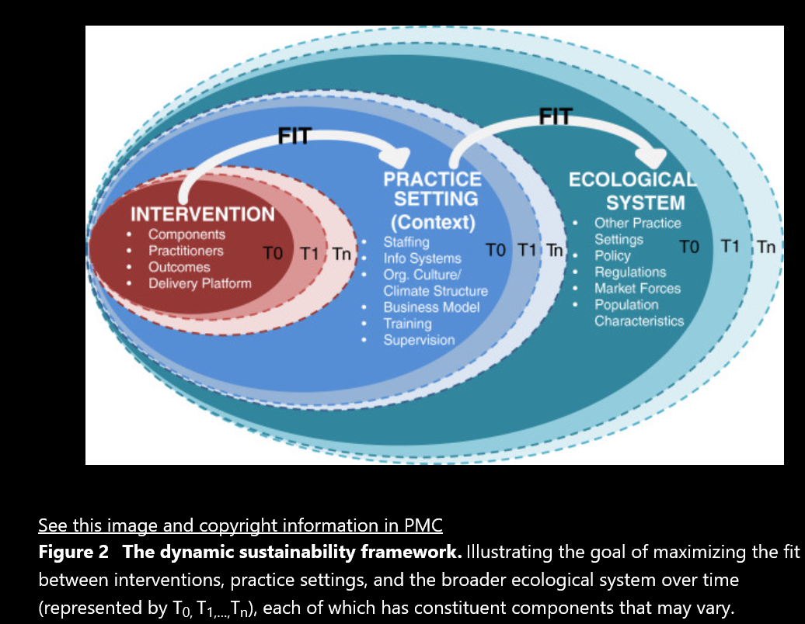
The Dynamic Sustainability Framework
Chambers DA, Glasgow RE and Stange K, 2013

Slide 9
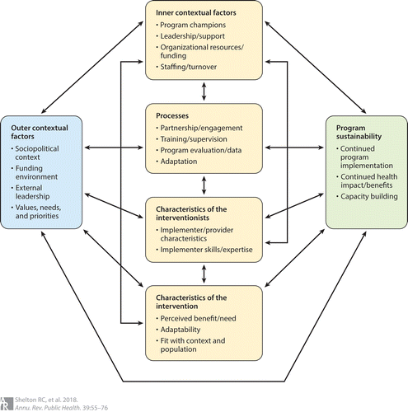
Integrated Sustainability Framework
Shelton et al., 2018

Slide 10
The Program Sustainability Assessment Tool: Domains and Definitions
Schell et al., 2013

Slide 11
Using the Program Sustainability Assessment Tool
for Sustainability Planning. https://sustaintool.org
Calhoun et al., 2014

Slide 12
Developing a Sustainability Plan – A10-Step Process
Create a shared understanding of what sustainability means to your partnership/coalition and other key community stakeholders;
Create a plan to work through the process;
Position partnership efforts to increase the odds of sustainability;
Look at both current and pending events/initiatives/changes that can impact the continuation of your partnership’s efforts;
Develop criteria to help determine which efforts to continue - potential criteria include: available resources (financial, organizational, human), level of community support, evidence of effectiveness based on early evaluation results, whether a need still exists for a particular activity.
A Sustainability Planning Guide for Healthy Communities. CDC, 2012
CDC (2012)

Slide 13
Step 6 - Decision-making flow chart – Sustainability Planning Guide. CDC, 2012

Slide 14
Developing a Sustainability Plan – A10-Step Process (Cont’d)
7. Create options for maintaining priority efforts – developing multiple/alternative strategies for continuing an effort is generally helpful;
8. Develop a sustainability plan – this step brings together the work completed in the first seven steps. Consider your sustainability plan “a living document” with sustainability strategies that can be revised as contextual factors and sources of funding change;
9. Implement the sustainability plan; create detailed action plans for each prioritized strategy and how it would be sustained;
10. Evaluate outcomes and revise as needed.
A Sustainability Planning Guide for Healthy Communities. CDC, 2012

Slide 15
A community-academic medical center partnership in East Baltimore: synthesis of 15-year results of a sustained collaborative program
Initial Development (1974-1979)
Development of a task force with representation from the community and the Johns Hopkins Medical Institutions
Clinical trial for hypertension control
Grant from the National Heart, Lung, and Blood Institute
Results showed significant improvement in control of hypertension
Second Phase (1979-1987)
Success of clinical trial led to a community-based demonstration phase in the same community
Trained community health workers (CHWs) yielded positive effects on hypertension control, enhanced linkage and access to care, and continuity of care
Levine, Becker and Bone, 1992

Slide 16
A community-academic medical center partnership in East Baltimore: synthesis of 15-year results of a sustained collaborative program (Cont’d)
Early planning for sustainability (first year of community demonstration phase)
Program champion: chairperson of Advisory Board and Assistant Director of a decentralized mayor’s office
Multiple strategies were developed before incorporating CHWs into the provider system/hospital emergency department
Funding obtained from a combination of federal and local sources
Third Phase (1987 and beyond)
Partnership efforts directed at sustaining and enhancing gains in the control of hypertension
Broadening community intervention approaches and goals to address related risks and diseases including smoking prevention and cessation, diabetes control, obesity, hyperlipidemia, asthma and other risks.
These more comprehensive programs were mediated through a variety of community and civic agencies, including schools and churches.
Levine, Becker and Bone, 1992

Slide 17
A community-academic medical center partnership in East Baltimore: synthesis of 15-year results of a sustained collaborative program (Cont’d)
Collaborative effort of Johns Hopkins and over 200 churches in East Baltimore was formalized into a new program entitled ‘Heart, Body and Soul’ broadening the scope of activities, diseases and risk factors
Steering committee chaired by one of the ministers under strong community leadership
Intervention programs trained church members, including ministers and health workers, to lead small groups and administer church-wide activities and health fairs
Financial support obtained from local, state and federal sources
Community ‘owns’ the programs.
Levine, Becker and Bone, 1992

Slide 18
Role of Research Centers in Promoting Partner Engagement and Sustainability
Centers can promote sustainability in a variety of ways, including:
Serving as a catalyst for networking and skills building;
Providing a source of support to academics, health practitioners and community members for learning about CBPR;
Providing coordination and synergy across CBPR projects and partners;
Providing flexible funding for exploring innovative approaches to CBPR;
Enhancing the legitimacy of CBPR by increasing its visibility within funding agencies, public health agencies, CBOs and academia.
Israel et al., 2006

Slide 19
References
1. Batan M, Butterfoss FD, Jaffe A, LaPier T. A Sustainability Planning Guide for Healthy Communities. Atlanta, GA: National Center for Chronic Disease Prevention and Health Promotion, 2010.
http://www.cdc.gov/healthycommunitiesprogram/pdf/sustainability_guide.pdf. Accessed July 6, 2020
2. Calhoun A et al., 2014. Using the Program Sustainability Assessment Tool to assess and plan for sustainability. Prev. Chronic Dis.11:130185
3. Chambers DA, Glasgow RE, Stange KC. 2013. The dynamic sustainability framework: addressing the paradox of sustainment amid ongoing change. Implement. Sci. 8:117
4. Israel BA et al., 2006. Challenges and facilitating factors in sustaining community-based participatory research partnerships: lessons learned from the Detroit, New York City and Seattle Urban Research Centers. J. Urban Health 83:1022-1039.
5. Levine DM, Becker DM, Bone LR. 1992. Narrowing the gap in health status of minority populations: a community-academic medical center partnership. Am J Prev Med 8:319-323
6. Program Sustainability Assessment Tool: PSAT: Sustaintool. Retrieved July 04, 2020, from https://sustaintool.org/psat/
7. Purnell TS et al., 2019. Overcoming barriers to sustaining health equity interventions: insights from the National Institutes of Health Centers for Population Health and Health Disparities. J. Health Care Poor Underserved 30:1212-1236.
8. Scheirer MA, Dearing JW. 2011. An agenda for research on the sustainability of public health programs. Am. J. Public Health 101:2059-2067.

Slide 20
References (Cont’d)
9. Schell SF et al., 2013. Public health program capacity for sustainability: a new framework. Implement. Sci. 8:15
10. Shediac-Rizkallah MC, Bone LR.1998. Planning for the sustainability of community-based health programs: conceptual frameworks and future directions for research, practice and policy. Health Educ. Res. 13:87-108.
11. Shelton RC, Cooper BR, Stirman SW. 2018. The sustainability of evidence-based interventions and practices in public health and health care. Annu. Rev. Public Health 39:55-76.

