Slide 1
Market Intelligence
Presentation Discussion

Slide 2
Market Intelligence and Planning at MetroHealth
Department
Purpose: Bring “the market reality” and “voice of the consumer” to the decision making arena
Structure: Market Planning and Primary Market Research reporting to Strategy
Beth Clegg, Sr. Market Research Associate
Key responsibilities: Design market research for the organization; obtaining insights from surveys, focus groups, interviews, etc., to connect consumer desires and ideals for the development and evaluation of business opportunities
Notes:
Why am I here?
I am incorporating stakeholder insight into business decisions – this includes the community, patients, employees, partners, influencers, donors, volunteers, etc.

Slide 3
Data collection methods - lately
Primary Research
Qualitative
In-person focus groups and interviews
Observations
Quantitative
Online surveys
Paper surveys
Secondary/Planning Data
Database/data mining
Pre-existing surveys
Census bureau
Purchased projections
Market share
Data searches

Slide 4
Tell the stakeholder story and connect it to the work that we need to do
Goal of the work
When I have been successful with this, it’s included…
Obtain clear purpose
Simplify – how simple can you get the information you've collected
Step process
Boil it down to what they “need” to know
Customize to your audience
Must include: recommendations, considerations and/or next steps
Allow evolution of presentation
MI Typical Audience
Executive team
Operations/ program owner
HARD!!

Slide 5
Examples of the story and the connection

Slide 6
In-patient Rehab
Notes:
22 page report
Each “event” has a slide and each specific question has a “slide”

Slide 7
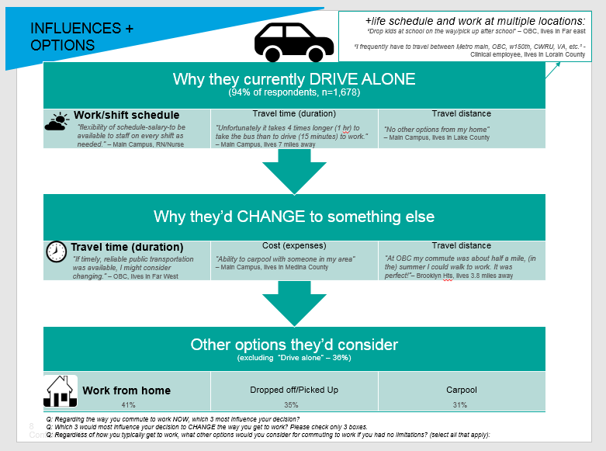
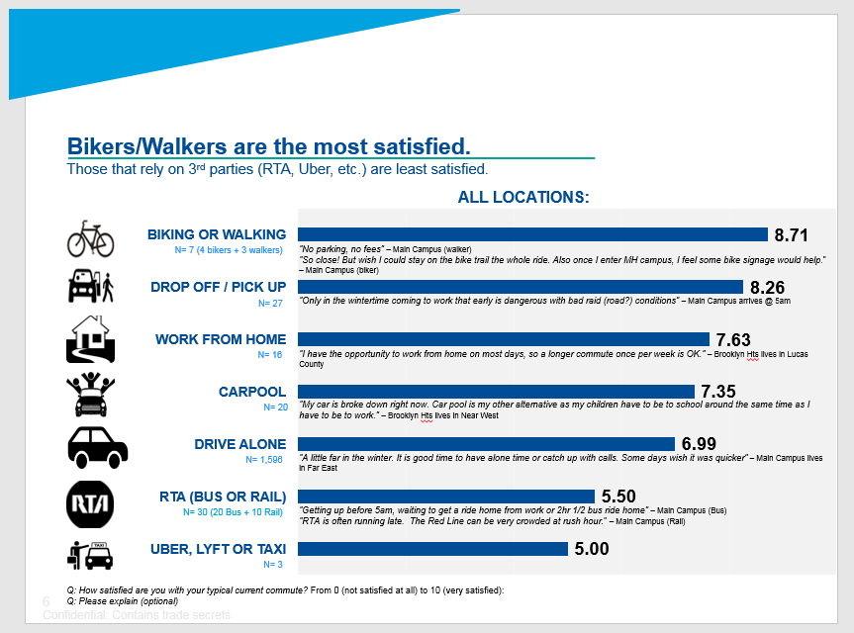
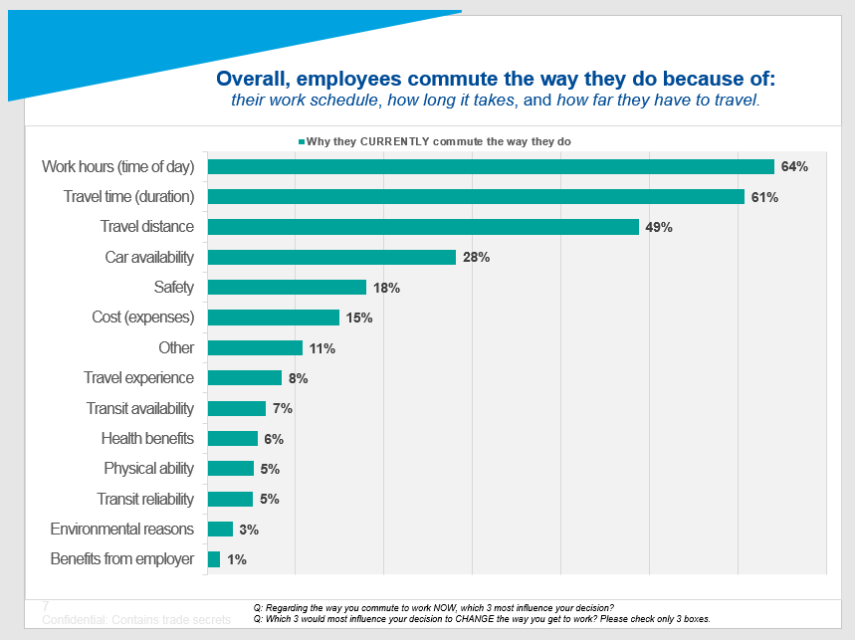
Commuter survey
Notes:
70+ slides

Slide 8
Near West Facility

Slide 9
Community Hospitals

Slide 10
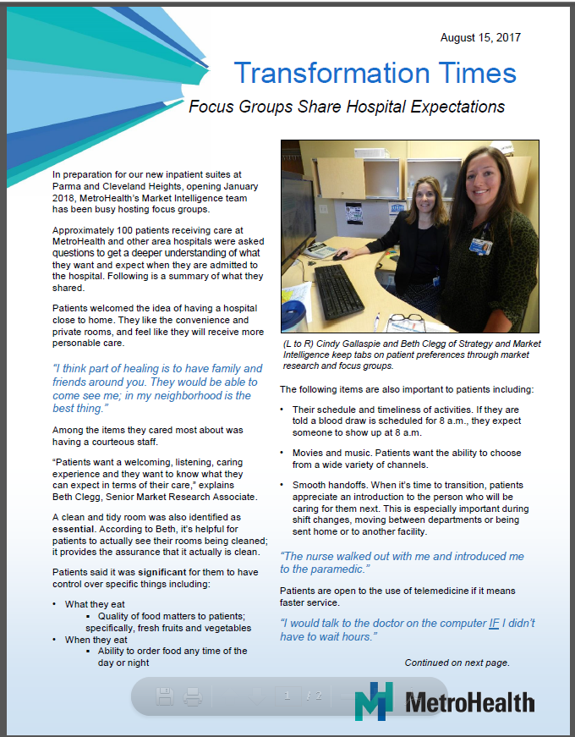
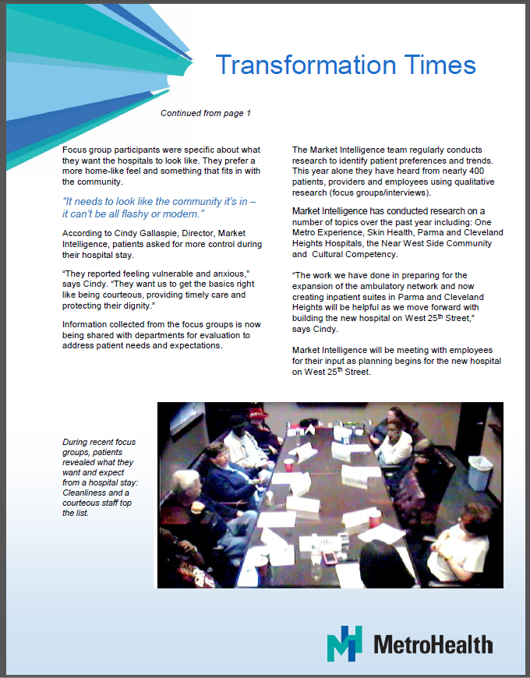
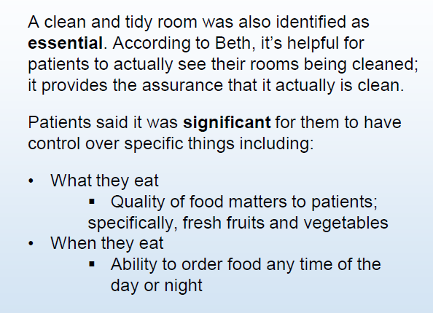
Community Hospitals

Slide 11
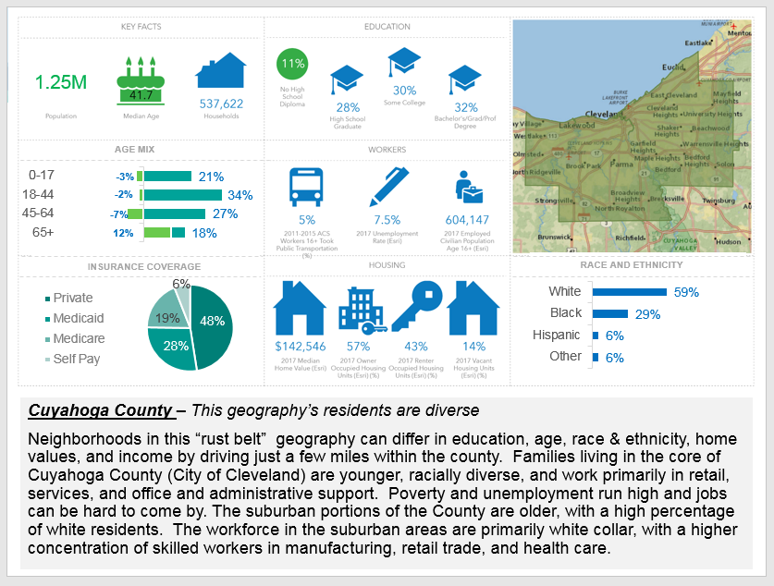
Secondary - Snapshot

