Slide 1
Julie Merker
CRSI Cohort #1
January 2013 – December 2014
Notes:
I started when my 7 year old was 3 months old!

Slide 2
CRSI Logic Model
Scholar
Outcomes
Organizational
Outcomes
Longer-term Impact
Inputs
Process
Outputs
Education
Increased
research knowledge
Delivery of two-year educational experience in applied research methods
Participation and retention of scholars in educational components
Funding for Scholars at 40% FTE buy-out over two years
Educational curriculum in research methods
Mentoring for scholar
Education for scholar’s supervisor
Increased evidence of research culture in organization
Increased skills in research communication
Increased research capacity in health and human service nonprofits in Cleveland
Application
Increased organizational commitment to research
Formulation and undertaking of specific research study within organizational context
Increased role as research resource in organization
Successful development and execution of context-specific study
Increased use of data to inform programming
Increased professional vision & insight
Mentoring
Ongoing mentoring by Scholarship staff and organizational supervisor
Robert L. Fischer, PhD
Professor, Case Western Reserve University
Notes:
Beech Brook was interested in doing more internal evaluation work. I was interested in learning new skills.
The three of us all had different backgrounds and skill sets, which allowed us to work together really well and learn from each other. We have been known to barter skills – some data analysis for a reiki session may have happened!

Slide 3
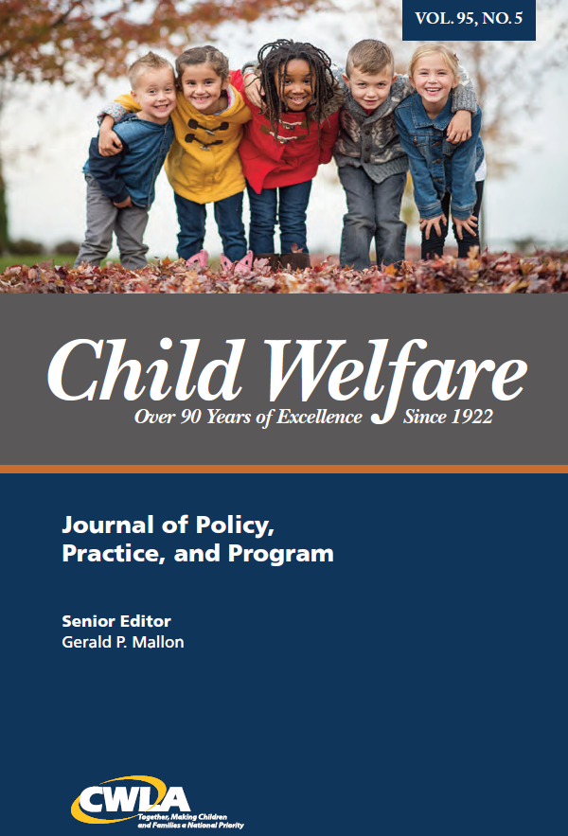
Community Research Scholar Initiative -Project Background-
STUDY TITLE: Prevalence of Chronic Illness Among Youth with Mental Health Diagnoses
SPECIFIC AIMS: Better understand the relationship of physical and mental health in youth; inform policy around the integration of physical and mental health delivery systems
METHODS: Exploratory study utilizing data-mining of the EMR
RESULTS:
Chronic conditions were likely under reported because 76% of clients did not report any.
Asthma was the most common chronic condition (20%). This was higher than national trends, but in line with state and county trends at the time.
Rates of being overweight or obese were higher than national averages.
Notes:
Nothing too earth shattering was learned in my study, but it got published!

Slide 4
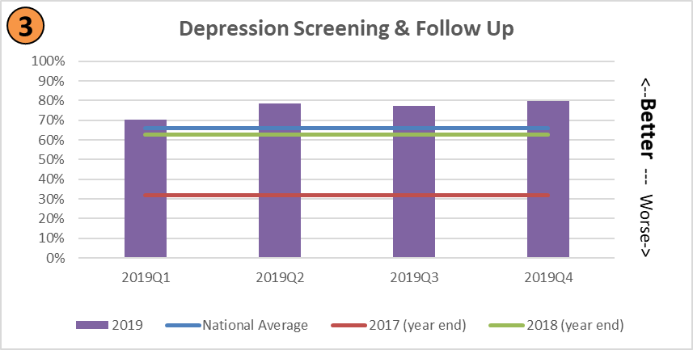
The Centers & Circle Health – Data Journey
DATA
Develop Common Language
Make Smart Decisions
Become Outcomes Focused
Tell Our Story
Notes:
Successes:
Develop a common language – standardizing and consistent messaging
Tell Our Story – data visualizations that are simple and clear cut
Outcomes Focused - Quality Improvement efforts: Improve 8 of 10 Clinical Quality Measures by 10% or more in 2019
Smart Decisions – operational and performance data

Slide 5
Research Projects & Partnerships
Internal Institutional Review Board: Cross-disciplinary group that reviews all proposed research and quality improvement projects prior to implementation
Uses the BRACE Toolkit to facilitate discussion between The Centers/Circle and the academic partner
Approaches to CHC Implementation of SDH Data Collection and Action (ASCEND)
Kaiser Permanente Center for Health Research
OCHIN, Inc.
Multi-Level Facilitation of Long-Acting Injection Use (MAP)
University of Texas Health Sciences Center
Case Western Reserve School of Medicine

