Slide 1
Carey Gibbons
CRSI Scholar: Cohort 2
Youth and Young Adult Outreach Worker
Northeast Ohio Coalition to End Homelessness
NEOCH

Slide 2





My CRSI Research
A QUALITATIVE LOOK AT THE HEALTH CARE EXPERIENCE OF TRANS WOMEN IN CLEVELAND:
WHAT ARE THE BARRIERS TO ACCESS AND GAPS IN SERVICE AS EXPERIENCED BY TRANS WOMEN SEEKING HEALTH CARE AMONG VARIOUS CUYAHOGA COUNTY HEALTH CLINICS?

Slide 3
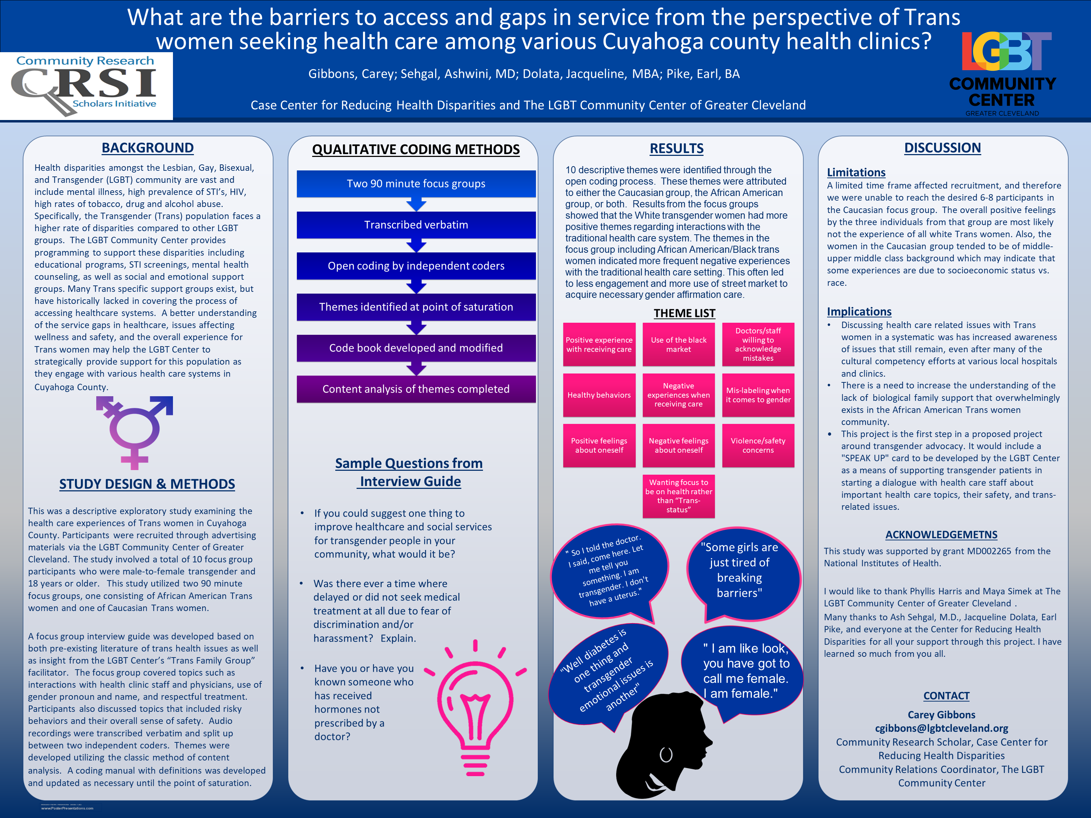
Poster Presentation

Slide 4
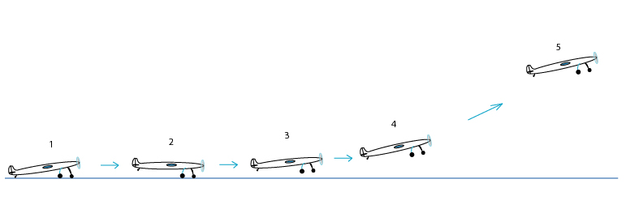
Where Did CRSI Take Me?
This Photo by Unknown author is licensed under CC BY-SA.

Slide 5

Who is NEOCH
The mission of neoch is to organize and empower homeless and at-risk men, women and children to break the cycle of poverty through public education, advocacy and the creation of nurturing environments.
NEOCH has developed its vision by actively listening to, mobilizing, and working with those currently experiencing homelessnes
We are a small but mighty staff of 8

Slide 6

Who I am Serving
The youth identify as:
14-24 yo
LGBTQ+
Aged out of foster care
Pregnant or have a child
Human Trafficking

Slide 7




Thank you for your time.
Any questions?

