Slide 1
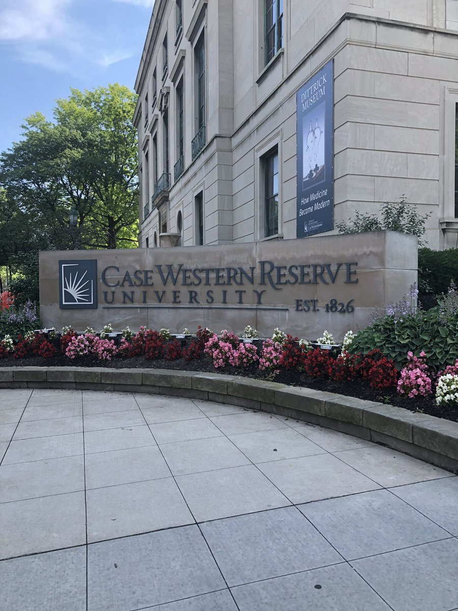
Emergency Food Assistance and Food Security
Owusua Yamoah, Ph.D., MA
07/09/2021

Slide 2
Introduction

Slide 3
Owusua Yamoah, PhD MA Post-Doctoral Scholar, Swetland Center for Environmental Health, CWRU
Education:
BSc. Development Planning
MA Urban Studies
Graduate Certificates in Urban Planning and Local Government Management
PhD in Spatially Integrated Social Science
Research Focus:
Food systems and Health Disparities
COVID-19 and Community Health
Geospatial Analysis for Community development and Population
Current Research:
Modeling the Future of Food in your Neighborhood Study (foodNEST 2.0)
Food Security and COVID-19 study
Building Capacity for Obesity Prevention
Ohio COVID-19 Study

Slide 4
Emergency Food Assistance and Food Security
Principal Investigator: Owusua Yamoah, PHD, MA
Co-investigator: Darcy Freedman, PHD, MPH
Community Partner: Kristen Mikelbank, MA

Slide 5
Background
The ability of households to meet the food needs of all members of their household, both in terms of quality and quantity and at all times continues to be a challenge for about 10.5 % of the American population.
Minority populations are however two times more likely to be food insecure (19.1%).
In Cuyahoga county, 56.0% of the African American population live in food deserts compared to 23.5% of Whites.

Slide 6
Food Insecurity and the distribution of Black/African American Population in Cuyahoga County

Slide 7
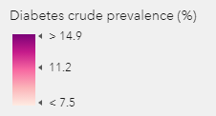
Food Insecurity and Health Outcomes
The association between food insecurity and negative health outcomes such as diabetes, obesity, chronic disease and overall poor health among children and adults is one of the underlining causes of health disparities in the United States.

Slide 8
Emergency Food Assistance Programs
Food banks and food pantries have supported food insecure households over the years and remain a value resource to communities with high food insecurity.
Each year, Feeding America through its partner food banks distributes about 4.3 billion meals throughout the United States.
In 2019, the Greater Cleveland Food Bank through its partners distributed 50.1 million meals across Northeast Ohio.
Research into food pantry availability, accessibility, users and usage patterns within the Greater Cleveland area is critical in addressing food insecurity and health disparities in the area.

Slide 9
Research Aims
Aim 1: Explore the spatiotemporal dynamics of emergency food assistance usage and availability.
Aim 2: Examine household food needs, perception of food security, pantry experience and the value of food pantries among pantry users across all user typologies through in-depth interviews and photovoice.
Aim 3: Identify the needs of the different typologies of food pantries, strategies, barriers and opportunities for addressing the food security needs in their community through interviews with food pantry managers.

Slide 10
Community Partner
The Greater Cleveland Food Bank is our community partner. Their role will include:
Provide pantry use data for food pantries in the Cleveland area
Connect researchers to food pantry sites and managers
Assist in dissemination of study findings

Slide 11
Study Timeline
We are currently waiting for the IRB approval for the study. We anticipate that this stage will be completed by mid-July.
We will begin analysis of the secondary data provided by the GCFB immediately following the IRB approval.
Primary data collection will begin in September 2021.

Slide 12
Thank you!

